Slide 1
Smart Building Energy Monitoring
Live per-floor energy, air-quality and water insight from a fog and edge pipeline
MSc in Cloud Computing · Fog and Edge Computing (H9FECC)
National College of Ireland

Slide 2
Why periodic checks fail here
A monthly bill is one number: it says nothing about which floor, which hour or which system is wasting energy.
The costly events are transient: a packed meeting room pushes CO2 past safe levels in minutes, and by the next walkthrough the evidence is gone.
Leaks run between inspections: a pipe flowing all weekend stays invisible until someone reads a meter on Monday.
This pipeline samples every floor every 2 to 5 seconds, so none of these stay hidden.
Thresholds the pipeline enforces:
55 kW: the floor average that raises a peak-load warning in this system.
1,000 ppm: the CO2 level the pipeline flags as poor air quality.
20 L/min: the sustained water flow treated as a suspected leak.

Slide 3
How it works: edge to cloud
Edge:
10 sensors, 5 types across 2 office floors, sample every 2 to 5 seconds.
Fog:
The fog node reduces each stream to one aggregate per window and raises alerts locally before anything reaches the cloud.
Cloud on AWS:
Amazon SQS message queue.
AWS Lambda serverless ingest.
DynamoDB time-series store.
Live dashboard on S3 with API Gateway.
The whole pipeline runs end-to-end on Docker with a local AWS emulator, and deploys to a real AWS account with a single scripted step.

Slide 4
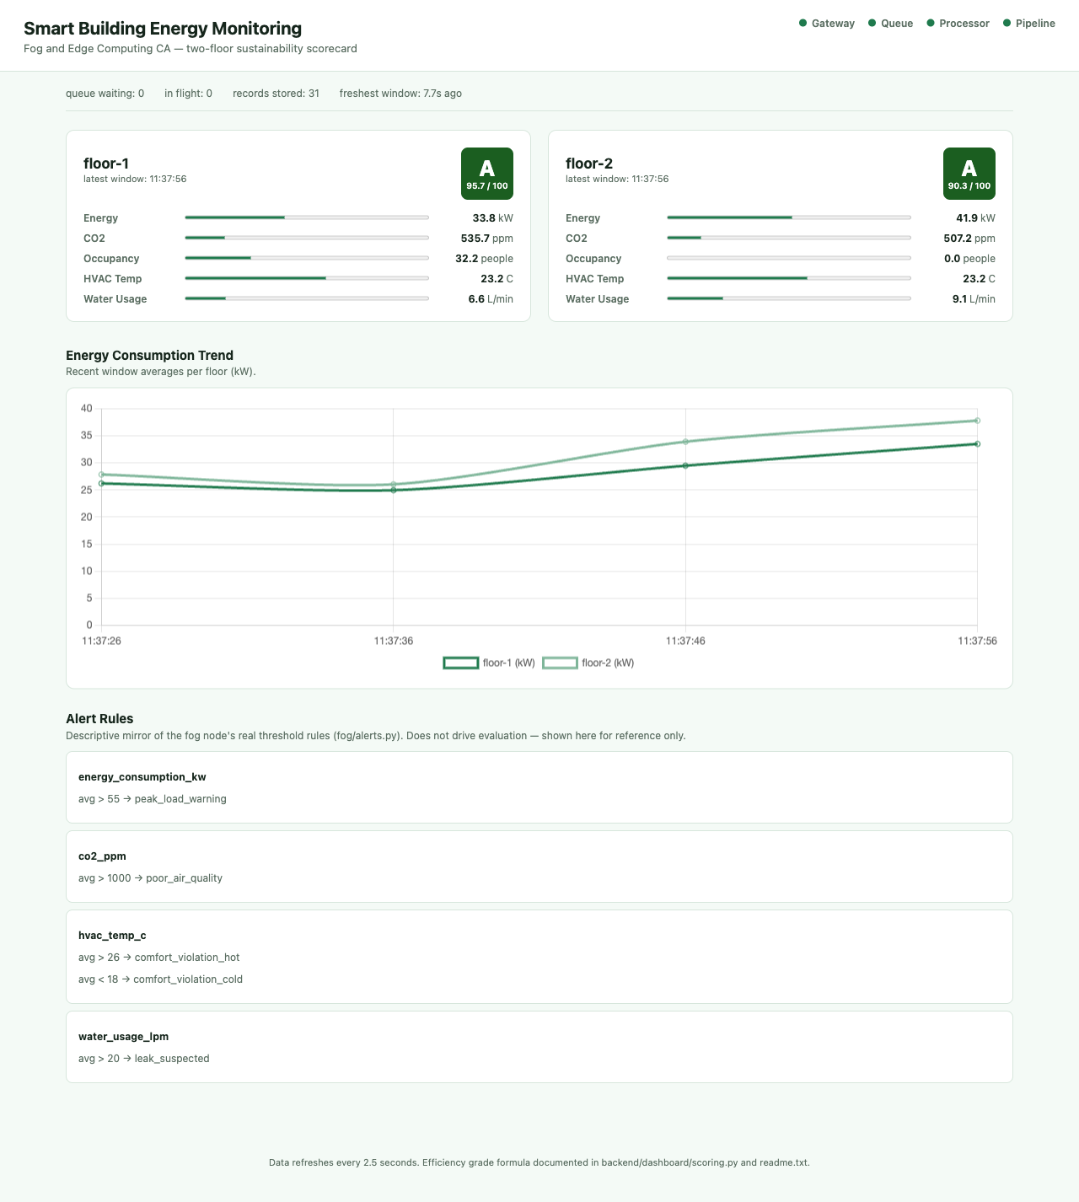
Demonstration highlights
Captured from the running stack: both floors grading A, with every health check green.
4 / 4 pipeline health checks green: gateway, queue, processor and pipeline.
129 automated tests pass, covering window math, alert rules and real HTTP handling.
2,000 message burst absorbed by the queue and drained in the load test.

Slide 5
Hardest part: ten threads, one buffer
The problem:
Every incoming sensor batch runs on its own operating-system thread, and they all need to update the same in-memory window buffers.
Why it was hard:
A buffer race throws no error; light testing looks perfect, and only under concurrent load do aggregates and alerts go quietly wrong, never reproducibly.
The fix:
A single-writer design: request threads only place batches on a thread-safe hand-off queue, and one background thread is the only code that touches the buffers.
The hand-off queue is the one door into shared state, so a single writer thread is all that ever touches the window buffers.
Real HTTP tests boot the actual server to prove it.

Slide 6
What this project shows
Think at the edge
The fog node turns two-second raw readings into windowed aggregates and local alerts before anything reaches the cloud.
Stay serverless
Amazon SQS, AWS Lambda and DynamoDB absorbed a 2,000-message burst with no servers to size or manage.
Prove it works
129 automated tests and an end-to-end pipeline check back every claim, and one scripted step takes it to a real AWS account.
Thank you. Questions?

