Slide 1
Two apiaries; weight, brood temperature, humidity, acoustic buzz, entrance traffic; a colony verdict at the edge
Beehive and Apiary Health Monitoring
Yashaswini Penumarthi
Student ID X24262404
MSc in Cloud Computing · Fog and Edge Computing (H9FECC)
National College of Ireland

Slide 2
A colony changes faster than the beekeeper visits
A honeybee colony can slide into starvation, chilled brood, or the run-up to a swarm within days, yet a hive is opened only every week or two.
Opening a hive is itself disruptive: it chills the brood nest and provokes the bees, so inspection is deliberately rare and the apiary is often far from the keeper.
Ten sensor points across two apiaries stream weight, brood-nest temperature, humidity, acoustic buzz frequency and entrance traffic every 1 to 3 seconds.
Sound leads the other signals: a colony preparing to swarm raises the pitch of its collective hum before its weight moves, so an acoustic rule is an early, non-invasive warning.
Four colony rules are scored on every 10-second window, at the edge:
Brood overheat above 36 degrees, brood chilling below 32, both on the window mean.
Colony starvation below 20 kg, and a swarming precursor when the mean buzz passes 350 hertz.

Slide 3
How it works: hive to dashboard
At the apiary, edge:
Sensors: 10 hive sensors across 2 apiaries.
Fog node: 10-second windows, aggregate, colony rules.
AWS cloud:
Amazon SQS: one summary per window, sent in batches.
AWS Lambda: serverless ingest of each summary.
DynamoDB: time-series store of every window.
Live dashboard: colony-health cards, served via S3 and API Gateway.
Verified end to end locally with Docker and an AWS emulator, then provisioned to real AWS in a single infrastructure-as-code apply of 24 resources.

Slide 4
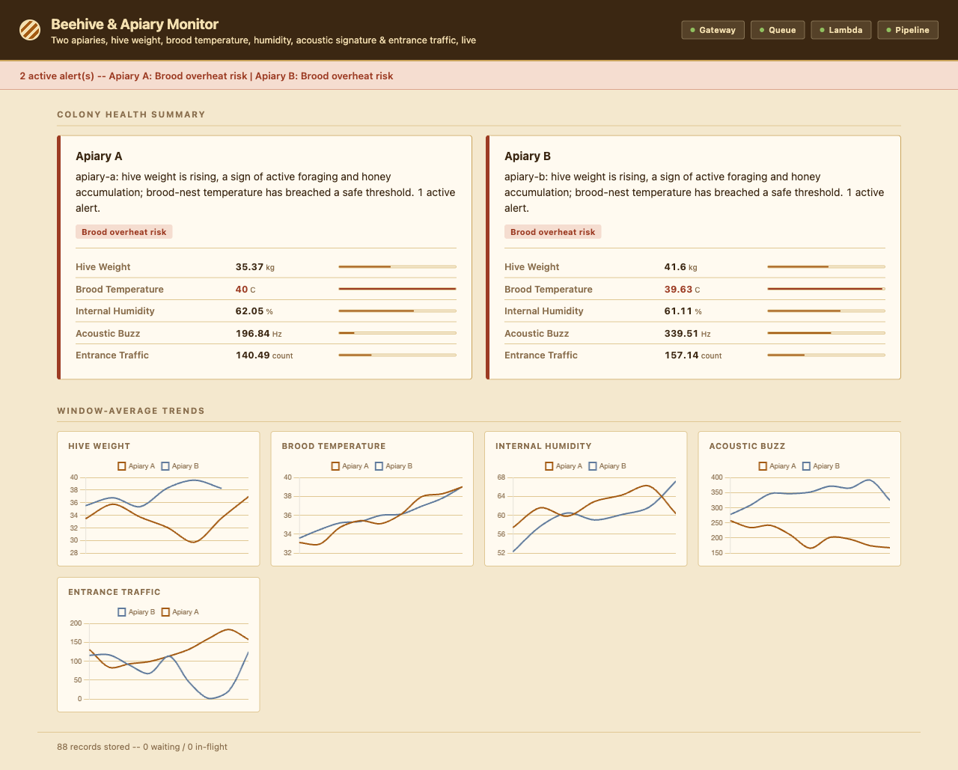
Demonstration highlights
Live dashboard: a colony-health card per apiary, each with a plain-language verdict and its five current readings against their ranges.
The alert banner names the two firing brood-overheat conditions, and both narratives report brood temperature breaching a safe threshold while weight is rising.
All four pipeline health checks green: gateway, queue, Lambda, and the end-to-end pipeline.
138 automated tests pass across sensors, fog, processor and dashboard.

Slide 5
The hardest part: a verdict, not a jittery number
The goal:
A beekeeper does not want five live graphs per hive; the useful answer is whether a colony is thriving, stressed, or about to swarm.
Why it was hard:
A single 10-second window is noisy - bees are loud and entrance traffic spikes - so a naive per-reading rule cries wolf, and one reading cannot tell a rising trend from a blip.
The fix:
Rules score the window mean or minimum, never a single sample; then the read tier reads a short history of recent windows and reduces it to a weight trend and a brood-thermal state, composed into one sentence per apiary.
The judgement lives in the read tier, where that history is already at hand, so the dashboard says "weight rising, brood temperature has breached a safe threshold" rather than showing a number to interpret.

Slide 6
What to take away
Decide at the edge: colony rules, including the acoustic swarming precursor, fire the moment a 10-second window closes, on site.
Ship summaries, not noise: one aggregate per window flows through Amazon SQS, AWS Lambda and DynamoDB, which is lean, cheap and durable.
Report a judgement: the read tier turns telemetry into a plain-language colony verdict, so the keeper reads a conclusion, not a chart.
Proven and portable: 138 tests pass and one infrastructure-as-code apply moves the whole pipeline onto real AWS.
Thank you. Questions?

