Slide 1
Patient Vitals Remote Monitoring
Continuous ward monitoring on a fog and serverless pipeline
Sri Venkat Bora
Student ID X25164414
MSc in Cloud Computing · Fog and Edge Computing (H9FECC)
National College of Ireland

Slide 2
Spot checks miss the moment that matters
Ward rounds are periodic: a manual observation captures one moment, and between rounds nobody is watching the numbers.
Deterioration is a trend: falling oxygen or a climbing heart rate develops over minutes, so a single reading in isolation can still look normal.
Thresholds need continuous data: this project watches five vitals for two patients around the clock and checks every window against clinical limits.
The numbers behind the monitor:
Below 92%: the blood-oxygen level that triggers a clinical hypoxia alert.
2 to 3 seconds: between readings from every bedside sensor.
10 seconds: the window in which vitals are aggregated and alert rules checked.

Slide 3
How it works: bedside to dashboard in seconds
Bedside sensors: 10 streams, five vitals for two patients, a reading every 2 to 3 seconds.
Fog gateway: 10-second windows aggregate each vital and check clinical alert rules.
Amazon SQS: one aggregate per vital per window, sent in batches.
AWS Lambda: serverless ingest, triggered straight off the queue.
Amazon DynamoDB: durable store for every windowed record.
Ward dashboard: live monitor, served on AWS from S3 behind API Gateway.
Runs end to end today on Docker with LocalStack standing in for the AWS services, and one scripted step packages the function, wires the queue trigger and moves the same pipeline onto real AWS.

Slide 4
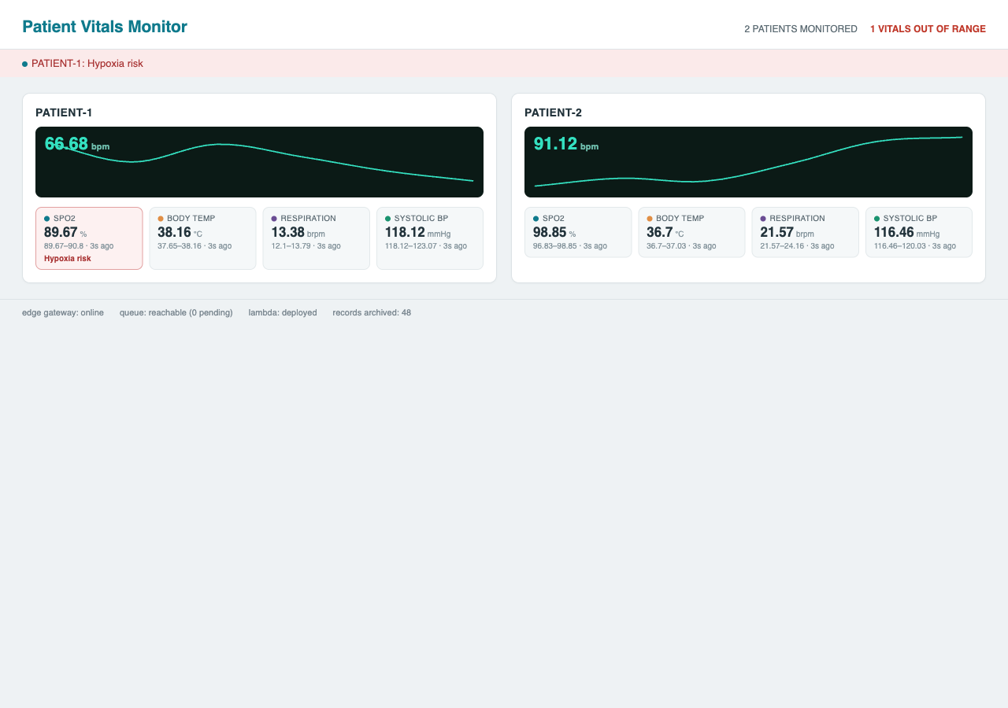
Demonstration: live monitor, alerts firing
Dashboard captured from the local end-to-end run: two patients live, one hypoxia alert active, pipeline status in the footer.
All pipeline checks green: edge gateway online, queue reachable, Lambda deployed, 48 records archived.
41 automated tests pass across the sensor, fog gateway, processor and dashboard modules.
Alerts fire on real data: hypoxia banner raised at SpO2 89.7%, crossing the 92% clinical trigger.

Slide 5
The hardest part: a bug no local test could catch
The problem:
The fog gateway's queue publisher shipped with the emulator's fake access keys hard-coded into every connection; locally everything worked, but on real AWS every send would be rejected the moment we deployed.
Why it was hard:
The emulator accepts any credentials, so all 41 tests and the full end-to-end check stayed green while the failure existed only in the real cloud (41/41 tests green with the cloud-only bug hidden).
The same audit surfaced two more silent issues: the record count read only the first page of the database scan, and aggregates left the gateway one message at a time.
How it was solved:
Fake keys are now attached only when an emulator endpoint is configured, and on real AWS the toolkit falls back to its own identity chain.
The count follows every page of the scan, sends are batched ten to a call, and new regression tests lock all three fixes in.
In total, 3 silent emulator assumptions were found and fixed in one cloud-readiness audit.

Slide 6
What this project shows
Intelligence lives at the edge: alert decisions happen at the bedside gateway within a ten-second window, and the cloud receives compact aggregates, not raw streams.
The backbone is serverless: Amazon SQS, AWS Lambda and DynamoDB scale with no servers to manage, and one scripted step takes the pipeline from emulator to real AWS.
Verified, not assumed: 41 automated tests plus an end-to-end pipeline check, including the failure modes only the real cloud would expose.
Thank you. Questions?

