Slide 1
Smart Parking Management
Two car parks, ten live sensor streams, one real-time capacity console.
MSc in Cloud Computing · Fog and Edge Computing (H9FECC)
National College of Ireland

Slide 2
A car park changes faster than anyone can check it
Occupancy, entry and exit flow, dwell time and gate health shift minute by minute; a manual count is stale almost as soon as it is written down.
Periodic walk-throughs sample each lot a few times a day, so drivers queue and circle on information that no longer describes the building.
A faulty entry gate quietly chokes a whole level, and between rounds nobody sees it happening.
By the time a lot is 90% full, 270 of its 300 spaces, drivers need redirecting immediately, not at the next scheduled check.
The scale to track:
600 spaces across two multi-level lots, 300 each.
10 continuous sensor streams, five metrics for each lot.
Fresh readings every 2 to 5 seconds from every sensor, far too fast to poll by hand.

Slide 3
How it works: sensor to live console
At the car park (edge):
Parking sensors: ten live streams across two lots covering occupancy, entry and exit rates, dwell time, and gate faults.
Fog node: windows each stream, aggregates it, and raises threshold alerts right at the edge.
In the AWS cloud:
Amazon SQS: one compact aggregate per window enters the queue, not every raw reading.
AWS Lambda: serverless ingest consumes the queue and transforms each record.
Amazon DynamoDB: every window stored for history, trends and pipeline health checks.
Live dashboard: per-lot capacity console hosted on Amazon S3, with data served via Amazon API Gateway.
Running end-to-end today on Docker with a local AWS emulator; the same pipeline deploys to AWS with a single scripted step.

Slide 4
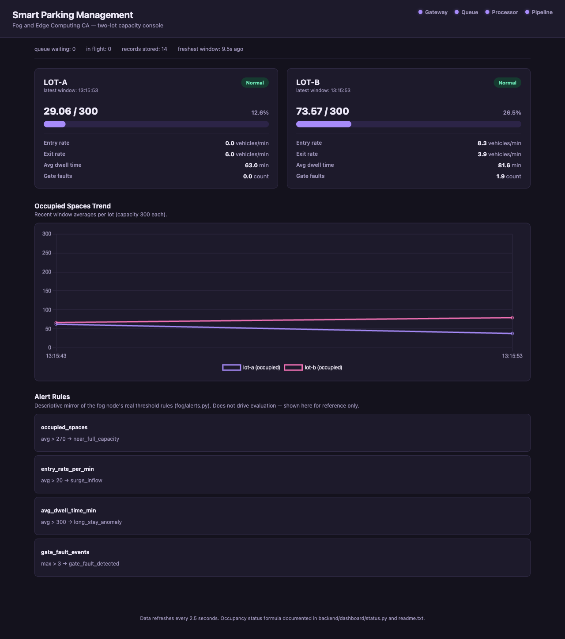
Demonstration highlights
Dashboard captured from the running pipeline on Docker with a local AWS emulator.
All four health checks green: gateway, queue, processor and end-to-end pipeline all report healthy.
127 automated tests pass, from window math and alert rules to real HTTP tests against live servers.
2,000-message burst absorbed: the load test floods the queue, then confirms the pipeline drains it.
Alerts fire on real thresholds: near-full flagged at 270 of 300 spaces, and gate alarms after repeated faults.

Slide 5
The hardest part: a fog node that never falls over
The problem:
The fog node absorbs nonstop posts from ten sensors and must hold their readings between windows, serving requests on real operating-system threads, so readings from both lots can land at exactly the same instant into the same shared buffer.
Why it was hard:
Neither failure shows up in a quick demo: an open-ended buffer only exhausts memory after hours of traffic, and a thread race only bites when two writes collide in the same microsecond.
The fix:
A bounded ring buffer per sensor stream, capped at 500 readings, the oldest silently evicted for the newest, with one lock guarding every write, so no stream can grow memory without limit and concurrent posts can no longer corrupt the buffer.
How we know it holds:
Tests force the buffer past its cap and watch eviction happen.
Real HTTP tests drive a live server, not a mocked transport.
A 2,000-message burst test fails if the pipeline ever stalls.

Slide 6
What to remember
Push intelligence to the edge:
The fog node reduces a continuous stream of raw readings to one aggregate per window and raises alerts before the cloud is even involved.
Trust comes from evidence:
127 automated tests, a scripted end-to-end check and a 2,000-message load test stand behind every claim on these slides.
Cloud-ready by construction:
Built on the AWS SDK end to end, the same pipeline deploys to AWS with a single scripted step.
Thank you. Questions?

