Slide 1
Smart City Operations Monitoring
Ten street sensors, one edge relay, one serverless cloud pipeline
Mohammed Hassan Ahmed
Student ID X25100963
MSc in Cloud Computing · Fog and Edge Computing (H9FECC)
National College of Ireland

Slide 2
Why occasional checking fails
Congestion, pollution spikes and full car parks build and fade within minutes, between any two manual checks.
A patrol or a monthly meter read captures one moment; the breach that matters happens after the clipboard leaves.
Streaming every raw reading to a distant cloud is the other extreme: heavy, slow and costly at city scale.
What a city needs is continuous local watching, with only compact summaries and alerts leaving the street.
35 micrograms per cubic metre is the pipeline's PM2.5 alert line; an air quality breach can rise and fade between manual reads.
75 dB is the noise violation threshold; residents feel every extra minute it goes unnoticed.
Each of ten street sensors reports one reading every 2 to 5 seconds continuously, and no manual process keeps up with that.

Slide 3
How it works: edge to cloud
City edge:
Street sensors: 10 devices, 5 metrics, 2 zones.
Fog node windows, aggregates and alerts, with a 10 second aggregation window at the edge relay.
AWS cloud:
Amazon SQS aggregate queue, AWS Lambda serverless ingest, and Amazon DynamoDB durable store.
Live dashboard on Amazon S3 and API Gateway.
5 alert rules are assessed beside the sensors, not in the cloud.
1 scripted step: verified locally on an AWS emulator, deploys to AWS unchanged.
Each zone and metric leaves the street as one compact summary every ten seconds, alerts already attached.

Slide 4
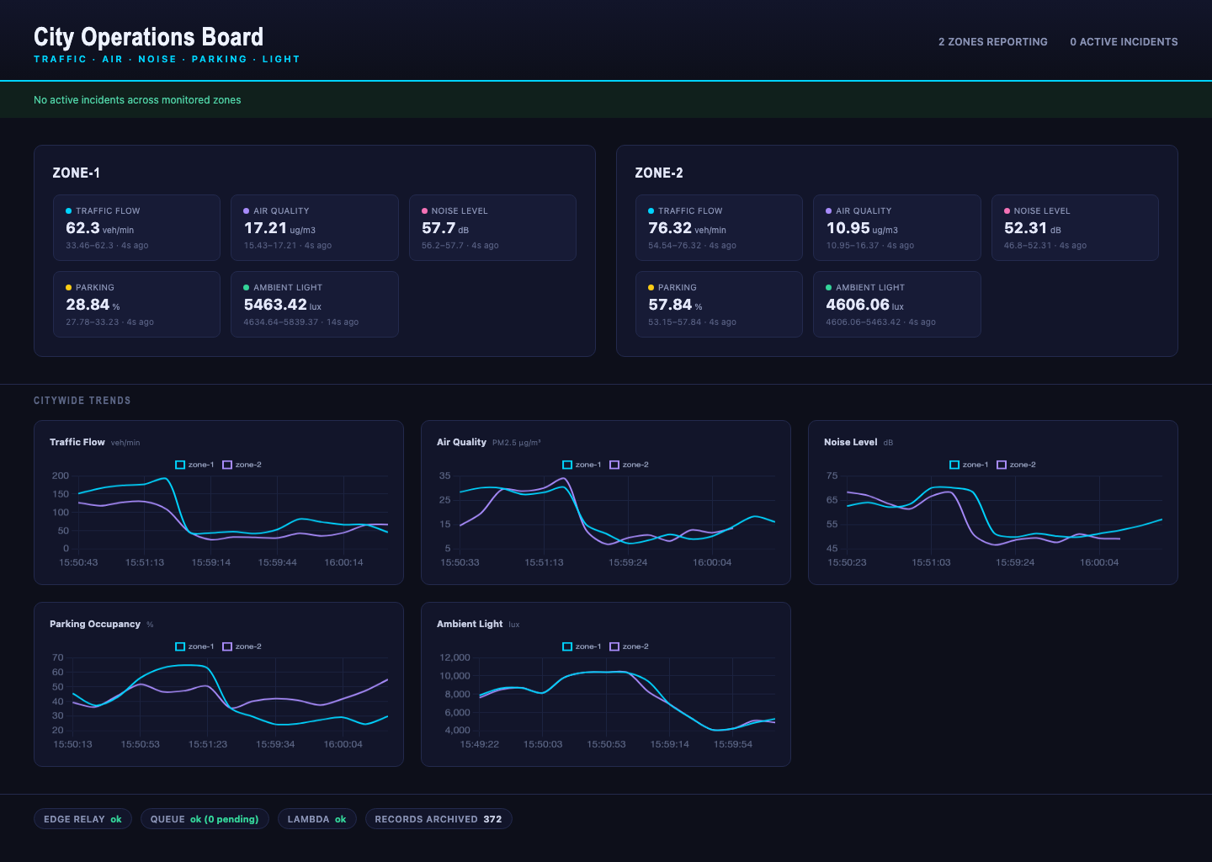
Demonstration highlights
Dashboard captured from the running stack.
Two zones reporting, five metrics per zone, citywide trend charts, and the health footer along the bottom edge.
All pipeline health checks green: edge relay online, queue reachable, Lambda deployed, records archived.
62 automated tests pass across the sensor, fog, processor and dashboard modules.
2,000-message burst absorbed: load test fired through 32 parallel workers as scalability evidence.
Five alert rules fire live: congestion, air quality, noise, parking and low visibility.

Slide 5
The hardest part: a silent race
Every ten seconds the fog node hands its buffer over for flushing. What happens to a reading that arrives at that exact instant?
The problem:
Sensor posts run on four parallel threads while a timer swaps the window buffer out for flushing. A reading landing mid-swap can be written into the retired buffer after the flush has already read it, and it simply vanishes.
Why it was hard:
Nothing fails: no exception, no log line, just one number quietly missing from a summary. The timing hole is microseconds wide, so ordinary tests pass every time and the loss would only surface under real concurrent load.
The fix:
Each buffer became a fenced generation. The flush closes the fence, waits for writers already inside to finish, then reads. A writer arriving after the fence is turned away and retries into the fresh buffer instead.
The ingest path stays lock-free; every reading now lands in exactly one window, guaranteed by the fence rather than a global lock.

Slide 6
Three things to take away
Alerts are computed beside the sensors: ten seconds from street reading to raised incident, and only compact summaries ever leave the edge.
The cloud side is serverless by construction: the same code runs against the local AWS emulator and real AWS, one scripted deployment step apart.
Correctness is proven, not assumed: 62 automated tests, an end-to-end pipeline check, a 2,000-message burst, and a fence for the bug that never showed itself.
Thank you. Questions?

