Slide 1
Event Intelligence for BTP
From Reactive Response to Proactive Deployment
▸ Dataset: 8,173 real ASTraM events · Bengaluru · Nov 2023 – Apr 2024
▸ Three pillars: Forecast Impact → Recommend Resources → Keep Learning
▸ Live prototype: Streamlit dashboard — Event Response + City Insights
▸ Every number traces back to BTP's own ASTraM records
Gridlock Hackathon 2.0 · PS2 · Bengaluru Traffic Police

Slide 2
The Problem: Three Gaps BTP Faces Today
BTP's own brief names the gaps — we built exactly one pillar per gap
GAP 1 — Impact Not Quantified
Officers arrive with no estimate of how long an event will last or whether the road will close. Every incident looks equally urgent.
GAP 2 — Experience-Driven Deployment
Manpower decisions depend on individual judgment — inconsistent across shifts and zones. No principled resource model exists.
GAP 3 — No Post-Event Learning
Each event is forgotten once cleared. Patterns repeat. The system never improves. The event mix keeps shifting undetected.
94% of events are unplanned | 62% (5,030) flagged High priority | Event mix shifts month-over-month without a learning loop

Slide 3
The Data: Real BTP Records — No Synthetic Fabrication
8,173 ASTraM events · 6 months · entire city · used as-is from the provided dataset
▸ Time span: November 2023 – April 2024 — 6 full months of city-wide incident data
▸ Coverage: all corridors, zones, junctions, and priority levels across Bengaluru
▸ 116 malformed timestamps caught and corrected during ingestion — zero silent data loss
▸ Features used at inference: event cause, type, corridor, zone, junction, police station,
vehicle type, priority, latitude/longitude, hour, day-of-week, month
▸ Only provided ASTraM data used — no external feeds, no synthetic rows
▸ Every figure traces to a specific cell in the dataset or EDA table — fully auditable

Slide 4
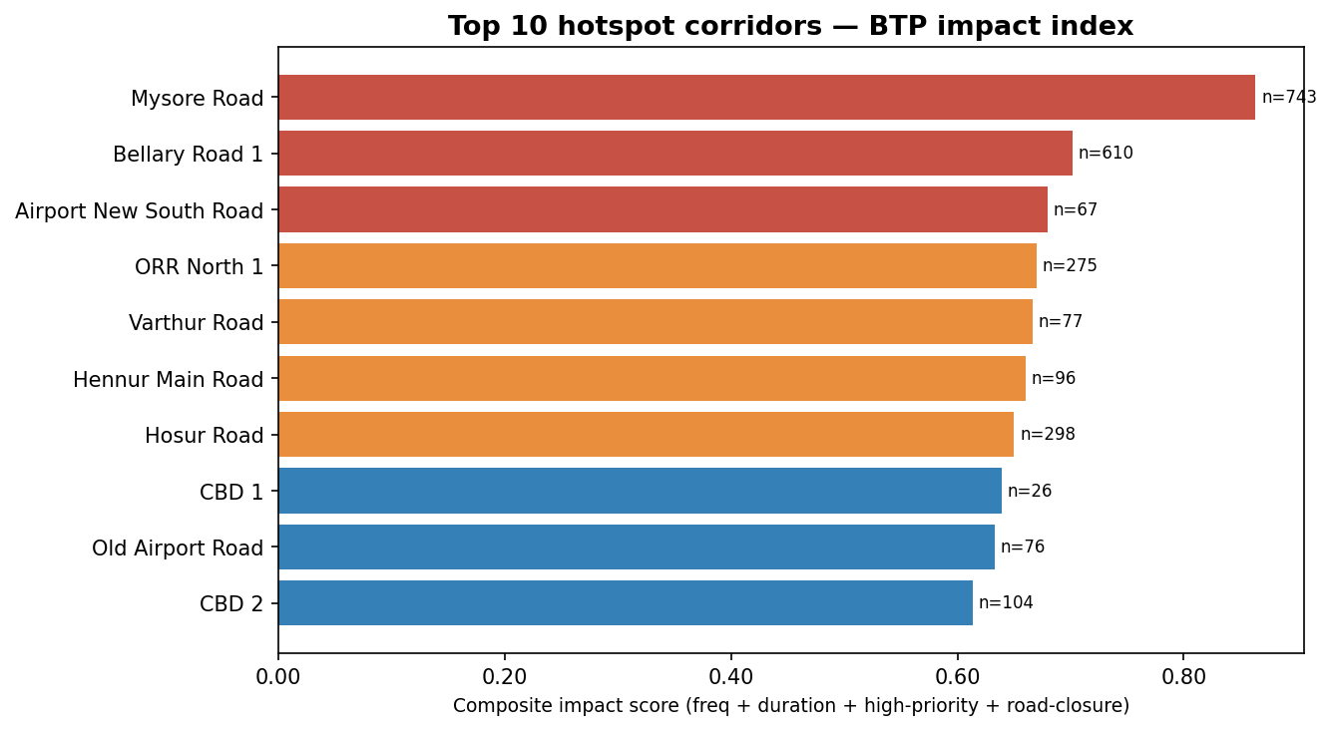
Key Insights: What the Data Actually Says
Four findings that directly shape the solution design
60% breakdowns · two corridors carry 100% high-priority
4,896 vehicle breakdowns — concentrated on Mysore Road (743 events) and Bellary Road 1 (610 events), both 100% high-priority
Construction = 5-hour bottleneck
Median clearance 296 min vs 41 min for breakdowns; P75 stretches to 427 min — 7× slower than a typical breakdown
80% of events are off-peak · 2 AM is the busiest single hour
845 events at 2 AM — uncleared night breakdowns become the 8 AM gridlock. Night-shift coverage is not optional; it is the peak-volume hour.
Event mix is drifting — static models degrade quietly
Breakdown share: 66% → 49% over 6 months. Road-closure rate: 6.4% → 9.4%. A frozen model never knows this.

Slide 5
Our Solution: Three Pillars + One Dashboard
One input (the event report). Three outputs. One interface.
PILLAR 1 — Forecast Impact
▸ Road-closure probability (AUC 0.816 on future data)
▸ Expected clearance time — benchmarked per cause from EDA
▸ Severity label: Low / Medium / High
PILLAR 2 — Recommendation Engine
▸ Officer count | Barricade flag | Diversion route
▸ Nearest responding police station
▸ Plain-English rationale — designed for field officers
PILLAR 3 — Post-Event Learning Loop
▸ Monthly retrain on new resolved events
▸ Drift monitoring — alert if AUC drops below 0.70
▸ Feb 2024 proof: retrained +1.8 pp vs frozen static model
Streamlit dashboard: Event Response + City Insights (map · hotspots · corridors) — live demo at the finale

Slide 6
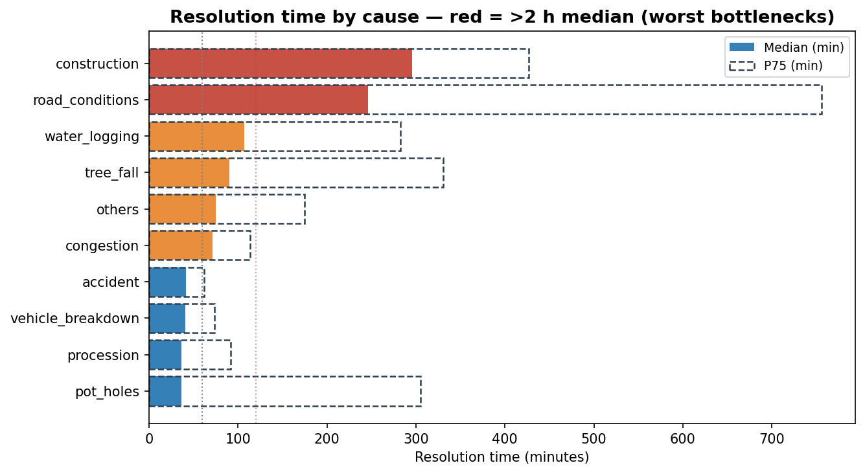
Pillar 1: Impact Forecasting — Model Results
CatBoost · time-based train/test split · trained on past, tested on future months
Road-closure classifier (CatBoost) — primary signal
Future months (Mar–Apr 2024) ROC-AUC 0.816 F1 0.450
Unseen corridors (6 held out) ROC-AUC ~0.70 (0.696) F1 0.335
Cold-start (unseen corridor + junction) ROC-AUC ~0.73 (0.731)
F1 is lower — road closures are rare (8.3%). AUC is the correct metric
for a skewed binary target; it measures ranking ability at all thresholds.
Top feature: event cause (36 pts) — closure risk estimated from cause alone
even when corridor is entirely unseen.
Duration benchmark — planning uncertainty
MAE ~103 min on future data. R² ≈ 0 (duration is not reliably predictable).
EDA cause medians used instead: breakdown 41 min · construction 296 min
Clearance time by cause — construction & road_conditions are the >2 h bottlenecks

Slide 7
Pillar 2: Recommendation Engine — A Worked Example
What a field officer sees within seconds of logging an event
Scenario: Construction on Mysore Road · 9 AM · High priority
Expected clearance
~296 min (EDA: construction median — nearly 5 hours)
Road-closure probability
68%
Severity
HIGH (all four scoring signals fire)
Recommended officers
10 (base 6 + 2 peak-hour + 2 closure bonus)
Barricading
YES (68% > 35% threshold = 4× the historical base rate)
Diversion
Magadi Road or Chord Road
Responding station
Halasuru Gate
▸ Officer count: severity tier sets base (Low=2, Med=4, High=6); peak-hour and closure bonuses are structured — no black box
▸ Barricade threshold 35% = 4× historical base rate of 8.3%
▸ Station fallback: corridor history → zone history → Haversine nearest — never crashes on unseen locations

Slide 8
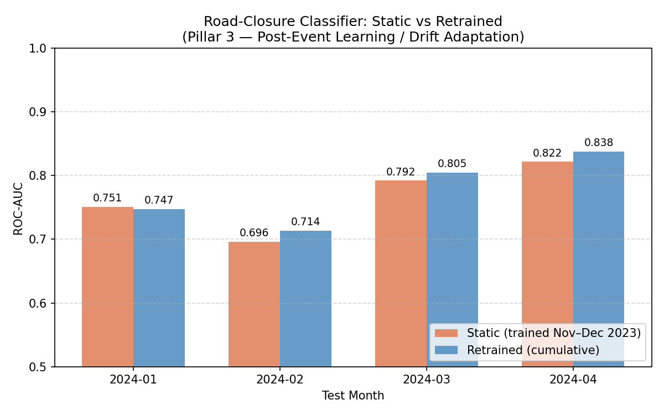
Pillar 3: The Learning Loop
A static model is a liability — the event mix is already shifting
Month tested
Static (frozen)
Retrained
Difference
Jan 2024
0.751
0.747
−0.004
Feb 2024
0.696
0.714
+0.018
Mar 2024
0.792
0.805
+0.013
Apr 2024
0.822
0.838
+0.016
Feb 2024 — the clearest drift case (static fell below the 0.70 alert line)
▸ Feb is the clearest case: static drops to AUC 0.696; retrained holds at 0.714
▸ Retraining never materially hurts (Jan: −0.004 pp, negligible)
▸ Recommended cadence: monthly — aligns with observed cause-mix shift
▸ Alert triggered automatically if AUC drops below 0.70

Slide 9
Robustness: Works on Data the Model Has Never Seen
Three validation dimensions — because production is always the future
Future time (primary)
Train Nov–Feb → test Mar–Apr 2024
AUC 0.816 (closure) · MAE ~103 min (duration) · R² ≈ 0 (intentional — use EDA medians)
Unseen locations
6 corridors held out entirely from training
AUC ~0.70 (0.696) · Cold-start (unseen corridor + junction): AUC ~0.73 (0.731)
Completely new event
Fog / Low Visibility on NH-44 Bypass — not in any training record
Degrades gracefully: zone fallback station · AUC-estimated closure · 41-min benchmark
▸ Out-of-fold target encoding (alpha=20) prevents leakage; new corridors fall back to global prior — no crash
▸ CatBoost handles completely unseen cause labels natively at inference time
▸ Three-layer station lookup (corridor → zone → Haversine) always returns a valid station
▸ 116 malformed timestamps caught and corrected — pipeline tolerates real-world messy ASTraM data
▸ 78/78 formal tests pass — including empty dict, all-unseen categories, and sparse inputs

Slide 10
Real-World Impact & Scalability for BTP
What changes the day BTP deploys this system
Immediate operational changes
What this is not
▸ Every logged event gets severity label + officer count in under 1 second
✗ Not a replacement for field judgment — officer counts are starting points
▸ Closure-risk events (Mysore Road construction 68%) trigger barricade pre-staging
✗ Not a real-time signal controller — it advises dispatchers, does not automate
▸ Night-shift gap quantified: 845 events at 2 AM demand staffed response
✗ Not a substitute for live traffic feed data — diversion routes not dynamically verified
▸ Seasonal planning: March surge (1,956 events) can be resourced in advance
Scalability — assessment
▸ Retraining: under 5 minutes on a laptop; new corridors handled without code changes
▸ Real-time feed: replace CSV loader with API call — all downstream logic unchanged
▸ Other cities: retrain on that city's data; one config change (fallback station)

Slide 11
Test Suite: 78/78 Passing — Zero Failures
Formal reproducible test suite covers every layer of the system
(32 tests) Data & Cleaning edge cases
Timestamp parsing · negative durations · unseen cause labels · missing fields
✓
(7 tests) Accuracy on unseen data
AUC on future months · unseen corridors · cold-start — no training data leakage
✓
(12 tests) predict_impact robustness
Empty dict · all-unseen categories · sparse input — always returns valid in-range output
✓
(24 tests) recommend() robustness
All 17 cause values · unseen corridor + cause · empty dict — always returns all 8 keys
✓
(3 tests) Dashboard smoke test
AppTest load · form submit · output rendered — zero exceptions on a full run
✓

Slide 12
Roadmap to Production
Built and working today — a clear path from prototype to daily BTP use.
What we've built
▸ Notebook: full EDA + model training + learning-loop comparison, all reproducible
▸ Streamlit dashboard — Event Response + City Insights, inference under 1 second per event
▸ Monthly retraining script ready to schedule; 78/78 formal tests pass
1
Access to a live ASTraM feed
Move from historical replay to real-time recommendations — pipeline is already built for it
2
Feedback labels from field officers
"Was the closure prediction right? Was manpower sufficient?" — closes the learning loop
3
Pilot corridor: Mysore Road · 30 days
Run recommendations alongside manual dispatch; compare officer utilisation and response time
Already live on Streamlit Cloud and fully reproducible — deployable on BTP's internal network today

