Slide 1
AI and Future
Imagine a business user interacts with LLM to create a simple Restful service with few lines of text,
I want to create a restful service UserService, with underlying table structure User(fname – String, lname – String, age – Integer)
User Table
Metadata in Hasura
Rest Endpoint

Slide 2
AI
Artificial Narrow Intelligence
General Artificial Intelligence

Slide 3
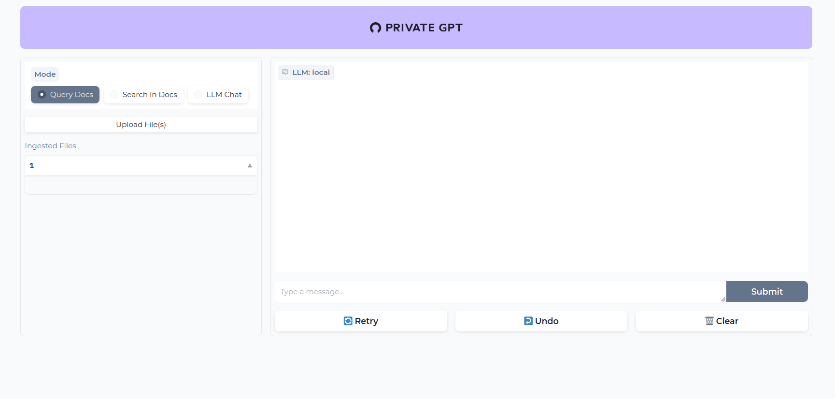
Private GPT

Slide 4
Open Source Models
Mistral
Microsoft Phi
Mosaic ML
Hugging Face LLMS

Slide 5
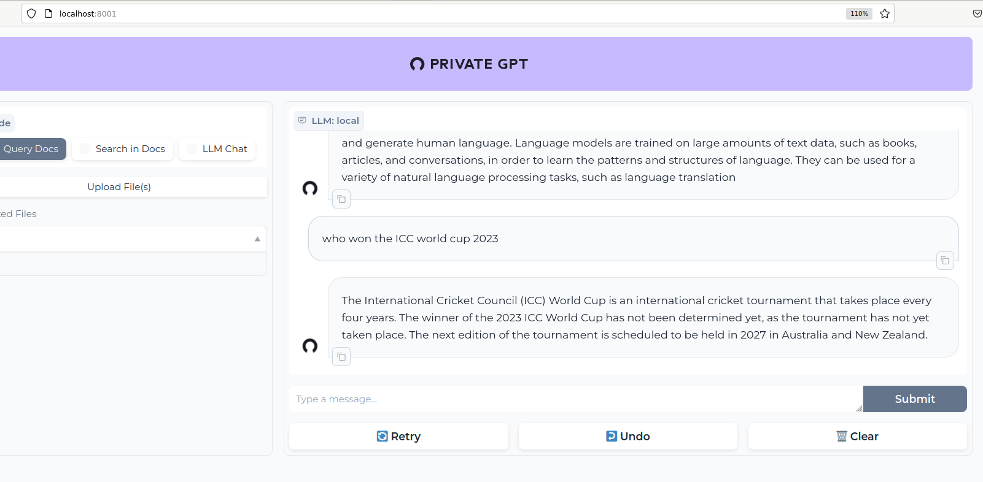
GPT missing Knowledge

Slide 6
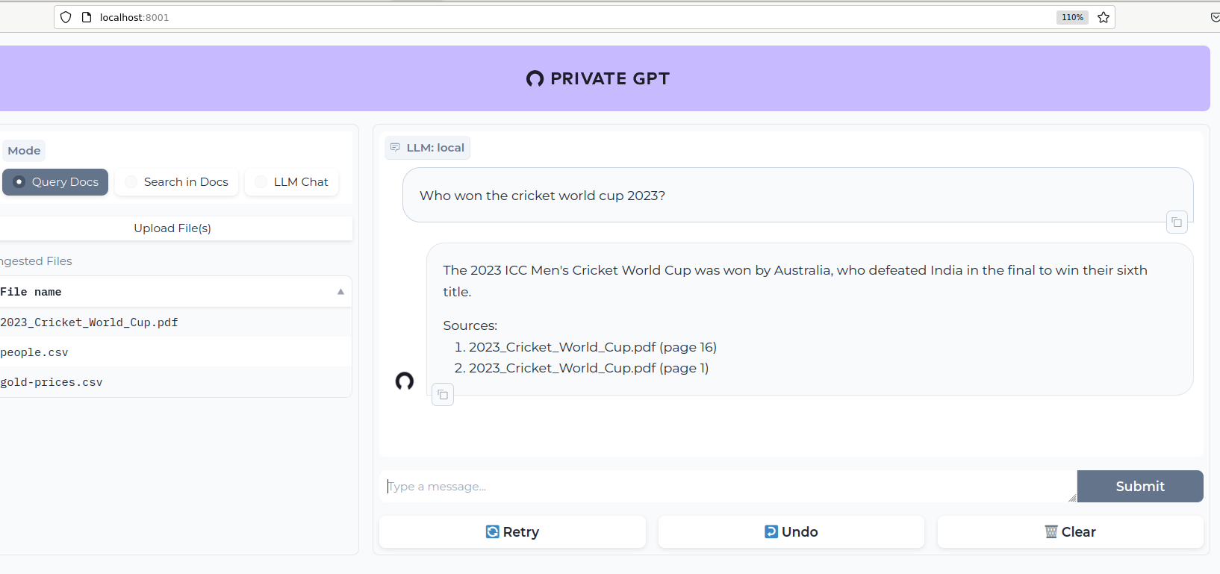
GPT additional Knowledge through RAG

Slide 7
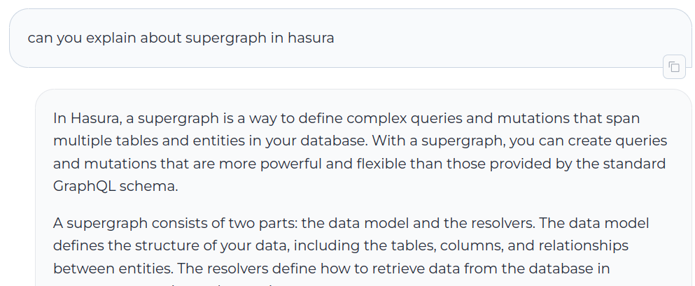
GPT with Hallucination
There is no two parts for supergraph in Hasura, clearly the model is not trained with the data and is an example of hallucination

Slide 8
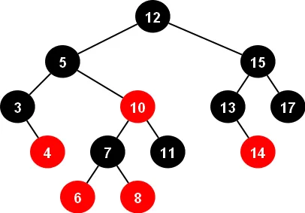
Database Search
R/B tree

Slide 9
TF / IDF
Information Retrieval
  The most pertinent document related to the word you are looking for ranked higher and results will be returned based on that.
Keyword Extraction
  Words received highest score in the document were the most pertinent to the document.

Slide 10
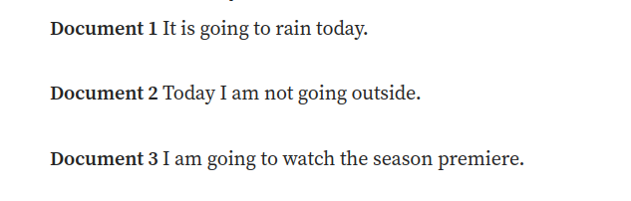
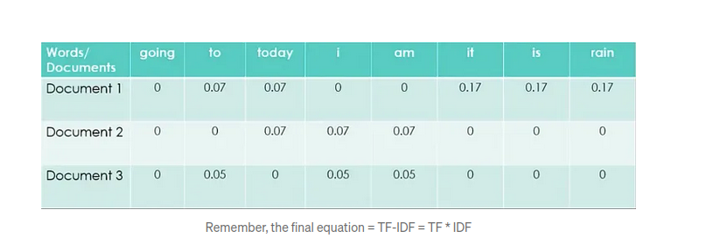
TF-IDF Example

Slide 11
Word Embeddings
Learned representation for text where words that have same meaning have a similar representation.

Slide 12
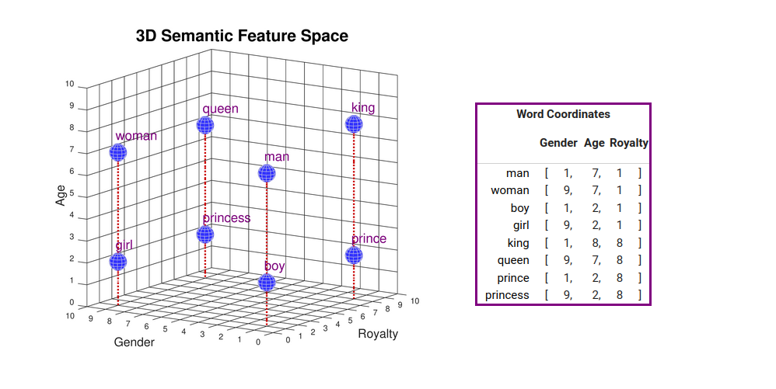
Vector Representation of Words

Slide 13
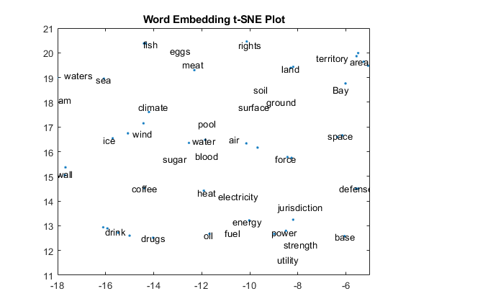
Word Embedding Visualization

Slide 14
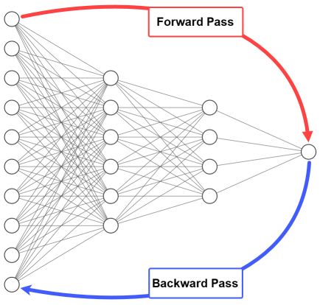
Neural Net and Deep Learning

Slide 15
Types of Neural Network
Convolutional Neural Network
  extra layer of processing that helps them to better identify patterns in images
Recurring Neural Network
  Used to Process sequence of inputs
Long Short Term Memory
  Similar to RNN, except tries to store the long term dependent information.
Transformer with Attention
  Understand the word context surrounding them and generate new text

Slide 16
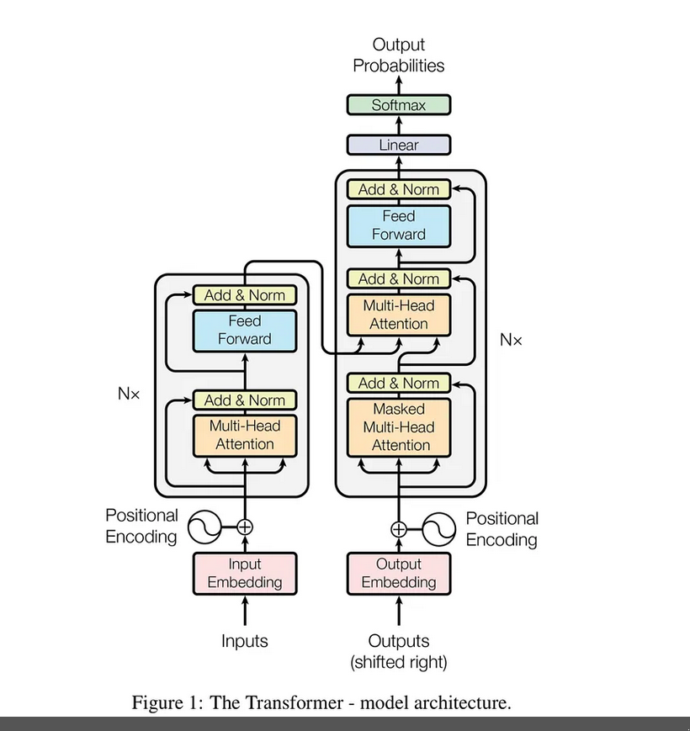
Transformer Architecture
Encoders:
Are designed to learn embeddings used for predictive modelling
Decoders: Are used to generate next word in the sentence.

Slide 17
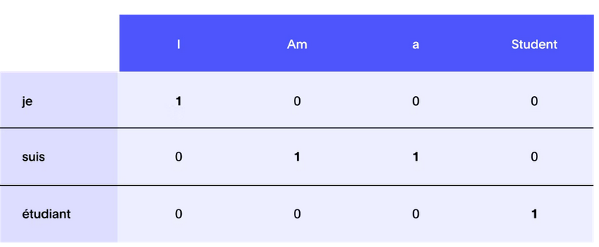
Transformer Example

Slide 18
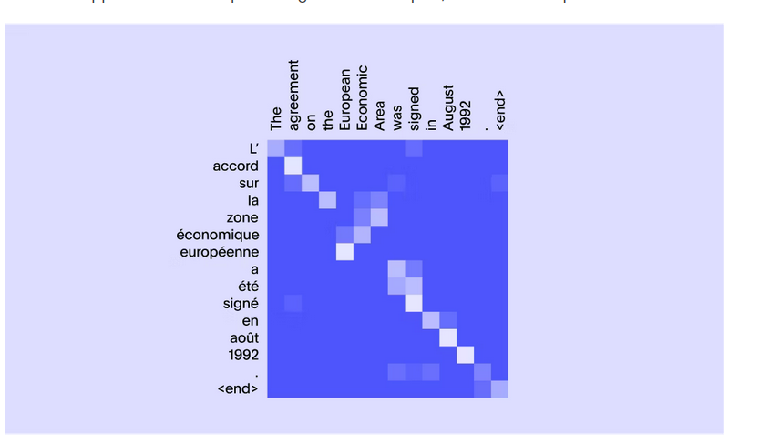
Transformer Example

Slide 19
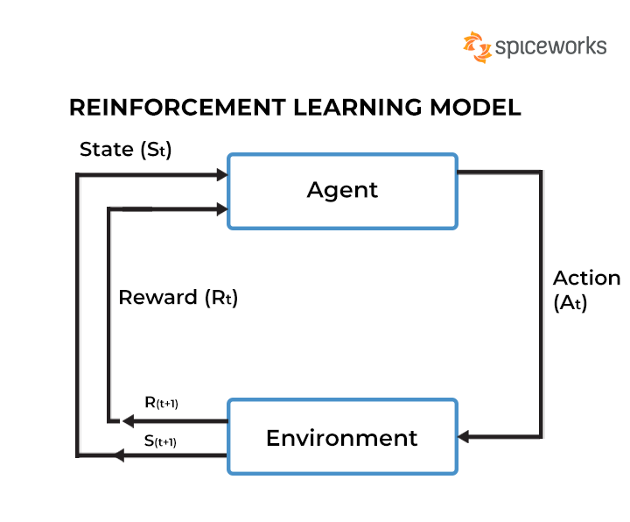
Reinforcement Learning

Slide 20
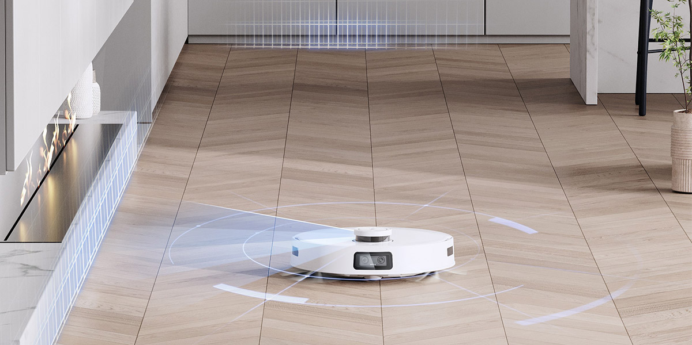
Reinforcement Learning
Example
States: all possible locations for the robot, status of each part of the floor (dirty/clean)
Actions: the robot can move in any direction;
Reward: -1 for every floor tile that is not clean
To maximize reward, the robot should try to follow the shortest path to visit all floor tiles that are not clean, suck up the dirt on each one of them.
Its reward function is not sparse; every time a tile gets cleaned, the robot receives a signal that something was improved; if it ever dumps in the wrong area, it receives a signal that things got worse.

Slide 21
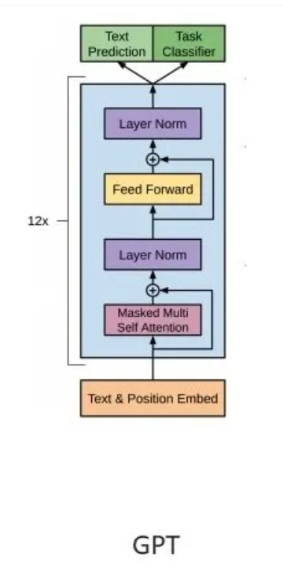
GPT
GPT / GPT 3 – is trained to predict the next word in the sentence that is why it is just using only the Decoder part of the transformer.

Slide 22
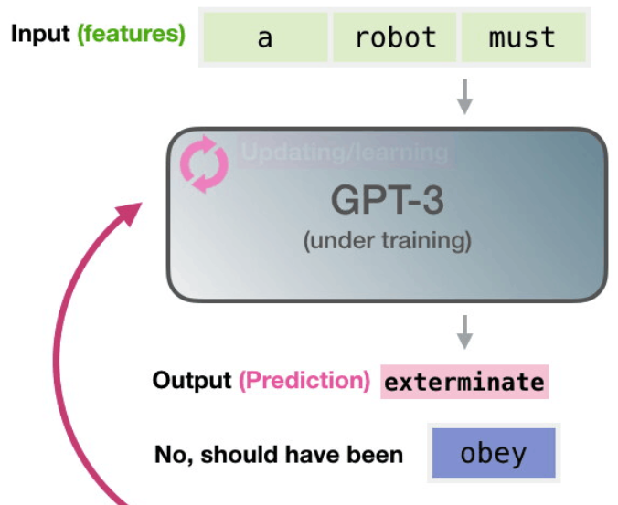
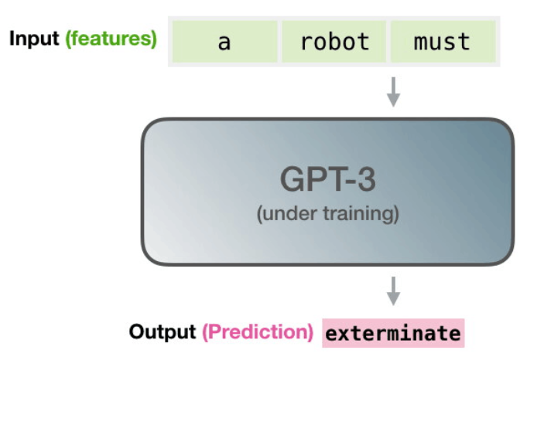
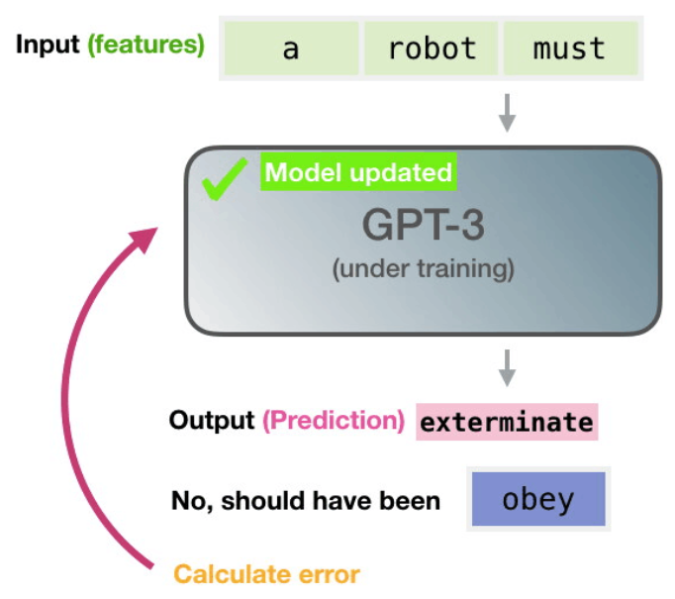
GPT Pre Training

Slide 23
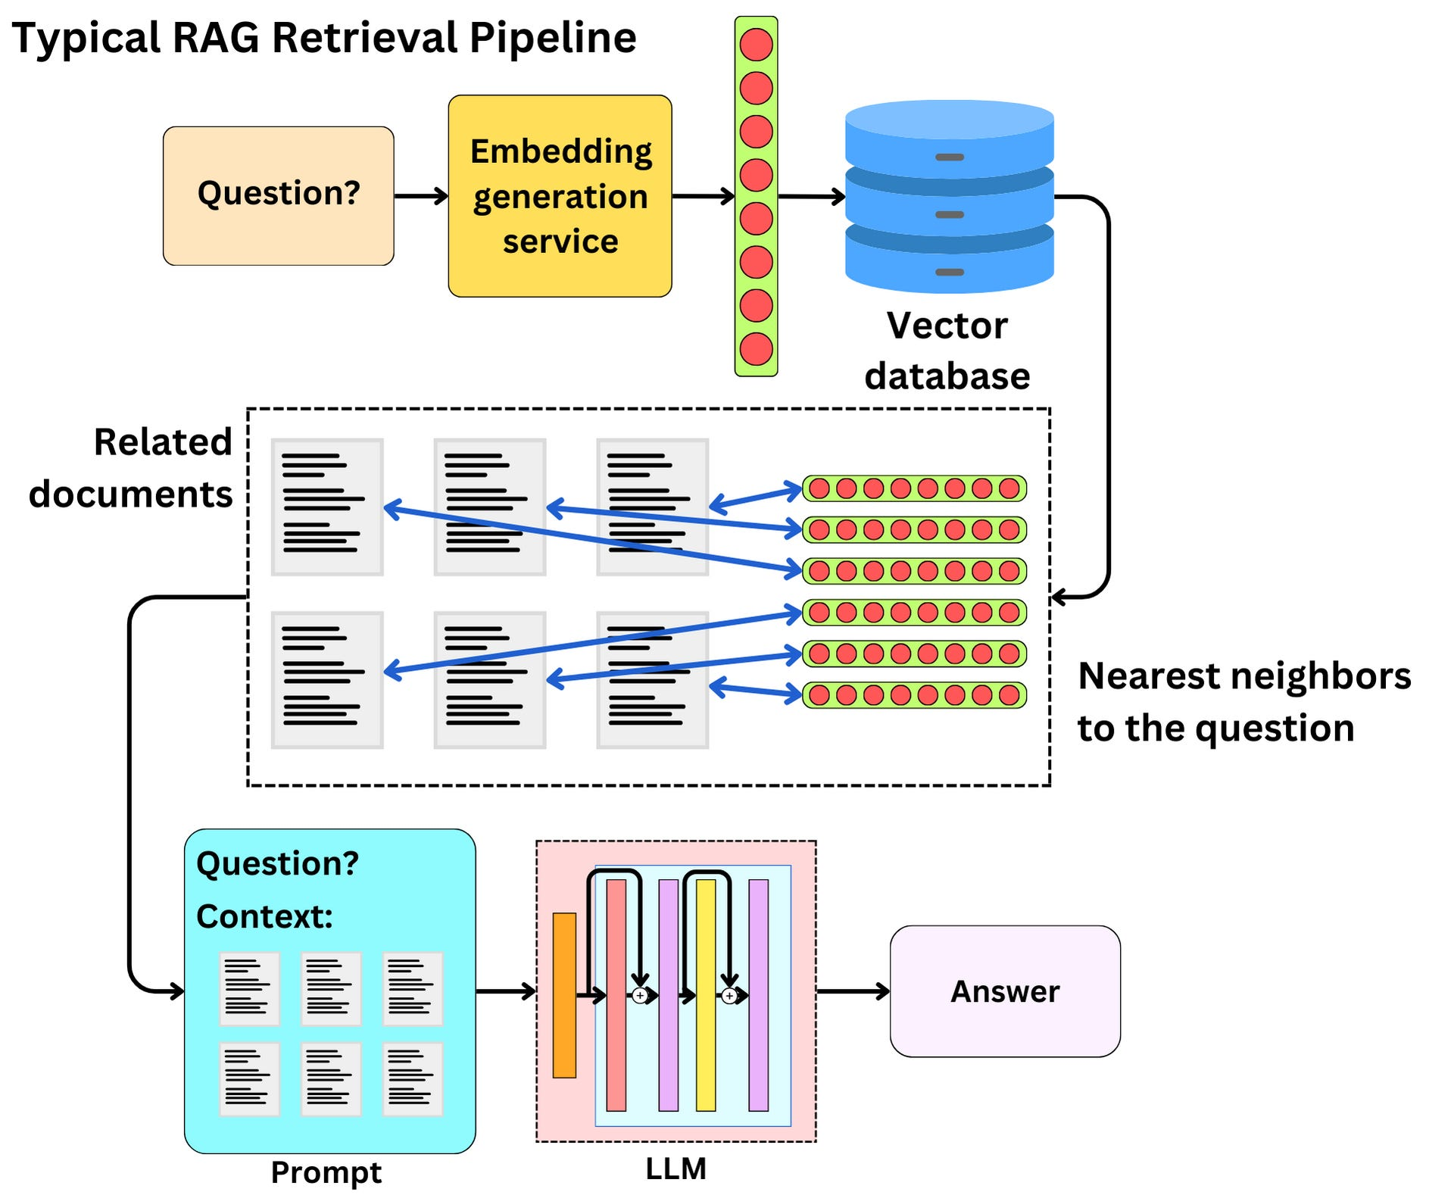
Retrieval Augmented Generation

