Slide 1
Artificial Intelligence

Slide 2
AI
Machines – repetitive task
Humans - Creativity

Slide 3
AI - Resources
https://arxiv.org/
https://openai.com/
https://paperswithcode.com/
https://towardsdatascience.com/
https://www.analyticsvidhya.com/
https://www.coursera.org/

Slide 4
AI Programming
Tensorflow
PyTorch
Keras
CNTK
FastAI

Slide 5
AI Competetion
Kaggle
Drivendata
Crowdanalytix

Slide 6
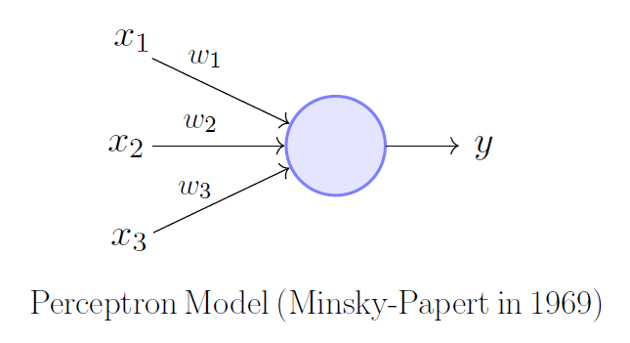
Pereptron

Slide 7
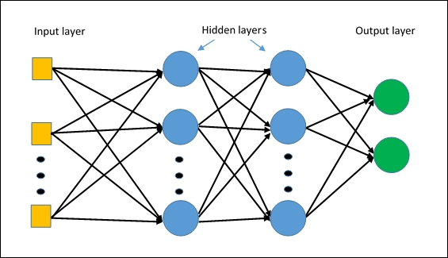
Multi Layer Perceptron

Slide 8
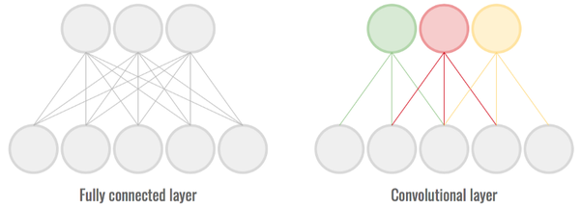
Convolutional Neural Network

Slide 9
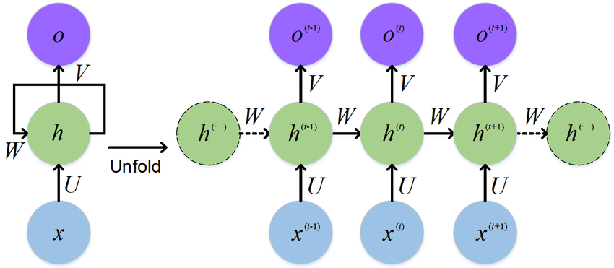
Recurrent Neural Networks

Slide 10
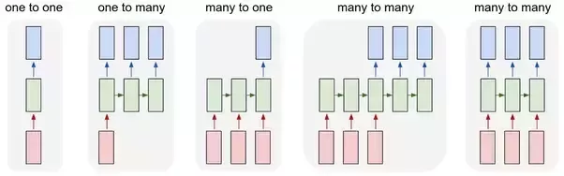
RNN
Image
Classification
Image
Caption
Sentiment
Analysis
Neural Machine Translation

Slide 11
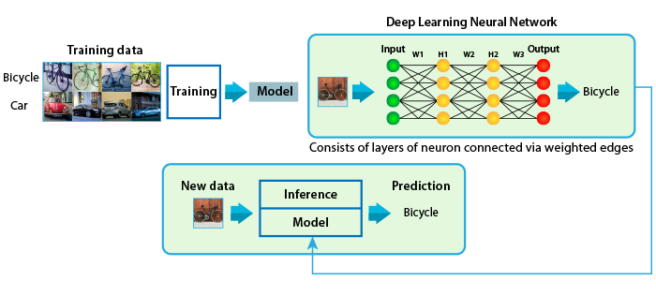
Training Model

Slide 12
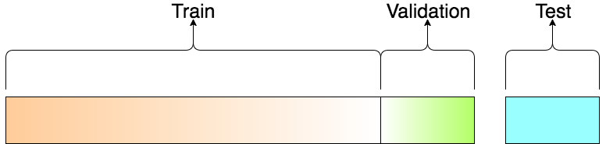
Training / Validation/ Testing

Slide 13
DataSets
Images
  MNIST
  OpenImages
  VisualQA
NLP
  IMDB review
  Yelp Review
  Sentiment140

Slide 14
IMAGES – MNIST

Slide 15
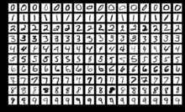
MNIST IMAGES

Slide 16

MNIST Flow
Image - Matrix
28 x 28
Image - Matrix
764 x 1
..
..

Slide 17
DEMO

Slide 18
Natural Language Processing
Branch of artificial intelligence that deals with the interaction between computers and humans using the natural language.
It is to read, decipher, understand, and make sense of the human languages in a manner that is valuable.

Slide 19
NLP in Use
Credit Worthiness
Chatbot
Sentiment Analysis
Market Intelligence

Slide 20
Natural Language Processing
Word Embeddings
Part of Speech Tagging
Named Entity Recognition
Sentiment Analysis

Slide 21
Word Embedding – One Hot Encoding
Can I eat the pizza
[1. 0. 0. 0. 0.] #can
[0. 0. 1. 0. 0.] #i
[0. 1. 0. 0. 0.] #eat
[0. 0. 0. 0. 1.] #the
[0. 0. 0. 1. 0.] #pizza

Slide 22
Word Embedding
Input
Embedding
Layer
NLP Task
Specific Layer

Slide 23
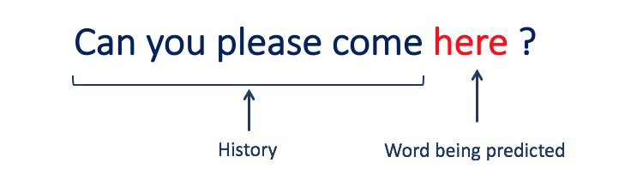
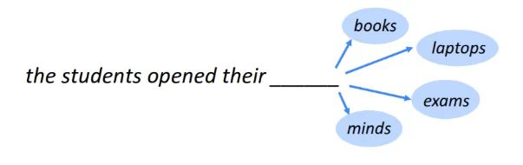
Language Model

Slide 24
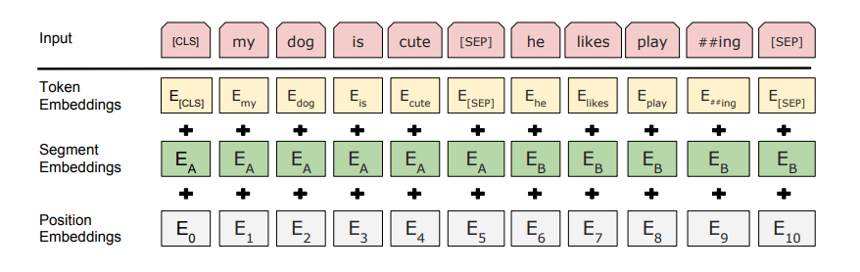
BERT

Slide 25
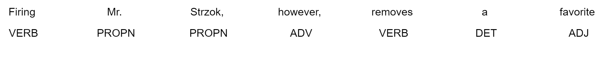
Part of Speech Tagging

Slide 26
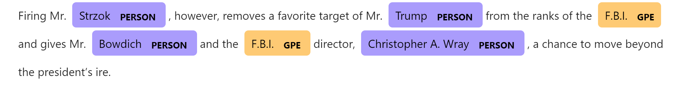
Name Entity Recognition

Slide 27
DEMO

Slide 28
Sentiment Analysis
0 - Negative
Input
Language
Model
Sentiment
Classifier
1 - Possitive

Slide 29
Sample data for Sentiment
Sl.No | Text | Supervised Output
1 | The most amazing customer service ever!!! Went to upgrade 4 lines. | 1
2 | This place is awful!! The only reason I upgraded is because I have been waiting on this phone forever... | 0

Slide 30
DEMO

Slide 31
Automated Sentiment Score of an Entity
Twitter Feed
Document
Categorizer by Entity
Sentiment
Analyser
Sentiment
Score

Slide 32
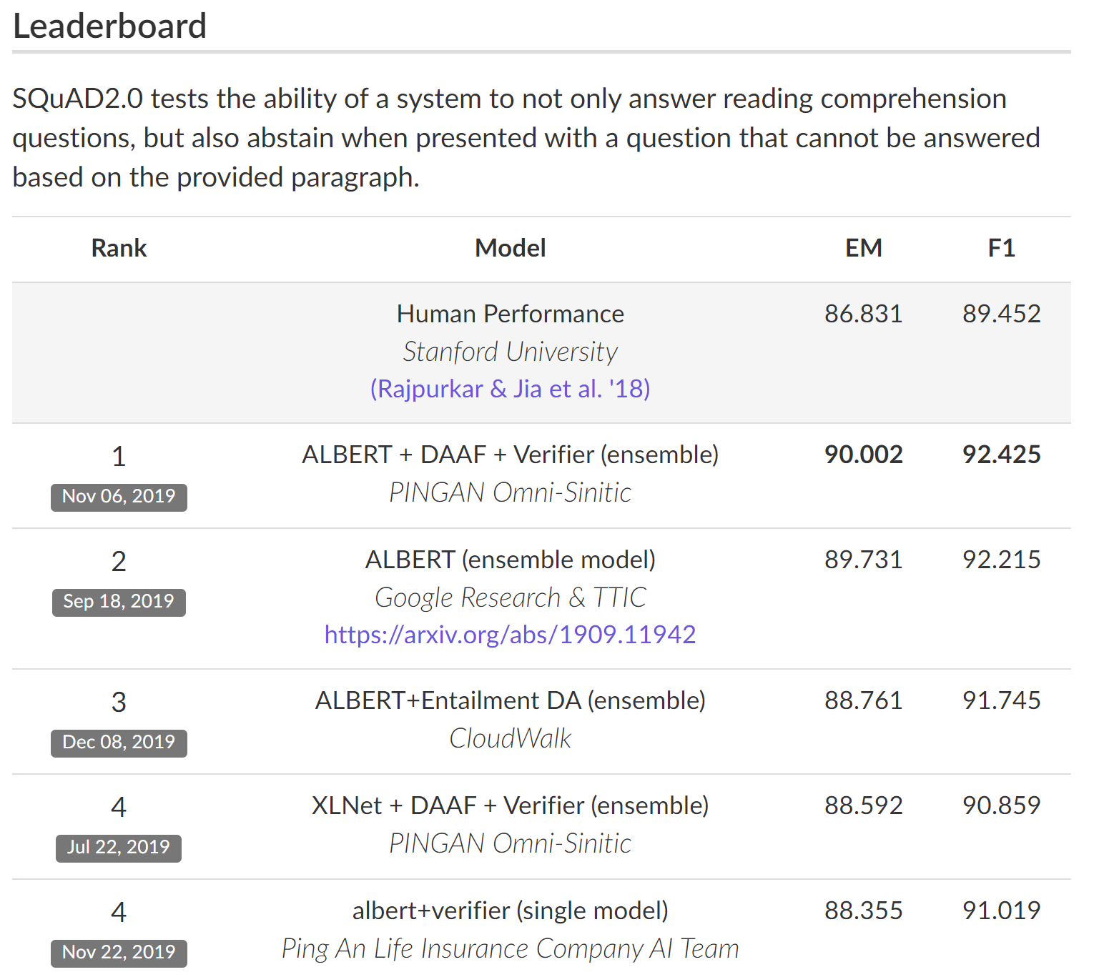
The Stanford Question Answering Dataset

Slide 33
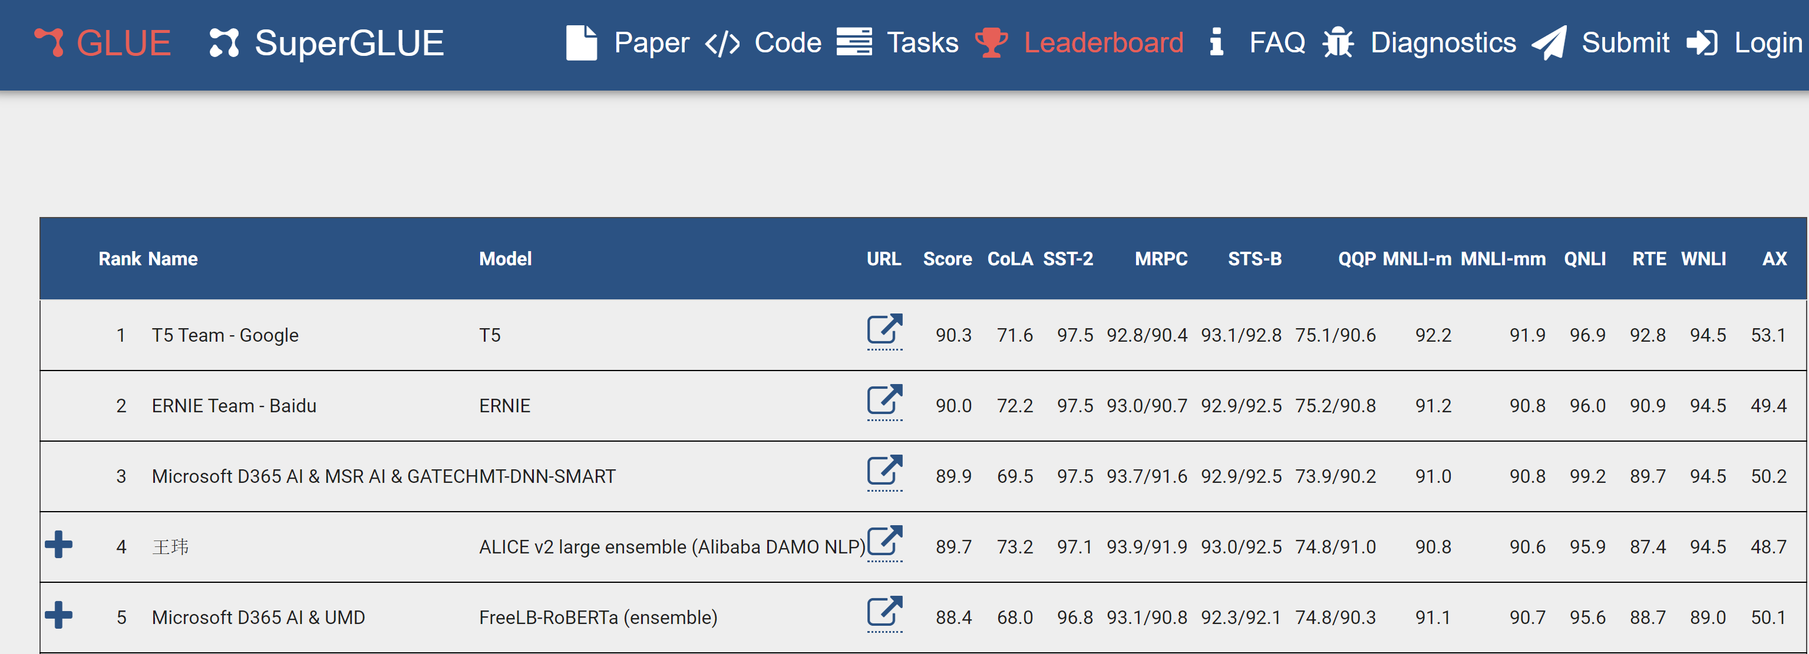
General Language Understanding Evaluation - BenchMark

Slide 34
NLP – Interesting Use cases
Open Domain Conversation
Box office predictions by scripts.
Quadratic Equation solving by Language model
Auto generated code for developers
Automated documentation of code.

Slide 35
Limitations of AI
Explanation of the outcome
Biased by the data
Lot of development efforts.
General Artificial Intelligence is long way to go.

Slide 36
Conclusion
Using AI / Robots where human life is in danger.
Embrace AI for new generations
Help and support from government for training the workforce for the future.

