Slide 1
Artificial Intelligence

Slide 2
AI
Machines – repetitive task
Humans - Creativity

Slide 3
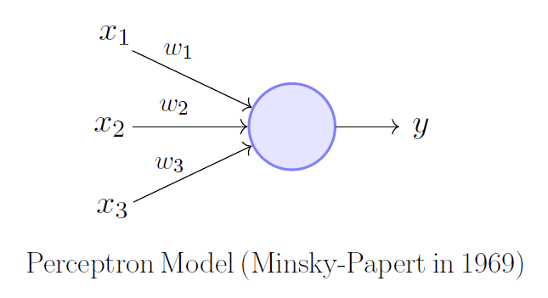
Pereptron

Slide 4
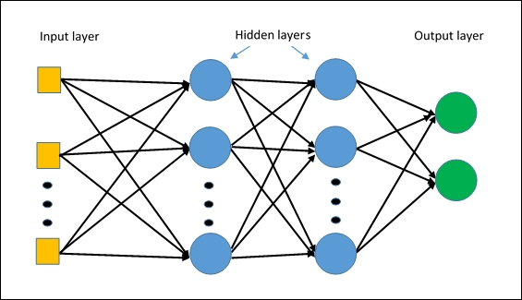
Multi Layer Perceptron

Slide 5
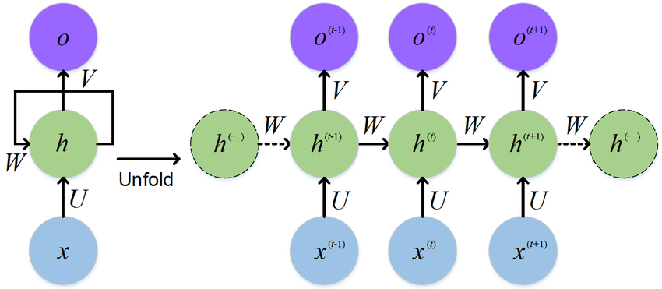
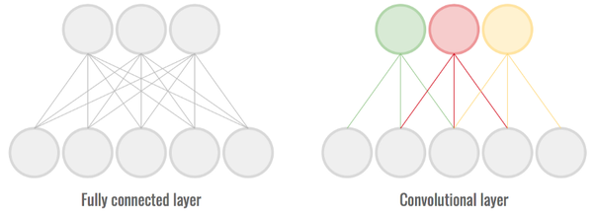
CNN / RNN

Slide 6
AI Programming
Tensorflow
PyTorch
Keras
CNTK
FastAI

Slide 7
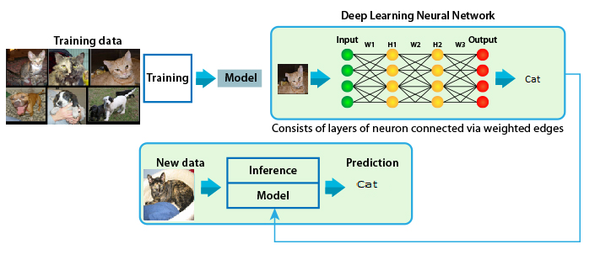
Training Model

Slide 8
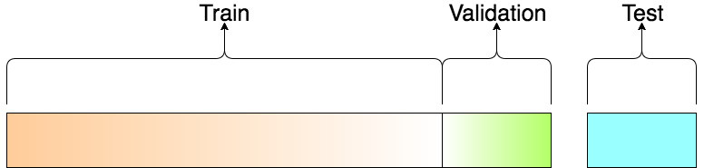
Training / Validation/ Testing

Slide 9
DataSets
Images
  MNIST
  OpenImages
  VisualQA
NLP
  IMDB review
  Yelp Review
  Sentiment140

