Slide 1
Cluster Analysis

Slide 2
Agenda
Definition
Approaches to Clustering
Implementation in python

Slide 3
Cluster Analysis
  Cluster is a group of objects that belongs to the same class.
  Clustering is the process of making a group of abstract objects into classes of similar objects.
  A cluster of data objects can be treated as one group.
  partition the set of data into groups based on data similarity and then assign the labels to the groups.
  adaptable to changes
  helps single out useful features that distinguish different groups.
  Multivariate technique

Slide 4
Applications of Cluster Analysis
  market research
  pattern recognition
  data analysis
  image processing.
  Demography

Slide 5
Objectives of Cluster Analysis
  Taxonomy Description
  Data Simplification
  Relationship identification

Slide 6
Measuring Similarity
  Correlational measures
  Distance measures

Slide 7
Measuring Distance
  Euclidean distance
  Squared euclidean distance
  City block distance
  Chebychev distance
  Mahalanobis distance

Slide 8
Types of distance
  Between cluster sum of squares
  Within cluster sum of squares

Slide 9
Types of clustering
  Hard clustering
  Soft clustering

Slide 10
Types of clustering algorithms
  Connectivity models
  Centroid models
  Distribution models
  Density models

Slide 11
K means clustering
  Specify the number of clusters
  Randomly assign each data point to cluster
  Compute cluster centroids
  Re-assign each point to the closest cluster centroid
  Re compute cluster centroids
  Repeat previous 2 steps until there is no improvement

Slide 12
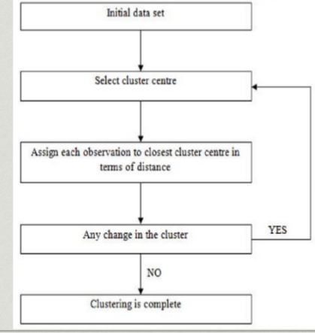
K means clustering

Slide 13
K means clustering-Pros and cons
  Advantages
    Ease of implementation
    High speed performance
    Suitable for large datasets
  Disadvantages
    Difficulty in selection of optimal clusters
    Random selection of initial centroids
    Not suitable for categorical variables

Slide 14
Applciations of K means
  Rating based clustering system
  E Commerce sites
  Enhanced marketing strategies

Slide 15
Heirarchical clustering
Can be visualised as a dendrogram
Dendrogram- tree like diagram depicting the sequences of merges/splits
No assumptions on the no. of clusters
Corresponds to taxonomies
Two types
  Agglomerative
  Divisive

Slide 16
Agglomerative Heirarchical clustering
Start by assigning each item to its own cluster
Find the closest pair of clusters and merge them into a single cluster
Compute distances between the new cluster and each of the old clusters.
Repeat steps 2 and 3 until all items are clustered into a single cluster.

Slide 17
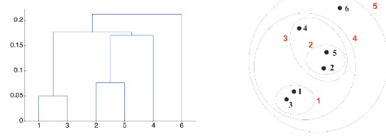
Dendrogram

Slide 18
Heirarchical clustering – Pros and cons
Advantages
  Outputs a hierarchical structure
  Easy to implement
Disadvantages
  Forward selection – Cannot go backward
  Not suitable for large datasets
  Very sensitive to outliers

Slide 19
Heirarchical clustering – Applications
Search engines
Generating taxonomies

Slide 20
Kmeans clustering – Implementation
import numpy as np
import matplotlib.pyplot as plt
from matplotlib import style
style.use("ggplot")
from sklearn.cluster import KMeans
from collections import Counter
from mpl_toolkits.mplot3d import Axes3D
from pylab import *

Slide 21
Kmeans clustering – Implementation
from sklearn.datasets import load_iris
#importing the Iris dataset with pandas
dataset = load_iris()
x = dataset.data[:, [1, 2, 3]]
print(x)
from sklearn.cluster import KMeans
wcss = []
for i in range(1, 11):
kmeans = KMeans(n_clusters = i, init = 'k-means++', max_iter = 300, n_init = 10, random_state = 0)
kmeans.fit(x)
wcss.append(kmeans.inertia_)

Slide 22
Kmeans clustering – Implementation
#Plotting the results onto a line graph, allowing us to observe 'The elbow'
plt.plot(range(1, 11), wcss)
plt.title('The elbow method')
plt.xlabel('Number of clusters')
plt.ylabel('WCSS') #within cluster sum of squares
plt.show()
kmeans = KMeans(n_clusters = 3, init = 'k-means++', max_iter = 300, n_init = 10, random_state = 0)
y_kmeans = kmeans.fit_predict(x)
plt.scatter(x[y_kmeans == 0, 0], x[y_kmeans == 0, 1], s = 100, c = 'red', label = 'Iris-setosa')
plt.scatter(x[y_kmeans == 1, 0], x[y_kmeans == 1, 1], s = 100, c = 'blue', label = 'Iris-versicolour')
plt.scatter(x[y_kmeans == 2, 0], x[y_kmeans == 2, 1], s = 100, c = 'green', label = 'Iris-virginica')

Slide 23
Kmeans clustering – Implementation
#Plotting the centroids of the clusters
plt.scatter(kmeans.cluster_centers_[:, 0], kmeans.cluster_centers_[:,1], s = 100, c = 'yellow', label ='Centroids')
plt.legend()
plt.show()

Slide 24
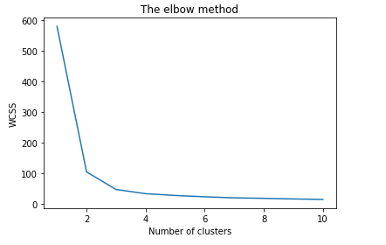
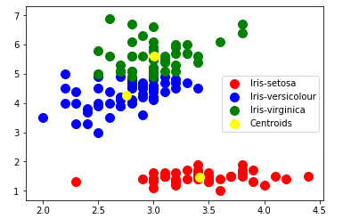
Kmeans Clustering - Implementation

Slide 25
Hierarchical clustering – Implementation
from matplotlib import pyplot as plt
from scipy.cluster.hierarchy import dendrogram, linkage
import numpy as np
%matplotlib inline
np.set_printoptions(precision=5, suppress=True)
np.random.seed(4711) # for repeatability of this tutorial
a = np.random.multivariate_normal([10, 0], [[3, 1], [1, 4]], size=[100,])
b = np.random.multivariate_normal([0, 20], [[3, 1], [1, 4]], size=[50,])
X = np.concatenate((a, b),)
print(X.shape) # 150 samples with 2 dimensions
plt.scatter(X[:,0], X[:,1])
plt.show()
Z = linkage(X, 'ward')

Slide 26
Hierarchical clustering – Implementation
from scipy.cluster.hierarchy import cophenet
from scipy.spatial.distance import pdist
c, coph_dists = cophenet(Z, pdist(X))
idxs = [33, 68, 62]
plt.figure(figsize=(10, 8))
plt.scatter(X[:,0], X[:,1]) # plot all points
plt.scatter(X[idxs,0], X[idxs,1], c='r') # plot interesting points in red again
plt.show()
plt.figure(figsize=(25, 10))
plt.title('Hierarchical Clustering Dendrogram')
plt.xlabel('sample index')
plt.ylabel('distance')
dendrogram(
Z,
leaf_rotation=90., # rotates the x axis labels
leaf_font_size=8., # font size for the x axis labels
)
plt.show()

Slide 27
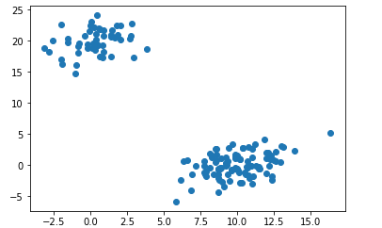
Hierarchical Clustering - Implementation

Slide 28
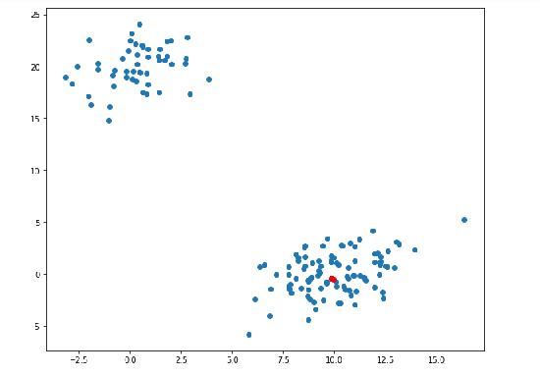
Hierarchical Clustering - Implementation

Slide 29
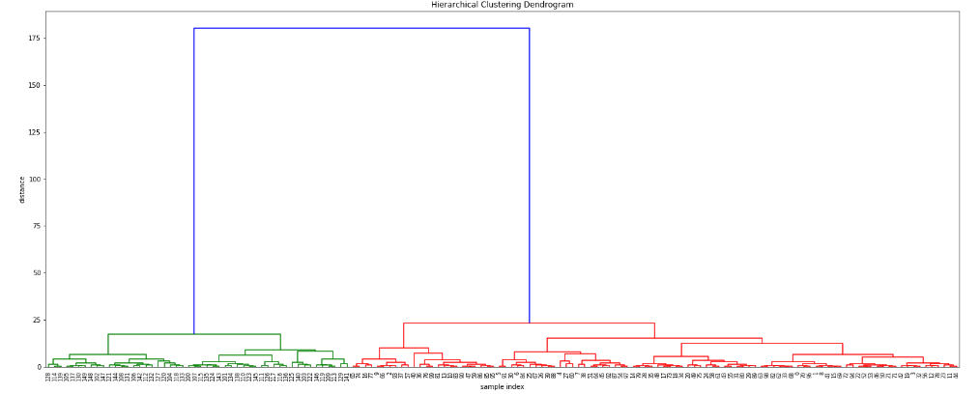
Hierarchical Clustering - Implementation

Slide 30
Summary
Learnt about
→Clustering
→Types of Clustering
→Clustering Algorithms

Slide 31
Thank You

