Slide 1
Decision trees

Slide 2
Agenda
Definition
Constructing a decision tree
Implementation in python

Slide 3
Decision trees
Visually represents decisions and decision making
Uses a tree like model
Used in data mining
Used in machine learning
Two types of decision trees
- Regression tree (output var – continuous)
- Classification tree (output var – categorical)
Supervised learning

Slide 4
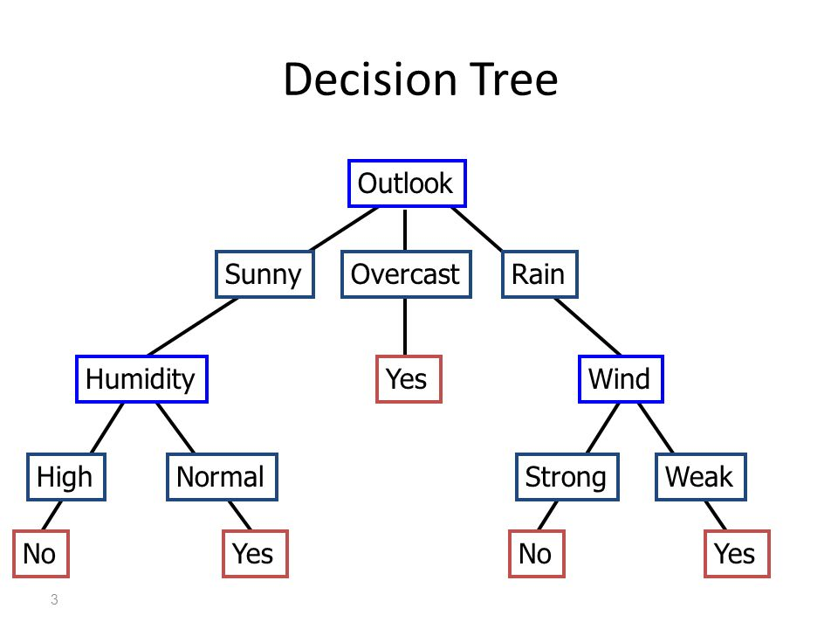
Decision trees

Slide 5
Constructing a decision tree
  Select the input variable to split
  Assign data to the node
  Repeat above steps till the nodes have statistical significance

Slide 6
Selecting a variable to split
  Gini index
  Entropy
  Chi square test

Slide 7
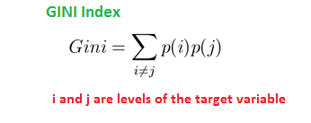
Gini index
Gini Index for Binary Target variable is
= 1 – P²(Target=0) – P²(Target=1)
Where target variable takes only 0 and 1.
Maximum value of Gini Index - all target values are equally distributed.
Minimum value of Gini Index will be 0 - all observations belong to one label.

Slide 8
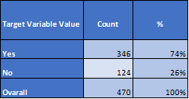
Gini index
Gini Index = 1 - 0.74² - 0.26²
= 1-0.5476 -0.0676
= 0.3848

Slide 9
Gini index
GINI of a split
-------------------
GINI (s,t) = GINI (t) – P_{L} GINI (t_{L}) – P_{R} GINI (t_{R})
Where
S : split
T : node
GINI (t) : Gini Index of input node t
P_{L} : Proportion of observation in Left Node after split, s
GINI (t_{L}) : Gini of Left Node after split, s
P_{R} : Proportion of observation in Right Node after split, s
GINI (t_{R}) : Gini of Right Node after split, s

Slide 10


Entropy
denoted by H(S) for a finite set S
measure of the amount of uncertainty or randomness in data

Slide 11
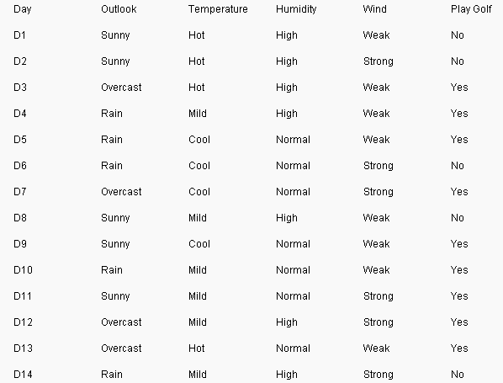
Entropy

Slide 12
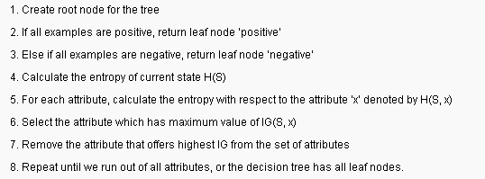
Constructing the tree using Entropy

Slide 13
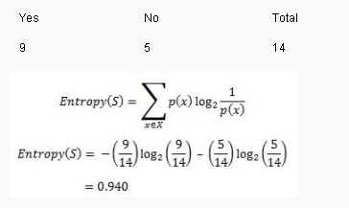
Constructing the tree using Entropy

Slide 14

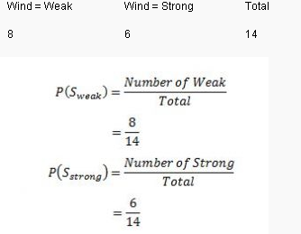
Constructing the tree using Entropy

Slide 15


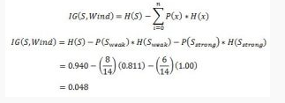
Constructing the tree using Entropy

Slide 16
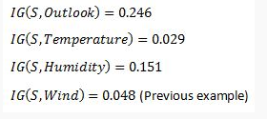
Constructing the tree using Entropy
We choose Outlook as the splitting variable since it has max information gain.

Slide 17
Decision trees – Advantages
Easy to understand
Useful in data exploration
Less data cleaning effort
Data type is not a constraint
Non Parametric
Does not get affected by outliers
Handles missing data

Slide 18
Decision trees – Disadvantages
Overfitting
Forward selection
Unstable model
Not an accurate model

Slide 19
Decision trees – Algorithms
CART
C5.0
CHAID

Slide 20
CART
Classification and Regression tree
Representation for cart model is binary tree.
Leaf nodes contain the output variable
Key ideas
    Recursive partitioning
    Pruning
    Allows the tree to fully grow, then prunes the tree
    Uses Gini index as splitting criteria

Slide 21
C 5.0
Developed by Quinlan
Uses binary tree or multi branches tree
Uses Information gain as splitting criteria
Converts trees into sets of rules
Improvement over C4.5
Less widely used than CART

Slide 22
CHAID
Chi-Square Automation Interaction Detection
Developed by Kass
Uses chi-square test
Both input and output variables – categorical
Modification of AID Tree
discover the relationship between variables.
discover the relationship between variables.

Slide 23
CHAID - Steps
Preparing predictors
Merging categories
Selecting the split variable

Slide 24
Implementation in Python
from sklearn.tree import DecisionTreeClassifier
from sklearn.model_selection import train_test_split
from sklearn.datasets import load_breast_cancer
from sklearn.externals.six import StringIO
from IPython.display import Image
cancer=load_breast_cancer()
#print(cancer)
X_train, X_test, y_train, y_test=train_test_split(cancer.data, cancer.target,stratify=cancer.target, random_state=42)
dtrees=DecisionTreeClassifier(random_state=0)
dtrees.fit(X_train, y_train)
print(dtrees.score(X_train, y_train))
print(dtrees.score(X_test, y_test))
dot_data = StringIO()

Slide 25
Implementation in Python
from sklearn.tree import export_graphviz
#dotfile = open("C:/Users/amitysoft/dtrees.dot", 'w')
export_graphviz(dtrees, out_file="dtrees.dot", class_names=["malignant","benign"],feature_names=cancer.feature_names, impurity=False,filled=True)

Slide 26
Summary
Learnt about
→decision tree
→decision tree algorithms
→implementation in Python

Slide 27
Thank You

