Slide 1
Artificial Neural Networks

Slide 2
Agenda
Definition
Further about ANN
Implementation in python

Slide 3
Artificial Neural Network
Computational system inspired by the
  Structure
  Processing Method
  Learning Ability
of a biological brain
Characteristics of Artificial Neural Networks
  A large number of very simple processing neuron-like processing
  elements
  A large number of weighted connections between the elements
  Distributed representation of knowledge over the connections
  Knowledge is acquired by network through a learning process

Slide 4
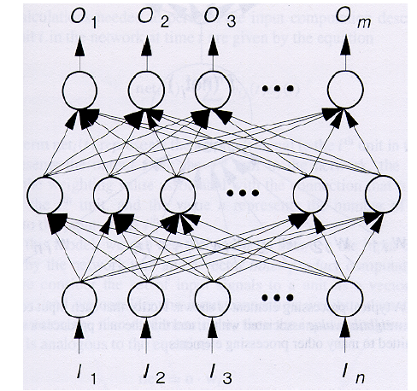
Artificial Neural Network

Slide 5
Why Artificial Neural Network?
Massive Parallelism
Distributed representation
Learning ability
Generalization ablity
- Fault tolerance

Slide 6
Applications
Pattern Classification
Clustering/Categorization
Function approximation
Prediction/Forecasting
Optimization
Content-addressable Memory
Control

Slide 7
Advantages
Involves human like thinking
Handle noisy or missing data
Work with large number of variables.
Provide general solution with good predictive accuracy.
Has got property of continuous learning
Deals with nonlinearity.

Slide 8
Disadvantages
Forgets
Not exact
Complex structure

Slide 9
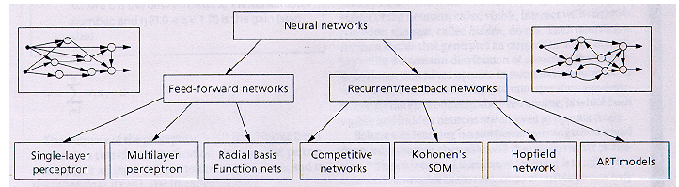
Types of Artificial Neural Network

Slide 10
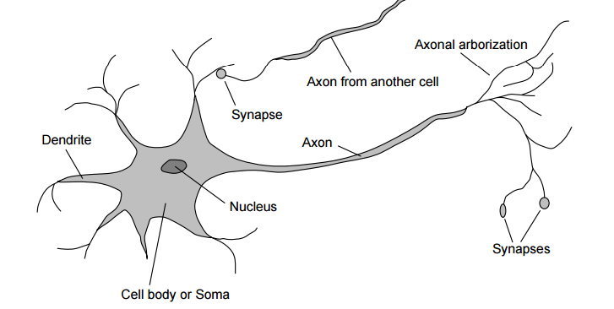
How the Brain works

Slide 11
Analogy with brain
Neuron-Node
Synapse- Edge
Synaptic efficiency – Weight
Firing frequency – Output of the node

Slide 12
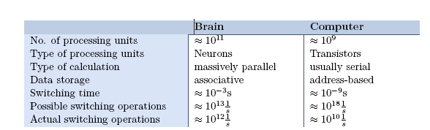
Comparison with brain

Slide 13
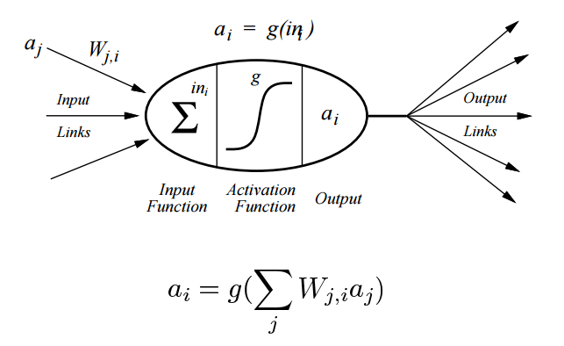
Structure of Node

Slide 14
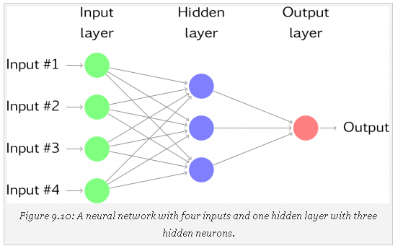
Structure of Neural Network

Slide 15
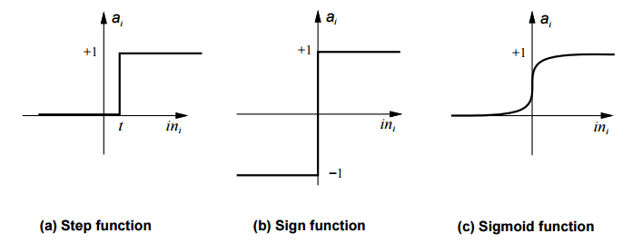
Different Threshold Functions

Slide 16
Learning
process by which a NN adapts itself to a stimulus by making proper parameter adjustments, resulting in the production of desired response.
Two kinds of learning
  Parameter learning:- connection weights are updated
  Structure Learning:- change in network structure

Slide 17
Classification of Learning
Supervised learning
Unsupervised learning
Reinforcement learning

Slide 18
Supervised Learning
Child learns from a teacher
Each input vector requires a corresponding target vector.
Training pair=[input vector, target vector]
Neural
Network
W
X
Y
(Input)
(Actual output)
Error
(D-Y) signals
Error
Signal
Generator
(Desired Output)

Slide 19
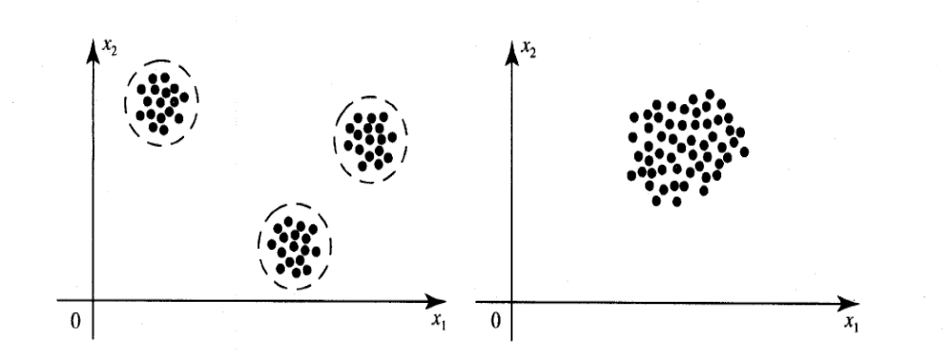
Unsupervised Learning
How a fish or tadpole learns
All similar input patterns are grouped together as clusters.
If a matching input pattern is not found a new cluster is formed

Slide 20
Reinforced learning
Imagine a robot that can act in a world, receiving rewards and punishments and determining from these what it should do.
Reinforcement learning is the problem of getting an agent to act in the world so as to maximize its rewards

Slide 21
Learning rate
Denoted by α.
Used to control the amount of weight adjustment at each step of training
Learning rate ranging from 0 to 1 determines the rate of learning in each time step

Slide 22
Learning rule
Its a method or a mathematical logic.
helps a Neural Network to learn from the existing conditions and improve its performance.
Some of them are
  Hebbian learning rule
  Perceptron learning rule
  Delta learning rule
  Correlation learning rule
  Outstar learning rule

Slide 23

Hebbian Learning rule
Feed forward unsupervised learning
If two neighbor neurons activated and deactivated at the same time. Then the weight connecting these neurons should increase.
When inputs of both the nodes are either positive or negative, then a strong positive weight exists between the nodes.
If the input of a node is positive and negative for other, a strong negative weight exists between the nodes.

Slide 24

Perceptron learning rule
, Supervised learning rule
Each connection in a neural network has an associated weight, which changes in the course of learning.
According to the perceptron learning rule, an example of supervised learning, the network starts its learning by assigning a random value to each weight.
The output value is calculated on the basis of a set of records for which the expected output value is known. This is the learning sample.
The network then compares the calculated output value with the expected value, and calculates an error function ∈, which can be the sum of squares of the errors occurring for each individual in the learning sample, computed as follows:

Slide 25

Delta learning rule
The delta learning rule or Windrow-Hoff learning rule is based on supervised learning.
This rule states that the modification in sympatric weight of a node is equal to the multiplication of error and the input.
Mathematically the delta rule can be given as follows:
The aim of applying the delta rule is to minimize the difference between the actual and expected output that is the error.

Slide 26

Correlation learning rule
The correlation rule assumes:
  A strong positive weight exists between the nodes with same sign of inputs.
  A strong negative weight exists between the nodes with opposite sign of inputs.
  Mathematically the correlation learning rule can be given as follows:

Slide 27
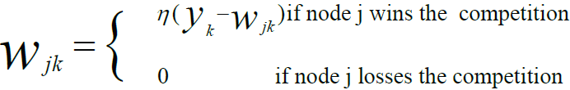
Outstar learning rule
The out star learning rule is used when it is assumed that nodes or neurons in a network are arranged in a layer.
The out start rule produces a desired response t for the layer of n nodes.
This type of learning is applied for all nodes in a particular layer.
The weights for nodes are updated as in Kohonen neural networks.

Slide 28
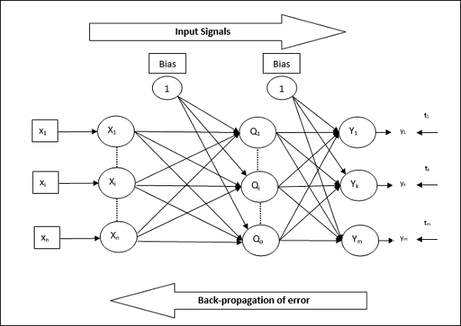
Back propagation algorithm
Phase 1 − Feed Forward Phase
Phase 2 − Back Propagation of error
Phase 3 − Updating of weights

Slide 29
Implementation in Python
import pandas as pd
# Location of dataset
url = "https://archive.ics.uci.edu/ml/machine-learning-databases/iris/iris.data"
# Assign colum names to the dataset
names = ['sepal-length', 'sepal-width', 'petal-length', 'petal-width', 'Class']
# Read dataset to pandas dataframe
irisdata = pd.read_csv(url, names=names)
X = irisdata.iloc[:, 0:4]
# Assign data from first fifth columns to y variable
y = irisdata.select_dtypes(include=[object])

Slide 30
Implementation in Python
from sklearn import preprocessing
le = preprocessing.LabelEncoder()
y = y.apply(le.fit_transform)
from sklearn.model_selection import train_test_split
X_train, X_test, y_train, y_test = train_test_split(X, y, test_size = 0.20) from sklearn.preprocessing import StandardScaler
scaler = StandardScaler()
scaler.fit(X_train)

Slide 31
Summary
Learnt about
→artificial neural network
→artificial neural network models
→learning rules
→learning algorithms

Slide 32
Thank You

