Slide 1
Principal Component Analysis and Factor Analysis

Slide 2
Agenda
Definition
Further about Principal Components and Factor Analysis
Implementation in python

Slide 3
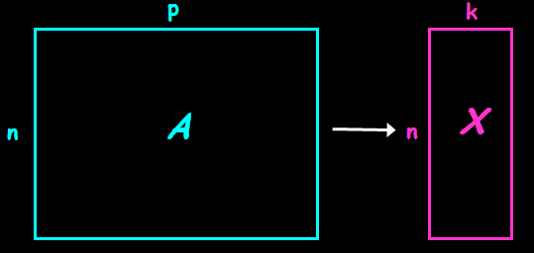
Dimensionality reduction technique
summarization of data with many (p) variables by a smaller set of (k) derived (synthetic, composite) variables.

Slide 4
Principal Component Analysis
probably the most widely-used and well-known of the “standard” multivariate methods
invented by Pearson (1901) and Hotelling (1933)
first applied in ecology by Goodall (1954) under the name “factor analysis”

Slide 5
Principal Component Analysis
Dimensionality reduction technique
Transforms a number of (possibly) correlated variables into a (smaller) number of uncorrelated variables called principal components.
Most common form of factor analysis.
The new variables are
    Linear combination of the original ones.
Unsupervised learning

Slide 6
Principal Component Analysis
takes a data matrix of n objects by p variables, which may be correlated, and summarizes it by uncorrelated axes (principal components or principal axes) that are linear combinations of the original p variables
the first k components display as much as possible of the variation among objects.

Slide 7
Principal Component Analysis
objective of PCA is to rigidly rotate the axes of this p-dimensional space to new positions (principal axes) that have the following properties:
  ordered such that principal axis 1 has the highest variance, axis 2 has the next highest variance, .... , and axis p has the lowest variance
  covariance among each pair of the principal axes is zero (the principal axes are uncorrelated).

Slide 8
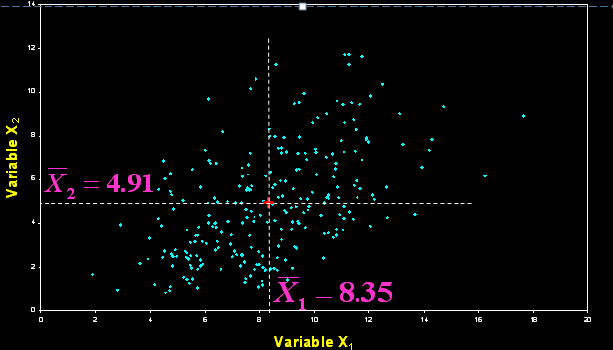
Principal Component Analysis
variables X₁ and X₂ have positive covariance & each has a similar variance.

Slide 9
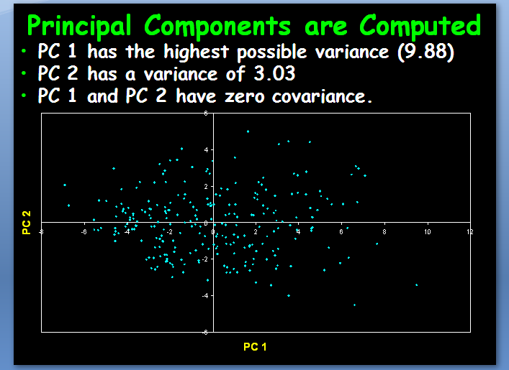
Principal Component Analysis

Slide 10
Principal Component Analysis
PCA uses Euclidean Distance calculated from the p variables as the measure of dissimilarity among the n objects
PCA derives the best possible k dimensional (k < p) representation of the Euclidean distances among objects.

Slide 11
Principal Component Analysis
So basically, PCA can be represented in 4 pretty simple steps.
1. Normalize the data. We’re dealing with covariance, so it’s a good idea to have features on the same scale.
2. Calculate the covariance matrix.
3. Find the eigenvectors of the covariance matrix.
4. Translate the data to be in terms of the components. This involves just a simple matrix multiplication.

Slide 12

Principal Component Analysis
in matrix notation, this is computed as
where X is the n x p data matrix, with each variable centered (also standardized by SD if using correlations).

Slide 13

Principal Component Analysis
finding the principal axes involves eigenanalysis of the cross-products matrix (S)
the eigenvalues (latent roots) of S are solutions (λ) to the characteristic equation
 | X₁ | X₂
X₁ | 6.6707 | 3.4170
X₂ | 3.4170 | 6.2384

Slide 14
Principal Component Analysis
the eigenvalues, λ₁, λ₂, ... λ_{p} are the variances of the coordinates on each principal component axis
the sum of all p eigenvalues equals the trace of S (the sum of the variances of the original variables).
λ₁ = 9.8783
λ₂ = 3.0308
Note: λ₁+λ₂ =12.9091
 | X₁ | X₂
X₁ | 6.6707 | 3.4170
X₂ | 3.4170 | 6.2384
Trace = 12.9091

Slide 15
What is a Factor
The key concept of factor analysis is that multiple observed variables have similar patterns of responses because they are all associated with a latent (i.e. not directly measured) variable.
For example, people may respond similarly to questions about income, education, and occupation, which are all associated with the latent variable socioeconomic status.

Slide 16
Factor analysis
technique used to reduce a large number of variables into fewer numbers of factors.
extracts maximum common variance from all variables and puts them into a common score
part of general linear model
method for investigating whether a number of variables of interest Y1, Y2, :: :, Yl, are linearly related to a smaller number of unobservable factors F1, F2, : ::, Fk .

Slide 17
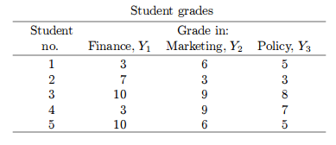
Factor analysis Example
Students entering a certain MBA program must take three required courses in ¯nance, marketing and business policy. Let Y1, Y2, and Y3, respectively, represent a student's grades in these courses.

Slide 18

Factor analysis Example
It has been suggested that these grades are functions of two underlying factors, F1 and F2, tentatively and rather loosely described as quantitative ability and verbal ability, respectively. It is assumed that each Y variable is linearly related to the two factors, as follows

Slide 19
Factor Analysis - Assumptions
No outlier
Adequate sample size
No perfect multicollinearity
Homoscedasticity
Linearity
Interval Data

Slide 20
Factor Analysis-Stages
  Factor analysis usually proceeds in two stages. In the First, one set of
  loadings is calculated which yields theoretical variances and covariances that fit the observed ones as closely as possible according to a certain criterion.
  These loadings, however, may not agree with the prior expectations, or may not lend themselves to a reasonable interpretation. Thus, in the second stage, the first loadings are rotated in an effort to arrive at another set of loadings that fit equally well the observed variances and covariance, but are more consistent with prior expectations or more easily interpreted.

Slide 21
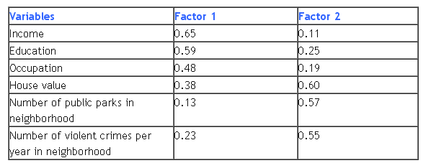
Factor loadings
  The relationship of each variable to the underlying factor is expressed by the so-called factor loading.
The variable with the strongest association to the underlying latent variable. Factor 1, is income, with a factor loading of 0.65.

Slide 22
Factor Analysis - Types
  There are basically two types of factor analysis:
  Exploratory factor analysis (EFA) attempts to discover the nature of the constructs influencing a set of responses.
  Confirmatory factor analysis (CFA) tests whether a specified set of constructs is influencing responses in a predicted way.

Slide 23
EFA steps
  Collect measurements
  Obtain the correlation matrix
  Select the number of factors for inclusion
  Extract your initial set of factors
  Rotate the factors to a final solution

Slide 24
CFA steps
  Define the factor model
  Collect measurements
  Obtain the correlation matrix
  Fit the model to the data
  Evaluate model adequacy

Slide 25
Factor rotations
  Varimax rotation
  Equimax rotation
  Quartimax rotation

Slide 26
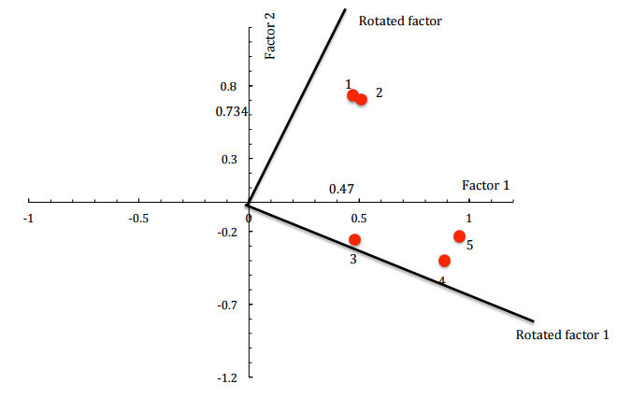
Variamx rotation
  In the Varimax Rotation, the new axes must be perpendicular to each other. The goal of factor ration is to obtain some of the loadings that are very large .

Slide 27
Uses of factor analysis
  Explore the patterns in data
  Confirm the hypothesis
  Dimensionality reduction

Slide 28
Implementation in Python
import matplotlib.pyplot as plt
from sklearn import datasets
from sklearn.decomposition import PCA
from sklearn.discriminant_analysis import LinearDiscriminantAnalysis
iris = datasets.load_iris()
X = iris.data
y = iris.target
target_names = iris.target_names
pca = PCA(n_components=2)
X_r = pca.fit(X).transform(X)
lda = LinearDiscriminantAnalysis(n_components=2)
X_r2 = lda.fit(X, y).transform(X)

Slide 29
Implementation in Python
# Percentage of variance explained for each components
print('explained variance ratio (first two components): %s'
% str(pca.explained_variance_ratio_))
plt.figure()
colors = ['navy', 'turquoise', 'darkorange']
lw = 2
for color, i, target_name in zip(colors, [0, 1, 2], target_names):
plt.scatter(X_r[y == i, 0], X_r[y == i, 1], color=color, alpha=.8, lw=lw,
label=target_name)
plt.legend(loc='best', shadow=False, scatterpoints=1)
plt.title('PCA of IRIS dataset')
plt.figure()
for color, i, target_name in zip(colors, [0, 1, 2], target_names):
plt.scatter(X_r2[y == i, 0], X_r2[y == i, 1], alpha=.8, color=color,
label=target_name)
plt.legend(loc='best', shadow=False, scatterpoints=1)
plt.title('LDA of IRIS dataset')
plt.show()

Slide 30
Summary
Learnt about
→principal components
→implementation in Python

Slide 31
Thank You

