Slide 1
Time Series Analysis

Slide 2
Agenda
Definition
Further about Time Series
Implementation in python

Slide 3
Time series analysis
Sequence of well defined data points measured at consistent time intervals over a period of time.
Data collected on an adhoc basis does not form a time series.
Analyse the trends
Forecast and monitor the data points
Informed decision making

Slide 4
Objectives of Time series analysis
Description – the first step is to plot the data to look for the possible presence of trends, seasonal variation, outliers (observations which do not appear to be consistent with the rest of the data) and turning points.
Modeling – to investigate the generating process of the time series; for example, analysing a series of monthly values of sales of automobiles in Brazil, we can want to know as these values of sales had been generated.
Prediction – it may be useful forecast future values of an observed time series. This is an important task in analysis of economic time series.

Slide 5
Time series analysis - Benefits
Descriptive analysis
Spectral analysis
Forecasting
Intervention analysis
Explanative analysis

Slide 6
Some important points to consider
Is there a trend
Is there seasonality
Are their outliers?
Is there a long-run cycle
Is there constant varianceover time
Are there any abrupt changes to either the level of the series or the variance?

Slide 7
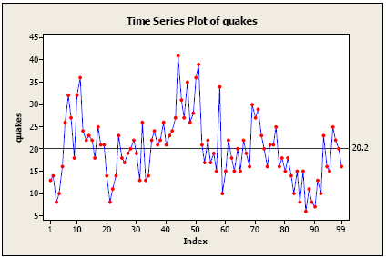
Some important points to consider
There is no consistent trend
there is no seasonality
There are no obvious outliers.
It’s difficult to judge whether the variance is constant or not.

Slide 8
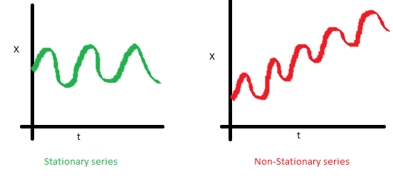
Basics of time series modelling
1. The mean of the series should not be a function of time rather should be a constant.

Slide 9
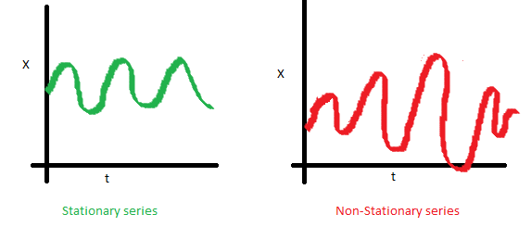
Basics of time series modelling
2. The variance of the series should not a be a function of time. This property is known as homoscedasticity.

Slide 10
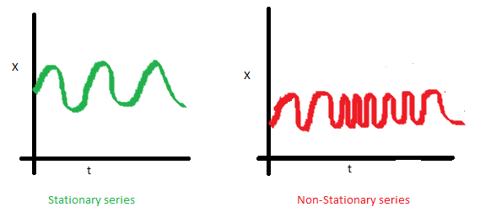
Basics of time series modelling
The covariance of the i th term and the (i + m) th term should not be a function of time.

Slide 11
Auto Regressive time series model
The current GDP of a country say x(t) is dependent on the last year’s GDP i.e. x(t – 1).
The hypothesis being that the total cost of production of products & services in a country in a fiscal year (known as GDP) is dependent on the set up of manufacturing plants / services in the previous year and the newly set up industries / plants / services in the current year.
But the primary component of the GDP is the former one.
Hence, we can formally write the equation of GDP as:
x(t) = alpha * x(t – 1) + error (t)
Xx(t-1)=alpha * x(t - 2) + error (t-1) and so on.

Slide 12
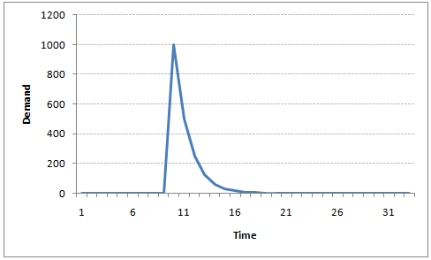
Auto Regressive time series model

Slide 13
Moving Average time series model
A manufacturer produces a certain type of bag, which was readily available in the market. Being a competitive market, the sale of the bag stood at zero for many days.
So, one day he did some experiment with the design and produced a different type of bag.
This type of bag was not available anywhere in the market. Thus, he was able to sell the entire stock of 1000 bags (lets call this as x(t) ).
The demand got so high that the bag ran out of stock. As a result, some 100 odd customers couldn’t purchase this bag. Lets call this gap as the error at that time point. With time, the bag had lost its woo factor. Following is a simple formulation to depict the scenario :
x(t) = beta * error(t-1) + error (t)

Slide 14
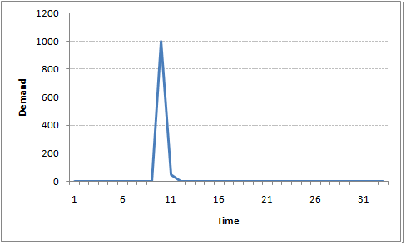
Moving Average time series model

Slide 15
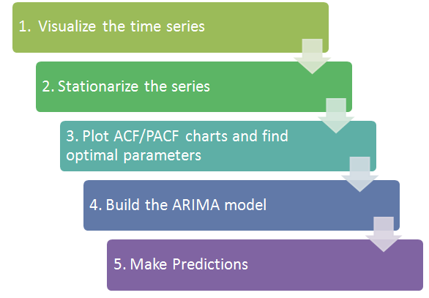
Time Series Analysis - Steps

Slide 16
Autocorrelation function
calculate the correlation for time series observations with observations with previous time steps, called lags.
It is called a serial correlation, or an autocorrelation.
Because the correlation of the time series observations is calculated with values of the same series at previous times
A plot of the autocorrelation of a time series by lag is called the AutoCorrelation Function.
The partial autocorrelation at lag k is the correlation that results after removing the effect of any correlations due to the terms at shorter lags.

Slide 17
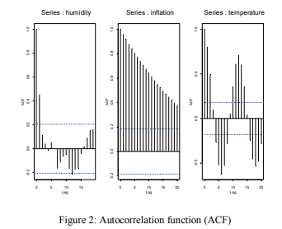

Autocorrelation function

Slide 18
Python Implementation
import pandas as pd
import numpy as np
import matplotlib.pylab as plt
%matplotlib inline
from matplotlib.pylab import rcParams
rcParams['figure.figsize'] = 15, 6
data = pd.read_csv('D:/valli/python datasets/AirPassengers.csv')
print(data.head())
print('\n Data Types:')
print(data.dtypes)
dateparse = lambda dates: pd.datetime.strptime(dates, '%Y-%m')

Slide 19
Python implementation
#2. Import the datetime library and use 'datetime' function:
from datetime import datetime
ts[datetime(1949,1,1)]
#1. Specify the entire range:
ts['1949-01-01':'1949-05-01']
#2. Use ':' if one of the indices is at ends:
ts[:'1949-05-01']
ts['1949']
plt.plot(ts)
from statsmodels.tsa.stattools import adfuller
def test_stationarity(timeseries):
#Determing rolling statistics
rolmean = pd.rolling_mean(timeseries, window=12)
rolstd = pd.rolling_std(timeseries, window=12)

Slide 20
Python implementation
#Plot rolling statistics:
orig = plt.plot(timeseries, color='blue',label='Original')
mean = plt.plot(rolmean, color='red', label='Rolling Mean')
std = plt.plot(rolstd, color='black', label = 'Rolling Std')
plt.legend(loc='best')
plt.title('Rolling Mean & Standard Deviation')
plt.show(block=False)
#Perform Dickey-Fuller test:
print('Results of Dickey-Fuller Test:')
dftest = adfuller(timeseries, autolag='AIC')
dfoutput = pd.Series(dftest[0:4], index=['Test Statistic','p-value','#Lags Used','Number of Observations Used'])

Slide 21
Python implementation
for key,value in dftest[4].items():
dfoutput['Critical Value (%s)'%key] = value
print(dfoutput)
ts_log = np.log(ts)
plt.plot(ts_log)
moving_avg = pd.rolling_mean(ts_log,12)
plt.plot(ts_log)
plt.plot(moving_avg, color='red')
ts_log_moving_avg_diff = ts_log - moving_avg
ts_log_moving_avg_diff.head(12)

Slide 22
Implementation in Python
ts_log_moving_avg_diff.dropna(inplace=True)
test_stationarity(ts_log_moving_avg_diff)
expwighted_avg = pd.ewma(ts_log, halflife=12)
plt.plot(ts_log)
plt.plot(expwighted_avg, color='red')
ts_log_ewma_diff = ts_log - expwighted_avg
test_stationarity(ts_log_ewma_diff)
ts_log_diff = ts_log - ts_log.shift()
plt.plot(ts_log_diff)
ts_log_diff.dropna(inplace=True)
test_stationarity(ts_log_diff)
ts_log_diff.dropna(inplace=True)
test_stationarity(ts_log_diff)

Slide 23
Implementation in Python
from statsmodels.tsa.seasonal import seasonal_decompose
decomposition = seasonal_decompose(ts_log)
trend = decomposition.trend
seasonal = decomposition.seasonal
residual = decomposition.resid
plt.subplot(411)
plt.plot(ts_log, label='Original')
plt.legend(loc='best')
plt.subplot(412)
plt.plot(trend, label='Trend')
plt.legend(loc='best')
plt.subplot(413)
plt.plot(seasonal,label='Seasonality')
plt.legend(loc='best')
plt.subplot(414)
plt.plot(residual, label='Residuals')
plt.legend(loc='best')
plt.tight_layout()

Slide 24
Implementation in Python
ts_log_decompose = residual
ts_log_decompose.dropna(inplace=True)
test_stationarity(ts_log_decompose)

Slide 25
Summary
Learnt about
→time series
→implementation in Python

Slide 26
Thank You

