Slide 1
Logistic Regression

Slide 2
Agenda
Definition
Logistic regression
Implementation in python

Slide 3
Regression
Logistic Regression is a classification algorithm.
It is used to predict a binary outcome (1 / 0, Yes / No, True / False) given a set of independent variables.
To represent binary / categorical outcome, we use dummy variables.
You can also think of logistic regression as a special case of linear regression when the outcome variable is categorical, where we are using log of odds as dependent variable.
It predicts the probability of occurrence of an event by fitting data to a logit function.

Slide 4
Logistic Regression – Important Points
GLM does not assume a linear relationship between dependent and independent variables.
The dependent variable need not to be normally distributed.
It does not uses OLS (Ordinary Least Square) for parameter estimation. Instead, it uses maximum likelihood estimation (MLE).
Errors need to be independent but not normally distributed.

Slide 5
Logistic Regression – Examples
Example 1: Suppose that we are interested in the factors
that influence whether a political candidate wins an election. The
outcome (response) variable is binary (0/1); win or lose.
The predictor variables of interest are the amount of money spent on the campaign, the amount of time spent campaigning negatively and whether or not the candidate is an
incumbent.
Example 2: A researcher is interested in how variables, such as GRE (Graduate Record Exam scores), GPA (grade point average) and prestige of the undergraduate institution, effect admission into graduate school. The response variable, admit/don’t admit, is a binary variable.

Slide 6
Logistic Regression - Derivation
  g(y) = βo + β(Age) ---- (a)
  In logistic regression, we are only concerned about the probability of outcome dependent variable ( success or failure).
p should meet following criteria:
  It must always be positive (since p >= 0)
  It must always be less than equals to 1 (since p <= 1)
To start with logistic regression, I’ll first write the simple linear regression equation with dependent variable enclosed in a link function:

Slide 7

Logistic Regression - Derivation
p = exp(βo + β(Age)) = e^(βo + β(Age)) ------- (b)
To make the probability less than 1, we must divide p by a number greater than p. This can simply be done by:
p = exp(βo + β(Age)) / exp(βo + β(Age)) + 1 = e^(βo + β(Age)) / e^(βo + β(Age)) + 1 ------ (c)
Using (a), (b) and (c), we can redefine the probability as:
p = e^y/ 1 + e^y --- (d)

Slide 8
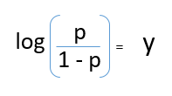
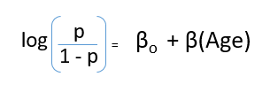
Logistic Regression - Derivation

Slide 9
Logistic Regression - Derivation
Logisticregression is a method for fitting a regression curve,y =f(x), when yconsists of binary coded (0, 1- -failure, success) data.
When the response is a binary (dichotomous) variable and x is numerical, logistic regression fits a logistic curve to therelationship between x and y.
Logisticcurve is an S-shaped or sigmoid curve, often used to model population growth.
A logistic curve starts with slow, linear growth, followed by exponential growth, which then slows again to a stablerate.

Slide 10
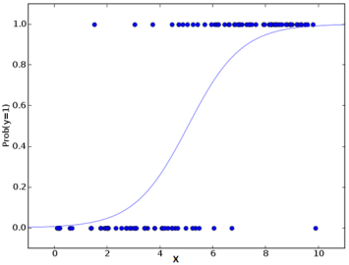
Logistic Curve

Slide 11
Logistic Regression - Derivation
The maximum likelihood estimate of a parameter is that value that maximizes the probability of the observed data.
We estimate α and β by those values and that maximize the probability of the observed data under the logistic regression model.

Slide 12
Logistic Regression – Dummy variables
When an explanatory variable is categorical we use dummy variables to contrast the different categories.
For each variable we choose a baseline category and then contrast all remaining categories with the base line.
If an explanatory variable has k categories, we need k-1 dummy variables to investigate all the differences in the categories with respect to the dependent variable.
For example suppose the explanatory variable was housing tenure coded like this:
Tenure
1: Owner occupier
2: renting from a private landlord
3: renting from the local authority
Choose a baseline category and create two dummy variables. For example

Slide 13
Logistic Regression – Dummy variables
if we chose owner occupier as the baseline category we would code the dummy variables like this.
Tenure | D0 | D1
Owner occupier | 0 | 0
Rented private | 0 | 1
Rented local authority | 1 | 0

Slide 14
Logistic Regression – Types
Binary logistic regression
Multinomial logistic regression
Multivariate logistic regression

Slide 15
Logistic Regression - Assumptions
Absence of multicollinearity
No outliers
Independence of errors

Slide 16
Binary Logistic Regression – When
When the dependent variable is non parametric
No homoscedascity
When dependent variable has only two levels
Presence of multivariate normality
Absence of linearity

Slide 17
Binary Logistic Regression – Linear or Non linear
It is a non linear regression
When we differentiate y with respect to βo, we get regression coefficient in the result.
So it is non linear

Slide 18
Binary Logistic Regression – Evaluation
The binary logistic model is evaluated on the basis of:
Residual deviance
Parsimony
Prediction Accuracy
Classification Accuracy

Slide 19
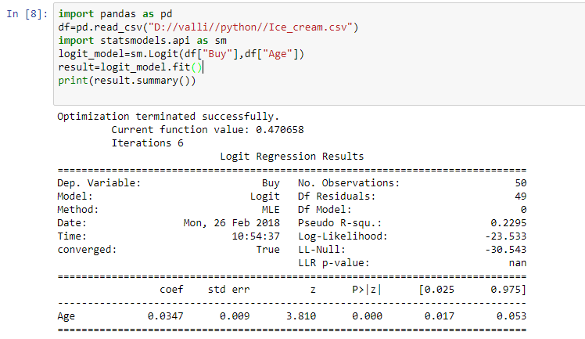
Binary Logistic Regression – Implementation

Slide 20
Summary
Learnt
Definition of Logistic regression
Derivation of Logistic regression
Efficiency of Logistic regression
Implementation of Logistic regression

Slide 21
Thank You

