Slide 1
Support Vector Machine

Slide 2
Agenda
Definition
Further about Support vectors
Implementation in python

Slide 3
Support vector machine
The SVM is a machine learning algorithm which
• solves classification problems
• uses a flexible representation of the class boundaries
• implements automatic complexity control to reduce overfitting
• has a single global minimum which can be found in polynomial time
overfitting is "the production of an analysis that corresponds too closely or exactly to a particular set of data, and may therefore fail to fit additional data or predict future observations reliably“.

Slide 4
Support vector machine
It is popular because
• it can be easy to use
• it often has good generalization performance
• the same algorithm solves a variety of problems with little tuning

Slide 5
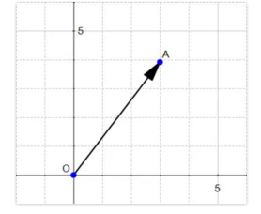
What is a vector
A vector is an object that has both a magnitude and a direction.
If A is a point then
OA is a vector. The magnitude or length of a vector xx is written ‖x‖ and is called its norm.

Slide 6
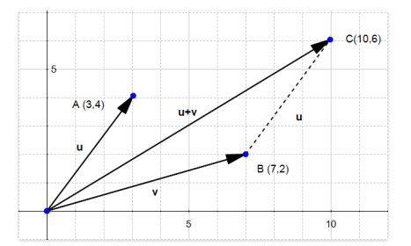
Sum of two vectors

Slide 7
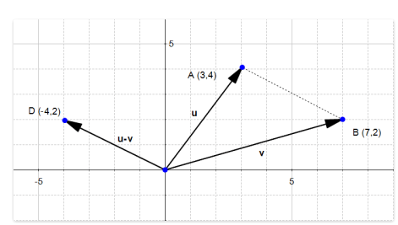
Difference of two vectors

Slide 8
Support vector
Boser, Guyon and Vapnik presented a paper in 1992 at COLT conference.
It is a supervised learning algorithm.
Used for classification and regression.
Preferred for classification.

Slide 9
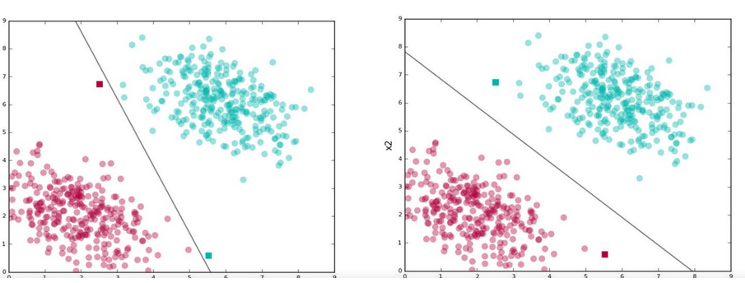
What SVM do

Slide 10
What SVM do
Find lines that correctly classify the training data
Among all such lines, pick the one that has the greatest distance to the points closest to it.
The closest points that identify this line are known as support vectors.
The region they define around the line is known as the margin.

Slide 11
Support vectors
Support vectors are the data points that lie closest to the decision surface (or hyperplane)
They are the data points most difficult to classify
They have direct bearing on the optimum location of the decision surface

Slide 12
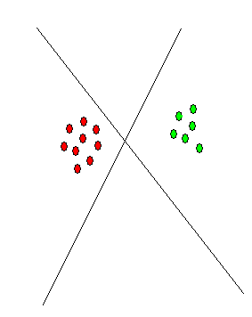
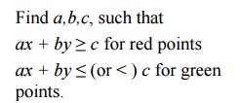
Support vectors
In general, lots of possible solutions for a,b,c (an infinite number!)
Support Vector Machine (SVM) finds an optimal solution

Slide 13
Which hyperplane to pick
Lots of possible solutions for a,b,c
Some methods find a separating hyperplane, but not the optimal one (e.g., neural net)
But: Which points should influence optimality?
– All points?
• Linear regression
• Neural nets
– Or only “difficult points” close to decision boundary
• Support vector machines

Slide 14
Which hyperplane to pick
Lots of possible solutions for a,b,c
Some methods find a separating hyperplane, but not the optimal one (e.g., neural net)
But: Which points should influence optimality?
– All points?
• Linear regression
• Neural nets
– Or only “difficult points” close to decision boundary
• Support vector machines

Slide 15
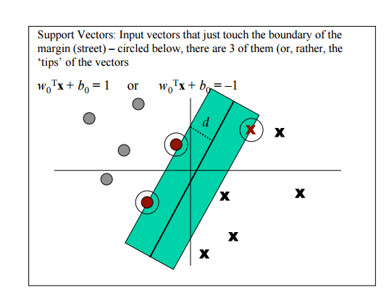
Which hyperplane to pick

Slide 16
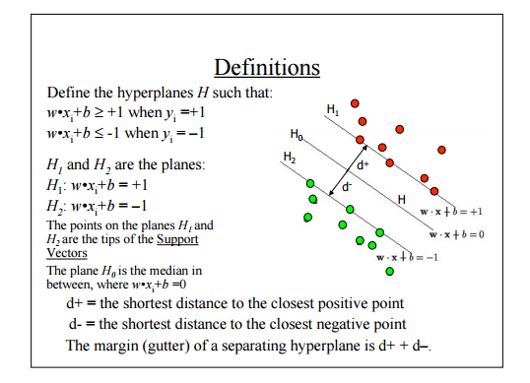
Which hyperplane to pick

Slide 17
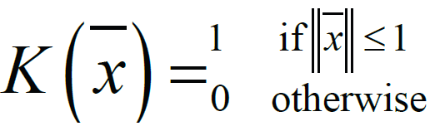
Kernel
SVM algorithms use a set of mathematical functions that are defined as the kernel.
The function of kernel is to take data as input and transform it into the required form.
Define kernel or a window function as follows:

Slide 18
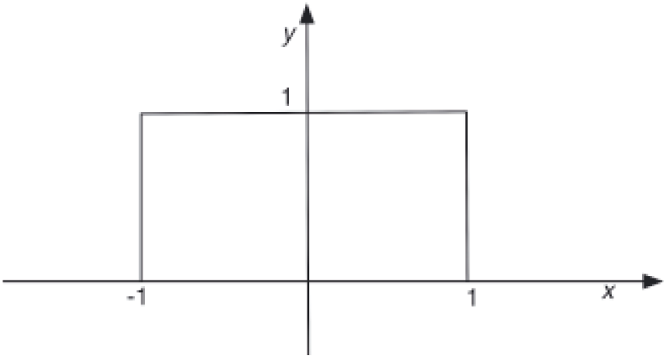
Kernel
This value of this function is 1 inside the closed ball of radius 1 centered at the origin, and 0 otherwise . As shown in the figure below:

Slide 19
Examples of Kernels
Kernel | Uses
Polynomial kernel | Popular in image processing.
Gaussian kernel | General-purpose kernel; used when there is no prior knowledge about the data.
Gaussian radial basis function (RBF) | General-purpose kernel; used when there is no prior knowledge about the data.
Laplace RBF kernel | General-purpose kernel; used when there is no prior knowledge about the data.
Hyperbolic tangent kernel | Used in neural networks.
Sigmoid kernel | Used as proxy for neural networks.

Slide 20
Examples of Kernels
Kernel | Uses
Bessel function of the first kind Kernel | Used to eliminate the cross term in mathematical functions.
ANOVA radial basis kernel | Used in regression problems.
Linear splines kernel in one-dimension | Useful when dealing with large sparse data vectors. It is often used in text categorization. The splines kernel also performs well in regression problems.

Slide 21
Implementation in Python
import numpy as np
import matplotlib.pyplot as plt
from sklearn import svm, datasets
iris = datasets.load_iris()
X = iris.data[:, :2] # we only take the first two features. We could
# avoid this ugly slicing by using a two-dim dataset
y = iris.target
C = 1.0 # SVM regularization parameter
svc = svm.SVC(kernel='linear', C=1,gamma=10).fit(X, y)
# create a mesh to plot in
x_min, x_max = X[:, 0].min() - 1, X[:, 0].max() + 1
y_min, y_max = X[:, 1].min() - 1, X[:, 1].max() + 1
h = (x_max / x_min)/100

Slide 22
Implementation in Python
xx, yy = np.meshgrid(np.arange(x_min, x_max, h),
np.arange(y_min, y_max, h))
plt.subplot(1, 1, 1)
Z = svc.predict(np.c_[xx.ravel(), yy.ravel()])
Z = Z.reshape(xx.shape)
plt.contourf(xx, yy, Z, cmap=plt.cm.Paired, alpha=0.8)
plt.scatter(X[:, 0], X[:, 1], c=y, cmap=plt.cm.Paired)
plt.xlabel('Sepal length')
plt.ylabel('Sepal width')
plt.xlim(xx.min(), xx.max())
plt.title('SVC with linear kernel')
plt.show()

Slide 23
Summary
Learnt about
→support vector machine
→implementation in Python

Slide 24
Thank You

