Slide 1
Bayesian network

Slide 2
Agenda
Definition
Further about Bayesian network
Implementation in python

Slide 3
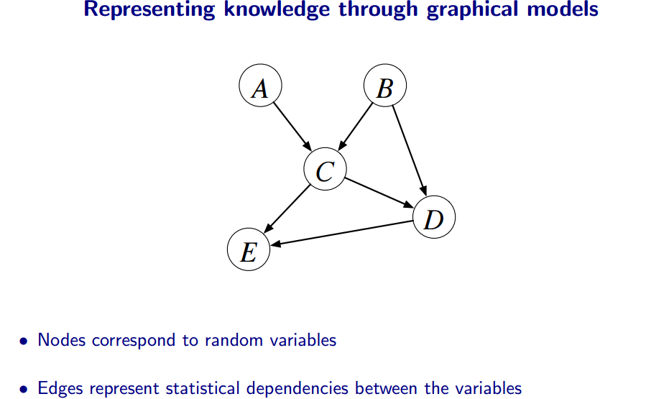
Graphical models

Slide 4
Why graphical models
intuitive way of representing and visualising the relationships between many
variables.
Interpret the conditional independence relationships

Slide 5
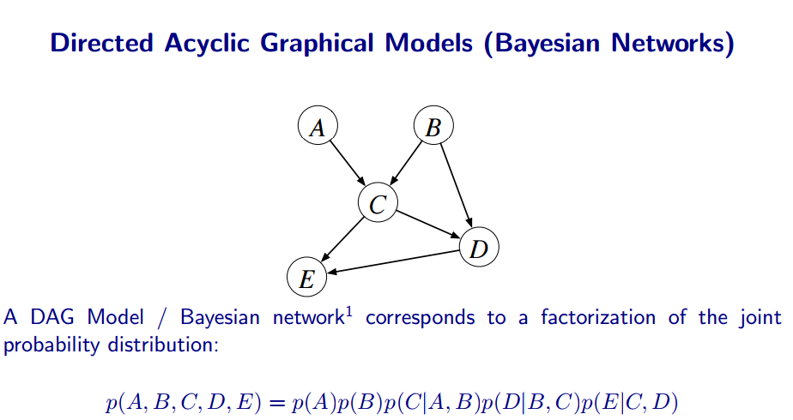
Graphical Models

Slide 6
Graphical Models - Terminologies
Adjacent nodes
Degree of a node
Polytree
Tree
Clique
Path

Slide 7
Graphical Models - Types
Directed graphical models
Undirected graphical models

Slide 8
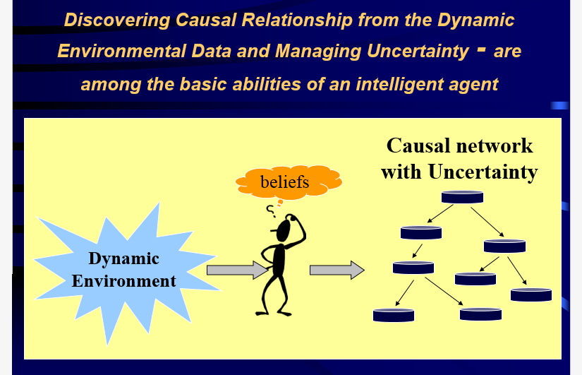
Bayesian network

Slide 9
Bayesian network - Definition
  Bayesian nets (BN) are a network-based framework for representing and analyzing models involving uncertainty;
  BN are different from other knowledge-based systems tools because uncertainty is handled in mathematically rigorous yet efficient and simple way
  BN are different from other probabilistic analysis tools because of network representation of problems, use of Bayesian statistics, and the synergy between these

Slide 10

Bayesian network - Why
Combining domain expert knowledge with data
Learning Causal relationships
<9.7 0.6 8 14 18>
<0.2 1.3 5 ?? ??>
<1.3 2.8 ?? 0 1 >
<?? 5.6 0 10 ??>
……………….

Slide 11
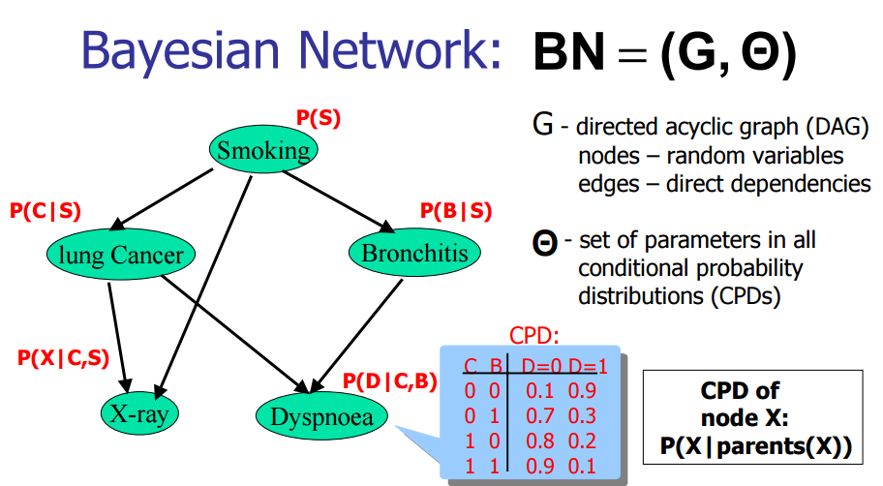
Graphical Models – Bayesian network

Slide 12
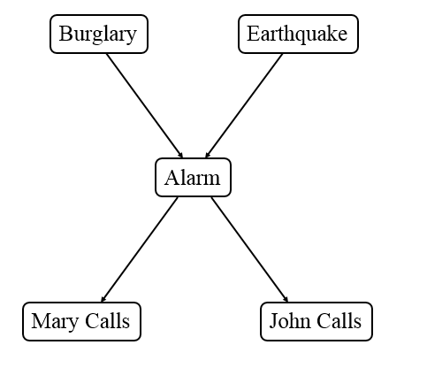
Graphical Models – Bayesian network

Slide 13
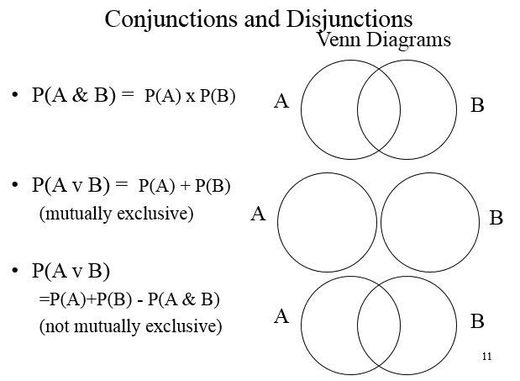
Graphical Models – Bayesian network

Slide 14
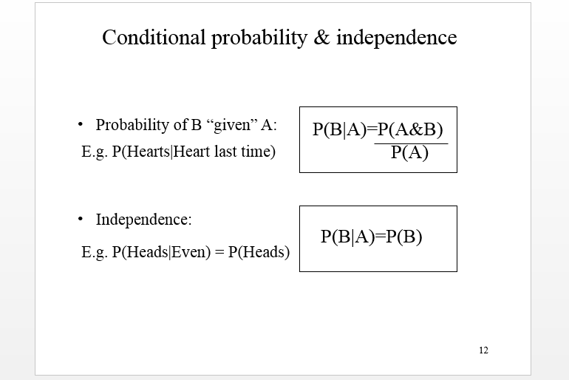
Graphical Models – Bayesian network

Slide 15
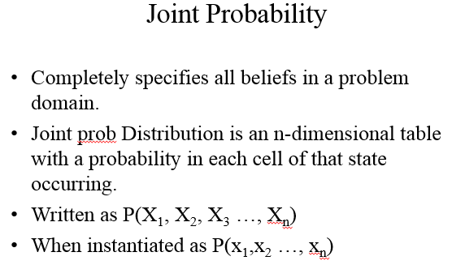
Graphical Models – Bayesian network

Slide 16
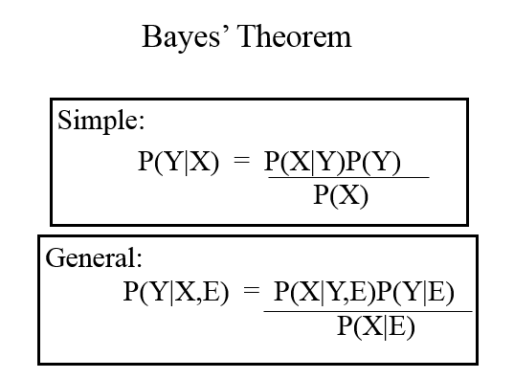
Graphical Models – Bayesian network

Slide 17
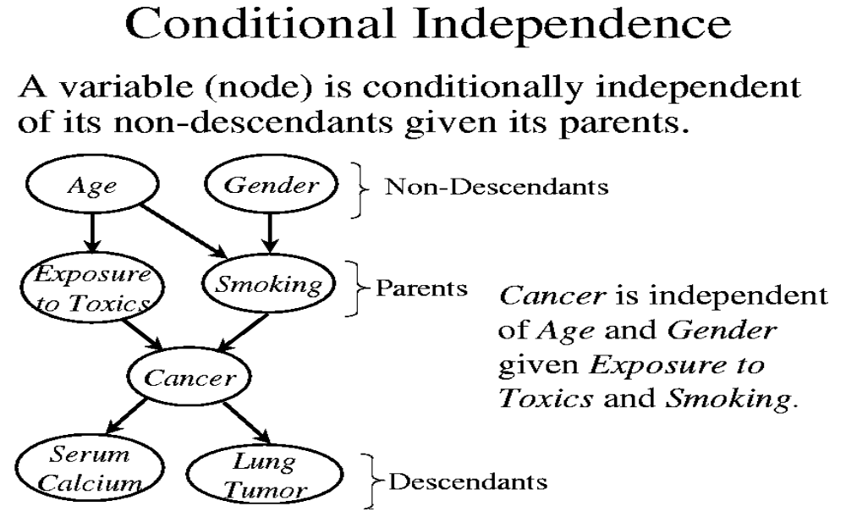
Bayesian network – Conditional Independence

Slide 18
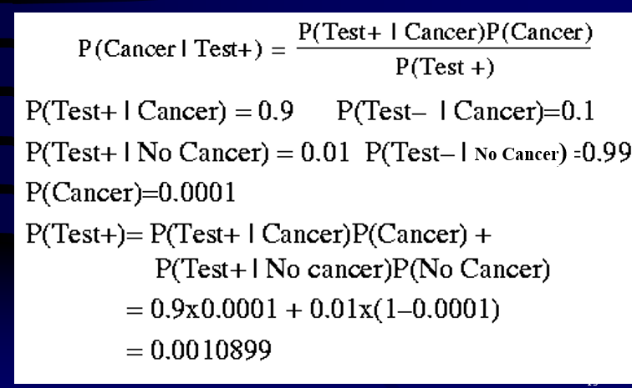
Bayesian network - Example

Slide 19
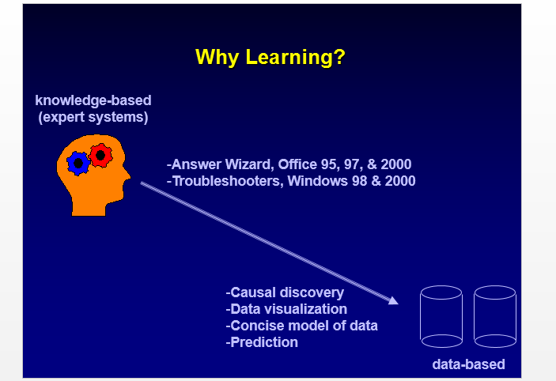
Graphical Models – Bayesian network

Slide 20
Graphical Models – Applications
Office Assistant in Microsoft Office 97
NASA applications
Microsoft Pregnancy and child care

Slide 21
Implementation in Python
from sklearn.naive_bayes import GaussianNB
import numpy as np
#assigning predictor and target variables
x= np.array([[-3,7],[1,5], [1,2], [-2,0], [2,3], [-4,0], [-1,1], [1,1], [-2,2], [2,7], [-4,1], [-2,7]])
Y = np.array([3, 3, 3, 3, 4, 3, 3, 4, 3, 4, 4, 4])
#Create a Gaussian Classifier
model = GaussianNB()
# Train the model using the training sets
model.fit(x, y)

Slide 22
Implementation in Python
#Predict Output
predicted= model.predict([[1,2],[3,4]])
print(predicted)

Slide 23
Summary
Learnt about
→bayesian networks
→implementation in Python

Slide 24
Thank You

