Slide 1
Control Structures in Python

Slide 2
Agenda
→Definition
→Conditional constructs
→Looping constructs

Slide 3
Control Structures
  alter the sequential execution of a program
  conditional constructs and looping constructs.

Slide 4
If
  if condition :
  statement(s)
  If the condition is true then the statement is executed.

Slide 5
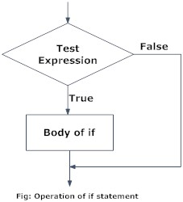
If flowchart

Slide 6
If Example
  number=4
  if number > 0:
  print(number, “is a positive number”)
  number=-4
  if number > 0:
  print(number, “is a negative number”)

Slide 7
If else
if condition:
  statement1
  else:
  statement2
  if condition is true, statement1 is executed.
  Otherwise statement2

Slide 8
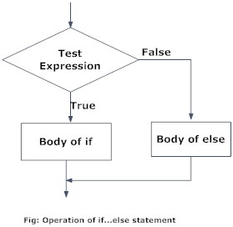
If else flowchart

Slide 9
If else Example
Num=8
if ( Num % 8 ==0):
print(Num,”is even”)
else:
print(Num,”is odd”)

Slide 10
if...elif...else
if condition1:
  statement1
  elif condition2:
  statement2
  else:
  statement3
  If condition1 is true statement is executed.
  Otherwise condition 2 is evaluated.
  If condition2 is true statement2 is executed. I
  If all conditions are false then else statement is executed.

Slide 11
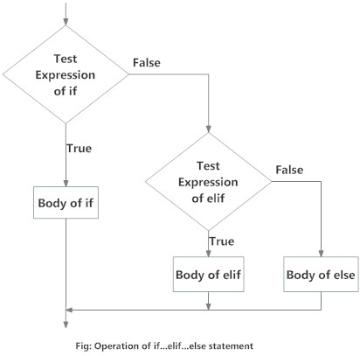
If elif else flowchart

Slide 12
If elif else Example
price = 34
if number > 100:
print(“Cheap rate")
elif number == 0:
print(“flat rate")
else:
print(“High rate")

Slide 13
Nested if Example
  number = float(input("Enter a number: "))
  if number >= 0:
  if number == 0:
  print("Zero")
  else:
  print("Positive number")
  else:
  print("Negative number")

Slide 14
For loop
for values in sequence:
Body of for loop
Value takes the value of the item inside the sequence.

Slide 15
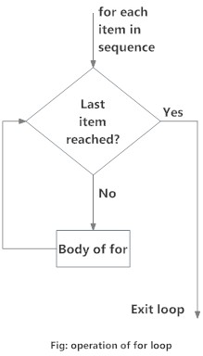
for flowchart

Slide 16
For Example
strlist=["one","two","three","four","five"]
for val in strlist:
print(val)

Slide 17
For Example
music = ['pop', 'rock', 'jazz']
# iterate over the list using index
for i in range(len(music)):
print("I like", music[i])

Slide 18
While loop
while test_condition:
Body of while
The body of the while loop executed as long as the condition is true.

Slide 19
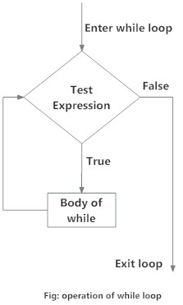
While flowchart

Slide 20
While Example
^{n = 10}
^{# initialize sum and counter}
^{sum = 0}
^{i = 1}
^{while i <= n:}
^{sum = sum + i}
^{i = i+1 # update counter}
^{# print the sum}
^{print("The sum is", sum)}

Slide 21
Exercises
WAP to calculate the sum of n numbers.
WAP to calculate the sum of digits of a number.
WAP to check whether a given number is prime.
WAP to generate the Fibonacci series.
WAP to generate the multiplication table of a given number.
WAP to traverse a fruits list.
WAP to reverse a string.
WAP to sort a list in ascending order.
WAP to check whether a given number is Armstrong or not.
WAP to search a given item and print its position in a given list.

Slide 22
Summary
Learnt about the
→basics of control structures
→if
→if else
→if elif else
→for
→while

Slide 23
Thank you

