Slide 1
Descriptive Statistics in Python

Slide 2
Agenda
Statistical variables
Statistical distributions
Descriptive Statistics

Slide 3
Statistical variables
  A variable - any characteristics, number, or quantity that can be measured or counted.
  It is also referred as data item.
  Eg : Age, Income, grades etc

Slide 4
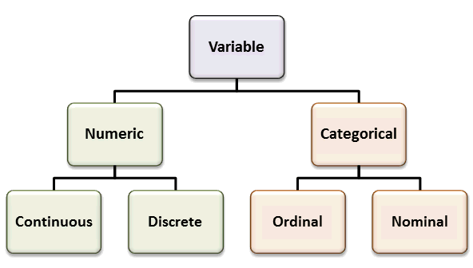
Statistical variables - Types

Slide 5
Statistical Distribution
  A probability distribution is a table or an equation that links each outcome of a statistical experiment with its probability of occurrence.
  Eg Occurrence of heads in a toss of two coins
Number of heads | Probability
0 | 0.25
1 | 0.50
2 | 0.25

Slide 6
Common Statistical Distributions
Bernoulli Distribution
Uniform Distribution
Binomial Distribution
Normal Distribution
Poisson Distribution

Slide 7
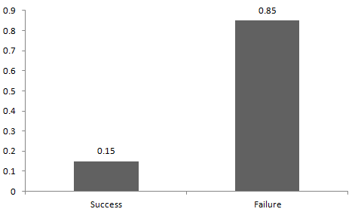
Bernoulli Distribution
  A Bernoulli distribution has only two possible outcomes,
  The probabilities of success and failure need not be equally likely.
  p<>q

Slide 8
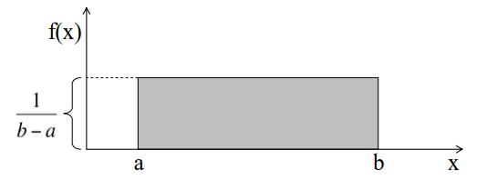
Uniform Distribution
  A Uniform distribution has equally likely outcomes.
  A is the maximum limit and B is the minimum limit.
Mean -> E(X) = (a+b)/2
Variance -> V(X) = (b-a)²/12

Slide 9
Binomial Distribution
  A distribution where only two outcomes are possible
  Criteria for binomial distribution
The number of observations or trials is fixed.
Each observation or trial is independent.
The probability of success is constant.
Mean -> µ = n*p
Variance -> Var(X) = n*p*q

Slide 10
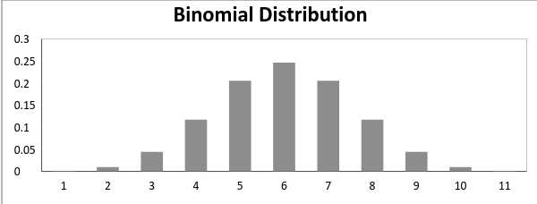
Binomial Distribution

Slide 11
Normal Distribution
Any distribution is normal if
The mean, median and mode of the distribution coincide.
The curve of the distribution is bell-shaped and symmetrical about the line x=μ.
The total area under the curve is 1.
Exactly half of the values are to the left of the center and the other half to the right.
Mean -> E(X) = µ
Variance -> Var(X) = σ^2

Slide 12
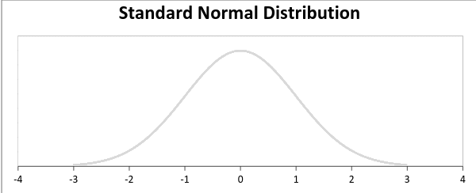
Normal Distribution

Slide 13
Poisson Distribution
Any distribution is Poisson if
Any successful event should not influence the outcome of another successful event.
The probability of success over a short interval must equal the probability of success over a longer interval.
The probability of success in an interval approaches zero as the interval becomes smaller.
Mean -> E(X) = µ
Variance -> Var(X) = µ

Slide 14
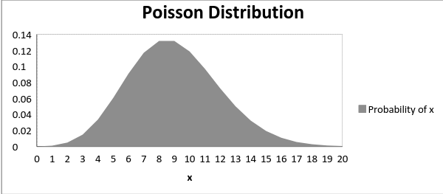
Poisson Distribution

Slide 15
Descriptive Statistics
  Describes the features of data in a study.
  Provides summaries about the sample.
  Basis of quantitative analysis
  Different from inferential statistics
  It is a single number that describes the entire data
  Eg : GPA of a student

Slide 16
Central tendency
  Central Tendency – Estimate of the center of distribution of the values.
    Mean
    Median
    Mode
    Range
    Dispersion
      Standard deviation

Slide 17

Mean
  Denotes the average.
  Calculation of average – Add all values and divide by the number of values.
  In a normal distribution mean=median=mode.

Slide 18
Mean – Advantage and Disadvantage
  Advantage :
    Popular technique.
    Eliminates random errors.
  Disadvantage :
    Can be affected by outliers.
    Can be biased.
    Cannot be used for categorical data.

Slide 19
Median
    middle data value in a ordered data set.
    Best when there are more outliers in the data.
    It is the second quartile.
    Suitable for ordinal data.

Slide 20
How to calculate Median
    For even number of data points
      arrange the numbers in order from smallest to largest and then count them.
      The median number will be the one exactly in the middle, with an equal amount of numbers on either side of it.
    For even number of data points
      arrange the numbers in order from smallest to largest and then count them.
      The median number will be the average of the two middle data points.

Slide 21
Mode
    The modal value of a set of data is the most frequently occurring value.
    Data can be unimodal, bimodal or trimodal.
    It is suitable for nominal data.
    To calculate mode, count the frequency of each data value in a set of data.
    The data value with the highest frequency is mode.
    Normal distribution is unimodal.

Slide 22
Range
    the difference between the maximum and minimum values of a set of data.
    used for continuous variables.
    affected by the outliers.

Slide 23
Quartiles
    values that divide your data into quarters.
The four quarters that divide a data set into quartiles are:
The lowest 25% of numbers.
The next lowest 25% of numbers (upto the median).
The second highest 25% of numbers (above the median).
The highest 25% of numbers.
Q1-25 percentile
Q2-50 percentile
Q3-75 percentile
Q4-100 percentile
50 percentile is median

Slide 24
Quartiles
The interquartile range is a value that is the difference between the upper quartile value and the lower quartile value.
To find the quartiles of the data set, use the following steps:
Order the data from least to greatest.
Find the median of the data set and divide the data set into two halves.
Find the median of the two halves.
also a measure of dispersion.

Slide 25
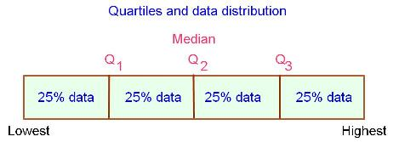
Quartiles

Slide 26
Standard deviation
measure of how spread out the numbers are from the mean.
a measure of dispersion.
When a data set has a large value, the values in the set are widely scattered; when it is small the items in the set are tightly clustered.
Its symbol is σ
Variance is the square of standard deviation.

Slide 27
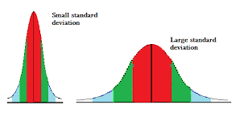
Standard deviation
To calculate the variance follow these steps:
Calculate the mean.
Then for each number, subtract the mean and square the result.
Calculate the average of the squared differences.
Divide the average by N-1.

Slide 28
Skew
It is a numerical measure of shape.
Skewness is a measure of symmetry
precisely, the lack of symmetry.
The skewness for a normal distribution is zero.
Negative values for the skewness indicate data that are skewed left
positive values for the skewness indicate data that are skewed right.
Left skew means that the left tail is long relative to the right tail.
skewed right means that the right tail is long relative to the left tail.

Slide 29
Kurtosis
how much of the ‘weight’ of the distribution is sitting in the tails as opposed to the middle of the distribution.
Kurtosis for a normal distribution is 3.
A positive value -have heavy-tails (i.e. a lot of data in your tails).
A negative value - light-tails (i.e. little data in your tails).

Slide 30
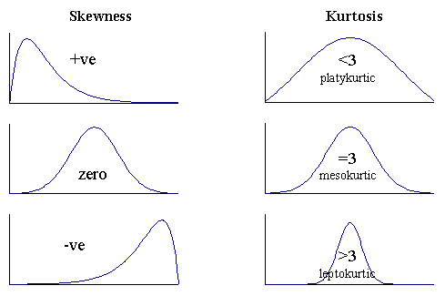
Skew and Kurtosis

Slide 31
Implementation in python
Use pandas and describe() for descriptive statistics
Import statistics for calculating the mean,median,mode
Import scipy.stats for calculating skew and kurtosis

Slide 32
Exercises
  Write a python code for calculating mean, median, mode of a list.
  Write a python code for obtaining the descriptive summary of a dataset
  Write a python code for calculating the skew and kurtosis of a list.

Slide 33
Exercises
    Learnt
    →The statistical meaning of mean, median,mode
    →The statistical meaning of probability distributions
    →The python implementation of mean, median, mode

Slide 34
Thank you

