Slide 1
Text Analytics and Sentimental analysis

Slide 2
Agenda
About Text Analytics
About Sentiment Analysis
Twitter Analysis in Python

Slide 3
About Text Analytics

Slide 4
Text Analytics
  Text Analytics = Data Mining + Lexicography

Slide 5
Why Text Analytics
Emails, online reviews, tweets, call center agent notes, survey results, and other types of written feedback all hold insight into the customers.
There is also a wealth of information in recorded interactions that can easily be turned into text.
Text analytics is the way to unlock the meaning from all of this unstructured text.

Slide 6
Text Mining
“…finding interesting regularities in large textual datasets…”
…where interesting means: non-trivial, hidden, previously unknown and potentially useful
“…finding semantic and abstract information from the surface form of textual data…”

Slide 7
Why dealing with Text is Tough?
Abstract concepts are difficult to represent
“Countless” combinations of subtle, abstract relationships among concepts
Many ways to represent similar concepts
  E.g. space ship, flying saucer, UFO
Concepts are difficult to visualize
High dimensionality
Tens or hundreds of thousands of features

Slide 8
Why dealing with Text is Easy?
Highly redundant data
  …most of the methods count on this property
Just about any simple algorithm can get “good” results for simple
tasks:
  Pull out “important” phrases
  Find “meaningfully” related words
  Create some sort of summary from documents

Slide 9
What dimensions are in text analytics?
Three major dimensions of text analytics:
  Representations
    …from character-level to first-order theories
  Techniques
    …from manual work, over learning to reasoning
  Tasks
    …from search, over (un-, semi-) supervised learning, to visualization, summarization, translation …

Slide 10
Who is in the text analysis arena?
Knowledge Rep. &
Reasoning / Tagging
Search & DB
Semantic Web
Web2.0
Information
Retrieval
Computational
Linguistics
Text Analytics
Data Analysis
Natural Language
Processing
Machine Learning
Text Mining

Slide 11
Document categorization
???
unlabeled
document
Machine learning
Document Classifier
labeled documents
document category
(label)

Slide 12
Algorithms for learning document classifiers
Popular algorithms for text categorization:
  Support Vector Machines
  Logistic Regression
  Perceptron algorithm
  Naive Bayesian classifier
  Winnow algorithm
  Nearest Neighbour

Slide 13
About Sentiment Analysis

Slide 14
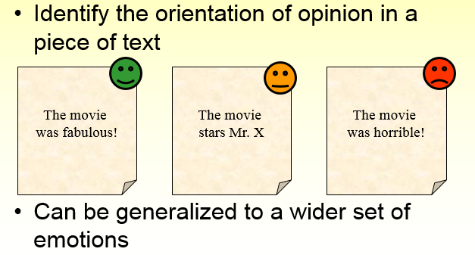
Sentiment Analysis

Slide 15
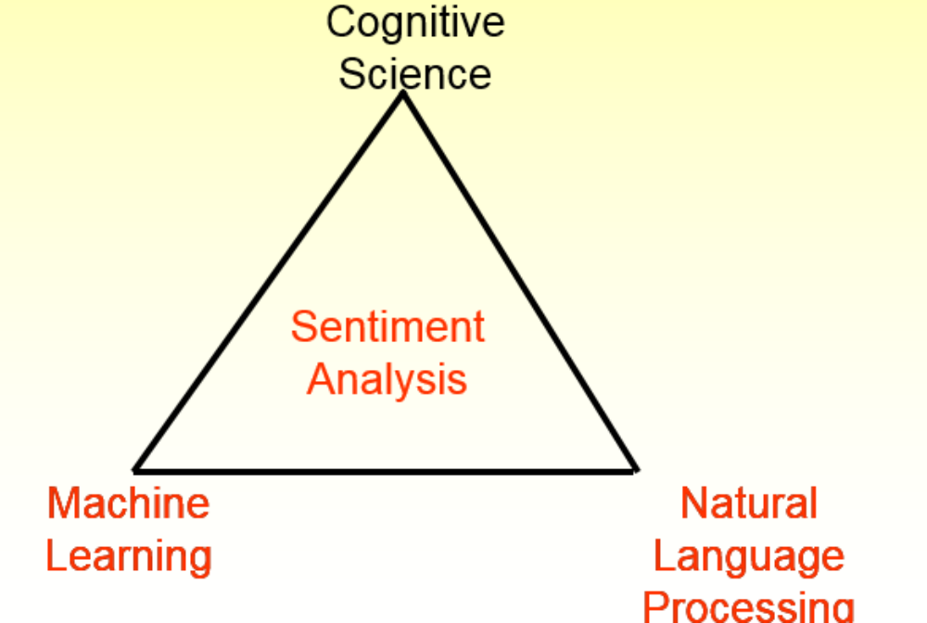
Tripod of Sentiment Analysis

Slide 16
Twitter Analyis
import re
import tweepy
from tweepy import OAuthHandler
from textblob import TextBlob
import matplotlib.pyplot as plt
class TwitterClient(object):
'''
Generic Twitter Class for sentiment analysis.
'''
def __init__(self):
'''
Class constructor or initialization method.
'''
# keys and tokens from the Twitter Dev Console
consumer_key = 'F1vOE7AhPhFjwutTFqeZBEztB'
consumer_secret = 'hqipYFZPi4BDlwy57haiwxIIA4Iq6EoEk9jTQWzUDprmjoMVae'
access_token = '1006031386405306368-95XMDQhJto2EnN4XtHZrapQZc1NRi3'
access_token_secret = 'Xl7fqo2rR1VQ6hJw6Q5Rn462QlrmlidgZbajdKxLzbcrE'

Slide 17
Twitter Analyis
# attempt authentication
try:
# create OAuthHandler object
self.auth = OAuthHandler(consumer_key, consumer_secret)
# set access token and secret
self.auth.set_access_token(access_token, access_token_secret)
# create tweepy API object to fetch tweets
self.api = tweepy.API(self.auth)
except:
print("Error: Authentication Failed")
def clean_tweet(self, tweet):
'''
Utility function to clean tweet text by removing links, special characters
using simple regex statements.
'''
return ' '.join(re.sub("(@[A-Za-z0-9]+)|([^0-9A-Za-z \t])|(\w+:\/\/\S+)", " ",
tweet).split())

Slide 18
Twitter Analyis
def get_tweet_sentiment(self, tweet):
'''
Utility function to classify sentiment of passed tweet
using textblob's sentiment method
'''
# create TextBlob object of passed tweet text
analysis = TextBlob(self.clean_tweet(tweet))
# set sentiment
if analysis.sentiment.polarity > 0:
return 'positive'
elif analysis.sentiment.polarity == 0:
return 'neutral'
else:
return 'negative'

Slide 19
Twitter Analyis
def get_tweets(self, query, count = 10):
'''
Main function to fetch tweets and parse them.
'''
# empty list to store parsed tweets
tweets = []
try:
# call twitter api to fetch tweets
fetched_tweets = self.api.search(q = query, count = count)
# parsing tweets one by one
for tweet in fetched_tweets:
# empty dictionary to store required params of a tweet
parsed_tweet = {}
# saving text of tweet
parsed_tweet['text'] = tweet.text
# saving sentiment of tweet
parsed_tweet['sentiment'] = self.get_tweet_sentiment(tweet.text)

Slide 20
Twitter Analyis
# saving text of tweet
parsed_tweet['text'] = tweet.text
# saving sentiment of tweet
parsed_tweet['sentiment'] = self.get_tweet_sentiment(tweet.text)
# appending parsed tweet to tweets list
if tweet.retweet_count > 0:
# if tweet has retweets, ensure that it is appended only once
if parsed_tweet not in tweets:
tweets.append(parsed_tweet)
else:
tweets.append(parsed_tweet)
# return parsed tweets
return tweets

Slide 21
Twitter Analyis
except tweepy.TweepError as e:
# print error (if any)
print("Error : " + str(e))
def main():
# creating object of TwitterClient Class
api = TwitterClient()
# calling function to get tweets
tweets = api.get_tweets(query = 'music', count = 200)
# picking positive tweets from tweets
ptweets = [tweet for tweet in tweets if tweet['sentiment'] == 'positive']
# percentage of positive tweets
print("Positive tweets percentage: {} %".format(100*len(ptweets)/len(tweets)))
# picking negative tweets from tweets
ntweets = [tweet for tweet in tweets if tweet['sentiment'] == 'negative']

Slide 22
Twitter Analyis
print("Negative tweets percentage: {} %".format(100*len(ntweets)/len(tweets)))
# percentage of neutral tweets
neutral = [tweet for tweet in tweets if tweet['sentiment'] == 'neutral']
print("Neutral tweets percentage: {} %".format(100*len(neutral)/len(tweets)))
# printing first 5 positive tweets
print("\n\nPositive tweets:")
for tweet in ptweets[:10]:
print(tweet['text'])
# printing first 5 negative tweets
print("\n\nNegative tweets:")
for tweet in ntweets[:10]:
print(tweet['text'])
colors = ['green', 'red', 'grey']
sizes = [(100*len(ptweets)/len(tweets)),(100*len(ntweets)/len(tweets)),(100*len

Slide 23
Twitter Analyis
## use matplotlib to plot the chart
plt.pie(x=sizes,shadow=True,colors=colors,labels=labels,startangle=90)
plt.title("twitter analysis on music")
plt.show()
if __name__ == "__main__":
# calling main function
main()

Slide 24
Summary
Learnt
→What is Text Analytics
→What is Sentiment Analysis
→Twitter Analysis in Python

Slide 25
Thank You

