Slide 1
Introduction to Python

Slide 2
Agenda
About Python
Python coding basics
Simple python programs

Slide 3
About Python

Slide 4
Python - History
  Developed by Guido Van Rossum in 1989.
  ABC programming language – predecessor of Python
  Influenced by two programming language
    ABC language
    Modula- 3
  Integrated
  Embeddable in applications

Slide 5
Why Python
Natural Syntax
Not so orthodox
Simple and easy
Beginner friendly
Less lines of code
Includes features of C and Java

Slide 6
Python
  interpreted, object-oriented, high-level programming language
  Supports object oriented approach, modules and packages
  Built in data structures
  Code maintenance with less effort
  Official language at Google

Slide 7
Python
  versatile and rich programming language
  Dynamic typing
  Multiple programming style
  Fast development and debugging

Slide 8
Python - Features
  Portable
  Open source
  Extensible
  Integrated

Slide 9
Language Properties
Everything is an object
Modules, classes, functions
Exception handling
Dynamic typing, polymorphism
Static scoping
Operator overloading
Indentation for block structure
Python page is a file with a .py extension

Slide 10
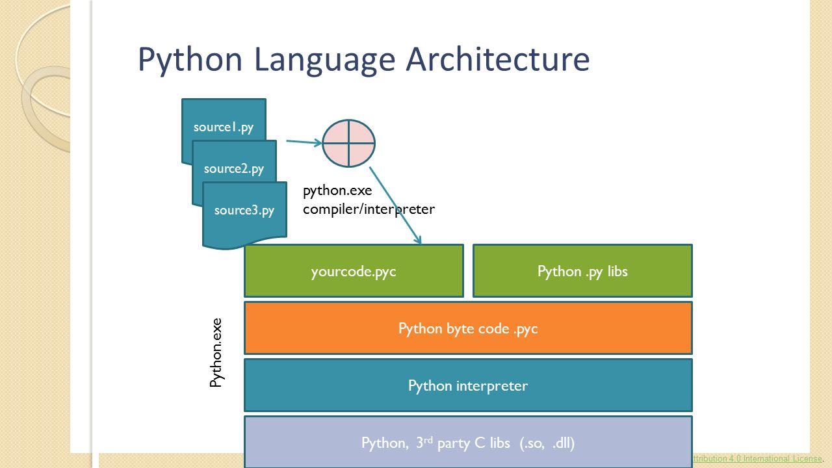
Language Architecture

Slide 11
Python Distributions
Python distributions provide
the Python interpreter,
Python packages
other related tools, such as editors.
Some of the popular distributions are :
WinPython
ActivePython
Anaconda
Enthought Canopy
Python(x,y)

Slide 12
Python Packages
sklearn :
  machine learning package which include a lot of ML algorithms.
NumPy :
  numeric python module - fast maths functions for calculations.
Pandas :
  Used to read and write different files
  Data manipulation –using dataframes.
Matplotlib:
  Used to plot graphs

Slide 13
Python Packages
scipy:
  library of software for engineering and science
Seaborn:
  Used for visualization
  Statsmodels
  Used for statiscal models

Slide 14
Python Applications
Web and Internet Development
Database Access
Desktop GUIs
Scientific & Numeric
Education
Network Programming
Software & Game Development

Slide 15
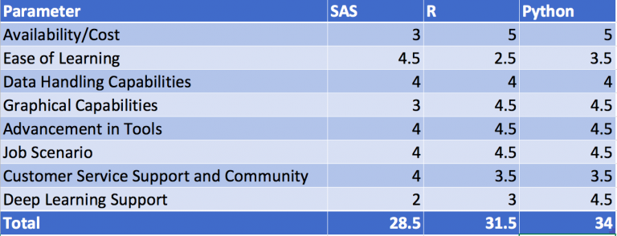
Comparison of Python with R and SAS

Slide 16
Advantages of Python
Extensive Support Libraries
Integration Feature
Improved Programmer’s Productivity

Slide 17
Disadvantages of Python
Difficulty in Using Other Languages
Weak in Mobile Computing
Gets Slow in Speed
Run-time Errors

Slide 18
Set up python
Choose Anaconda distribution
Launch Jupyter notebook

Slide 19
Why Anaconda Distribution
Contains porting for all the popular data science python libraries
scikit-learn, numpy,pandas, scipy, matplotlib etc.
jupyter notebook and Ipython distribution.
Saves from importing numerous libraries separately
Has a great package manager
Preinstalled and ready to run for a typical machine learning project.
Can do nearly everything in anaconda vs standard python

Slide 20
Anaconda Navigator
Anaconda Navigator is a desktop graphical user interface
It is included in Anaconda
It allows you to launch applications
easily manage conda packages environments and channels
It makes it easy without the need to use command line commands.

Slide 21
Anaconda Navigator
The applications that can be launched are
Jupyterlab
Jupyter notebook
Qtconsole
Spyder
Glueviz
Orange3
Rstudio

Slide 22
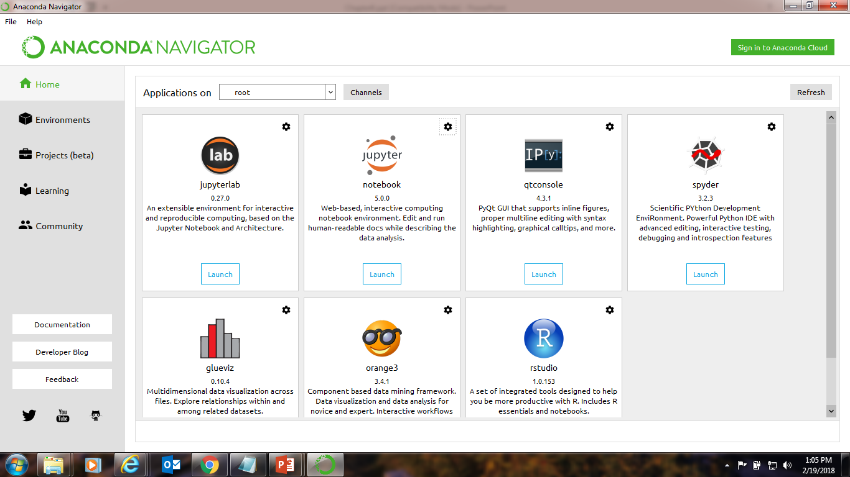
Anaconda Navigator

Slide 23
JUPYTER notebook
Jupyter Notebooks - increasingly popular system
Combines code, text, output, images into a single notebook file
Edit, View and use the single notebook in web browser

Slide 24
JUPYTER lab
An extensible environment for interactive and reproducible computing
next-generation user interface for Project Jupyter.
offers all the familiar building blocks of the classic Jupyter Notebook
It has a flexible and powerful user inteface
JupyterLab will replace the classic Jupyter Notebook

Slide 25
Qt Console
A rich Qt-based console for working with Jupyter kernels,
supports rich media output, session export, and more.
Qt console is a very lightweight application - like a terminal
It provides a number of enhancements only possible in a GUI

Slide 26
SPYDER
Powerful interactive development environment
"Scientific Python Development EnviRonment" (SPYDER)
used to write and execute the Python code with JUPYTER notebook

Slide 27
Glueviz
Used for data visualization
Visualizes the relationship within and across the dataset.

Slide 28
Orange
component-based data mining software
data visualization, exploration, preprocessing and modeling techniques.
nice and intuitive user interface or, for more advanced users

Slide 29
RStudio
integrated development environment (IDE) for the R
Some of its features include:
Customizable workbench
Syntax highlighting editor with code completion.
Execute code directly from the source editor (line, selection, or file).
Runs on all major platforms (Windows, Mac, and Linux)

Slide 30
Python programming Basics
There are two modes for using the Python interpreter:
Interactive Mode
Script Mode
Interactive mode – Python prompt
Script mode – Python source code in .py file

Slide 31
Basics
Assignment uses = and comparison uses ==.
-For numbers + - * / % are as expected.
-Special use of + for string concatenation.
Special use of % for string formatting (as with printf in C)
Logical operators are words (and, or, not)
not symbols

Slide 32
Programming Basics
The basic printing command is print.
The first assignment to a variable creates it.
- Variable types don’t need to be declared.
- Python figures out the variable types on its own.

Slide 33
Comments
Start comments with # – the rest of line is ignored.
Can include a “documentation string”
The development environment, debugger, and other tools use it

Slide 34
Whitespace
Whitespace is meaningful in Python: especially
indentation and placement of newlines.
- Use a newline to end a line of code.
  - Use \ when must go to next line prematurely.
No braces { } to mark blocks of code in Python…
Use consistent indentation instead.
The first line with less indentation is outside of the block.
The first line with more indentation starts a nested block
Often a colon appears at the start of a new block.
(E.g. for function and class definitions.)

Slide 35
Assignment
Binding a variable setting a name to hold a reference to some object.
→ Assignment creates references, not copies
Names in Python - do not have intrinsic type.
Objects have types.
determines the type of the reference automatically based on the data object assigned to it.
create a name the first time it appears on the left side of an assignment expression
A reference is deleted via garbage collection

Slide 36
Multiple Assignment
a,b,c=3,5,7
a=b=c=3

Slide 37
Variable Naming Rules
Names are case sensitive and cannot start with a number
can contain letters, numbers, and underscores.
bob Bob _bob _2_bob_ bob_2 BoB
reserved words:
and, assert, break, class, continue, def, del, elif,
else, except, exec, finally, for, from, global, if,
import, in, is, lambda, not, or, pass, print, raise,
return, try, while
Keywords should not be used as variable names

Slide 38
Python operators
Arithmetic Operators
Assignment Operators
Comparison (Relational) Operators
Logical Operators
Identity Operators
Bitwise Operators
Membership Operators

Slide 39
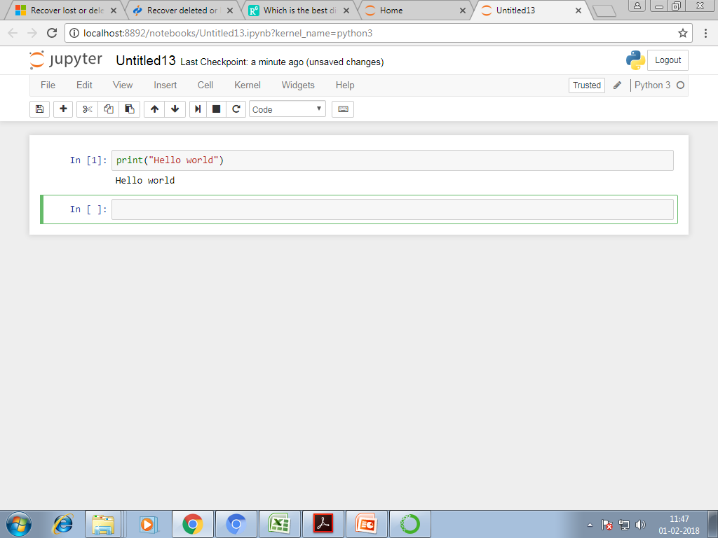
Hello world program

Slide 40
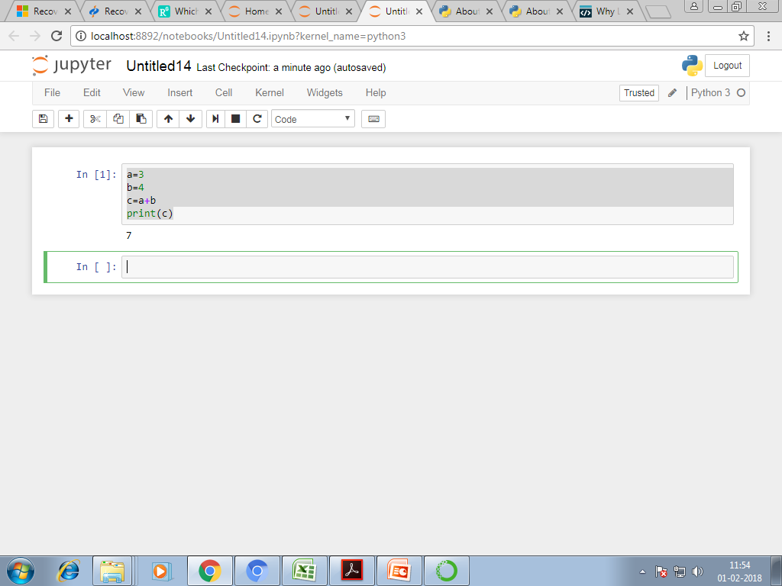
Sum of two numbers

Slide 41
Exercises
WAP to add three numbers.
WAP to subtract two numbers.
WAP to calculate the average of three numbers.
WAP to calculate the simple interest.
WAP to convert Fahrenheit to Celsius.
WAP to swap two variables without using a temporary variable.
WAP to swap two variables using temporary variable.

Slide 42
Summary
Learnt
→What is python
→basic coding in python
→basic programming in python

Slide 43
Thank You

