Slide 1
Data Structures in Python

Slide 2
Agenda
→Strings
→Lists
→Tuples
→Dictionary

Slide 3
Data Structures
Primitive
Non Primitive
Integer
Float
String
Boolean
Array
List
Tuple
Dictionary
Set
File
Linear
Non Linear
Stack
Queue
Tree
Graph

Slide 4
Strings
  A piece of text in programming
  Characters are not supported in Python.
  A character is a string of length 1.
  It is enclosed in double quotes or single quotes.

Slide 5
Creating Strings
  Creating Strings is easy,
  Enclose the characters in single or double quotes or triple quotes.
  Eg string1=“Hai Python”
  String2=‘Hello Python’
  String3=“””hai python, how are you.
  This python course will help you to learn python!!!”””

Slide 6
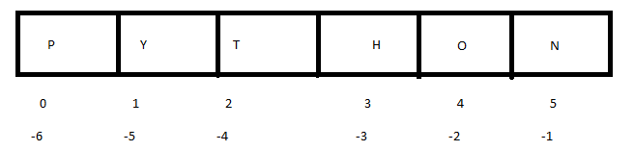
Strings – Accessing elements
  String elements - accessed through indices
  Indices - positive or negative
  Indices –specified by range

Slide 7
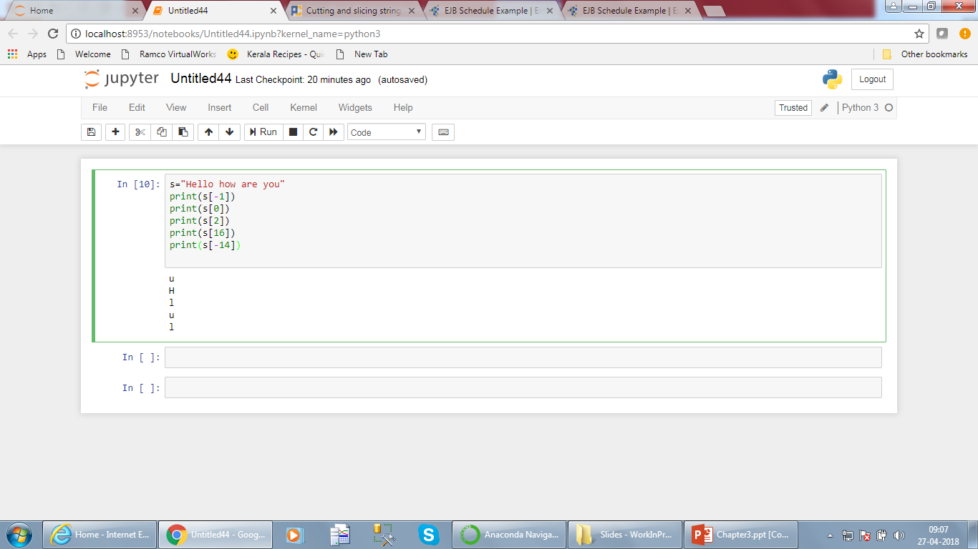
Strings – Accessing elements

Slide 8
Strings – Immutable
Strings can be assigned values
the individual elements cannot be changed.
The entire string can be changed.
Str=“Hai Darwin”
Str[0]=“J”
This operation is invalid.
the strings are immutable.

Slide 9
String Manipulation
Strings can be manipulated using methods like
  Len
  Enumerate
  Find
  Upper
  Lower
  Split
  Replace

Slide 10
Len method
prints the length of the string
The len method takes only the input string
Str=“python programming”
print(len(str))

Slide 11
Enumerate method
returns an enumerate object.
contains the index and value of all the items in the string as pairs.
str = 'cold‘
# enumerate()
list_enum = list(enumerate(str))
print('list(enumerate(str) = ', list_enum)
Output
list(enumerate(str) = [(0, 'c'), (1, 'o'), (2, 'l'), (3, 'd')]

Slide 12
Find method
returns the lowest index of the substring (if found).
If not found, it returns -1.
Find parameters
  sub - substring to be searched in the str string.
  start and end (optional) - substring is searched within str[start:end]
returns an integer value.
If substring exists inside the string,
  returns the lowest index where substring is found.
  else returns -1.

Slide 13
Find method
quote = 'Let it be, let it be, let it be‘
result = quote.find('let it')
The output will be 11.

Slide 14
Split method
breaks up a string at the specified separator
returns a list of strings.
Syntax
str.split([separator [, maxsplit]])
separator (optional)- The is a delimiter.
The string splits at the specified separator.
If the separator is not specified, any whitespace (space, newline etc.) string is a separator.
maxsplit (optional) - The maxsplit defines the maximum number of splits.
The default value of maxsplit is -1, meaning, no limit on the number of splits.

Slide 15
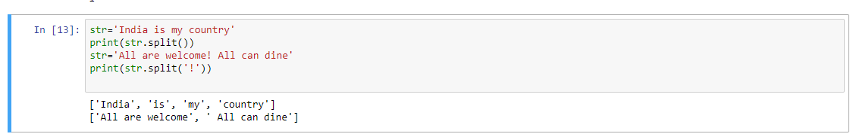
Split method
It returns a list of strings.

Slide 16
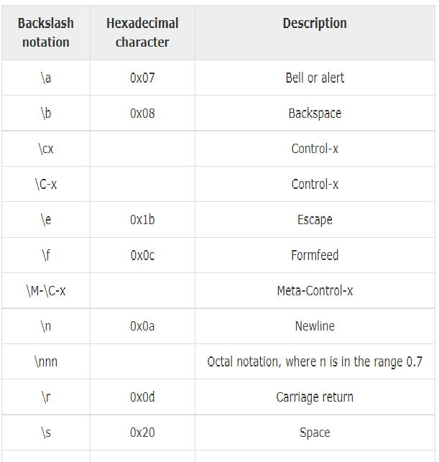
Escape sequences

Slide 17
Escape sequences
>>> print 'apple', 'orange', 'pear'
apple orange pear
>>> print 'apple\torange'
apple orange
>>> print 'apple\norange'
apple
orange

Slide 18
Triple Quotes
Triple quotes can be used to create multiline strings.
Special character will be treated as part of string itself

Slide 19
List
It is a sequence.
Items in a list need not be of the same type.
Lists are mutable
A list is created by placing all the items (elements) inside a square bracket [ ], separated by commas.
My_list=[‘apple’, ’guava’, ’orange’]
My_list=[‘apple’,[‘cherry’, ‘papaya’], ’lichi’]

Slide 20
Basic list operations
Length
    Len is the operator for length.
Concatenation
    The concatenating operator is ‘+’.
Repetition
    The repetition operator is ‘*’.
Membership
    test if an item exists in a list or not, using the keyword in.
Iteration
    iterate though each item in a list with for loop

Slide 21
Built in Functions
Len
  Calculates the length of the list.
List
  Converts a tuple into list
Max
  Returns item from the list with max value.
  Min
    Returns item from the list with min value.

Slide 22
List methods
Append
  List.append(obj)
  Appends object obj to list
Count
  List.count(obj)
  Returns count of how many times obj occurs in list
Extend
  List.extend(seq)
  Appends the contents of seq to list

Slide 23
List methods
Insert
  List.insert(obj,index)
  Inserts object obj into list at offset index
Remove
  List.remove(obj)
  Removes object from list
Reverse
  List.reverse()
  Reverses objects of list in place

Slide 24
Tuple
It is a sequence like list.

Slide 25
Basic tuple operations
Length
Concatenation
Repetition
Membership
Iteration

Slide 26
Built in Functions
Len
Tuple
Max
Min

Slide 27
Dictionary
set of key value pairs
Keys should be immutable objects-String, Integer,Float.
Keys cannot be duplicate.
Creating a dictionary is placing items inside curly braces {} separated by comma.
An item has a key and the corresponding value expressed as a pair, key: value.
my_dict = {1: 'apple', 2: 'ball'}

Slide 28
Accessing values from Dictionary
We cannot use index.
We can use keys directly or by get method.
my_dict = {'name':'Jack', 'age': 26}
# Output: Jack
print(my_dict['name'])
# Output: 26
print(my_dict.get('age'))

Slide 29
How to add values to Dictionary
my_dict = {'name':'Jack', 'age': 26}
# update value
my_dict['age'] = 27
#Output: {'age': 27, 'name': 'Jack'}
print(my_dict)
# add item
my_dict['address'] = 'Downtown'
# Output: {'address': 'Downtown', 'age': 27, 'name': 'Jack'}print(my_dict)

Slide 30
How to add values to Dictionary
It is mutable.
add new items or change the value of existing items using = operator.
If the key is already present, value gets updated,
else a new key: value pair is added to the dictionary.

Slide 31
Built in Functions
Sr.No. | Function with Description
1 | len(dict) Gives the total length of the dictionary. This would be equal to the number of items in the dictionary.
2 | str(dict) Produces a printable string representation of a dictionary
3 | type(variable) Returns the type of the passed variable. If passed variable is dictionary, then it would return a dictionary type.

Slide 32
Built in Methods
Sr.No. | Methods with Description
1 | dict.clear()Removes all elements of dictionary dict
2 | dict.copy()Returns a shallow copy of dictionary dict
3 | dict.fromkeys()Create a new dictionary with keys from seq and values set to value.
4 | dict.get(key, default=None)For key key, returns value or default if key not in dictionary
5 | dict.has_key(key)Returns true if key in dictionary dict, false otherwise
6 | dict.items()Returns a list of dict's (key, value) tuple pairs
7 | dict.keys()Returns list of dictionary dict's keys
8 | dict.setdefault(key, default=None)Similar to get(), but will set dict[key]=default if key is not already in dict
9 | dict.update(dict2)Adds dictionary dict2's key-values pairs to dict
10 | dict.values()Returns list of dictionary dict's values

Slide 33
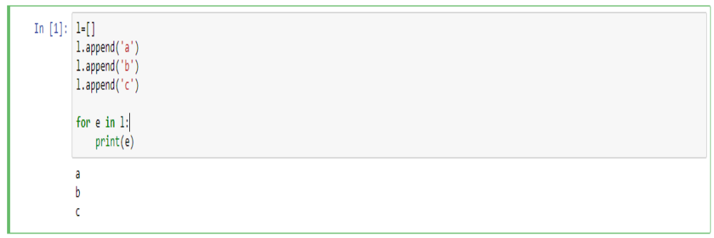
Implementation of lists

Slide 34
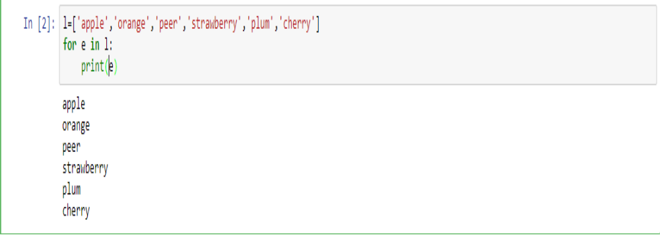
Implementation of lists

Slide 35
Implementation of lists

Slide 36
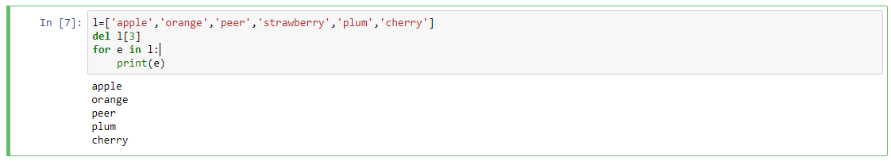
Implementation of lists

Slide 37
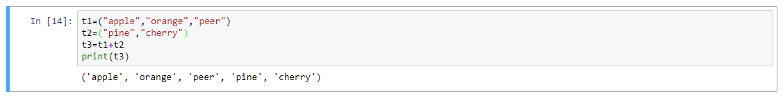
Implementation of tuples

Slide 38
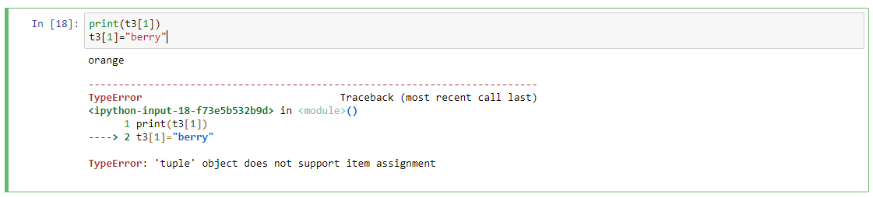
Implementation of tuples

Slide 39
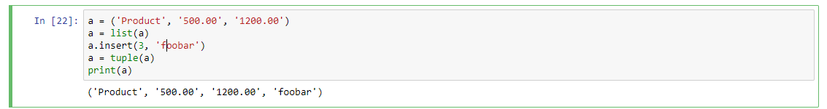
Implementation of tuples

Slide 40
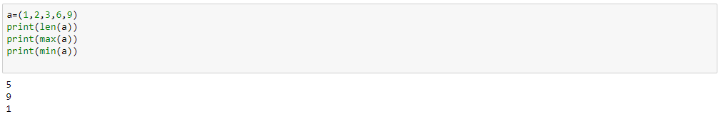
Implementation of tuples

Slide 41
Implementation of dictionary

Slide 42
Implementation of dictionary

Slide 43
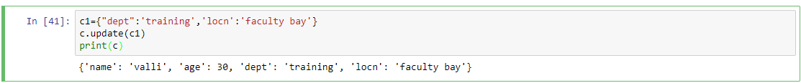
Implementation of dictionary

Slide 44
Exercises
WAP to calculate the sum of elements of a list.
WAP to input the list elements and output the list elements.
WAP to calculate the maximum in a list without using the built in function.
WAP to sort the list without using the built in function.
WAP to implement queue structure using list.
WAP to implement stack structure using list.
WAP to remove duplicates in a tuple.
Write a Python program to find the list of words that are longer than n from a given list of words.

Slide 45
Exercises
9. Write a Python program to check a list is empty or not.
10. Write a Python program to remove duplicates from a list.
11. Write a Python program that takes two lists and returns True if they have at least one common member.
12. Write a Python program to print the numbers of a specified list after removing even numbers from it.
13. Write a Python program to find the smallest number in a list.
14. Write a Python program to get the frequency of the elements in a list.

Slide 46
Exercises
15. Write a Python program to concatenate elements of a list.
16. Write a Python script to concatenate following dictionaries to create a new one. Sample Dictionary :
dic1={1:10, 2:20}
dic2={3:30, 4:40}
dic3={5:50,6:60}
Expected Result : {1: 10, 2: 20, 3: 30, 4: 40, 5: 50, 6: 60}
17. Write a Python program to multiply all the items in a dictionary.

Slide 47
Summary
Learnt
How to create a string
How to access the members of string
How to create a list
How to access the members of list
How to create a tuple
How to access the memebrs of a tuple
How to create a dictionary
How to access the members of dictionary

Slide 48
Thank you

