Slide 1
File Manipulation in Python

Slide 2
Agenda
→Reading the files
→Writing the files

Slide 3
CSV File handling
  import pandas as pd
  Dataframe=pd.read_csv(“filename”)

Slide 4
Excel File handling
  import pandas as pd
  Dataframe=pd.read_excel(“filename”)

Slide 5
Text File handling
  import pandas as pd
  Dataframe=pd.read_fwf(“filename”)

Slide 6
SQL file
  Install Mysql.
  Create a database and table.
  Using pymysql, connect to the database
  fetch rows using cursor.
  Manipulate the recordset using for loop.

Slide 7
SQL file
  import pymysql
  conn = pymysql.connect(host='127.0.0.1', user='root', passwd='admin', db='db')
  cur = conn.cursor()
  cur.execute("SELECT * from emp")
  for r in cur:
  print(r)
  cur.close()
  conn.close()

Slide 8
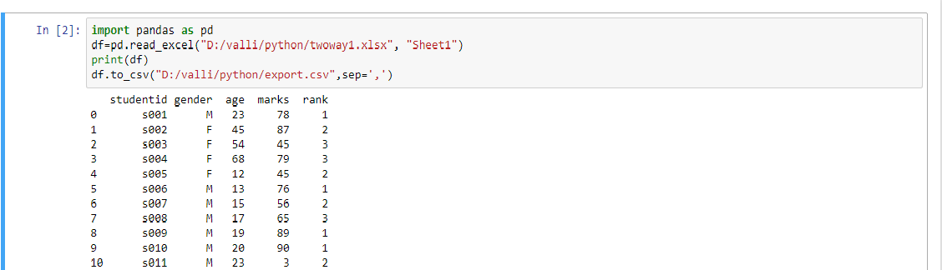
Write to csv file
Use to_csv method of dataframe.

Slide 9
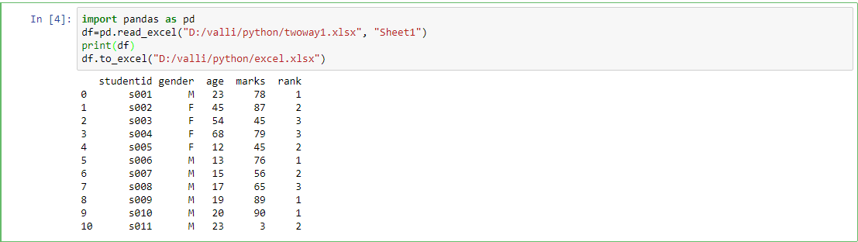
Write to excel file
Use to_excel method of dataframe.

Slide 10
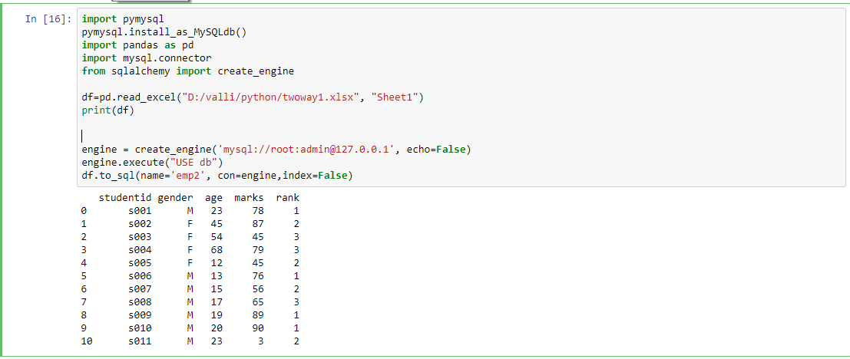
Write to sql file
Use to_sql method of dataframe.
!pip install pymysql

Slide 11
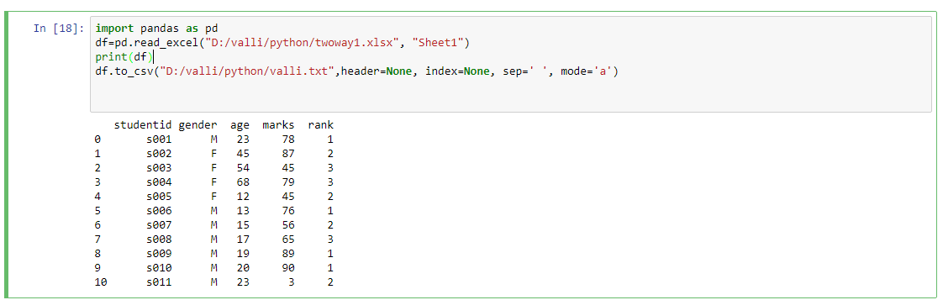
Write to text file
Use to_csv method of dataframe.Use separator as ‘ ‘.

Slide 12
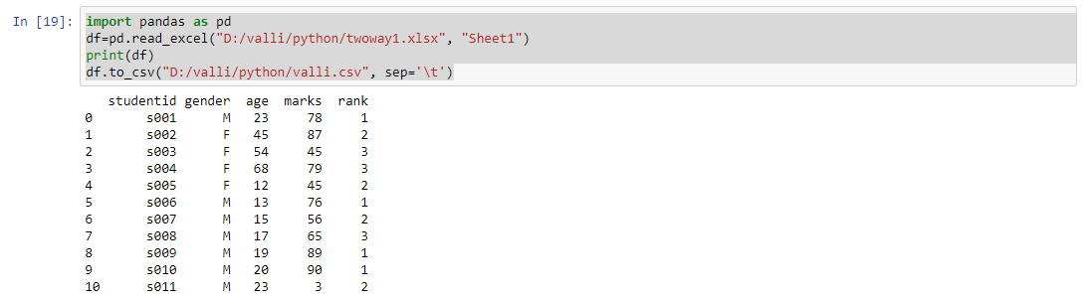
Write to tab separated file
Use to_csv method of dataframe.Use separator as ‘ \t‘.

Slide 13
Exercises
  WAP to read a csv file and handle its columns and rows
  WAP to read a excel file and handle its columns and rows
  WAP to read a text file and handle its columns and rows
  WAP to read a tab separated file and handle its rows and columns.
  WAP to read records from employee table.
  WAP to insert records into employee table.
  WAP to calculate the average salary of employees.

Slide 14
Summary
  Learnt
        How to read from
        →csv file
        →excel file
        →sql file
        →text file
        How to write to
        →csv file
        →excel file
        →sql file
        →text file

Slide 15
Thank you

