Slide 1
Graphical Analysis

Slide 2
Agenda
Definition
Types of graphs
Implementation in python

Slide 3
Statistical Graph
  It is a visual representation of data and statistical results.
  Effective and easy to interpret.
  Quantifies, sorts, presents data elegantly.
  It can be univariate, bivariate and multivariate.

Slide 4
Univariate Graphs

Slide 5
Bar Diagram
  shows the difference in frequency or percentage among the categories of a categorical variable.
  categories are displayed as rectangles of equal width with their height proportional to the frequency or percentage of the category.
  Bars - plotted vertically or horizontally.
  has two axes – one for category and the other for data values.

Slide 6
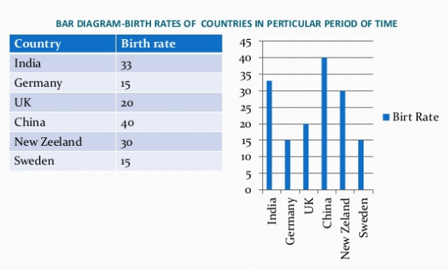
Bar Diagram

Slide 7
Histogram
  shows the difference in frequency or percentage among the categories of a interval ratio variable
  The categories - displayed as contiguous bar of width proportional to the width of the category
  height proportional to the frequency or percentage of the category
  It is useful for continuous data.
  Similar to bar chart.
  shows the mode, spread and symmetry of data
  Small bins produce multimodality and large bins produce unimodality

Slide 8
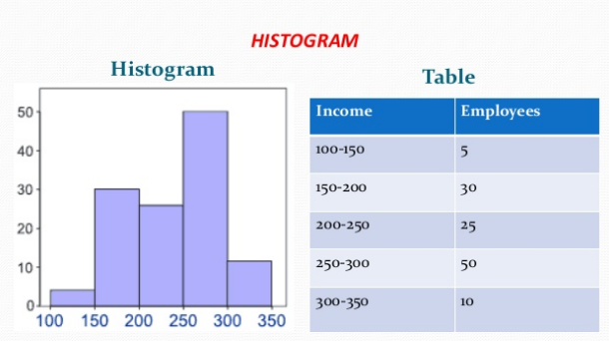
Histogram

Slide 9
Pie chart
  It shows the difference in frequency or percentage among the categories of a nominal variable.
  The categories are displayed as segments of a circle whose pieces added up to 100% of the total frequencies.
  It is circular graphical representation.
  Also called divided circle diagram.

Slide 10
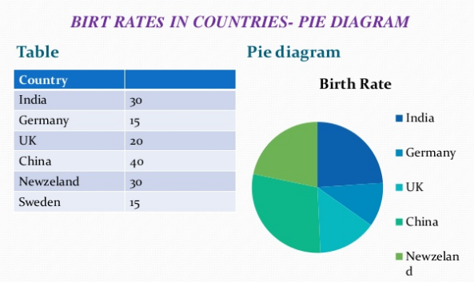
Pie chart

Slide 11
Index plot
  An index plot is a scatterplot of values on some measure plotted serially against the associated observation (case) number within the sample.
  helps in highlighting extreme values in a sample
  indicates trends when the data are, for instance, in spatial or time order
  also called univariate scatter plot.
  Displays the values of a single variable for each observation using symbols, with values of the variable for each observation plotted relative to the observation number

Slide 12
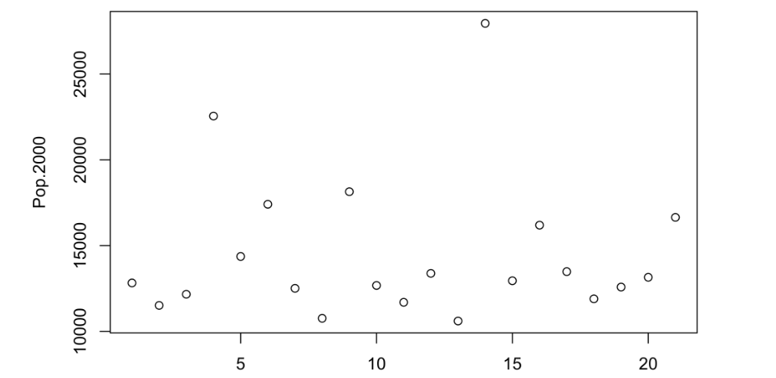
Index plot
Index

Slide 13
Bivariate Graphs

Slide 14
Box plot
  The two types of variables are explanatory and response variable.
  Explanatory variable is plotted on x axis and the response variable on y axis.
  standardized way of displaying the distribution of data based on the five point summary
  preferred when the explanatory variable is categorical.

Slide 15
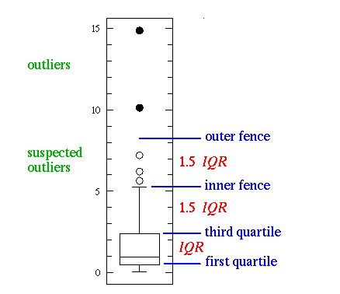
Box plot

Slide 16
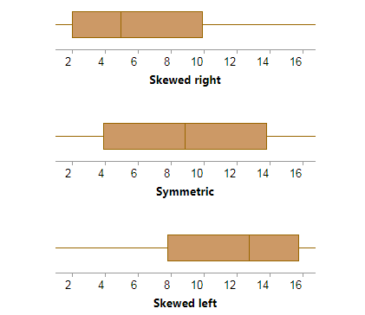
Box plot
  They provide information about the shape of the data.

Slide 17
Scatter plot
  preferred when the explanatory variable is continuous.
  called scatter diagram or correlation chart.
  determine how closely the two variables are related.

Slide 18
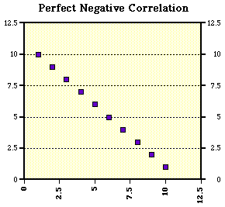
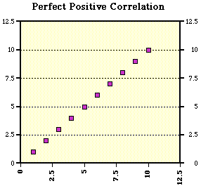
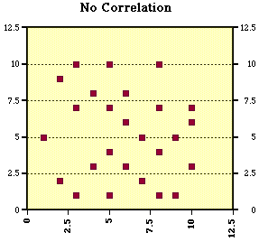
Scatter plot

Slide 19
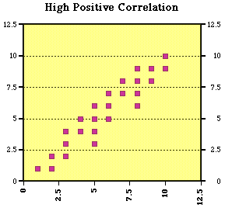
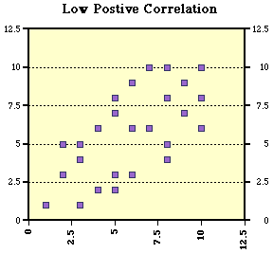
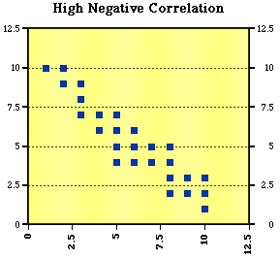
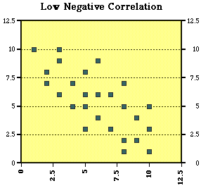
Scatter plot

Slide 20
Multivariate Graphs

Slide 21
Bubble plot
  The bubble plot displays the values of three variables at a time using graduated symbols (usually circles), where the value of one variable determines the relative position of the symbol along the X-axis and the value of a second variable determines the relative position of the symbol along the Y-axis, and the value of the third variable is used to determine the size of the symbol.

Slide 22
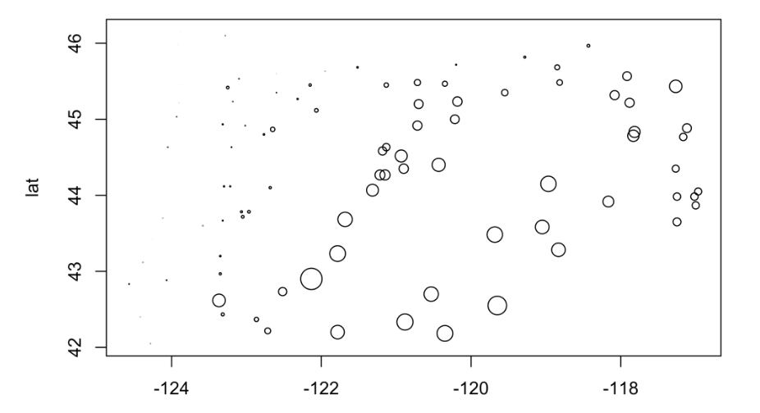
Bubble plot example
Ion

Slide 23
Coplot
  Conditioning scatter plots involves creating a multipanel display, where each panel contains a subset of the data.
  The idea is that the individual panels should illustrate the relationship between a pair of variables, over part of the range of the two marginal “conditioning” variables (i.e. the relationship “conditional on one marginal variable lying in one particular interval, and the other lying in a different interval.”)
  This coplot contains scatter diagrams for Yes as a function of the log(10) of Population, conditioned by country (i.e. one “response” variable and one “conditioning” variable.)

Slide 24
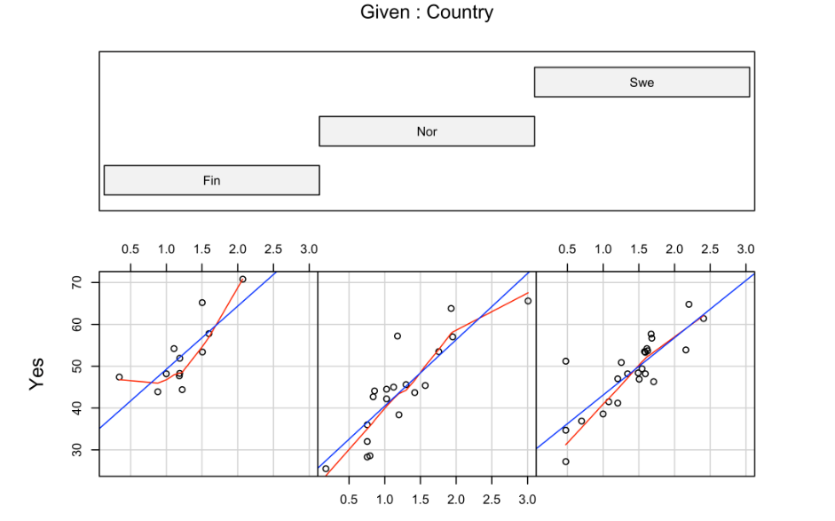
Coplot example
Log10(population)

Slide 25
Implementation of plots in python
  The matplotlib can be used to plot different plots.

Slide 26
Implementation of plots in python
  The matplotlib can be used to plot different plots.

Slide 27
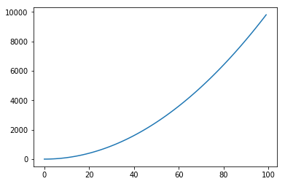
Normal plot in python
%matplotlib inline
import matplotlib.pyplot as plt #importing matplot lib library
import numpy as np
x = range(100)
#print x, print and check what is x
y =[val**2 for val in x]
#print y
plt.plot(x,y) #plotting x and y

Slide 28
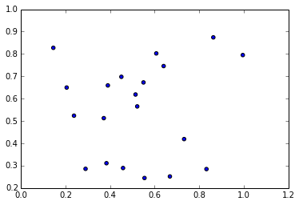
Scatter plot in python
sct = np.random.rand(20, 2)
print sct
plt.scatter(sct[:,0], sct[:,1]) # I am plotting a scatter plot.

Slide 29
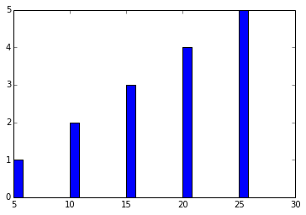
Scatter plot in python
ghj =[5, 10 ,15, 20, 25]
it =[ 1, 2, 3, 4, 5]
plt.bar(ghj, it) # simple bar graph

Slide 30
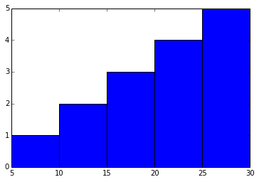
Scatter plot in python
ghj =[5, 10 ,15, 20, 25]
it =[ 1, 2, 3, 4, 5]
plt.bar(ghj, it, width =5)# you can change the thickness of a bar, by default the bar will have a thickness of 0.8 units

Slide 31
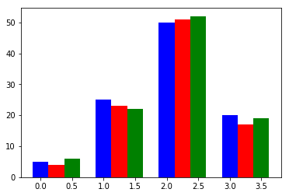
Multiple bar charts in python
new_list = [[5., 25., 50., 20.], [4., 23., 51., 17.], [6., 22., 52., 19.]]
x = np.arange(4)
print(x)
plt.bar(x + 0.00, new_list[0], color ='b', width =0.25)
plt.bar(x + 0.25, new_list[1], color ='r', width =0.25)
plt.bar(x + 0.50, new_list[2], color ='g', width =0.25)

Slide 32
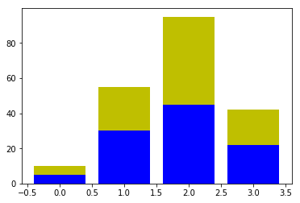
Stacked bar charts in python
p = [5., 30., 45., 22.]
q = [5., 25., 50., 20.]
x =range(4)
plt.bar(x, p, color ='b')
plt.bar(x, q, color ='y', bottom =p)

Slide 33
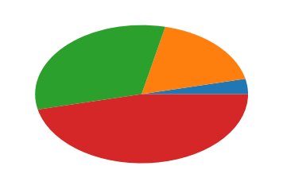
Pie charts in python
y = [5, 25, 45, 65]
plt.pie(y)

Slide 34
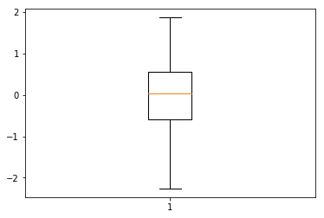
Box plots in python
d = np.random.randn(100)
plt.boxplot(d)

Slide 35
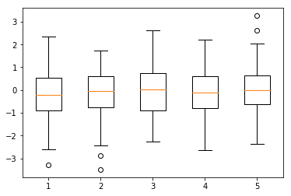
Box plots in python
d = np.random.randn(100, 5) # generating multiple box plots
plt.boxplot(d)

Slide 36
Summary
  Learnt how to draw
        Bar chart
        Histogram
        Pie chart
        Index chart
        Bubble plot
        Coplot

Slide 37
Thank You

