Slide 1
Hypothesis testing

Slide 2
Agenda
Definition
Types of hypothesis test
Implementation in python

Slide 3
Statistical Hypothesis
  A statistical hypothesis - assumption about a population parameter.
  A parameter is a measurable characteristic - a mean or a standard deviation.
  to determine whether a statistical hypothesis is true would be to examine the entire population.
  researchers typically examine a random sample from the population.
  If sample data are not consistent with the statistical hypothesis, the hypothesis is rejected.

Slide 4
Statistical Hypothesis
There are two types of statistical hypotheses.
Null hypothesis. The null hypothesis, denoted by H₀, is usually the hypothesis that sample observations result purely from chance.
Alternative hypothesis. The alternative hypothesis, denoted by H₁ or H_{a}, is the hypothesis that sample observations are influenced by some non-random cause.

Slide 5
Steps in hypothesis testing
State the hypotheses. This involves stating the null and alternative hypotheses.
The hypotheses are stated in such a way that they are mutually exclusive. That is, if one is true, the other must be false.
Formulate an analysis plan. The analysis plan describes how to use sample data to evaluate the null hypothesis.
The evaluation often focuses around a single test statistic.
Analyze sample data. Find the value of the test statistic (mean score, proportion, t statistic, z-score, etc.) described in the analysis plan.
Interpret results. Apply the decision rule described in the analysis plan. If the value of the test statistic is unlikely, based on the null hypothesis, reject the null hypothesis.

Slide 6
Decision errors
Two types of errors can result from a hypothesis test.
  Type I error. A Type I error occurs when the researcher rejects a null hypothesis when it is true.
  The probability of committing a Type I error is called the significance level.
  This probability is also called alpha, and is often denoted by α.
  Type II error. A Type II error occurs when the researcher fails to reject a null hypothesis that is false.
  The probability of committing a Type II error is called Beta, and is often denoted by β.
  The probability of notcommitting a Type II error is called the Power of the test.

Slide 7
Decision Rules
  P-value.
  The strength of evidence in support of a null hypothesis is measured by the P-value.
  Suppose the test statistic is equal to S.
  The P-value is the probability of observing a test statistic as extreme as S, assuming the null hypotheis is true.
  If the P-value is less than the significance level, we reject the null hypothesis.

Slide 8
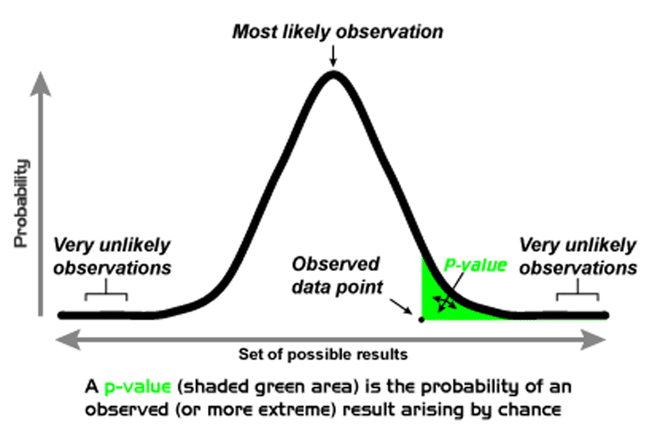
P Value

Slide 9
Decision Rules
  Significance level
  We can say that if a statistician states that some result is "highly significant", then he mean by say that it might be very probably true.
  In statistical researches, the statistical significance test removes the possibility of a results to be arose by chance.
  This allows the rejection of null hypothesis (say H0).
  The level of significance for a statistical hypothesis test is defined as the fixed probability of wrong rejection of null hypothesis when if in fact it is true.
  The significance level is said to be the probability of type I error.
  Also known as confidence level.

Slide 10
One tailed and two tailed tests
  A test of a statistical hypothesis, where the region of rejection is on only one side of the sampling distribution, is called a one-tailed test
  H0: mean is not greater than 5
  A test of a statistical hypothesis, where the region of rejection is on both sides of the sampling distribution, is called a two-tailed test.
  H0:mean is equal to 5

Slide 11
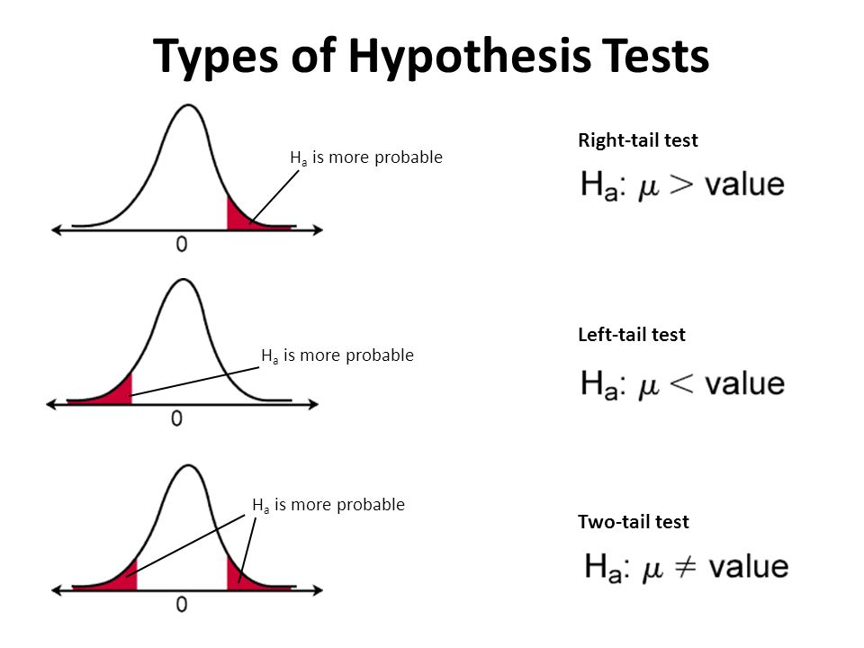
One tailed and two tailed tests

Slide 12
Degrees of freedom
  In statistics, the number of values in a study that are free to vary.
  For example, if you have to take ten different courses to graduate, and only ten different courses are offered, then you have nine degrees of freedom. Nine semesters you will be able to choose which class to take; the tenth semester, there will only be one class.

Slide 13
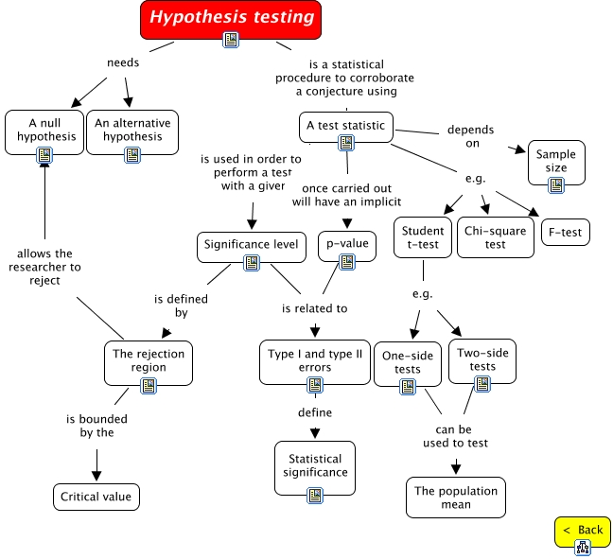
Hypothesis tests

Slide 14
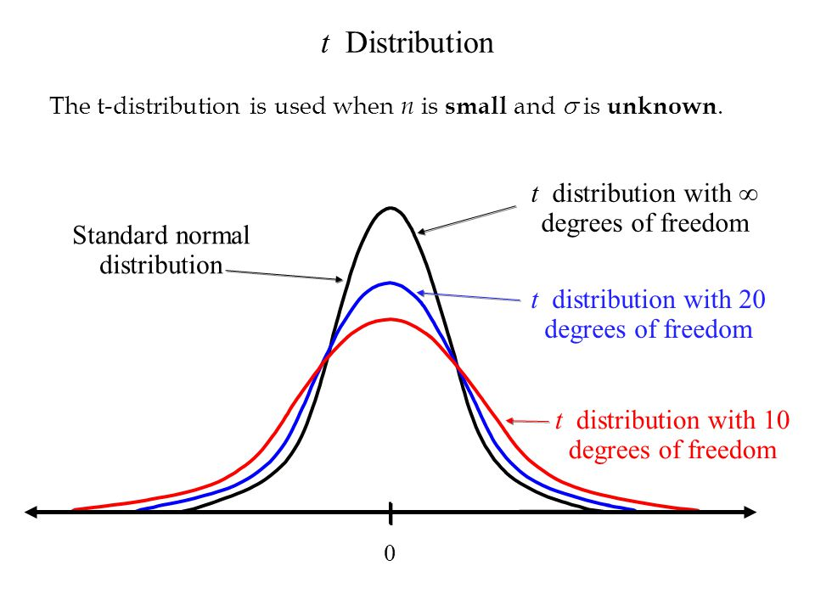
T Distribution
When n is large, there is no difference between t distribution and normal distribution.

Slide 15
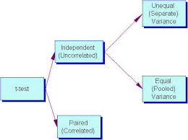
T test

Slide 16
One sample t test
  Assumptions for t test
The sampling method is simple random sampling.
The sampling distribution is normal or nearly normal.
The sampling distribution is normal if
The population distribution is normal.
The population distribution is symmetric, unimodal and without outliers, and the sample size is 15 or less.
The population distribution is moderately skewed, unimodal, without outliers, and the sample size is between 16 and 40.
The sample size is greater than 40, without outliers.
SE = s / sqrt( n )
t = (xbar - μ) / SE

Slide 17
Two sample t test
  Assumptions for t test
The sampling method for each sample is simple random sampling.
The samples are independent.
Each population is at least 20 times larger than its respective sample.
The sampling distribution is normal
t=(x1bar-x2bar)/SE

Slide 18
Paired t test
  Assumptions for t test
The sampling method for each sample is simple random sampling.
The test is conducted on paired data. (As a result, the data sets are not independent.)
The sampling distribution is approximately normal
t=(dbar-mu)/SE

Slide 19
Paired t test
  Assumptions for t test
The sampling method for each sample is simple random sampling.
The test is conducted on paired data. (As a result, the data sets are not independent.)
The sampling distribution is approximately normal
t=(dbar-mu)/SE

Slide 20
U test
When comparing two independent samples when the outcome is not normally distributed and the samples are small, a nonparametric test is appropriate.
A popular nonparametric test to compare outcomes between two independent groups is the Mann Whitney U test.
The Mann Whitney U test, sometimes called the Mann Whitney Wilcoxon Test or the Wilcoxon Rank Sum Test, is used to test whether two samples are likely to derive from the same.
Some investigators interpret this test as comparing the medians between the two populations.

Slide 21
Chi square goodness of fit test
The chi-square goodness of fit test is appropriate when the following conditions are met:
The sampling method is simple random sampling.
The variable under study is categorical.
The expected value of the number of sample observations in each level of the variable is at least 5.
For a chi-square goodness of fit test, the hypotheses take the following form.
H₀: The data are consistent with a specified distribution.
H_{a}: The data are not consistent with a specified distribution.
Χ² = Σ [ (O_{i} - E_{i})² / E_{i} ]

Slide 22
Chi square test for independence
The test is applied when you have two categorical variables from a single population.
It is used to determine whether there is a significant association between the two variables.
The test procedure described is appropriate when the following conditions are met:
  The sampling method is simple random sampling.
  The variables under study are each categorical.
  If sample data are displayed in a contingency table, the expected frequency count for each cell of the table is at least 5.
  H₀: Variable A and Variable B are independent.
  H_{a}: Variable A and Variable B are not independent.

Slide 23
Python implementation

Slide 24
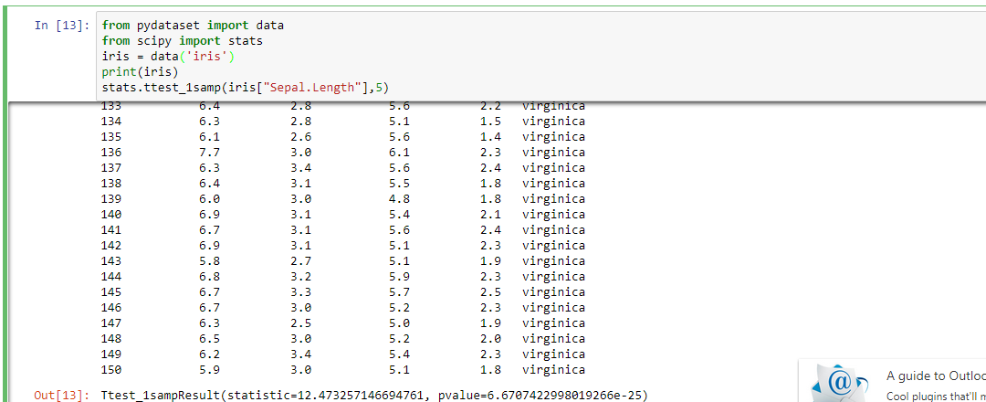
One sample t test

Slide 25
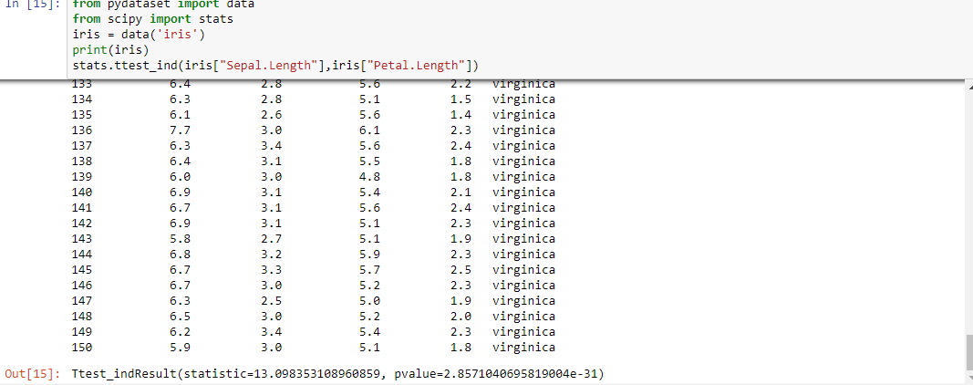
Two sample t test

Slide 26
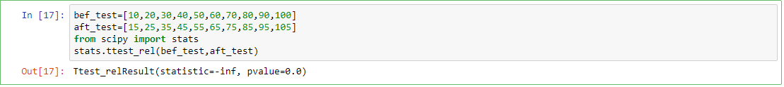
Paired t test

Slide 27
U test
import numpy as np
from scipy.stats import ttest_1samp, wilcoxon, ttest_ind, mannwhitneyu
# daily intake of energy in kJ for 11 women
daily_intake = np.array([5260,5470,5640,6180,6390,6515,
6805,7515,7515,8230,8770])
# one sample t-test
# null hypothesis: expected value = 7725
t_statistic, p_value = ttest_1samp(daily_intake, 7725)
# p_value < 0.05 => alternative hypothesis:
# data deviate significantly from the hypothesis that the mean
# is 7725 at the 5% level of significance
print("one-sample t-test", p_value)
# one sample wilcoxon-test
z_statistic, p_value = wilcoxon(daily_intake - 7725)
print("one-sample wilcoxon-test", p_value)

Slide 28
U test
energ = np.array([
# energy expenditure in mJ and stature (0=obese, 1=lean)
[9.21, 7.54],[7.53, 2.43],[7.48, 5.67],[8.08, 6.67],[8.09, 9.01],[10.15, 5.4],[8.40, 3.2],[10.88, 2.3],[6.13, 6.5],[7.90, 3.45],[11.51, 7.89],[12.79, 1.23],[7.05, 5.78],[11.85, 8.90],[9.97, 7.67],[7.48, 3.45],[8.79, 5.66],[9.69, 7.89],[9.68, 4.56],[7.58, 7.90],[9.19, 3.67],[8.11, 7.77]])
print(energ)
# similar to expend ~ stature in R
group1 = energ[:, 0]
group2 = energ[:, 1]
# two-sample t-test
# null hypothesis: the two groups have the same mean
# this test assumes the two groups have the same variance...
# (can be checked with tests for equal variance)
# independent groups: e.g., how boys and girls fare at an exam
# dependent groups: e.g., how the same class fare at 2 different exams
t_statistic, p_value = ttest_ind(group1, group2)

Slide 29
U test
# p_value < 0.05 => alternative hypothesis:
# they don't have the same mean at the 5% significance level
print("two-sample t-test", p_value)
# two-sample wilcoxon test
# a.k.a Mann Whitney U
u, p_value = mannwhitneyu(group1, group2)
print("two-sample wilcoxon-test", p_value)
# pre and post-menstrual energy intake
intake = np.array([[5260, 3910],[5470, 4220],[5640, 3885],[6180, 5160],[6390, 5645],[6515, 4680],[6805, 5265],
[7515, 5975],[7515, 6790],[8230, 6900],[8770, 7335]])
pre = intake[:, 0]
post = intake[:, 1]

Slide 30
U test
# paired t-test: doing two measurments on the same experimental unit
# e.g., before and after a treatment
t_statistic, p_value = ttest_1samp(post - pre, 0)
# p < 0.05 => alternative hypothesis:
# the difference in mean is not equal to 0
print("paired t-test", p_value)
# alternative to paired t-test when data has an ordinary scale or when not
# normally distributed
z_statistic, p_value = wilcoxon(post - pre)
print("paired wilcoxon-test", p_value)

Slide 31
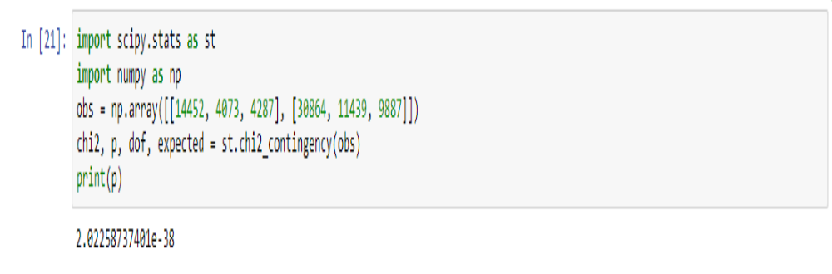
Chi square test

Slide 32
Summary
Learn how to conduct
→One sample t test
→Two sample t test
→ Paired t test
→ One sample u test
→ Two sample u test
→ Paired u test
→ Chisquare test

Slide 33
Thank you

