Slide 1
Linear Regression

Slide 2
Agenda
Definition
Simple linear regression
Multiple linear regression
Implementation in python

Slide 3
Regression
Linear regression is a basic and commonly used type of predictive analysis.
The overall idea of regression is to examine two things:
(1) does a set of predictor variables do a good job in predicting an outcome (dependent) variable?
(2) Which variables in particular are significant predictors of the outcome variable, and in what way do they–indicated by the magnitude and sign of the beta estimates–impact the outcome variable?
Naming the Variables - There are many names for a regression’s dependent variable.
It may be called an outcome variable, criterion variable, endogenous variable, or regressand.
The independent variables can be called exogenous variables, predictor variables, or regressors and explanatory variable.
Eg :positive relationship between unemployment and government spending.

Slide 4
Regression
Three major uses for regression analysis are
determining the strength of predictors,
forecasting an effect, and
(3) trend forecasting.

Slide 5
Regression
There are several types of linear regression analyses available to researchers.
Simple linear regression
1 dependent variable (interval or ratio), 1 independent variable (interval or ratio or dichotomous)
Multiple linear regression
1 dependent variable (interval or ratio) , 2+ independent variables (interval or ratio or dichotomous)
Logistic regression
1 dependent variable (dichotomous), 2+ independent variable(s) (interval or ratio or dichotomous)

Slide 6
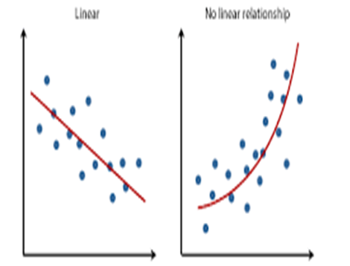
Regression

Slide 7
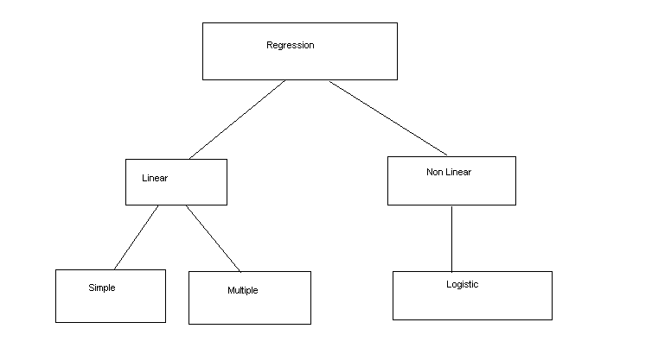
Regression

Slide 8
Simple Linear Regression
The linear relationship between the two variables is given by
Y=b0+b1*x+Ɛ
Where Y is the dependent variable and x is the independent variable. Ɛ is the random error component.
b0 is the y intercept and b1 is the slope.

Slide 9
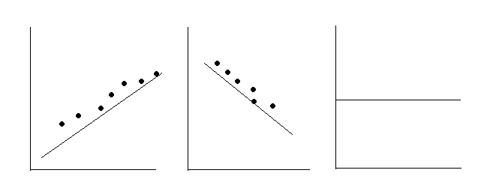
Simple Linear Regression
b1 is +ve b1 is –ve b1=0
Increasing relnship Decreasing relnship No relnship

Slide 10
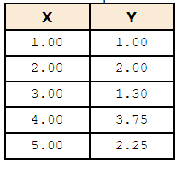
Linear Regression - Example
The independent variable can be plotted on the x axis and dependent variable can be plotted on the y axis. The linear relationship can be approximated using the regression line.

Slide 11
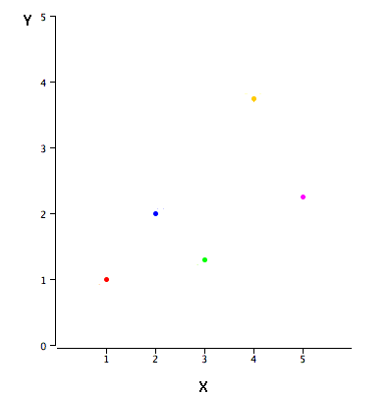
Linear Regression – Scatter plot

Slide 12
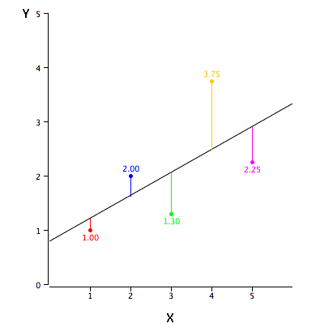
Linear Regression - Example
Linear regression consists of finding the best-fitting straight line through the points. The best-fitting line is called a regression line. The black diagonal line in Figure is the regression line and consists of the predicted score on Y for each possible value of X. The vertical lines from the points to the regression line represent the errors of prediction.

Slide 13
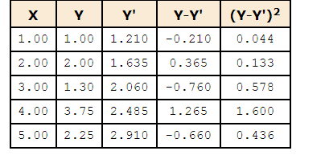
Linear Regression - Example
By far, the most commonly-used criterion for the best-fitting line is the line that minimizes the sum of the squared errors of prediction.

Slide 14
Linear Regression - Example
The formula for a regression line is
Y' = bX + A
where Y' is the predicted score, b is the slope of the line, and A is the Y intercept. The equation for the line in Figure is
Y' = 0.425X + 0.785
For X = 1,
Y' = (0.425)(1) + 0.785 = 1.21.
For X = 2,
Y' = (0.425)(2) + 0.785 = 1.64.

Slide 15

Linear Regression - Example
The slope (b) can be calculated as follows:
b = r s_{Y}/s_{X}
and the intercept (A) can be calculated as
A = M_{Y} - bM_{X}.
For these data,
b = (0.627)(1.072)/1.581 = 0.425
A = 2.06 - (0.425)(3) = 0.785

Slide 16
Assumptions for Linear Regression
Linearity
Homoscedascity
Normality
Independence

Slide 17
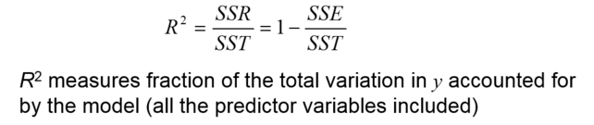
Efficiency of the model
R² lies between 0 and 1. For perfect positive regression R2 =1

Slide 18
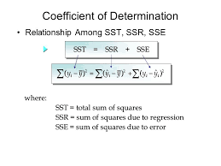
Efficiency of the model

Slide 19
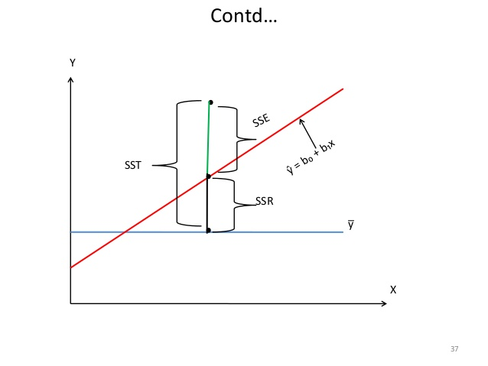
Efficiency of the model

Slide 20
Multiple Regression
Multiple regression models thus describe how a single response variable Y depends linearly on a number of predictor variables.
The selling price of a house can depend on the desirability of the location, the number of bedrooms, the number of bathrooms, the year the house was built, the square footage of the lot and a number of other factors.
The height of a child can depend on the height of the mother, the height of the father, nutrition, and environmental factors.

Slide 21
Multiple Regression
A multiple linear regression model with k predictor variables X1, X2, ..., Xk and a response Y , can be written as
y = β0 + β1x1 + β2x2 + ··· βkxk + Ɛ
Where β0…. βk are the regression coefficients and Ɛ is the random error component. Ɛ

Slide 22
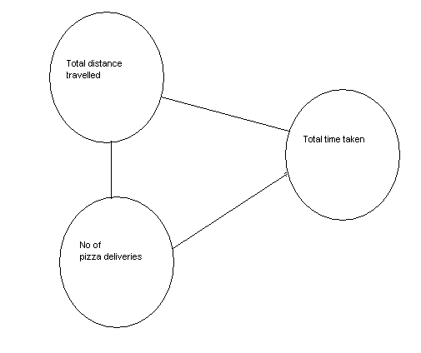
Multicollinearity
It is the condition in which there is a strong correlation between the independent variables which affects the accuracy of regression model.
Example

Slide 23
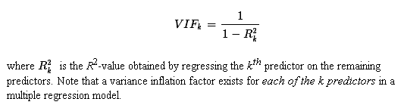
Variance Inflation Factor
variance inflation factor (VIF) quantifies how much the variance is inflated.
The standard errors — and hence the variances — of the estimated coefficients are inflated when multicollinearity exists.

Slide 24
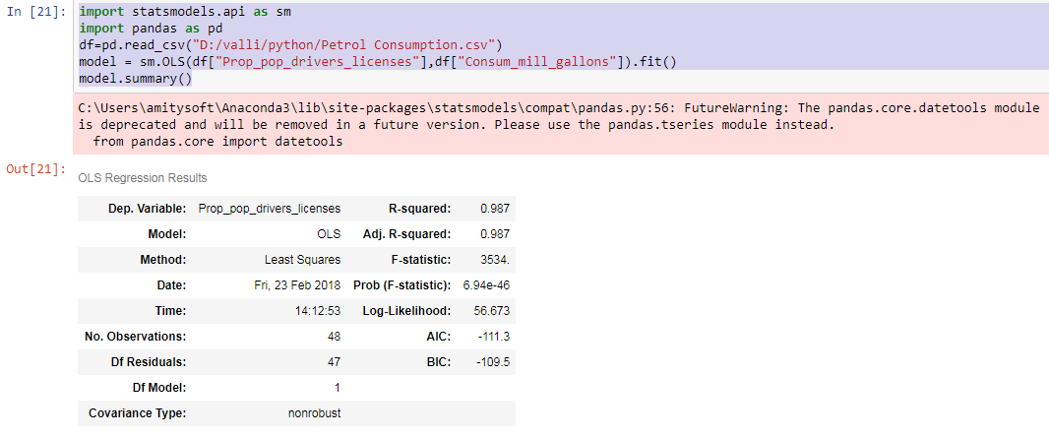
Implementation in python-SLR

Slide 25
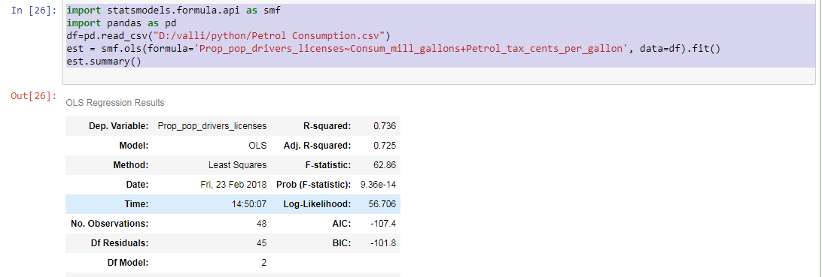
Implementation in python-MLR

Slide 26
Implementation in python-SLR
import pandas as pd
import numpy as np
import statsmodels.formula.api as smf
labels=('in_num','num_burger')
row1=(566, 444, 454, 440, 760, 881, 1091, 783, 666, 564, 750,
650, 1054, 1245, 616, 564, 652, 704, 683, 1125, 1294, 676, 557, 568,
450, 748, 1371, 1297, 615, 568)
row2=(2728, 2098, 2111, 2009, 3635, 4171, 5244, 3695, 3088, 2674,
3591, 3013, 5045, 6118, 2851, 2698, 3015, 3409, 3179, 5510, 6232,
3211, 2582, 2710, 2115, 3515, 6665, 6239, 2862, 2665)
df = pd.DataFrame(np.array((row1,row2)))
df=df.transpose()
df.columns=labels
print(df)
bur_reg=smf.ols(formula='num_burger~in_num',data=df).fit()
bur_reg.summary()

Slide 27
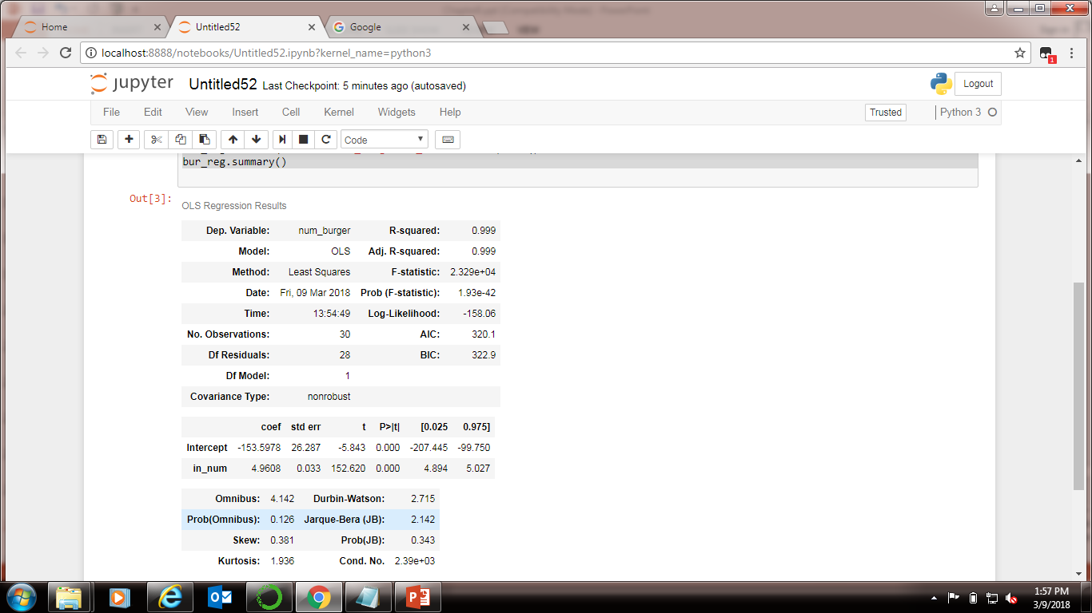
Implementation in python-SLR

Slide 28
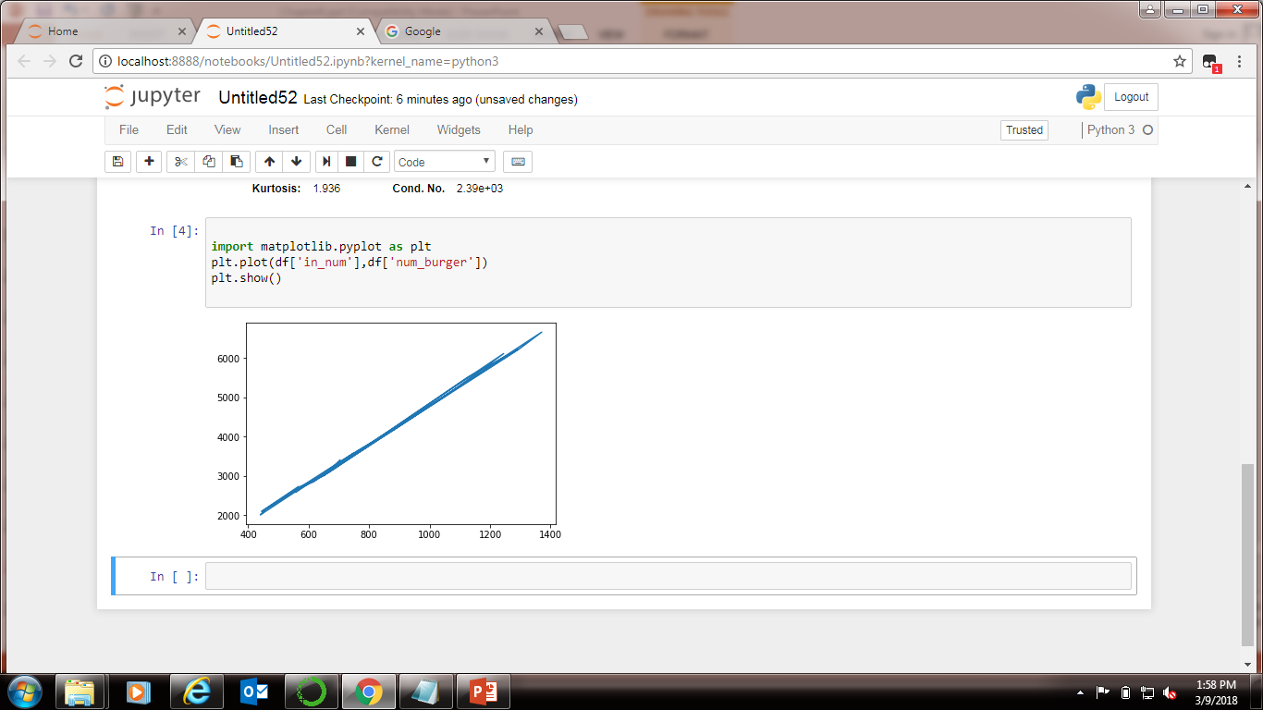
Implementation in python-Scatter plot
import matplotlib.pyplot as plt
plt.plot(df['in_num'],df['num_burger'])
plt.show()

Slide 29
Implementation in python-VIF
import pandas as pd
import numpy as np
from patsy import dmatrices
import statsmodels.api as sm
from statsmodels.stats.outliers_influence import variance_inflation_factor
df = pd.read_csv('D:/valli/python/Petrol Consumption.csv')
df.dropna()
df = df._get_numeric_data() #drop non-numeric cols
df.head()
df = df[['Prop_pop_drivers_licenses','Consum_mill_gallons', 'Petrol_tax_cents_per_gallon']].dropna()

Slide 30
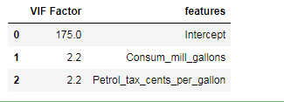
Implementation in python-VIF
y, X = dmatrices('Prop_pop_drivers_licenses ~ Consum_mill_gallons + Petrol_tax_cents_per_gallon', df, return_type='dataframe')
vif = pd.DataFrame()
vif["VIF Factor"] = [variance_inflation_factor(X.values, i) for i in range(X.shape[1])]
vif["features"] = X.columns
vif.round(1)

Slide 31
Summary
Learnt
→Basics of linear regression
→ types of linear regression
→ efficiency of a Linear regression model
→ implementation of linear regression in python

Slide 32
Thank You

