Slide 1
NORMALIZATION

Slide 2
Types of Normalization
First Normal Form (1NF)
Second Normal Form (2NF)
Third Normal Form (3NF)
Boyce and Codd Normal Form (BCNF)
Fourth Normal Form (4NF)
Fifth Normal Form (5NF)

Slide 3
BCNF: It stands for Boyce Codd Normal form, which is the next version of 3NF. Sometimes, it is also pronounced as 3.5 NF. A normal form is said to be in BCNF if it follows the given conditions:
A table or relation must be in 3NF.
If a relation R has functional dependencies (FD) and if A determines B, where A is a super Key, the relation is in BCNF

Slide 4
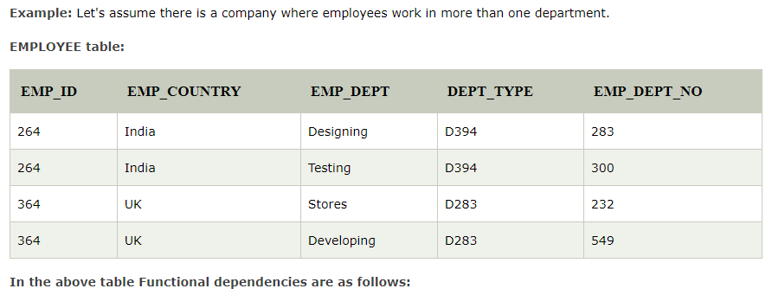

Slide 5
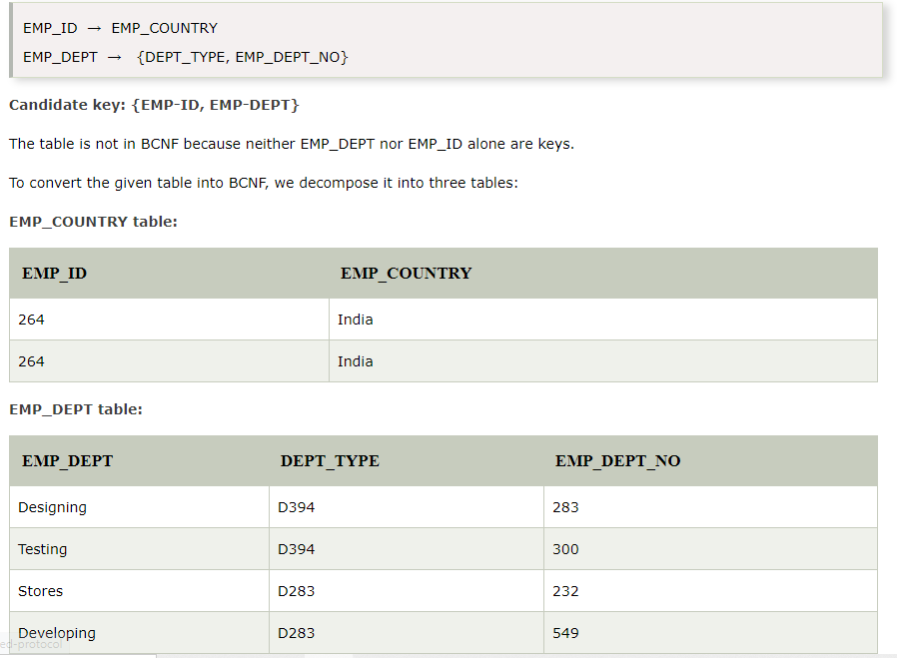

Slide 6
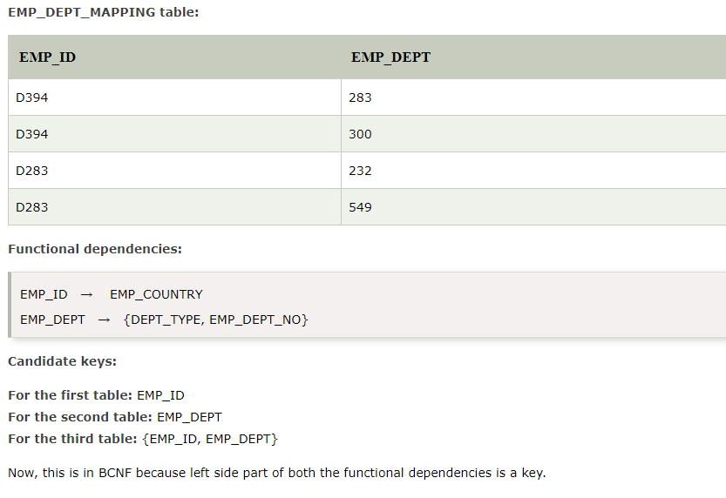

Slide 7
Fourth Normal Form (4 NF): A relation is said to be Fourth Normal Form (4NF) if it follows the given conditions:
A table must be in BCNF.
There should be no multivalued dependency in the table.
For example, if the dependency A -> B, for a single value of A, more than one value of B exists. Then the relation is said to be a multivalued dependency.
Following is the condition for being multivalued dependency:
For a multivalued dependency A -> B, for a single value of A, there are multiple values of B.
If a table has at least three columns, they have a multivalued dependency.
For a relation with A, B and C columns, where B and C should be independent.

Slide 8
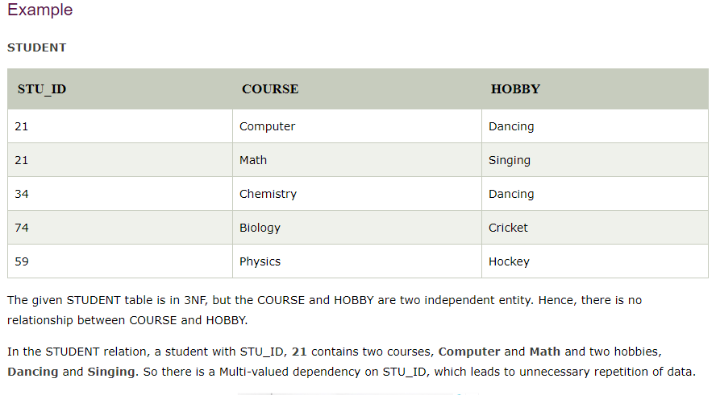

Slide 9


Slide 10
Fifth Normal Form (5 NF): A relation is said to be 5NF if it follows the given conditions:
The table should be in 4NF.
There should not be Join Dependency or further non-loss decomposed.
It is also known as Project Join Normal Form (PJNF).
Join dependency: A relation (R) is said to be a Join dependency if the relation (R) schema can be divided into smaller sets of tables R1, R2 … Rn that can be redesigned by joining multiple tables to the original table (R).

