Slide 1
ALPINE
Autonomous LPL Financial's Probabilistic Integrity & Non-compliance Elicitation
Valmik Nahata, Alexandra Maxon, Karim Barajas, Yang Yue, Arlene Garcia
Team 30
Notes:
Valmik

Slide 2
Agenda
Problem Statement
Why ALPINE?
Architecture (Data Streams)
Architecture (Mathematical Analysis & More)
Visualizations
LPL Financial's AI-Native Objectives
Future Development & Safeguards
Technology Stack & Research
Notes:
Valmik

Slide 3
Problem Statement
Notes:
Valmik

Slide 4
Problem Statement
Financial institutions faced over $4.3 billion in compliance-related fines in 2024, with studies suggesting internal misconduct is a leading driver of regulatory violations
Siloed departmental reporting systems create blind spots where 60-70% of early warning signals go undetected before escalation
Current manual review processes miss critical cross-departmental patterns, leading to delayed incident detection averaging 14-16 months post-occurrence
Fragmented compliance tools fail to unify AML monitoring, communication surveillance, and employee conduct analysis
Notes:
Valmik

Slide 5
Why ALPINE?
Notes:
Alexa

Slide 6
Why ALPINE?
Holistic risk aggregation platform integrating financial transactions, internal communications, code repositories, and HR incident data
Real-time probabilistic scoring engine using weighted multi-modal analysis across compliance domains
Automated policy violation detection aligned with FINRA Rules 3310, 3110, 2210, SEC AML requirements, and state-level regulations (DFPI, CPPA)
Proactive risk identification replacing reactive incident response workflows
Notes:
Alexa

Slide 7
Architecture
Notes:
Valmik

Slide 8
Architecture (Data Streams)
 | Source #1 | Source #2 | Source #3 | Source #4
Transaction Records | Wires | Trades | ACH | Cash
Internal Communications | Slack | Email | Teams | Phone Calls
Employee Background | BrokerCheck | Criminal History | LinkedIn | CRD
Account Activity Logs | Browser History | ChatGPT History | Authorizations | Search History
Code Documentation | GitHub | GitLab | Confluence | Jira
HR Incident Reports | Workday | ServiceNow | Hotline | Manager
Colored text represents implemented data (API integrations & 1-to-1 simulations)
Notes:
Valmik

Slide 9
Architecture (Data Streams) cont.
Transaction analysis tracks structuring behavior, velocity spikes, distribution anomalies, cross-border red flags
Communication analysis identifies collusion language, urgency indicators, coordinated activity, timing patterns
Behavioral monitoring reviews disciplinary history, access pattern changes, account modifications, reactivation events
Code & HR signals detect credential exposure, documentation gaps, complaint trends, team-level patterns
Alert routing sends critical cases (90+) to CCO, elevated cases (75-89) to active monitoring, moderate cases (60-74) to review queue
Notes:
Karim
ALPINE ingests risk signals across transactions, communications, internal behavior, and code-plus-HR indicators.
These signals are normalized into a single risk score and routed automatically — with critical cases escalated immediately, elevated cases actively monitored, and moderate cases queued for review.

Slide 10
Architecture (Mathematical Analysis & More)
High-impact roles (registered reps, managers, admins) = 3.0x weight, moderate roles (sales, operations) = 2.0x, standard = 1.0x baseline
AUM responsibility (+0.5x per $50M), prior violations (+1.5x), system privileges (+0.8x), clean 5+ year record (-0.3x)
FINRA 3310/3110/2210, SEC 17a-4, Bank Secrecy Act, DFPI, CPPA
Real-time transaction monitoring, hourly communication scans, daily regulatory reconciliation
Notes:
Karim
Risk is prioritized using a weighted scoring model that reflects role impact, assets under management, prior violations, and system privileges, with decay for long clean histories.
Monitoring runs continuously — real-time for transactions, hourly for communications, and daily for regulatory alignment.

Slide 11
Visualizations
Notes:
Valmik

Slide 12
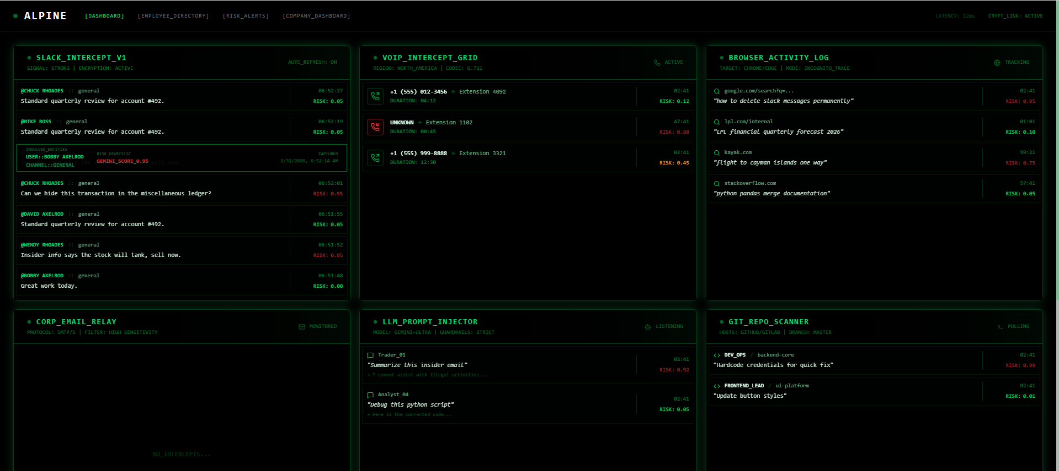
Dashboard
Insert photo
Notes:
Valmik

Slide 13
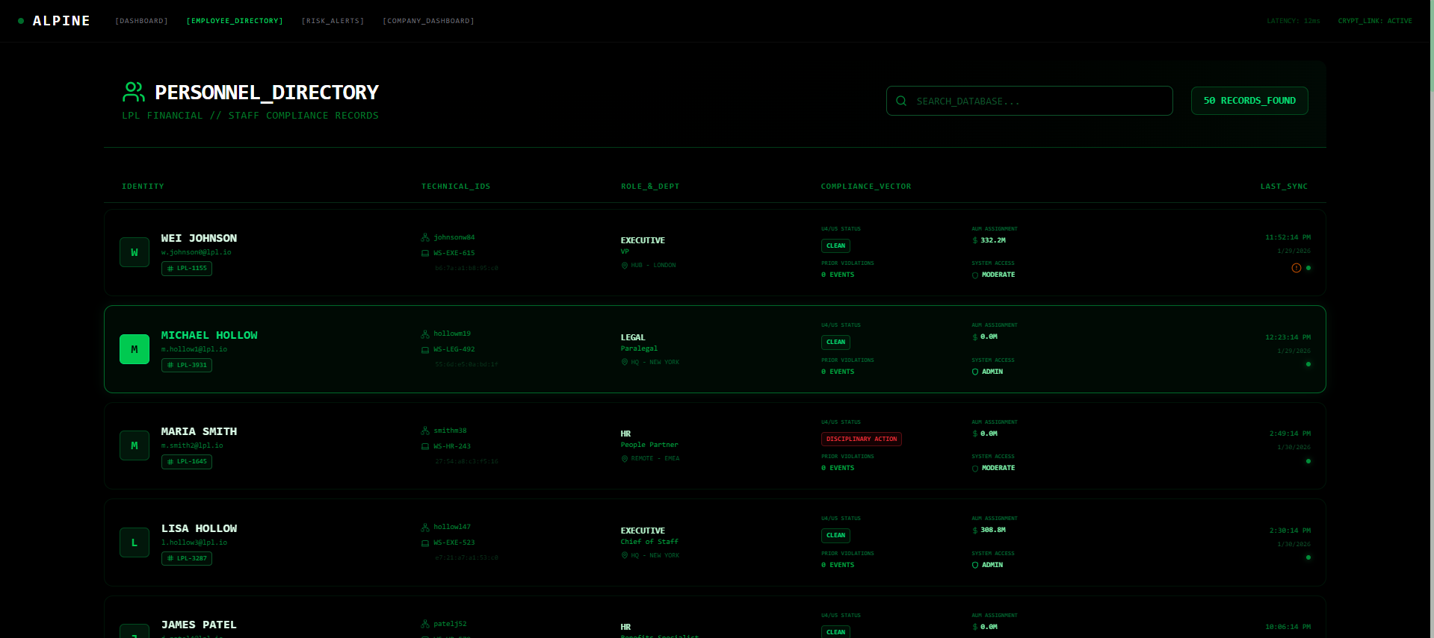
Employee / Personnel Directory
Insert photo
Notes:
Valmik

Slide 14
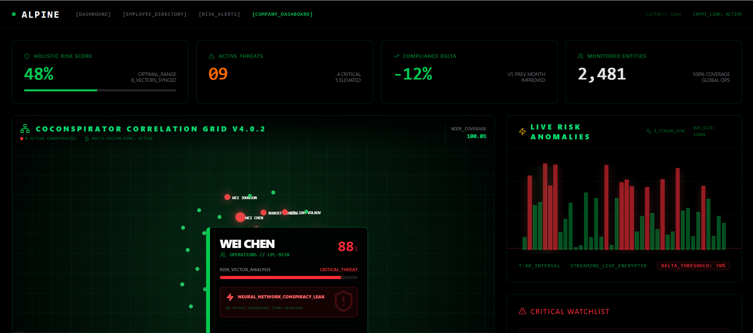
Company Dashboard / Overview
Insert photo
Notes:
Valmik

Slide 15
Dashboard and Insights
Enterprise-wide employee risk rankings updated in real-time
Relationship mapping identifies suspicious coordination patterns
Investigation files bundle all evidence with timestamps and regulatory context
Leadership reports generated automatically for disciplinary and legal review
Audit trails track each case from alert to resolution
Notes:
Karim
ALPINE provides real-time enterprise risk rankings, relationship mapping for coordinated behavior, and investigation files that automatically bundle evidence with regulatory context. Leadership reports and full audit trails ensure every case is traceable from alert to resolution

Slide 16
LPL Financial's AI-Native Objectives
Notes:
Yang

Slide 17
LPL Financial's AI-Native Objectives
Unified AI-native compliance platform connecting financial analytics, natural language processing, and code security domains
Estimated 70-85% reduction in incident detection latency through automated cross-departmental correlation
Enhanced trust framework replacing fragmented internal reporting with transparent, auditable compliance workflows
Proactive risk mitigation preventing reputational damage and regulatory penalties down the line through early intervention
Notes:
Yang

Slide 18
Future Development & Safeguards
Notes:
Alexa

Slide 19
Future Development & Safeguards
Accuracy improvements through training on resolved cases, compliance feedback loops, active learning to cut false positives
External integrations with adverse media APIs, litigation databases, credit agencies for financial distress signals
Detection expansion covers voice transcription, trading desk logs, predictive risk modeling
Regulatory scaling for international standards (MiFID II, GDPR), adjacent sectors (banking, insurance, wealth management)
Notes:
Alexa

Slide 20
Technology Stack & Research
Notes:
Valmik

Slide 21
Technology Stack & Research
AI-assisted development with GitHub Copilot, VSCode + GitHub Copilot, Cursor, Antigravity, and Kiro for accelerated prototyping
APIs & tool calls include Slack API, Gmail API, GitHub REST API, internal chat logging systems (OpenAI/Claude conversation stores), Chrome Extensions API (Browser & Search history), Gemini API, and more.
Cloud infrastructure with Amazon RDS for scalable database deployment
We received insights from current and former employees at LPL Financial, and others including, Bank of America, Morgan Stanley, and Verizon, on relevant compliance threats
Notes:
Valmik

Slide 22
Questions

