Slide 1
How can sensitivity analysis help CAT model building and forming your view of risk?
Valentina Noacco (NERC Knowledge Exchange Fellow)
Francesca Pianosi (Senior Lecturer in Water and Environmental Engineering)
Thorsten Wagener (Professor of Water and Environmental Engineering)
Department of Civil Engineering, University of Bristol, UK
[KE Fellowship: NE/R003734/1]

Slide 2




Aim of my KE Fellowship (Nov 2017 – Oct 2020)
Improving decision-making under uncertainty by transferring state-of-the-art methods for Global Sensitivity Analysis (GSA), tools (SAFE software toolbox) and expertise to the (re)insurance sector and catastrophe community.
Goal
Objectives
Partners
2017
Understand major sources of uncertainty in the insurance modelling process
2018
Demonstrate benefits of using
Global Sensitivity Analysis
(through case studies)
2019
Transfer knowledge and engage wider insurance sector
(through workshops, training material, embedding SAFE on OASIS platform, …)
2020

Slide 3
Deliverables
Developed pilot case study with actuarial team at AXA XL
Developed training material for actuaries
Delivered tutorials on GSA/SAFE use for actuaries at AXA XL and Bristol Actuarial Society
Developed pilot case studies with JBA Risk Modelling, OASIS and AXA XL on cat models
Developed training material for cat community
Delivered presentations/workshops on GSA/SAFE use at OASIS conference and at 3 major re/insurance companies
Embedding SAFE on the OASIS platform
Actuarial community
Catastrophe community
Training material available at: www.safe-insurance.uk/Outputs.html
Notes:
With the work with AXA XL I was able to reach the actuarial community, through workflows and the SAFE toolbox in R.
The PiWind case study was a proof-of-concept to demonstrate the feasibility of linking the python version of SAFE with models on the OASIS platform through a jupyter notebook. This work hopes to reach the CAT model users community, who might be interested in forming their view of risk from using 3rd party black-box models.
The case study with JBA aims to show of the validity of using GSA to other CAT developers and to demonstrate the value of using GSA to the CAT users community too.

Slide 4
Outline
What is Global Sensitivity Analysis (GSA)?
How does GSA work?
What are the main benefits of using GSA?
Examples of GSA applications from insurance and beyond
Brief tutorial on how to use the SAFE toolbox

Slide 5
What is Sensitivity Analysis and how does it compare to Uncertainty Analysis?
UA focuses on quantifying the uncertainty in a model output.
SA focuses on attributing output uncertainty to the different sources of uncertainty.
[1] Characterize uncertainty of input factors
[2] Forward
propagate
uncertainty
[3] Estimate output uncertainty
[4] Estimate
sensitivity indices
INPUT SAMPLING
CAT MODEL EXECUTION
POST PROCESSING
Vulnerability curves
Event set param.
Loss
Hazard param.
Exceedance Probability
Exposure data

Slide 6
How does it work?
[1] Characterize uncertainty of input factors
[2] Forward propagate uncertainty
[3] Estimate output uncertainty
[4] Estimate sensitivity indices
INPUT FACTORS
Event set param.
Identification of key contributors to uncertainty of output
(…)
p₁
p₂
Hazard param.
Vulnerability curves
Event set param.
(…)
Loss
p₃
p₄
CAT model execution
Hazard param.
Exposure data
Exposure data
Exceedance Probability
Vulnerability curves
[5] Open up model and revise it
Notes:
Global Sensitivity Analysis has the following main steps:
Characterize uncertainty of input factors – Inputs sampling (i.e. choose inputs whose influence on the model output will be investigated with GSA, define their range of variability or a probability distribution, sample a number of input combinations from such ranges/distributions). An input factor is any element that can be changed before running the model. It can be a continuous variable (as parameters in the event set module or hazard component) or a discrete variable (as the spatial resolution of the exposure data or the choice of vulnerability curve to use). An output instead is any variable that is obtained after the model execution.
Propagate the uncertainty forward in your model (The model is repeatedly run against each of the sampled combinations of inputs).
Uncertainty analysis – The output samples so obtained can be used to visually explore the output uncertainty (e.g. probability distribution of the losses for different return periods). This can be very informative, as often only one Exceedance Probability curve is obtained by running a CAT model.
Perform Global Sensitivity analysis – Input and output samples are quantitatively analysed in order to obtain a set of sensitivity indices. The sensitivity indices measure the relative contribution of each input factor to the output uncertainty. Post processing step (less computationally expensive than running the model), where the GSA method of choice is applied to identify the contribution of each input to the uncertainty of the output. Iin this mock example, the vulnerability curves would be the most influential input, followed by the exposure data, and then the parameters in the event set component and hazard module).
Open up your model and revise it (e.g. fix the inputs not influential to their default values (no time needs to be spent in calibrating them), invest in reducing the uncertainty of the most influential input(s), if the GSA results show any unexpected behaviour in the inputs/outputs relationship (e.g. visualised as scatterplots of inputs/output(s)) revise the relevant parts of the model/fix bugs). This step is especially important for a model developer, but might allow model users to ask meaningful questions to model vendors.
Steps 1, 3 and 4 can be performed with the SAFE software toolbox which is available in Python, R or Matlab.

Slide 7
Currently, most SA applications in re/insurance consider variations of the inputs One-At-a-Time (OAT)
With OAT SA, the input factors are varied, one at a time, by a prescribed amount (perturbation) while all others are held constant at their baseline values.
input factor x₃
input factor x₁
input factor x₂
y = f(x₁,x₂,x₃)
x₁
x₃
Tornado plot
input factors
x₂
-40 -20 0 +20 +40
variation of output y
Notes:
Local SA focuses on fixed points in the space of the input and aims to address the behaviour near parameters nominal value to safely assume local linear dependences on the parameter.
Important non-linear effects in model output might arise when parameters are interacting and when solution becomes discontinuous.

Slide 8
Currently, most SA applications in re/insurance consider variations of the inputs One-At-a-Time (OAT)
With OAT SA, the input factors are varied, one at a time, by a prescribed amount (perturbation) while all others are held constant at their baseline values.
Useful when baseline value has a clear meaning for the model user
(e.g. ‘optimal’ set-up after model calibration).
input factor x₃
input factor x₁
input factor x₂
y = f(x₁,x₂,x₃)
x₁
x₃
Tornado plot
input factors
x₂
-40 -20 0 +20 +40
variation of output y
Notes:
The OAT approach has two main disadvantages. Firstly, OAT sampling only explores a small portion of the space of variability of the input factors, especially as the number of input factors increases.
Secondly, the OAT approach cannot detect interactions between input factors, i.e. the fact that the joint perturbations of two (or more) input factors may induce larger (or smaller) output variations than the perturbation of
each individual factor.

Slide 9
SA methods using All-At-a-Time (AAT) investigate model response independently of baselines
With OAT SA, the input factors are varied, one at a time, by a prescribed amount (perturbation) while all others are held constant at their baseline values.
AAT SA investigates the effects of variation of uncertain inputs across their entire variability space, by varying all the input factors simultaneously.
input factor x₃
input factor x₃
input factor x₁
input factor x₁
input factor x₂
y = f(x₁,x₂,x₃)
input factor x₂
1
.5
0
x₁
x₃
sensitivity of output y
Tornado plot
input factors
x₂
-40 -20 0 +20 +40
x₁ x₂ x₃
variation of output y
input factors
Notes:
GSA relies on sampling based methods for uncertainty propagation and fully map the space of possible model predictions from the various model uncertain input parameters and then rank the significance of the input uncertainty contribution to the model output variability.

Slide 10
SA methods using All-At-a-Time (AAT) investigate model response independently of baselines
With OAT SA, the input factors are varied, one at a time, by a prescribed amount (perturbation) while all others are held constant at their baseline values.
AAT SA investigates the effects of variation of uncertain inputs across their entire variability space, by varying all the input factors simultaneously.
input factor x₃
input factor x₃
input factor x₁
input factor x₁
input factor x₂
y = f(x₁,x₂,x₃)
input factor x₂
1
.5
0
x₁
The sensitivity to each inputs factor considers the direct influence of that input as well as the joint influence due to interactions.
x₃
sensitivity of output y
Tornado plot
input factors
x₂
-40 -20 0 +20 +40
x₁ x₂ x₃
variation of output y
input factors
Notes:
GSA relies on sampling based methods for uncertainty propagation and fully map the space of possible model predictions from the various model uncertain input parameters and then rank the significance of the input uncertainty contribution to the model output variability.

Slide 11
What are the main benefits of using GSA?
Allows to identify most influential input factors:
Where is the acquisition of new data going to be most useful?
Which parameters should be the focus of a more detailed calibration?
What is the impact of different modelling choices?
Supports model validation
How does the model behave when run beyond the default set-up?
Do the outputs respond to input variations as expected and physically reasonable?
Pianosi et al 2016, Environmental Modeling & Software (open access)
Wagener and Pianosi, 2019, Earth-Science Reviews (open access)

Slide 12
Application to JBA’s Global Flood Model
Input factors considered:
Vulnerability function
Buffer size
Number of disaggregation points
Notes:
Disclaimer:
Here we are using an early development version of JBA’s Global Flood Model. This is a proof of concept only, and the results shown should not be considered exemplificative of JBA’s Global Flood Model version for release.
In this case study the inputs are:
- vulnerability function (different number of steps are considered, discrete variable). For the purpose of this work basic vulnerability curves were chosen, but the model supports vulnerability curves of any level of detail deemed appropriate.
- buffer size (radius [m] of a circular buffer from which a flood depth is extracted from the flood map for damage calculations)
- number of disaggregation points (number of points into which aggregate exposure data is disaggregated, we started with country level aggregate data and used Global Exposure Dataset to disaggregate)

Slide 13
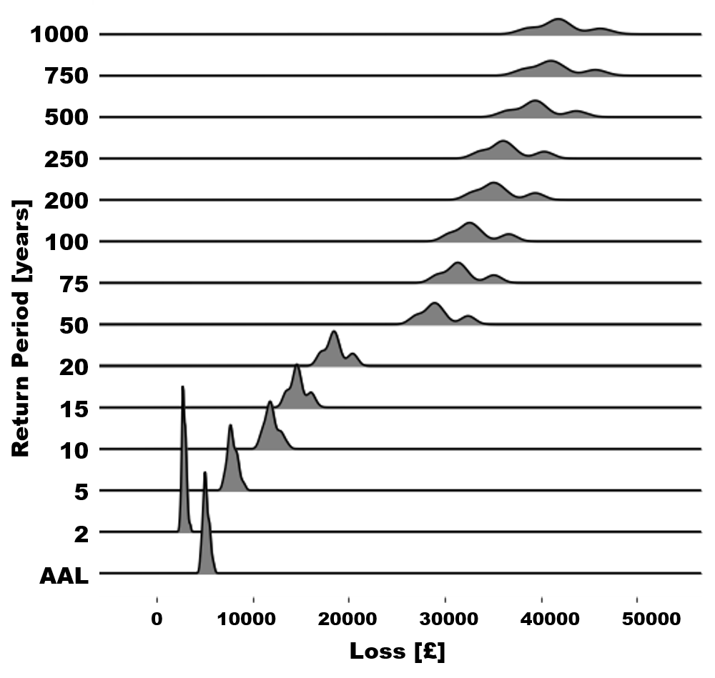
Application to JBA’s Global Flood Model
Input factors considered:
Vulnerability function
Buffer size
Number of disaggregation points
Before
They used predefined distributions to inform uncertainty.
Now
They can estimate the output uncertainty based on the inputs factors’ ranges of variability they think are sensible.
Notes:
How does the distribution of your losses vary by return period?
PLOT – distribution of losses from the 100 runs of the model each with different parameters, varied by SAFE within the ranges we’ve set.
What JBA says:
We can now much more easily use data from sensitivity analysis to inform uncertainty rather than predefined distributions

Slide 14
Application to JBA’s Global Flood Model
Input factors considered:
Vulnerability function
Buffer size
Number of disaggregation points
Before
They used predefined distributions to inform uncertainty.
Now
They can estimate the output uncertainty based on the inputs factors’ ranges of variability they think are sensible.
GSA allows to increase our understanding of the model beyond default set-up
Notes:
How does the distribution of your losses vary by return period?
PLOT – distribution of losses from the 100 runs of the model each with different parameters, varied by SAFE within the ranges we’ve set.
What JBA says:
We can now much more easily use data from sensitivity analysis to inform uncertainty rather than predefined distributions

Slide 15
Application to JBA’s Global Flood Model
Input factors considered:
Vulnerability function
Buffer size
Number of disaggregation points
Before
They used predefined distributions to inform uncertainty.
Now
They can estimate the output uncertainty based on the inputs factors’ ranges of variability they think are sensible.
For higher return periods
losses increase,
as well as their uncertainty.
Notes:
How does the distribution of your losses vary by return period?
PLOT – distribution of losses from the 100 runs of the model each with different parameters, varied by SAFE within the ranges we’ve set.
What JBA says:
We can now much more easily use data from sensitivity analysis to inform uncertainty rather than predefined distributions

Slide 16
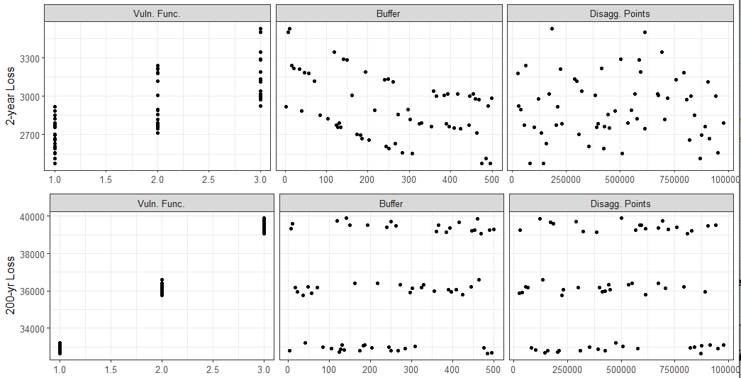
Application to JBA’s Global Flood Model
We can visually inspect the relationships between input factors and the losses for the return periods we are most interested in.
And check if they meet our expectations.
Notes:
What JBA says:
Can explore relationships between a range of values within a parameter and loss – can be done now if you run and plot many times, but SAFE automates the sampling from the range of values and produce accessible outputs for quick decision making.
Example: for this geographical location and specific portfolio, increasing the buffer size reduces the AAL and 2-year loss, but has little impact on the 200-year loss.
Can test which parameters have the biggest impact on loss for the part of the EP curve you’re most interested in.

Slide 17
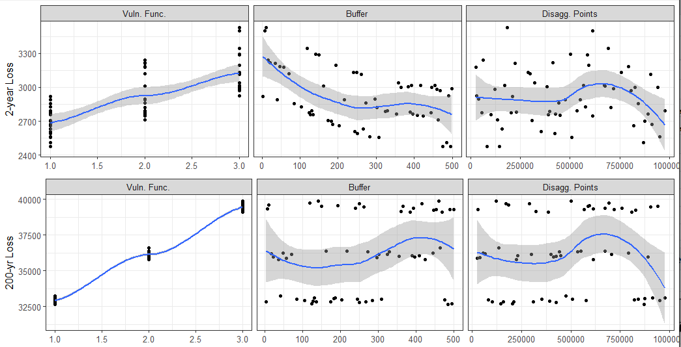
Application to JBA’s Global Flood Model
An input is influential when its pattern varies across the x-axis.
The shape of the vulnerability function strongly conditions the output for both return periods.
The buffer size is more influential for the 2year-loss.
Notes:
What JBA says:
Can explore relationships between a range of values within a parameter and loss – can be done now if you run and plot many times, but SAFE automates the sampling from the range of values and produce accessible outputs for quick decision making.
Example: for this geographical location and specific portfolio, increasing the buffer size reduces the AAL and 2-year loss, but has little impact on the 200-year loss.
Can test which parameters have the biggest impact on loss for the part of the EP curve you’re most interested in.

Slide 18
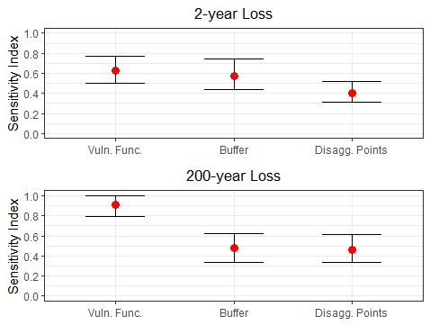
Application to JBA’s Global Flood Model
GSA allows to automatically estimate the most influential inputs.
The most influential input factors vary with the RP.
If the 200-year loss is of interest, special focus should be given to the vulnerability function.
Notes:
There are some assumptions and choices that are hard coded in the modelling chain, but now they know what to focus on, as they were able to explore in a structured way how varying multiple inputs at the same time impacts the output.
Plots show a sensitivity index on the Y axis, and each parameter on the X. 1 is very sensitive, 0 makes no impact at all.
JBA says:
Can produce plots like this to answer questions such as:
Which parameter are the losses to our portfolio most sensitive?
Does the dominant parameter vary by return period?
Are there any parameters which have no impact and therefore warrant little attention?

Slide 19
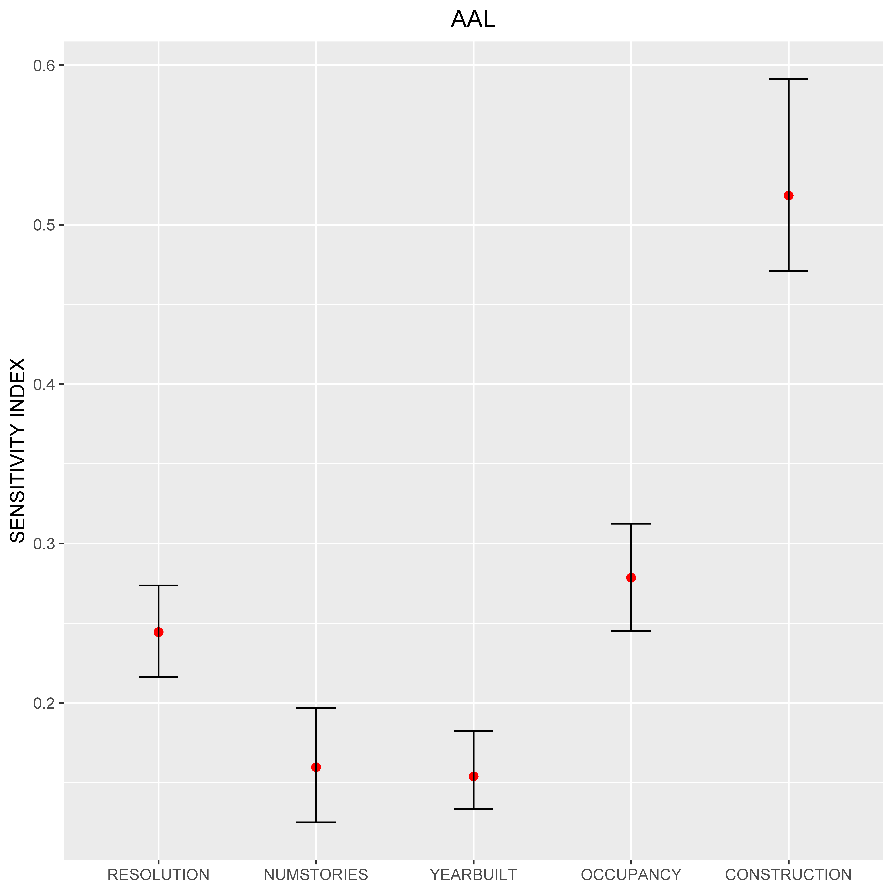
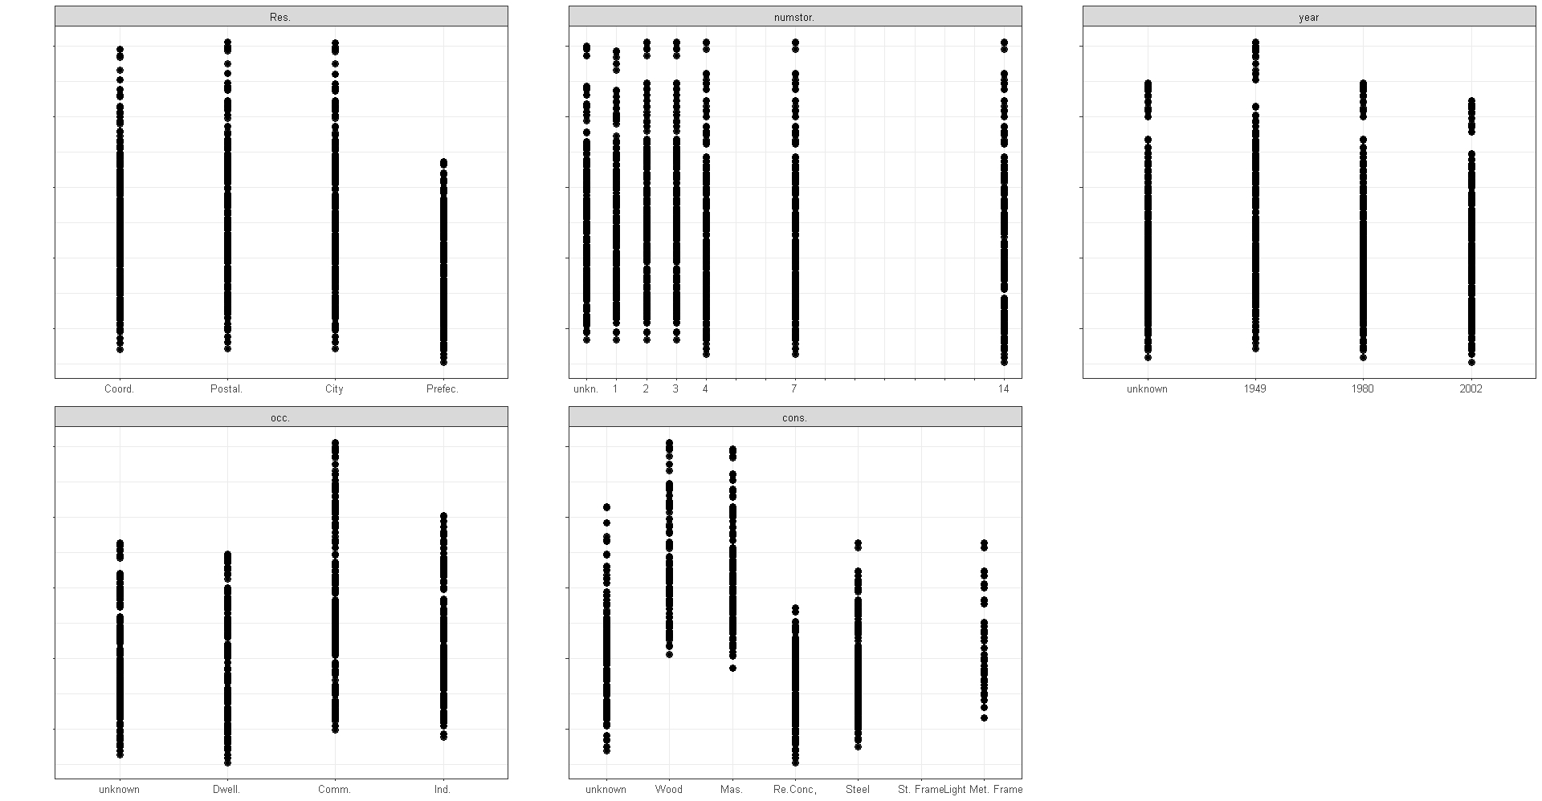
Application with AXA XL on a 3rd party wind peril model
AAL
RESOLUTION
NUM. STORIES
YEAR BUILT
Investments to reduce uncertainty should focus on collecting better construction data.
AAL
Coord. Postal City Prefec.
Unkn.
1
2
3
4
7
14
Unkn. 1949 1980 2002
OCCUPANCY
CONSTRUCTION
AAL
Unkn. Dwell. Comm. Ind.
Unkn.
Wood
Mas.
Re Conc.
Steel
Light Met. Frame
RESOLUTION NUMSTORIES YEARBUILT OCCUPANCY CONSTRUCTION
Notes:
Spatial resolution was thought to be the most influential input factor, while if you want to invest in higher resolution data, for this peril and region, there is no point to get at higher resolution than City.

Slide 20
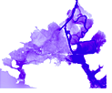
Application to a flood inundation model
Savage et al. 2016 Water Resources Research
Input factors
Forcing Hydrograph
Channel friction
Floodplain friction
Spatial resolution
DEM
Input datasets,
parameters and
GSA can be applied to a range of input factors,
Both continuous and discrete
modelling choices

Slide 21
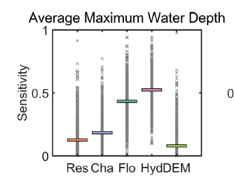
Application to a flood inundation model
Savage et al. 2016 Water Resources Research
Sensitivity index
Input factors
The forcing hydrograph being the most influential validates our understanding of the model.
Forcing Hydrograph
Channel friction
Floodplain friction
Spatial resolution
DEM
Input datasets,
parameters and
modelling choices
Notes:
The fact that the boundary conditions are influential for the AMWD is intuitive as the volume of water that enters the basin directly influences the volume of water available to inundate the floodplain especially for a large flood event where out of bank flow is inevitable.
It is also intuitive that the floodplain friction parameter is influential for AMWD, as by having a larger friction force the velocity of flood water on the floodplain is reduced, which allows water to build up, increasing water depths.
The effect of the spatial resolution and DEM resampling is shown to be relatively unimportant for AMWD, meaning that any variations on a local scale are cancelled out when average out over the whole domain, indicating that there are no large-scale variations in conveyance between the different resolutions and DEMs.

Slide 22
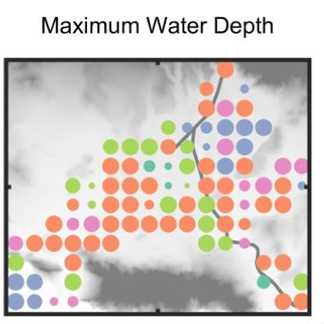
Application to a flood inundation model
Savage et al. 2016 Water Resources Research
Input factors
Modelling choices become influential when looking at individual locations.
Forcing Hydrograph
Channel friction
Floodplain friction
Spatial resolution
DEM
Input datasets,
parameters and
modelling choices
Notes:
It shows that there is large spatial variability in the classification of the most influential input factor. Although spatial resolution and choice of DEM are not highly influential when water depths are averaged over the whole domain, we find these factors to be more influential in many areas when assessing individual locations. The spatial resolution of the model is most commonly ranked as the most influential factor
across the basin. One reason for this could be a result of differences in the representation of floodplain features and embankments at different spatial resolutions.
Furthermore, an extreme difference in the elevation between neighboring cells could alter flow pathways that would significantly affect local inundation patterns. Over the whole domain, however, this effect is averaged out across the cells, which is why we do not see similar influence of spatial resolution for the spatially lumped outputs.
This shows that if a decision maker is concerned with water depths at a specific location then the spatial resolution and DEM becomes very important.
However, despite this, there are still locations in the flood domain where the influence of parametric and boundary condition uncertainty overcomes the local surface.

Slide 23
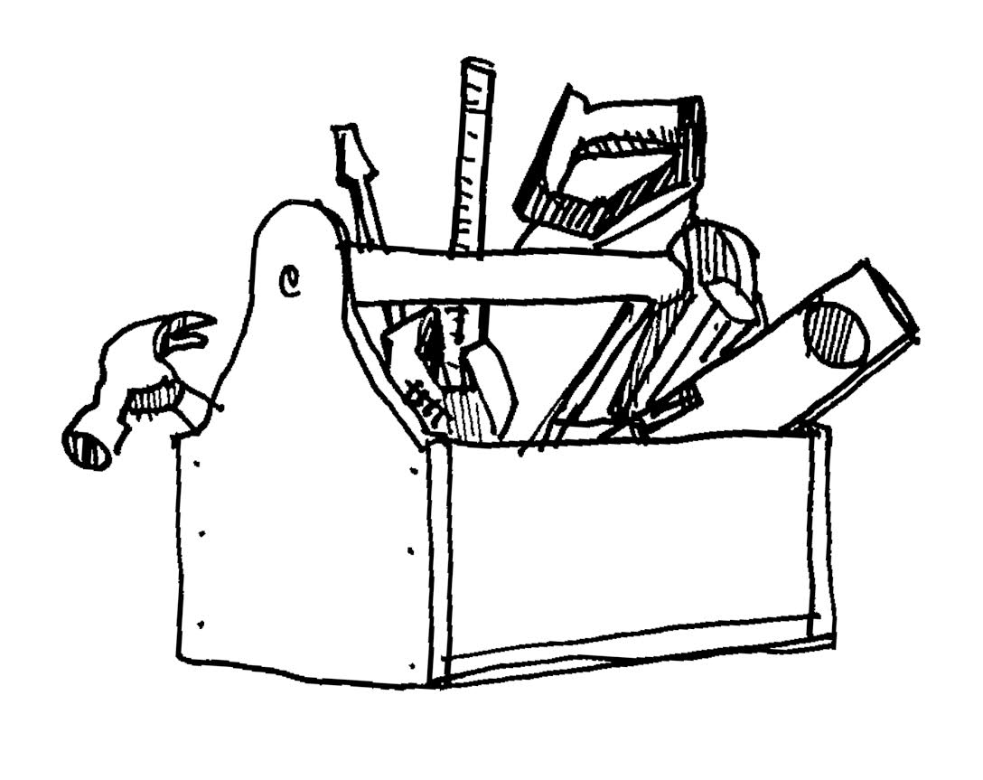
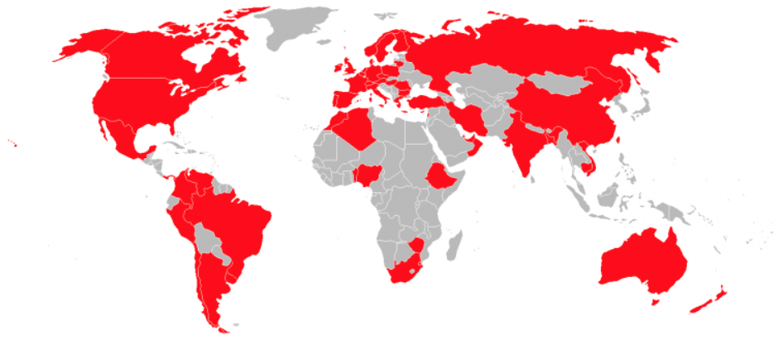
The SAFE toolbox
Developed in 2014 by Pianosi et al.
Over 2000 users in academia in 50+ countries
Python, R and Matlab versions available
Easy to use, flexible, modular structure, easy to integrate with models running outside Python, R or Matlab
Open access and open source
Variety of case studies available
Many visualisation functions
Lots of commented code and workflows
www.safetoolbox.info

Slide 24

The modular structure of SAFE enables easy coupling to stand-alone models
GSA steps
folders in SAFE Toolbox
 | X
1
2
…
N
 | 1 | 2 | … | M
sampling
AAT_Sampling.m OAT_sampling.m lhcube.m
lhcube_shrink.m
lhcube_extend.m
input samples
Characterize uncertainty of input factors
Forward propagate uncertainty
Model execution can be done outside SAFE
 | Y
1
2
…
N
 | 1 | … | P
output samples
Elementary Effects Test
EET
EET_indices.m EET_plot.m EET_convergence.m
Estimate sensitivity indices
Regional Sensitivity Analysis
RSA
VBSA
VBSA_indices.m VBSA_convergence.m VBSA_resampling.m
 | S
1
…
P
 | 1 | 2 | … | M
Variance-Based Sensitivity Analysis
sensitivity indices
…
Notes:
There is a folder with visualisation functions and there are workflow scripts for each GSA method with guides you through the steps to apply for a method to an example model.

Slide 25
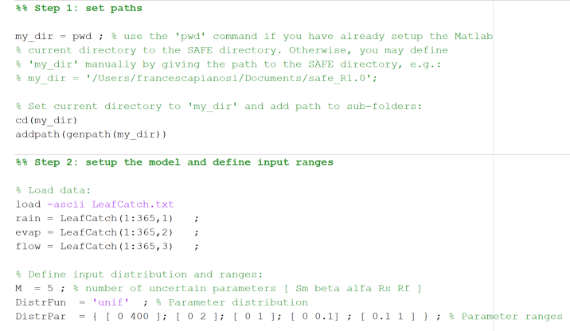

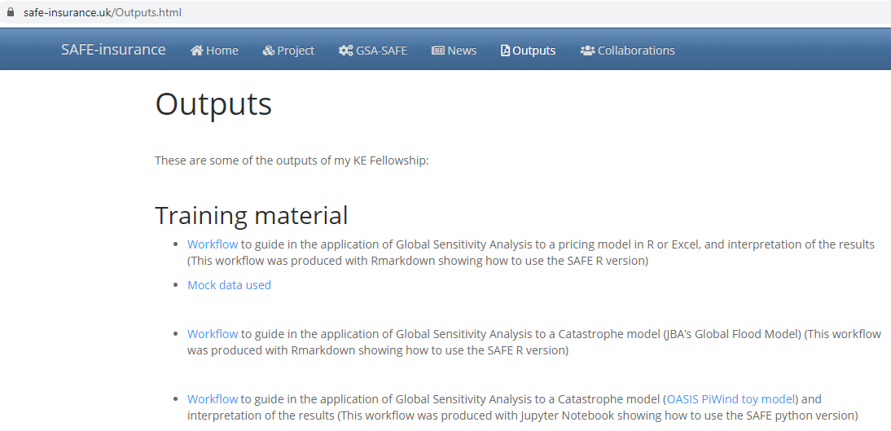
Resources available
Inside SAFE toolbox (no manual, documentation embedded in scripts as comments, workflow scripts guide you through the steps to perform GSA)
SAFE Toolbox website www.safetoolbox.info (FAQ page contains explanations, references and code to answer common questions)
My website www.safe-insurance.uk (Outputs page contains re/insurance case studies + code)

Slide 26
References
Review papers to get started:
Pianosi et al. 2016 Sensitivity analysis of environmental models: A systematic review with practical workflow. Environmental Modelling and Software, 79 (https://doi.org/10.1016/j.envsoft.2016.02.008)
Wagener and Pianosi 2019 What has Global Sensitivity Analysis every done for us? … Earth-Science Reviews, 194 (https://research-information.bris.ac.uk/ws/portalfiles/portal/189945689/Wagener_Pianosi_ESR_11.pdf)
Technical guidelines:
Noacco et al. 2019 Matlab/R workflows to assess critical choices in Global Sensitivity Analysis using the SAFE toolbox. MethodsX (https://doi.org/10.1016/j.mex.2019.09.033)
Introduction to the SAFE toolbox:
Pianosi et al. 2015 A Matlab toolbox for Global Sensitivity Analysis. Environmental Modelling and Software. 70 (https://doi.org/10.1016/j.envsoft.2015.04.009)
Examples:
Savage et al. 2016 Quantifying the importance of spatial resolution and other factors through global sensitivity analysis of a flood inundation model. Water Resources Research. 52 (https://doi.org/10.1002/2015WR018198)

Slide 27
Appendix

Slide 28
GSA allows to achieve different objectives
Ranking
Which input factors have more influence on the model’s response?
Screening
Is there any input factor that has negligible influence on the model’s response?
Model inputs
Model inputs
Then possible SA methods:
Regional Sensitivity Analysis
Elementary Effects
Variance Based
Then possible SA methods:
Elementary Effects
Variance Based
Sensitivity Index
Sensitivity Index
x1 x2 x3 x4 x5
x1 x2 x3 x4 x5
→ x₃ > x₅ > x₄ > x₁ > x₂
→ x₂ non influential
Mapping
Are there subranges of the input factors that map into “significant” (e.g. extreme) output values?
Input factors
Model output
Then possible SA methods:
Regional Sensitivity Analysis
Classification and Regression Trees
x₁ x₂ x₃ x₄ x₅
Output (e.g. flood depth) above a threshold
→ specific subranges of the inputs give a flood depth above a threshold

Slide 29
Classification of GSA methods
SA purpose
Sampling approach
Screening
Ranking
Mapping
Type of SA
~M
Perturbation & derivatives
LOCAL
One At the Time
(OAT)
Multiple-starts perturbation
EET
~10-100 x M
DELSA
Monte-Carlo filtering
RSA
>100 x M
Correlation & Regression Analysis
CC,PCC, SRCC, PRCC,CCA
Number of model evaluations
CART
GLOBAL
LR (SRC)
All At the Time (AAT)
Variance- based
&
Density- based
eFAST , FAST
>1000 x M
entropy-based,
δ-sensitivity,
PAWN
VBSA
M: number of input factors

