Slide 1
How can sensitivity analysis help CAT model building and forming your view of risk?
Valentina Noacco (NERC Knowledge Exchange Fellow)
Francesca Pianosi (Lecturer in Water and Environmental Engineering)
Thorsten Wagener (Professor of Water and Environmental Engineering)
Department of Civil Engineering, University of Bristol
[KE Fellowship: NE/R003734/1]

Slide 2
Topics
What is Global Sensitivity Analysis (GSA)?
What can you use GSA for?
How does GSA work?
Examples of benefits of using GSA

Slide 3
What is Sensitivity Analysis? and how does it compare to Uncertainty Analysis?
UA focuses on quantifying the uncertainty in a model output.
SA focuses on attributing output uncertainty to the different sources of uncertainty.
[1] Characterize uncertainty of input factors
[2] Forward propagation of uncertainty
[3] Uncertainty Analysis
[4] Sensitivity Analysis
INPUT SAMPLING
CAT MODEL EXECUTION
POST PROCESSING
Vulnerability curves
Event set param.
Loss
Hazard param.
Exceedance Probability
Exposure data

Slide 4
What can you use SA for?
To increase understanding of the model, beyond default set-up (validation)
Is the relationship between model inputs and outputs as expected? Any odd behaviour?
To identify priorities for uncertainty reduction (improvement)
What do I need to make it more robust?
To support decision-making (use)
Improve communication between modellers and decision-makers
Pianosi et al 2016, Environmental Modeling & Software
Wagener and Pianosi, 2019, Earth-Science Reviews

Slide 5
How does it work?
[1] Characterize uncertainty of input factors
[2] Forward propagation of uncertainty
[3] Uncertainty Analysis
[4] Sensitivity Analysis
INPUT FACTORS
Event set param.
Identification of key contributors to uncertainty of output
(…)
p₁
p₂
Hazard param.
Vulnerability curves
Event set param.
(…)
Loss
p₃
p₄
CAT MODEL
Hazard param.
Exposure data
Exposure data
Exceedance Probability
Vulnerability curves
[5] Open up model and revise it

Slide 6
What is the difference between Local and Global SA?
Local SA investigates the effects of variation of uncertain inputs from a baseline point
input factor x₃
input factor x₁
input factor x₂
y = f(x₁,x₂,x₃)
x₁
x₃
input factors
x₂
-40 -20 0 +20 +40
variation of output y

Slide 7
What is the difference between Local and Global SA?
Local SA investigates the effects of variation of uncertain inputs from a baseline point
Useful when you have a clear baseline point and are only interested in what happens for small deviations from it
input factor x₃
input factor x₁
input factor x₂
y = f(x₁,x₂,x₃)
x₁
x₃
input factors
x₂
-40 -20 0 +20 +40
variation of output y

Slide 8
GSA investigates model response independently of baselines
Local SA investigates the effects of variation of uncertain inputs from a baseline point
Global SA investigates the effects of variation of uncertain inputs across their entire variability space
input factor x₃
input factor x₃
input factor x₁
input factor x₁
input factor x₂
y = f(x₁,x₂,x₃)
input factor x₂
1
.5
0
x₁
x₃
sensitivity of output y
input factors
x₂
-40 -20 0 +20 +40
x₁ x₂ x₃
variation of output y
input factors

Slide 9
GSA investigates model response independently of baselines
Local SA investigates the effects of variation of uncertain inputs from a baseline point
Global SA investigates the effects of variation of uncertain inputs across their entire variability space
Useful when there is no specific baseline but one is interested in exploring the model response against different combinations of inputs
input factor x₃
input factor x₃
input factor x₁
input factor x₁
input factor x₂
y = f(x₁,x₂,x₃)
input factor x₂
1
.5
0
x₁
x₃
sensitivity of output y
input factors
x₂
-40 -20 0 +20 +40
x₁ x₂ x₃
variation of output y
input factors

Slide 10
EXAMPLes of using GSA

Slide 11
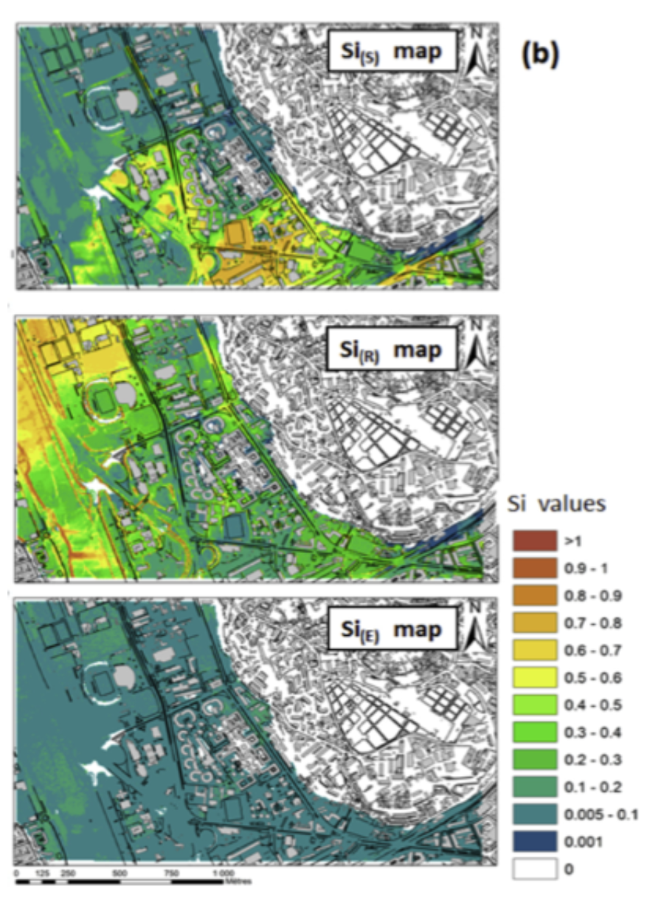
GSA can help to prioritise efforts to reduce uncertainty
Input:
Output: water depth
Application to a flood inundation model
1. Level of details in representing above ground features
Abily et al. 2016 Environmental Modeling & Software
2. Spatial resolution
3. Measurement errors in topographic data
Notes:
Modeller choices (first two figures) are overall much more important than measurement errors in this particular case.

Slide 12
GSA can help to prioritise efforts to reduce uncertainty
Input:
Output: water depth
Application to a flood inundation model
1. Level of details in representing above ground features
Abily et al. 2016 Environmental Modeling & Software
2. Spatial resolution
No need to worry about measurement errors here
3. Measurement errors in topographic data
Notes:
Modeller choices (first two figures) are overall much more important than measurement errors in this particular case.

Slide 13
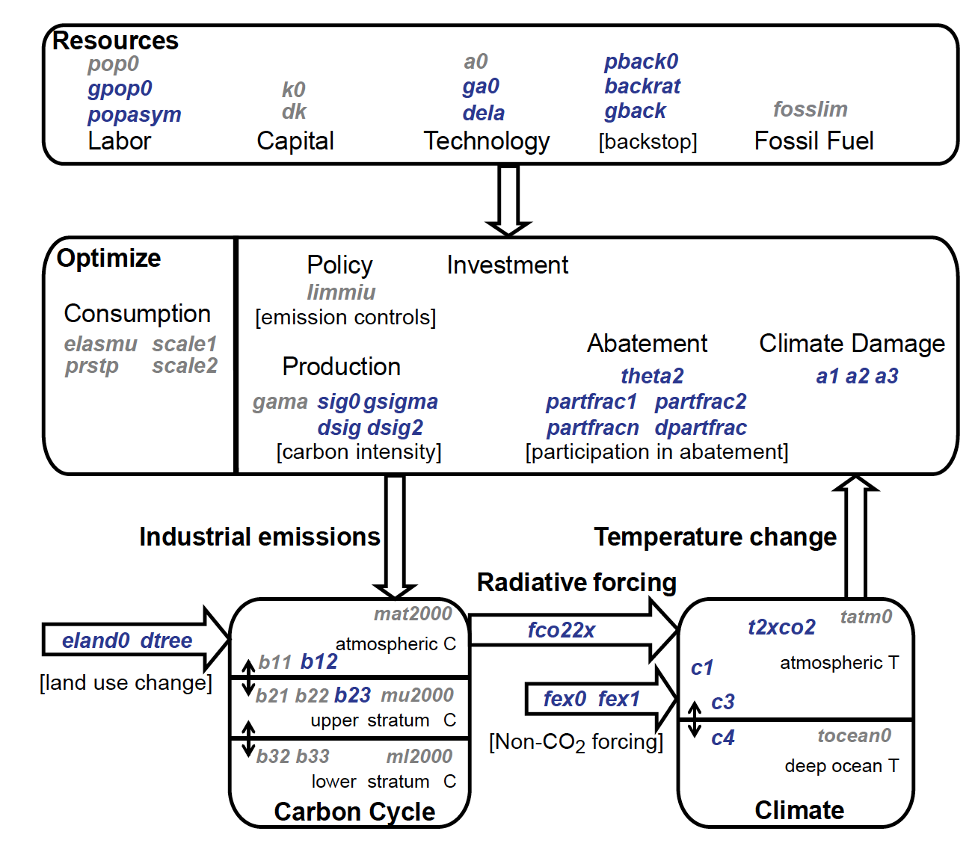
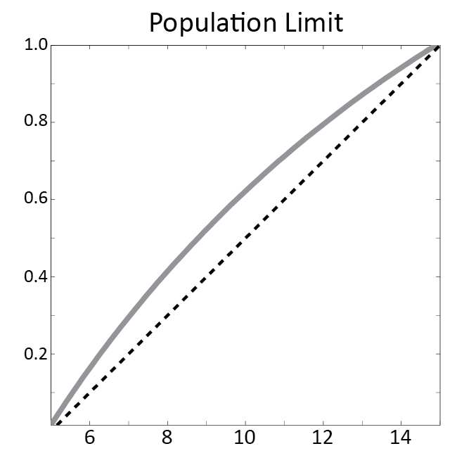
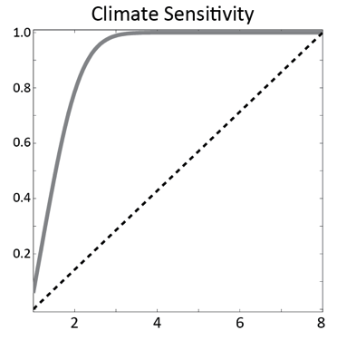
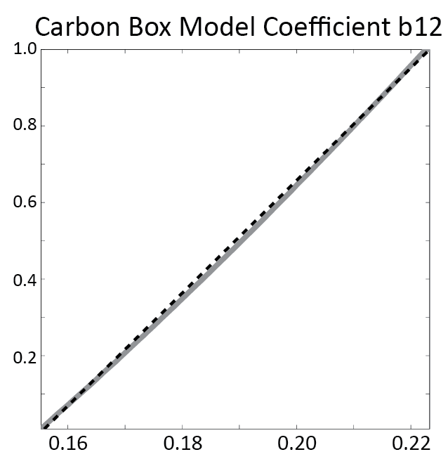
GSA can help to understand which input values lead to ‘significant’ outputs
Butler et al. 2014 Environmental Modeling & Software
Application to an integrated assessment model of climate change
Model runs producing global temperature increase < 2°C (17%)
Population growth param.
Model runs producing global temperature increase > 2 °C
Climate sensitivity param.
Carbon cycle model param.
Notes:
IAMs seek to inform our understanding of the coupled natural and economic systems that shape mitigation and adaptation decisions.
Only 17% of simulations led to the output of interest (< 2 degrees), which it’s also an input not on our control (exchange between the earth system and the atmosphere), unlike population growth and emissions, therefore it means that either the models is not suitable for its purpose (inputs under control of decision maker not influential), or that not matter how we act we won’t be able to reduce increase below 2 degrees.

Slide 14
GSA can help to understand which input values lead to ‘significant’ outputs
Butler et al. 2014 Environmental Modeling & Software
Application to an integrated assessment model of climate change
Model runs producing global temperature increase < 2°C (17%)
Population growth param.
Model runs producing global temperature increase > 2 °C
Climate sensitivity param.
Carbon cycle model param.
Range of values leading to below 2°C increase
Notes:
IAMs seek to inform our understanding of the coupled natural and economic systems that shape mitigation and adaptation decisions.
Only 17% of simulations led to the output of interest (< 2 degrees), which it’s also an input not on our control (exchange between the earth system and the atmosphere), unlike population growth and emissions, therefore it means that either the models is not suitable for its purpose (inputs under control of decision maker not influential), or that not matter how we act we won’t be able to reduce increase below 2 degrees.

Slide 15
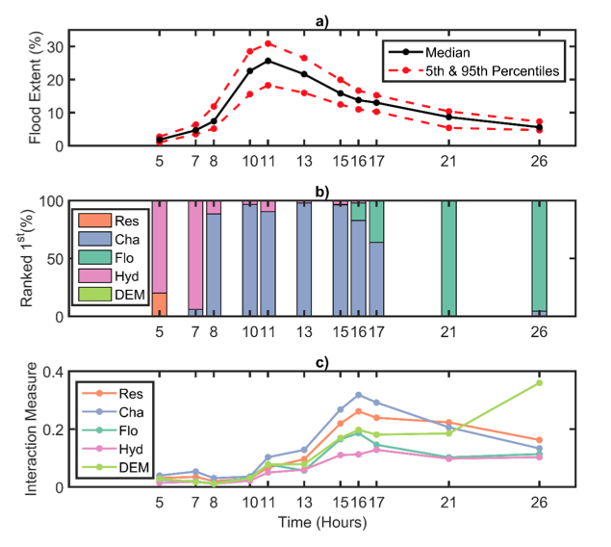
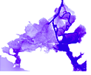
GSA can be used to test models and inform decision-making
Application to a flood inundation model
Savage et al. 2016 Water Resources Research
Uncertainty in predicted flood extent (% of cells where water depth >0.10 m)
Spatial resolution
Channel friction
Floodplain friction
Forcing Hydrograph
DEM
30
Median 90% confidence interval
20
Flood extent (%)
10
0
5
10
15
21
26
time (hours)
Most important contributors to flood extent uncertainty
100
Ranked 1st (%)
50
0
5
10
15
21
26
time (hours)
Notes:
a) from 52,500 model realisations.
b) Proportion of bootstrap resamples where an input factor was ranked most influential at each timeslice.
Flood extent is a spatially lumped output: % cells flooded
Uncertainty in the prediction of flood extent through time: median with 90% confidence interval
Below we see through time the 2 most influential input factors on the flood extent uncertainty (as the proportion of bootstrap resamples where an input factor was ranked most influential at each time slice):
We can see that at the beginning (during rising limb) the most influential factor is the forcing hydrograph (i.e. boundary condition), while as the flood extent increases the channel friction becomes the most influential factor (during peak flood inundation). This remains the case until the flood wave is almost fully receded at which point the floodplain friction parameter becomes the most influential factor (during drying phase).
The channel friction is ranked the most influential for the majority of time slices. This is because once bankfull discharge is reached, the channel friction parameter has the most influence on how quickly water is routed onto the floodplain and therefore affects the rate of floodplain inundation,
whereas the boundary conditions are more influential on the maximum limit that floods will spread to within the domain and how quickly bankfull discharge is reached as these are controlled by the volume of water available to flood.
The fact that the influence of Manning’s roughness coefficients changes during a flood event indicates that it may be important for future studies to allow these parameters to be either time or depth varying parameters.
The variation in the most influential factor through time, from the boundary conditions to the channel friction
and finally to floodplain friction, indicates that if a decision maker is interested in the dynamics of inundation
through the passage of the flood wave then they should carefully consider each of these uncertainties.
It is important to note that the variation in modeled flood extent at the end of the flood event is smaller than the variation during the peak of the flood.
However, the influence of floodplain friction on the recession of floodwaters could still be of interest for emergency planners who may be concerned with
quantifying the uncertainty when determining how quickly flood waters will recede, for example for traffic management if roads or railways become inundated.
Furthermore, the recession and duration of a flood event is also of interest for insurance purposes, such as for estimating business interruption losses, though
the importance of floodplain friction would depend on the uncertainty of the boundary conditions for a given forecast or design flood event.
From these results we would assume that spatial resolution and DEM are not influential, but if you consider other output metrics instead the results might change.
If you need to use the model in real-time than if you’re interested in the flood extent it’s better to run the model multiple times to constrain the uncertainty in the output due to parameter uncertainty, rather than running the model with a finer spatial resolution but only one time, given that for this output the most influential inputs are the parameters, but for outputs other inputs might be those most influential.

Slide 16
GSA can be used to test models and inform decision-making
Most influential inputs change during the flood event
Application to a flood inundation model
Uncertainty in predicted flood extent (% of cells where water depth >0.10 m)
Spatial resolution
Channel friction
Floodplain friction
Forcing Hydrograph
DEM
30
Median 90% confidence interval
20
Flood extent (%)
10
0
5
10
15
21
26
time (hours)
Most important contributors to flood extent uncertainty
100
Ranked 1st (%)
50
0
5
10
15
21
26
time (hours)
Notes:
a) from 52,500 model realisations.
b) Proportion of bootstrap resamples where an input factor was ranked most influential at each timeslice.
Flood extent is a spatially lumped output: % cells flooded
Uncertainty in the prediction of flood extent through time: median with 90% confidence interval
Below we see through time the 2 most influential input factors on the flood extent uncertainty (as the proportion of bootstrap resamples where an input factor was ranked most influential at each time slice):
We can see that at the beginning (during rising limb) the most influential factor is the forcing hydrograph (i.e. boundary condition), while as the flood extent increases the channel friction becomes the most influential factor (during peak flood inundation). This remains the case until the flood wave is almost fully receded at which point the floodplain friction parameter becomes the most influential factor (during drying phase).
The channel friction is ranked the most influential for the majority of time slices. This is because once bankfull discharge is reached, the channel friction parameter has the most influence on how quickly water is routed onto the floodplain and therefore affects the rate of floodplain inundation,
whereas the boundary conditions are more influential on the maximum limit that floods will spread to within the domain and how quickly bankfull discharge is reached as these are controlled by the volume of water available to flood.
The fact that the influence of Manning’s roughness coefficients changes during a flood event indicates that it may be important for future studies to allow these parameters to be either time or depth varying parameters.
The variation in the most influential factor through time, from the boundary conditions to the channel friction
and finally to floodplain friction, indicates that if a decision maker is interested in the dynamics of inundation
through the passage of the flood wave then they should carefully consider each of these uncertainties.
It is important to note that the variation in modeled flood extent at the end of the flood event is smaller than the variation during the peak of the flood.
However, the influence of floodplain friction on the recession of floodwaters could still be of interest for emergency planners who may be concerned with
quantifying the uncertainty when determining how quickly flood waters will recede, for example for traffic management if roads or railways become inundated.
Furthermore, the recession and duration of a flood event is also of interest for insurance purposes, such as for estimating business interruption losses, though
the importance of floodplain friction would depend on the uncertainty of the boundary conditions for a given forecast or design flood event.
From these results we would assume that spatial resolution and DEM are not influential, but if you consider other output metrics instead the results might change.
If you need to use the model in real-time than if you’re interested in the flood extent it’s better to run the model multiple times to constrain the uncertainty in the output due to parameter uncertainty, rather than running the model with a finer spatial resolution but only one time, given that for this output the most influential inputs are the parameters, but for outputs other inputs might be those most influential.

Slide 17
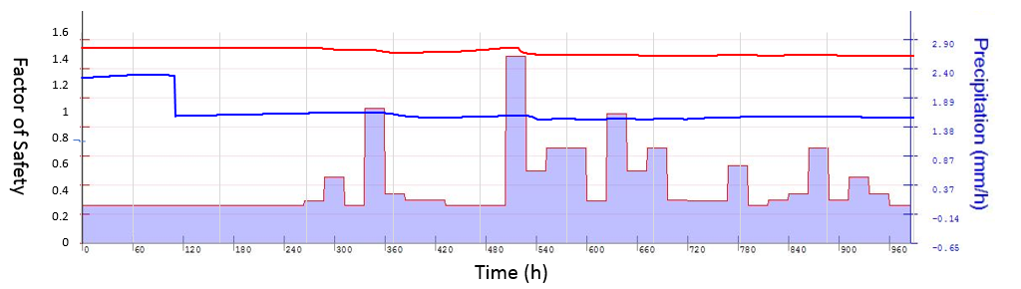


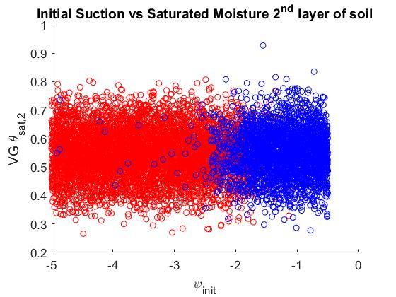
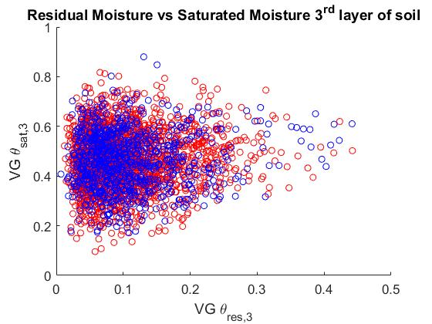
GSA can be used to validate models – If it doesn’t meet expectation it can help debugging
Application to a landslide model
Bozzolan et al. in preparation
Notes:
There is a numerical instability in some model runs which is due to a specific range of values of one parameter, which is due to model simplification.
We can see that for other parameters there is no subrange of values in particular that it’s causing the instability therefore
It must be the parameter on the x axis of the first figure.
There are some structural limitations under some condition of the simulated slope.
The value of the initial suction depends on the value of the initial water table which shouldn’t go beyond a threshold for some values of the slope.
By reducing the values of a parameter that was leading to unrealistic simulations the model structural uncertainty has been reduced.

Slide 18
GSA can be used to validate models – If it doesn’t meet expectation it can help debugging
Application to a landslide model
Bozzolan et al. in preparation
Odd behaviour, no rain but factor of safety drops
Range of values that should be avoided
Notes:
There is a numerical instability in some model runs which is due to a specific range of values of one parameter, which is due to model simplification.
We can see that for other parameters there is no subrange of values in particular that it’s causing the instability therefore
It must be the parameter on the x axis of the first figure.
There are some structural limitations under some condition of the simulated slope.
The value of the initial suction depends on the value of the initial water table which shouldn’t go beyond a threshold for some values of the slope.
By reducing the values of a parameter that was leading to unrealistic simulations the model structural uncertainty has been reduced.

Slide 19
GSA Workflow
User’s choices
EXPERIMENT SETUP
Choose the input factors subject to SA
Define other model inputs not subject to SA
Define the scalar model output(s)
SA steps
Choose the SA method(s)
1. INPUT SAMPLING
Define the input variability space (ranges/PDFs/ …)
Choose the sampling strategy (random uniform, latin hypercube,…)
Choose the sample size (depending on the SA method and number of input factors)
2. MODEL EVALUATION
Recommended practice
Check model behaviour (and possibly filter out samples)
3. POST PROCESSING
(GSA)
Assess robustness and convergence
Visualize results
Assess credibility of SA

Slide 20
GSA allows to achieve different objectives
Ranking
Which input factors have more influence on the model’s response?
Screening
Is there any input factor that has negligible influence on the model’s response?
Model inputs
Model inputs
Then possible SA methods:
Regional Sensitivity Analysis
Elementary Effects
Variance Based
Then possible SA methods:
Elementary Effects
Variance Based
Sensitivity Index
Sensitivity Index
x1 x2 x3 x4 x5
x1 x2 x3 x4 x5
→ x₃ > x₅ > x₄ > x₁ > x₂
→ x₄ non influential
Mapping
Are there subranges of the input factors that map into “significant” (e.g. extreme) output values?
Input factors
Model output
Then possible SA methods:
Regional Sensitivity Analysis
Classification and Regression Trees
x₁ x₂ x₃ x₄ x₅
Output (e.g. flood depth) above a threshold
→ specific subranges of the inputs give a flood depth above a threshold

Slide 21
Classification of GSA methods
SA purpose
Sampling approach
Screening
Ranking
Mapping
Type of SA
~M
Perturbation & derivatives
LOCAL
One At the Time
(OAT)
Multiple-starts perturbation
EET
~10-100 x M
DELSA
Monte-Carlo filtering
RSA
>100 x M
Correlation & Regression Analysis
CC,PCC, SRCC, PRCC,CCA
Number of model evaluations
CART
GLOBAL
LR (SRC)
All At the Time (AAT)
Variance- based
&
Density- based
eFAST , FAST
>1000 x M
entropy-based
δ-sensitivity
VBSA
M: number of input factors

Slide 22
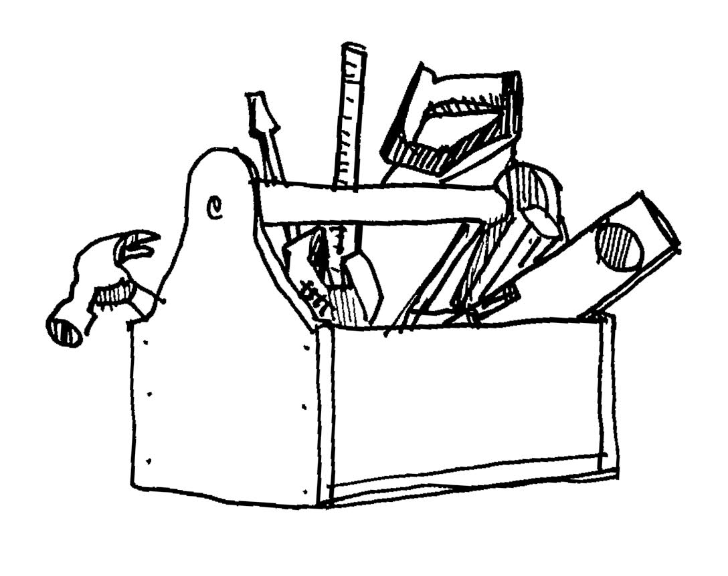
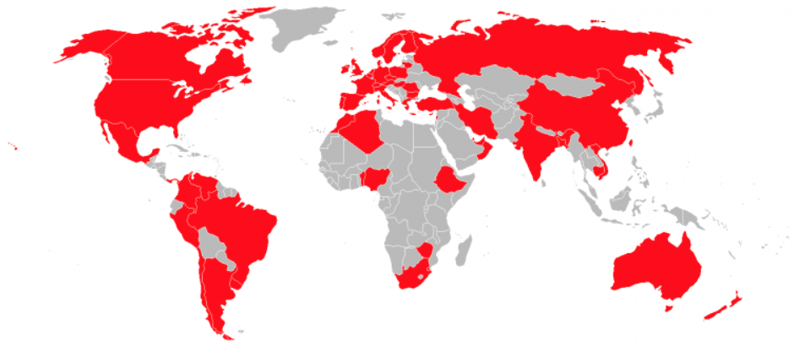
SAFE Toolbox for Sensitivity Analysis
Developed in 2014 by Pianosi et al.
Over 1800 users in academia in 50+ countries
Python, R and Matlab versions available
Easy to use, flexible, modular structure, easy to integrate with models running outside Python, R or Matlab
Open access and open source
Variety of case studies available
Many visualisation functions
Lots of commented code and workflows
www.safetoolbox.info

Slide 23

Modular structure of SAFE
GSA steps
folders in SAFE Toolbox
 | X
1
2
…
N
 | 1 | 2 | … | M
sampling
AAT_Sampling.m OAT_sampling.m lhcube.m
lhcube_shrink.m
lhcube_extend.m
input samples
SAMPLING INPUT SPACE
MODEL EVALUATION
 | Y
1
2
…
N
 | 1 | … | P
output samples
POST PROCESSING
Elementary Effects Test
EET
EET_indices.m EET_plot.m EET_convergence.m
Regional Sensitivity Analysis
RSA
VBSA
VBSA_indices.m VBSA_convergence.m VBSA_resampling.m
 | S
1
…
P
 | 1 | 2 | … | M
Variance-Based Sensitivity Analysis
sensitivity indices
…

Slide 24
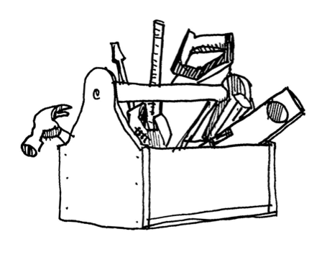
The key to a successful application often lies in making ’good’ set-up choices (definition of input variability space, choice of outputs, etc)
Conclusions
Uncertainty and Sensitivity Analysis are very useful to investigate the propagation of uncertainty through a model and hence support their improvement, validation and use for inference or decision-making
Some guidance in:
Noacco et al. (in press). Matlab/R workflows to assess critical choices in Global Sensitivity Analysis using the SAFE toolbox. MethodsX (currently accessible at: https://eartharxiv.org/pu83z/)
www.safetoolbox.info (Python, R, matlab)

Slide 25
References
Review papers to get started:
Pianosi et al. 2016 Sensitivity analysis of environmental models: A systematic review with practical workflow. Environmental Modelling and Software, 79.
Wagener and Pianosi 2019 What has Global Sensitivity Analysis every done for us? … Earth-Science Reviews, 194.
Technical guidelines:
Noacco et al. in press Matlab/R workflows to assess critical choices in Global Sensitivity Analysis using the SAFE toolbox. MethodsX (currently accessible at: https://eartharxiv.org/pu83z/)
Introduction to SAFE toolbox:
Pianosi et al. 2015 A Matlab toolbox for Global Sensitivity Analysis. Environmental Modelling and Software. 70.
Examples:
Savage et al. 2016 Quantifying the importance of spatial resolution and other factors through global sensitivity analysis of a flood inundation model. Water Resources Research. 52.
Abily et al 2016 Spatial Global Sensitivity Analysis of High Resolution classified topographic data use in 2D urban flood modelling. Environmental Modelling & Software, 77.
Butler et al. 2014 Identifying parametric controls and dependencies in integrated assessment models using global sensitivity analysis. Environmental Modelling & Software, 59.
Bozzolan et al. in preparation. Exploring the effect of informal urban activities on rainfall triggered landslides hazard

