Slide 1

EZEEFIN / CUSTOMER WALKTHROUGH
One connected
concierge journey.
A complete page-by-page demonstration plan for the public site, customer account and staff operations platform.
Synthetic-data demonstration

Slide 2
The experience moves from promise to proof.
Use the walkthrough in this order so every screen answers the question created by the one before it.
01
02
03
04
Public experience
Customer account
Staff operations
Case workspace
Build confidence and capture the right request.
Show continuity, readiness and next actions.
Show queues, ownership and customer context.
Demonstrate coordinated execution and audit.
PLATFORM MAP
02

Slide 3
03
The public site turns uncertainty into a guided request.
Show the premium promise first, then the transparent process and three enquiry paths.
PUBLIC EXPERIENCE
PUBLIC EXPERIENCE
03

Slide 4
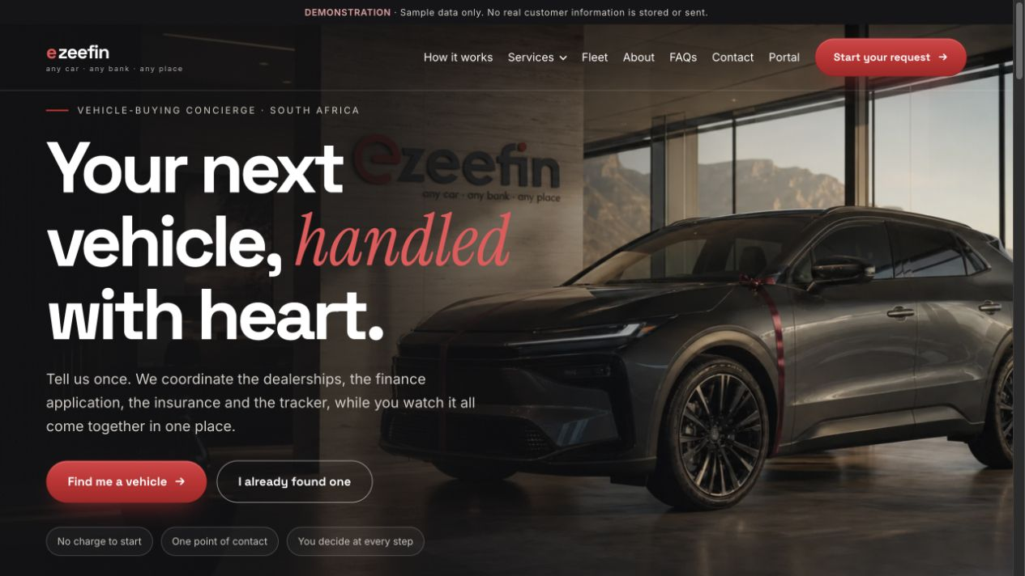
PUBLIC EXPERIENCE
Homepage
/
Introduces EzeeFin as a premium vehicle concierge and directs visitors into a guided request.
WHAT TO SHOW
01
Editorial showroom hero and primary request action
02
Concierge promise, service narrative and journey preview
03
Authentic delivery proof and closing conversion
WHY IT MATTERS
Builds confidence before asking for personal details.
PUBLIC EXPERIENCE
04

Slide 5
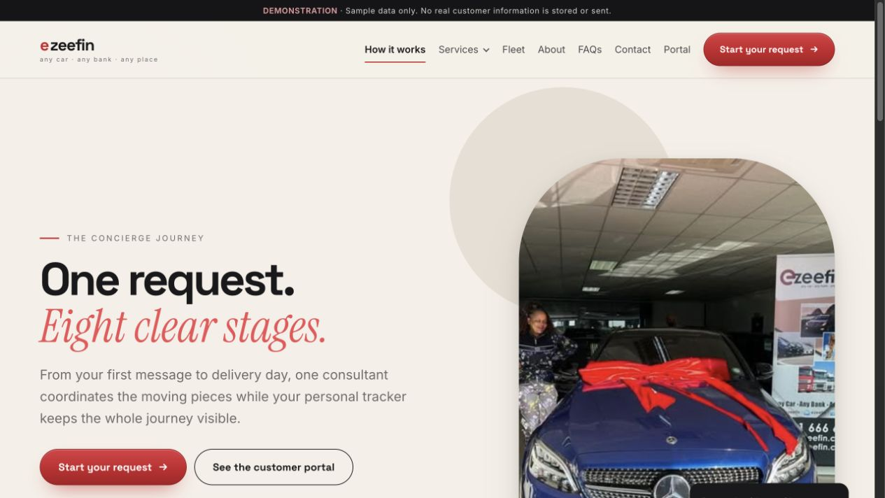
PUBLIC EXPERIENCE
How it works
/how-it-works
Explains the complete journey from first request to delivery.
WHAT TO SHOW
01
Eight customer-visible stages
02
What EzeeFin handles and what the customer provides
03
Contextual action to start a request
WHY IT MATTERS
Makes a complex process feel transparent and manageable.
PUBLIC EXPERIENCE
05

Slide 6
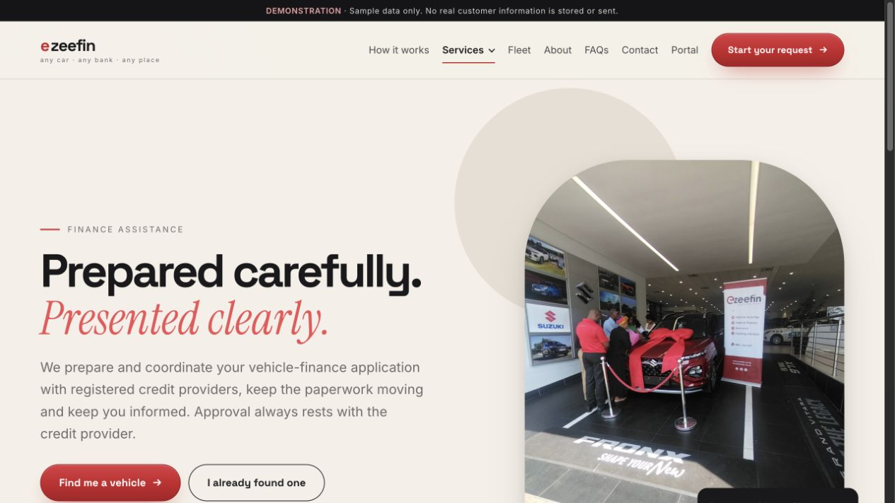
PUBLIC EXPERIENCE
Finance assistance
/services/finance-assistance
Explains EzeeFin’s coordination role with registered credit providers.
WHAT TO SHOW
01
Finance-focused editorial hero
02
Benefits, preparation steps and required information
03
Transparent legal wording and FAQs
WHY IT MATTERS
Sets accurate expectations without implying credit approval.
PUBLIC EXPERIENCE
06

Slide 7
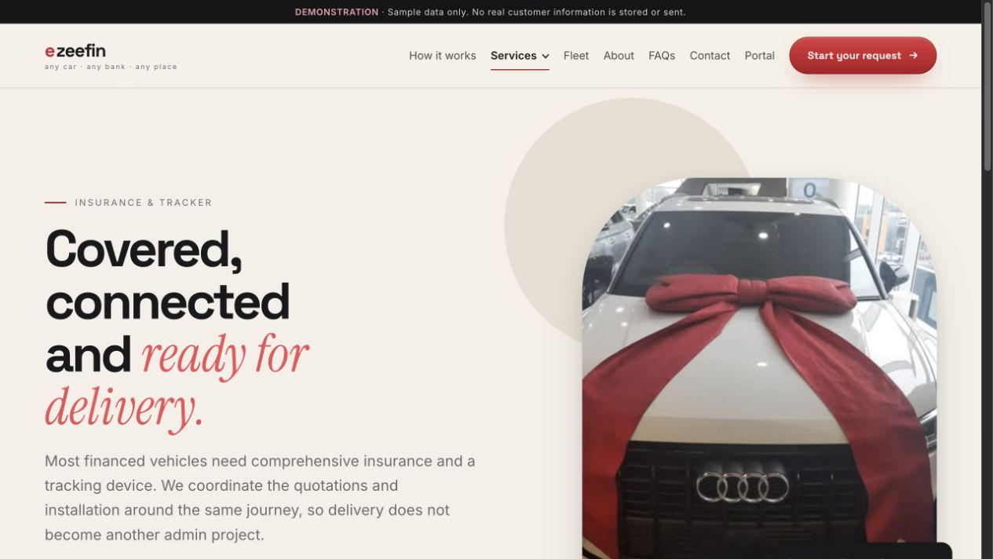
PUBLIC EXPERIENCE
Insurance and tracker
/services/insurance-and-tracker
Shows how insurance and tracker quotations are coordinated.
WHAT TO SHOW
01
Cover and tracker service overview
02
Quotation process and customer choices
03
Provider-role clarification and guided request action
WHY IT MATTERS
Connects vehicle sourcing to a ready-for-the-road handover.
PUBLIC EXPERIENCE
07

Slide 8
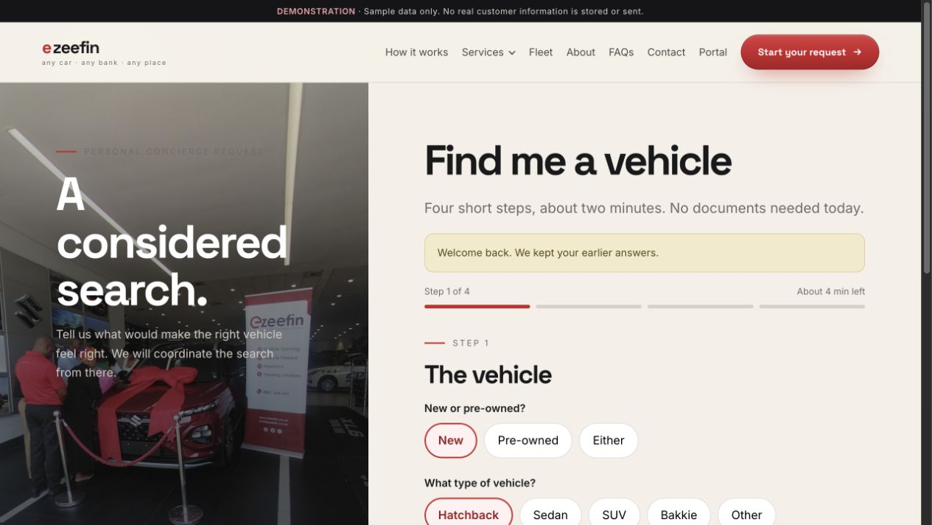
PUBLIC EXPERIENCE
Find me a vehicle
/find-me-a-vehicle
Captures vehicle preferences through a guided, resumable consultation.
WHAT TO SHOW
01
Named stages and expected completion time
02
Vehicle, budget and contact field groups
03
Validation, consent and reference confirmation
WHY IT MATTERS
Turns a broad vehicle need into a structured sourcing brief.
PUBLIC EXPERIENCE
08

Slide 9
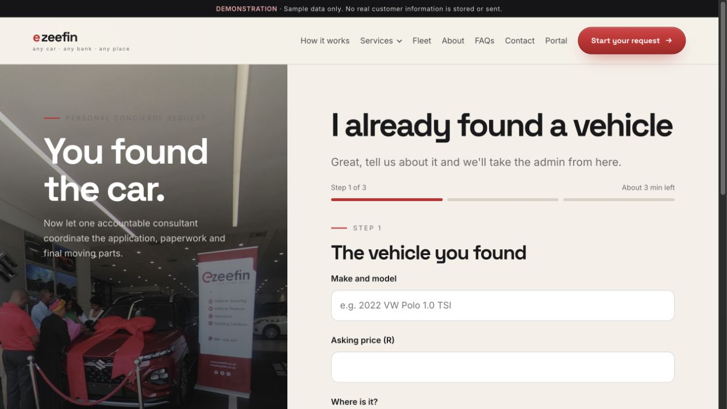
PUBLIC EXPERIENCE
I found a vehicle
/found-a-vehicle
Captures the identified vehicle and the assistance still required.
WHAT TO SHOW
01
Vehicle and dealership details
02
Finance, cover and tracker support choices
03
Consent, draft restoration and handoff reference
WHY IT MATTERS
Creates a faster route for customers who have already done the search.
PUBLIC EXPERIENCE
09

Slide 10
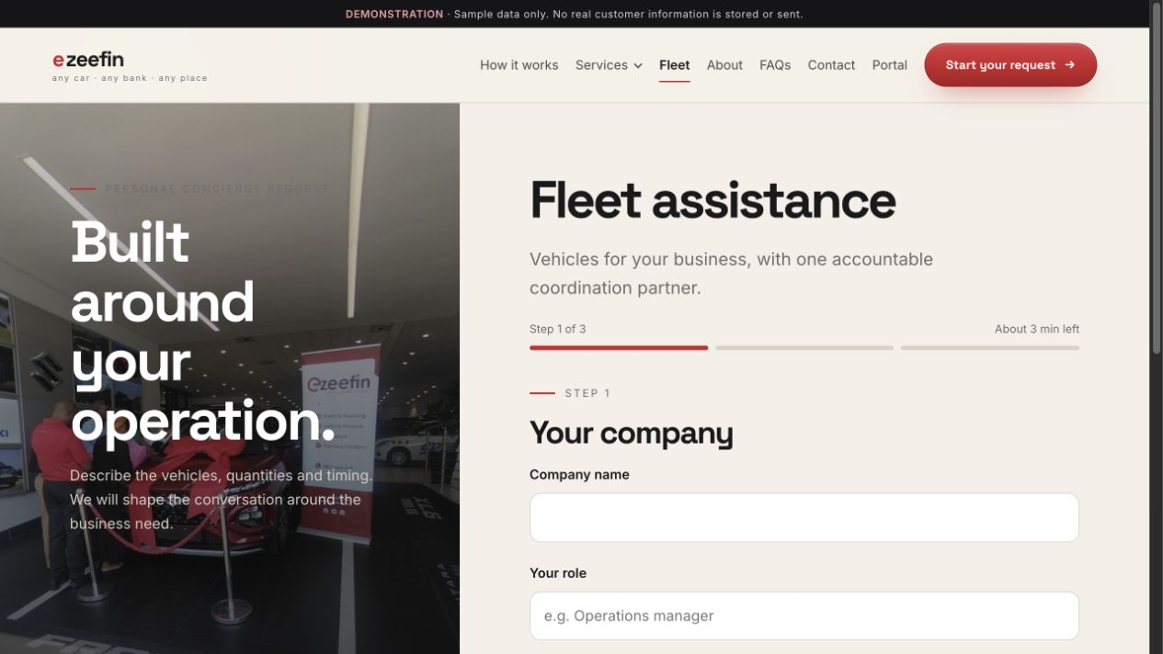
PUBLIC EXPERIENCE
Fleet enquiry
/fleet
Collects company, fleet and operational requirements.
WHAT TO SHOW
01
Business and contact context
02
Vehicle quantity, use and timing
03
Consultation handoff and reference confirmation
WHY IT MATTERS
Provides a dedicated path for more complex commercial needs.
PUBLIC EXPERIENCE
10

Slide 11
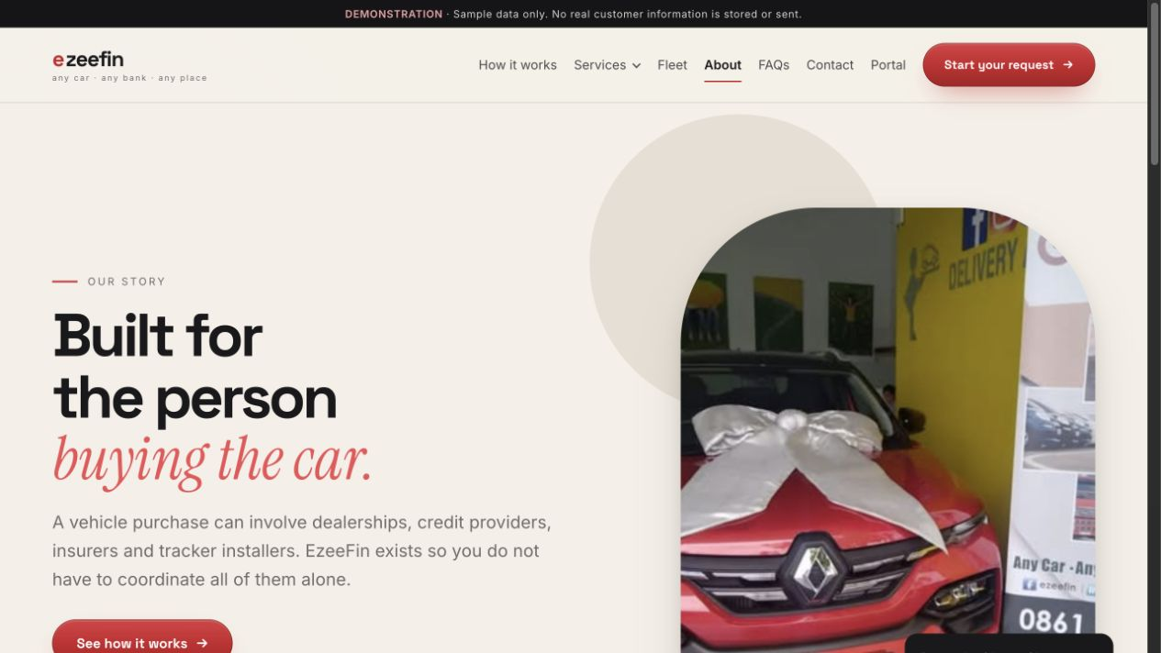
PUBLIC EXPERIENCE
About EzeeFin
/about
Presents the company story, operating principles and authentic proof.
WHAT TO SHOW
01
Brand and service narrative
02
Real delivery photography
03
Principles, credibility and contact action
WHY IT MATTERS
Reinforces that the service is human, established and accountable.
PUBLIC EXPERIENCE
11

Slide 12
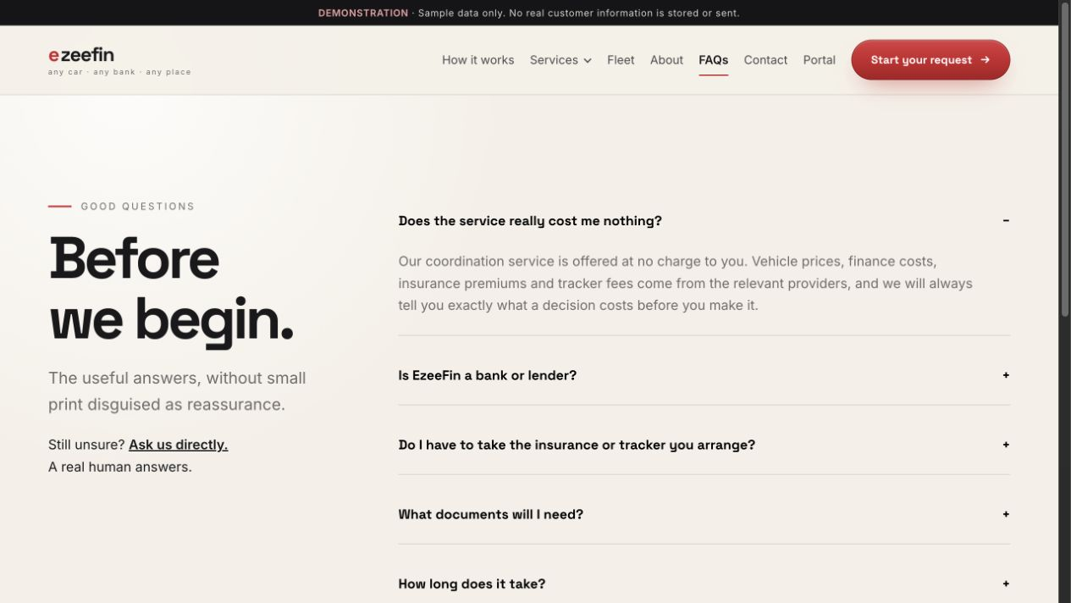
PUBLIC EXPERIENCE
Frequently asked questions
/faqs
Answers common questions in categorized, accessible accordions.
WHAT TO SHOW
01
Categories for sourcing, finance, delivery and support
02
Large accordion touch targets
03
Clear next step when an answer needs personal guidance
WHY IT MATTERS
Reduces uncertainty without forcing a customer to contact support.
PUBLIC EXPERIENCE
12

Slide 13
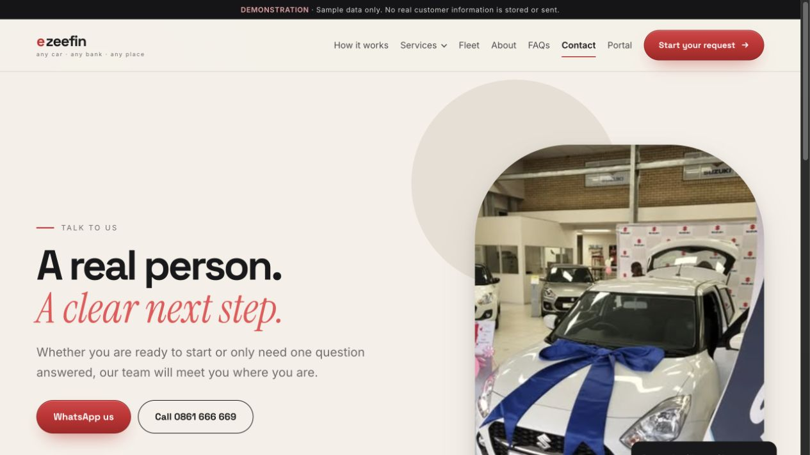
PUBLIC EXPERIENCE
Contact
/contact
Provides direct concierge contact and a clearly separated complaints path.
WHAT TO SHOW
01
Phone, email and WhatsApp options
02
Office details and availability expectations
03
Complaints and escalation information
WHY IT MATTERS
Makes human help easy to find and sets response expectations.
PUBLIC EXPERIENCE
13

Slide 14
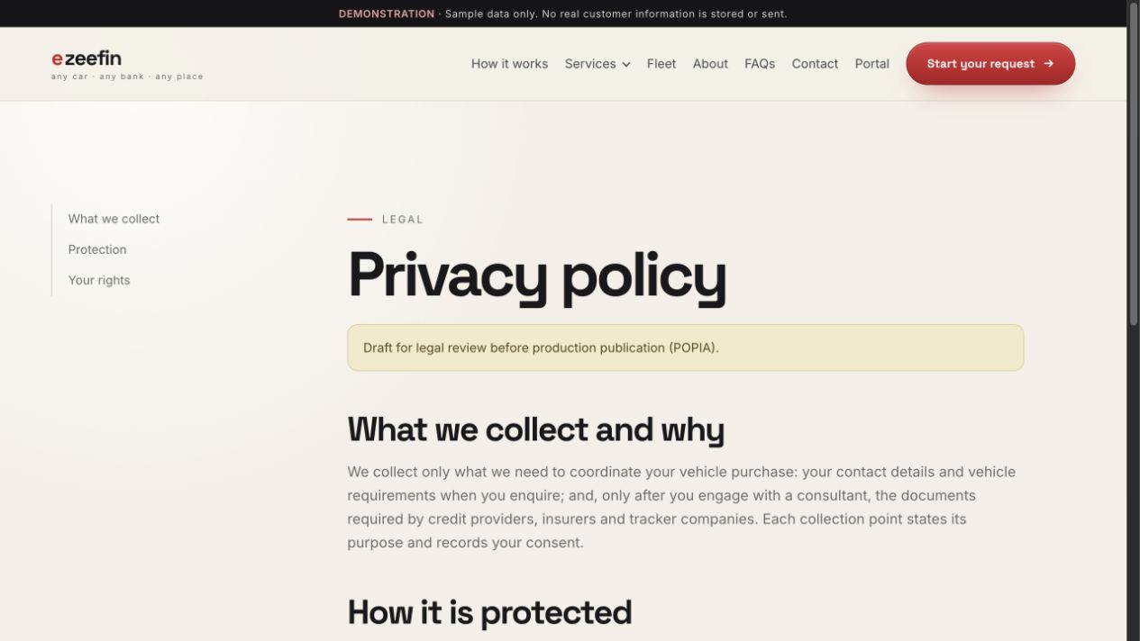
PUBLIC EXPERIENCE
Privacy notice
/privacy
Explains how personal information is handled in a calm reading layout.
WHAT TO SHOW
01
Desktop contents rail
02
Readable legal sections and retention context
03
Visible legal-review notice
WHY IT MATTERS
Supports informed consent and POPIA review.
PUBLIC EXPERIENCE
14

Slide 15
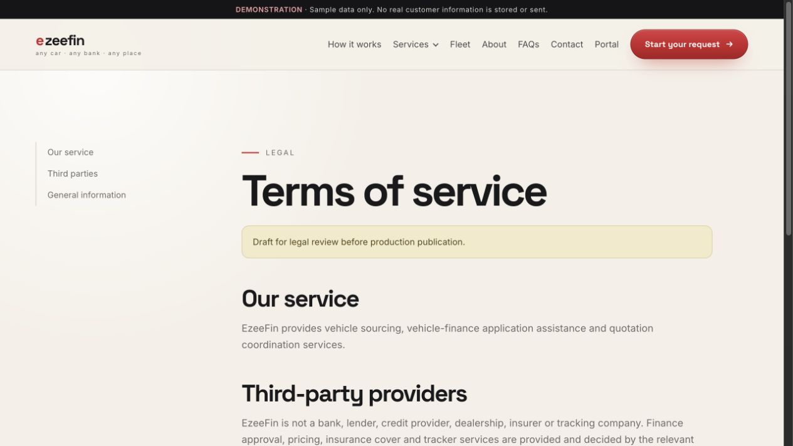
PUBLIC EXPERIENCE
Terms of use
/terms
Sets service boundaries, responsibilities and legal conditions.
WHAT TO SHOW
01
Structured contents navigation
02
Readable service and responsibility sections
03
Preserved legal-review notice
WHY IT MATTERS
Clarifies the operating relationship before a customer proceeds.
PUBLIC EXPERIENCE
15

Slide 16
16
The account keeps the customer informed beyond the enquiry.
Show next actions, reusable information, documents, conversations and history.
CUSTOMER PORTAL
CUSTOMER PORTAL
16

Slide 17
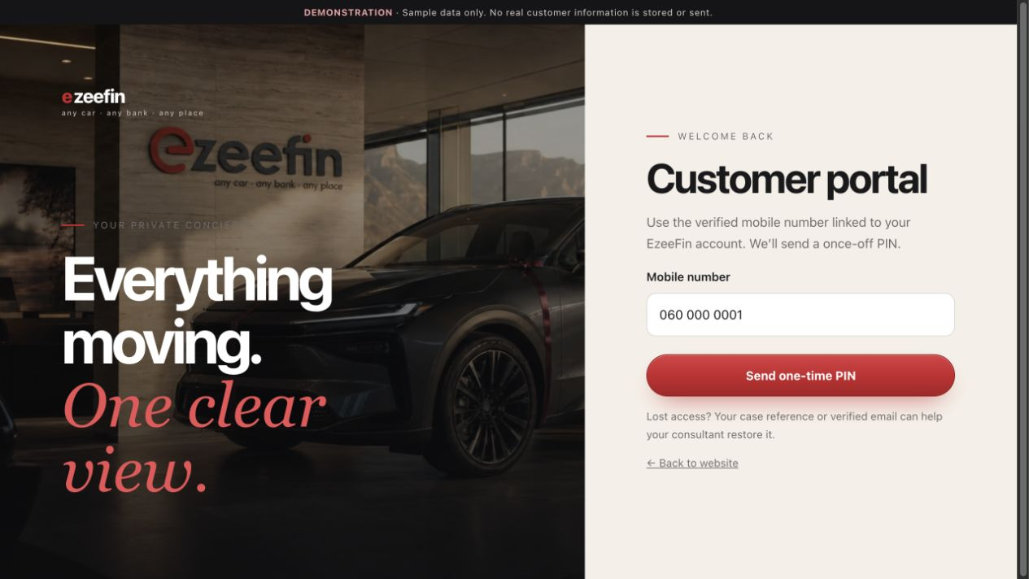
CUSTOMER PORTAL
Customer sign-in
Provides passwordless access through a verified mobile and one-time PIN.
/portal
WHAT TO SHOW
01
Mobile-number entry
02
Demo OTP step and privacy reassurance
03
Clear path into the private account
WHY IT MATTERS
Keeps sign-in simple while reserving step-up verification for sensitive actions.
CUSTOMER PORTAL
17

Slide 18
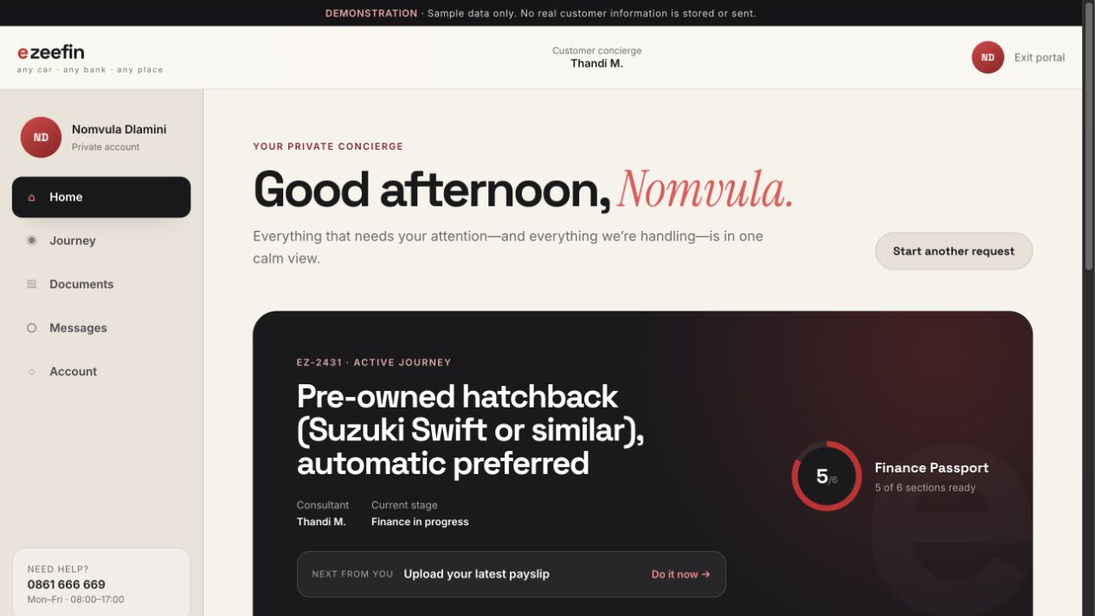
CUSTOMER PORTAL
Customer home
Presents the active journey, next action and account readiness in one view.
/portal/home
WHAT TO SHOW
01
Journey reference, consultant and current stage
02
Finance Passport readiness and next customer action
03
Messages, document alerts, appointments and history
WHY IT MATTERS
Answers the customer’s main question: what needs my attention now?
CUSTOMER PORTAL
18

Slide 19
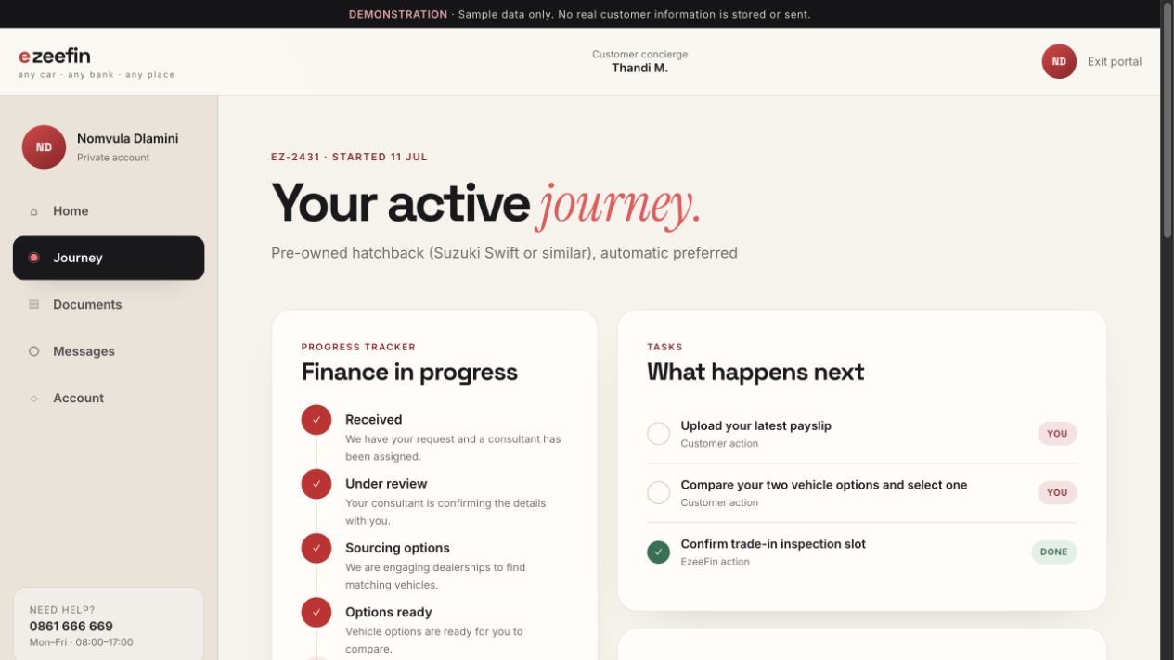
CUSTOMER PORTAL
Journey
Combines progress, tasks, vehicle options and provider coordination.
/portal/journey
WHAT TO SHOW
01
Customer-visible stage timeline
02
Customer and EzeeFin tasks
03
Vehicle choices, finance and cover coordination
WHY IT MATTERS
Keeps the whole purchase journey understandable without exposing sensitive internal outcomes.
CUSTOMER PORTAL
19

Slide 20
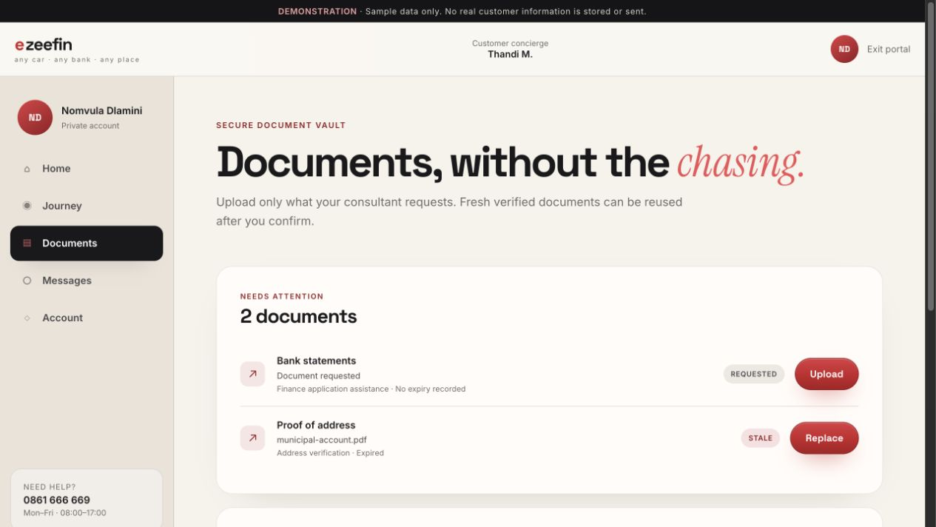
CUSTOMER PORTAL
Document vault
Shows requested and reusable documents with freshness and verification status.
/portal/documents
WHAT TO SHOW
01
ID, licence, address, payslip and statement records
02
Upload date, purpose, expiry and journey usage
03
Requested, uploaded, verified and stale states
WHY IT MATTERS
Reduces repeated document requests and explains why each document is needed.
CUSTOMER PORTAL
20

Slide 21
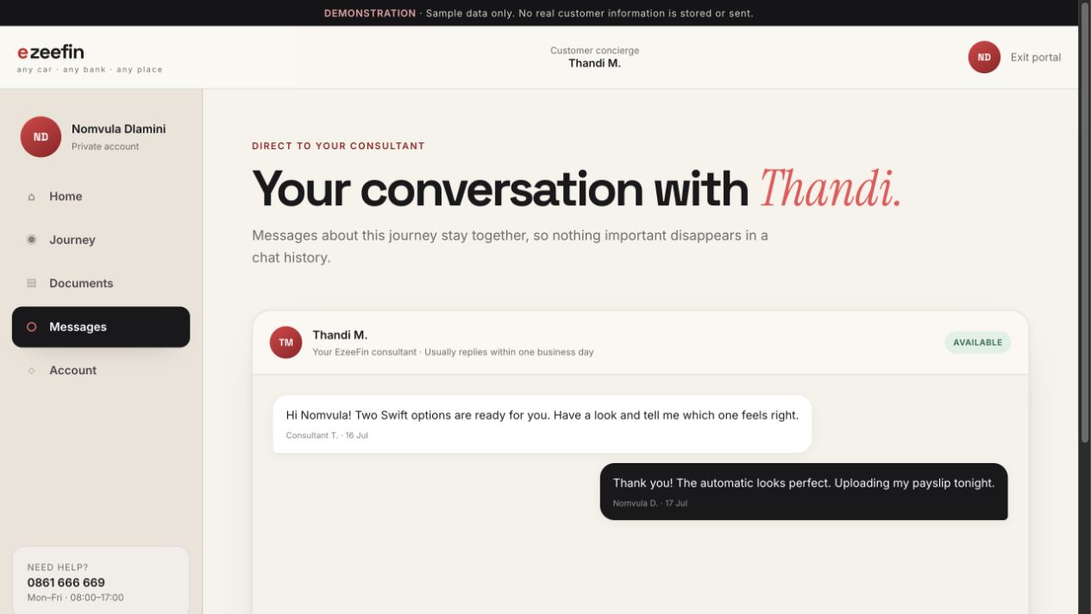
CUSTOMER PORTAL
Customer messages
Provides a bounded conversation with the assigned consultant.
/portal/messages
WHAT TO SHOW
01
Conversation history with staff identity
02
Persistent message composer
03
Support fallback when the portal is not enough
WHY IT MATTERS
Keeps journey communication attached to the customer’s case.
CUSTOMER PORTAL
21

Slide 22
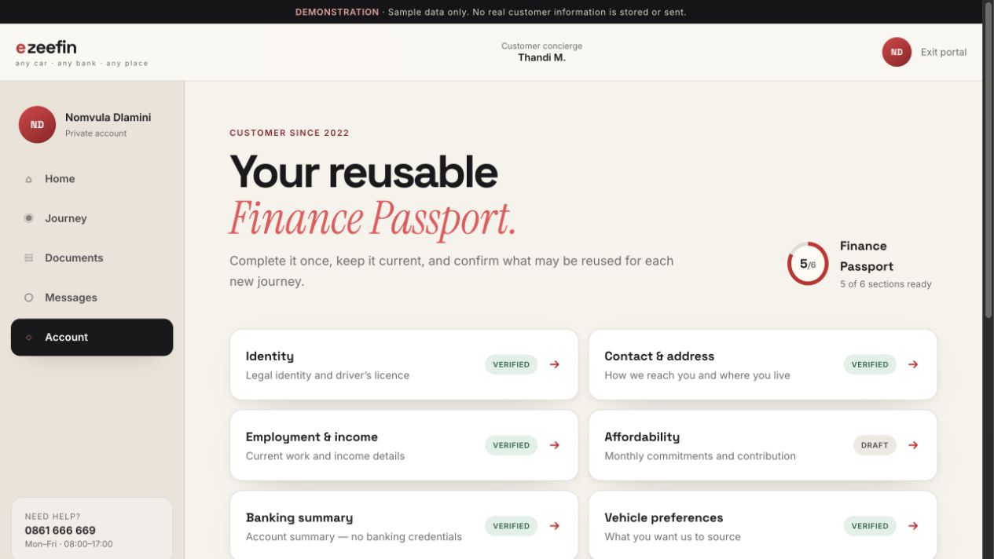
CUSTOMER PORTAL
Account and Finance Passport
Summarizes reusable profile readiness, preferences, privacy and history.
/portal/account
WHAT TO SHOW
01
Readiness shown as sections, never a credit score
02
Seven profile states from Not started to Stale
03
Links to preferences, privacy and journey history
WHY IT MATTERS
Turns one enquiry profile into a reusable long-term customer account.
CUSTOMER PORTAL
22

Slide 23
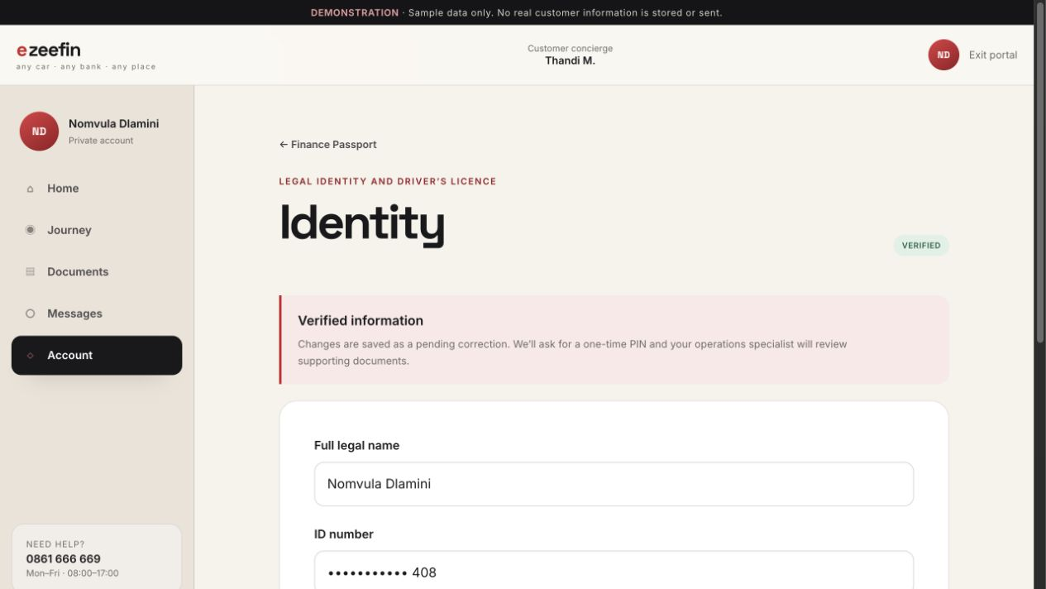
CUSTOMER PORTAL
Finance Passport section
Lets customers review or correct one profile section at a time.
/portal/account/passport/identity
WHAT TO SHOW
01
Short labeled fields and masked sensitive values
02
Save, confirmation and review states
03
Pending corrections preserve the prior verified value
WHY IT MATTERS
Makes profile maintenance understandable and auditable.
CUSTOMER PORTAL
23

Slide 24
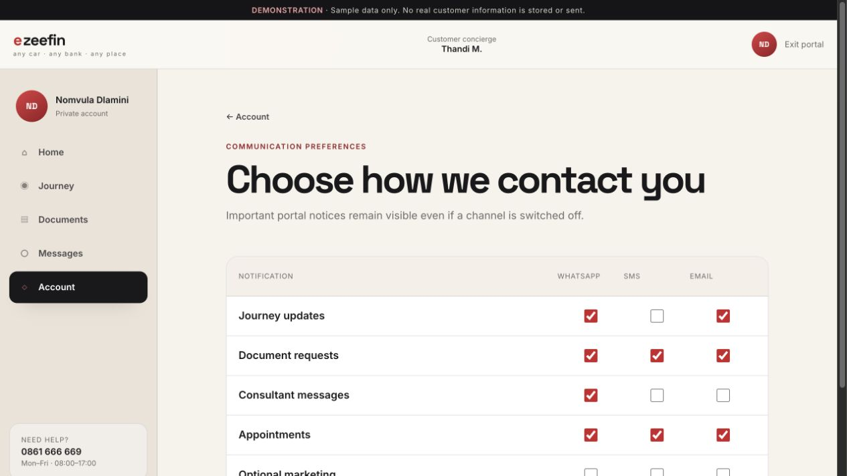
CUSTOMER PORTAL
Notification preferences
Controls WhatsApp, SMS and email by alert type.
/portal/account/notifications
WHAT TO SHOW
01
Journey, document, message and appointment alerts
02
Separate optional marketing controls
03
Mobile-friendly 44px channel controls
WHY IT MATTERS
Respects customer channel choice without hiding essential portal notices.
CUSTOMER PORTAL
24

Slide 25
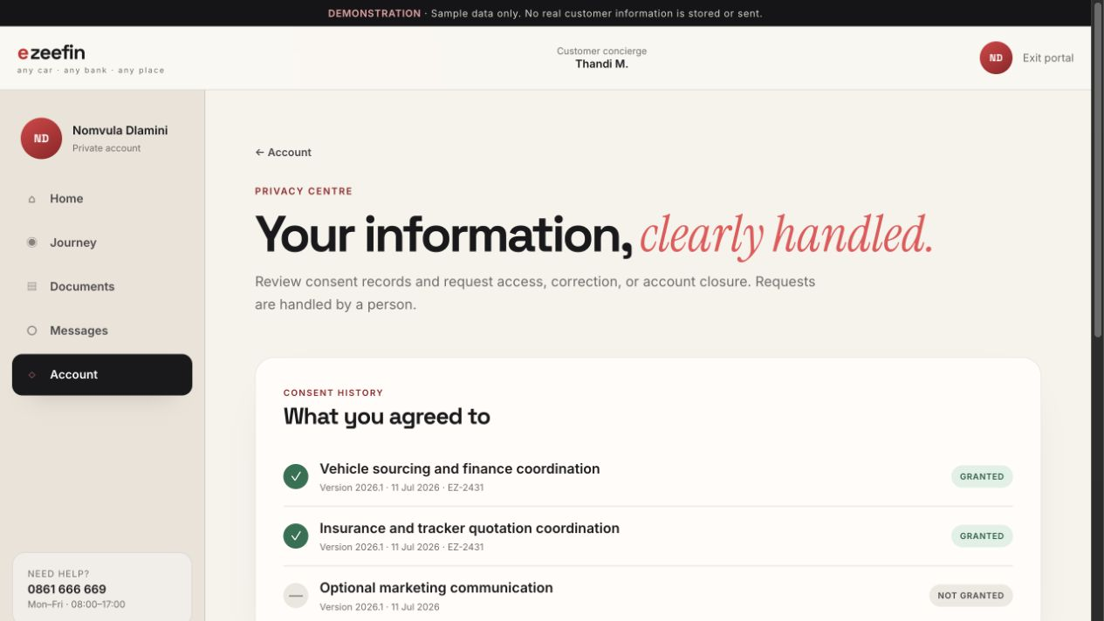
CUSTOMER PORTAL
Privacy centre
Makes consent and personal-data rights visible inside the account.
/portal/account/privacy
WHAT TO SHOW
01
Journey-specific consent history
02
Data access, correction and closure requests
03
Plain-language retention explanation
WHY IT MATTERS
Gives customers practical control over their information.
CUSTOMER PORTAL
25

Slide 26
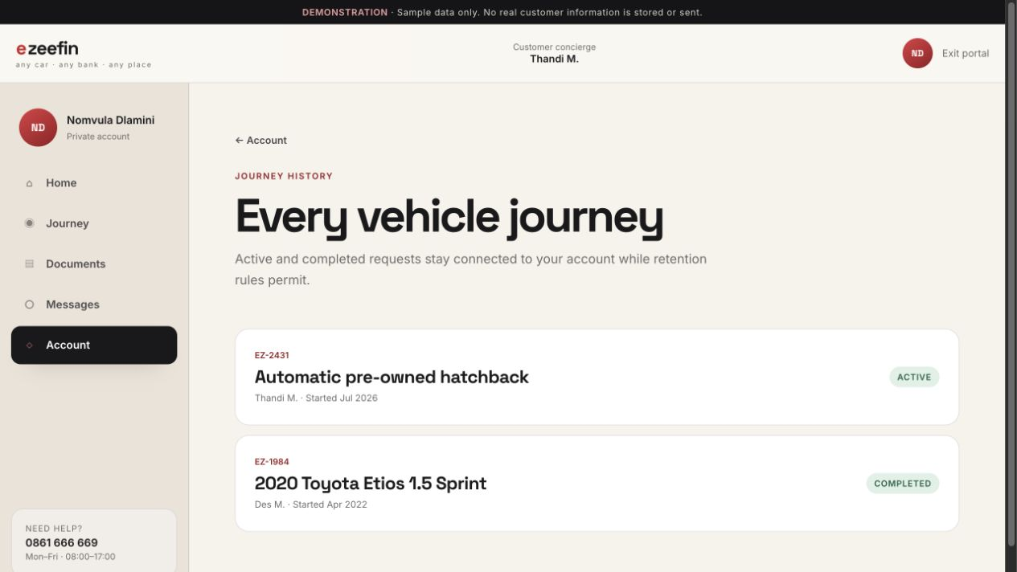
CUSTOMER PORTAL
Journey history
Shows active and completed vehicle journeys linked to the account.
/portal/account/history
WHAT TO SHOW
01
Reference, consultant and important dates
02
Final delivered vehicle for completed journeys
03
Archived journey context where retention permits
WHY IT MATTERS
Creates continuity for returning customers.
CUSTOMER PORTAL
26

Slide 27
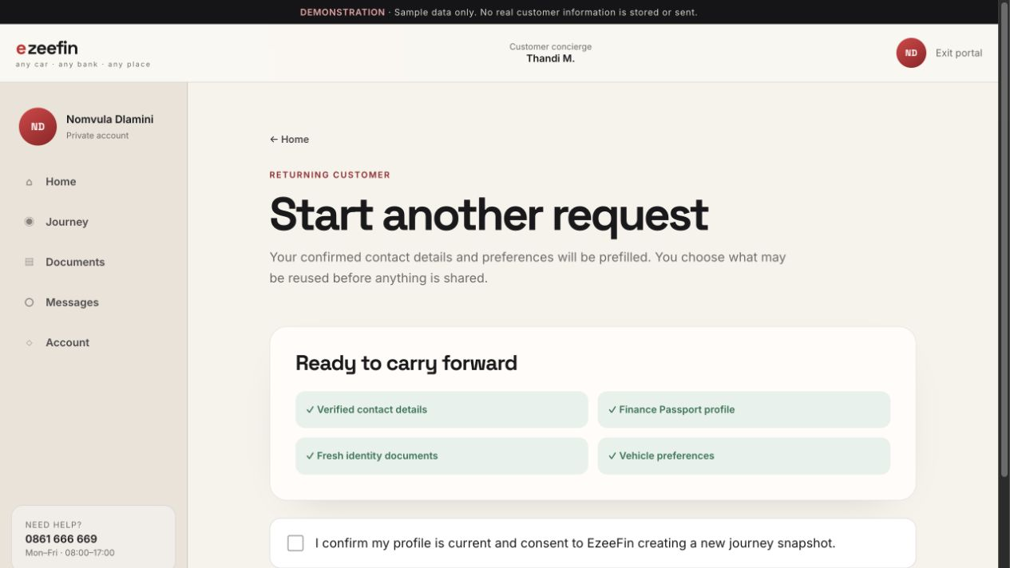
CUSTOMER PORTAL
Start another journey
Starts a new request using confirmed profile data after reconfirmation.
/portal/new-journey
WHAT TO SHOW
01
Prefilled contact and vehicle preferences
02
Explicit choice of reusable profile and documents
03
Fresh journey consent before sharing
WHY IT MATTERS
Makes repeat business quicker without silently reusing personal information.
CUSTOMER PORTAL
27

Slide 28
28
Daily work begins with priority, not navigation.
Show how leads, customers, reviews and operational queues stay connected.
STAFF OPERATIONS
STAFF OPERATIONS
28

Slide 29
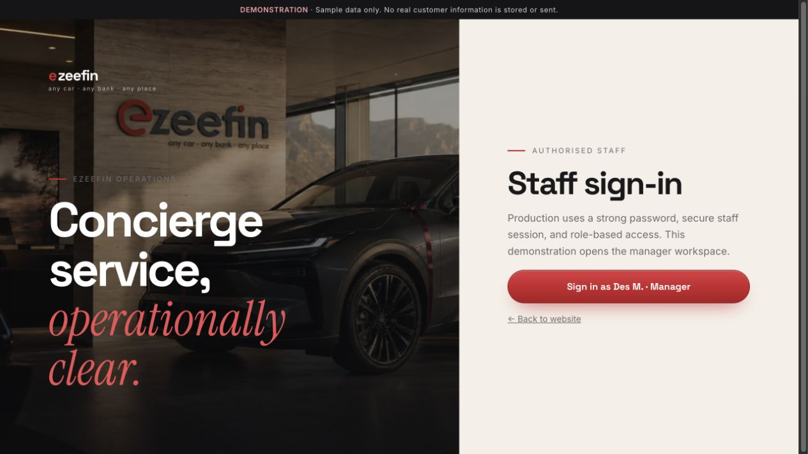
STAFF OPERATIONS
Staff sign-in
/admin
Introduces secure staff access and the manager demonstration workspace.
WHAT TO SHOW
01
Staff identity and password entry
02
Role-based access explanation
03
Direct handoff into operations
WHY IT MATTERS
Separates customer access from operational permissions.
STAFF OPERATIONS
29

Slide 30
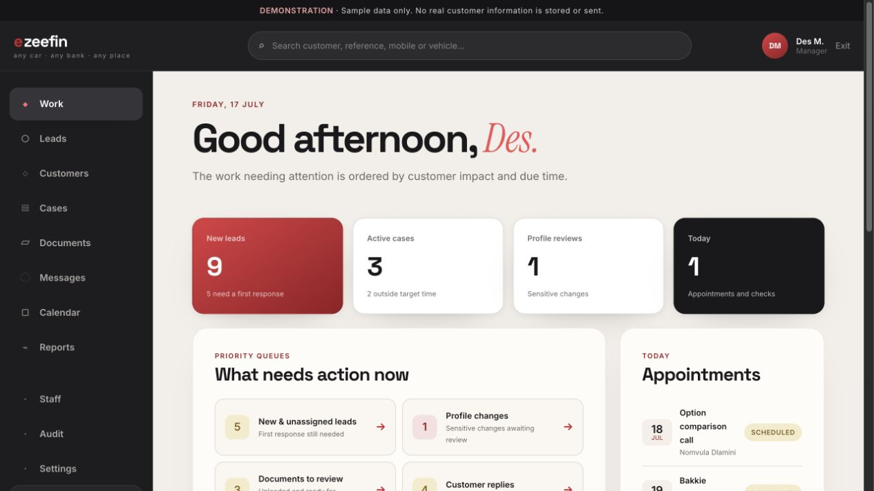
STAFF OPERATIONS
Operations work queue
Prioritizes daily work by customer impact and due time.
/admin/work
WHAT TO SHOW
01
New leads, reviews, documents and customer replies
02
Stalled cases, provider follow-ups and failed notifications
03
Appointments and recent operational activity
WHY IT MATTERS
Staff begin with actionable queues instead of browsing disconnected tables.
STAFF OPERATIONS
30

Slide 31
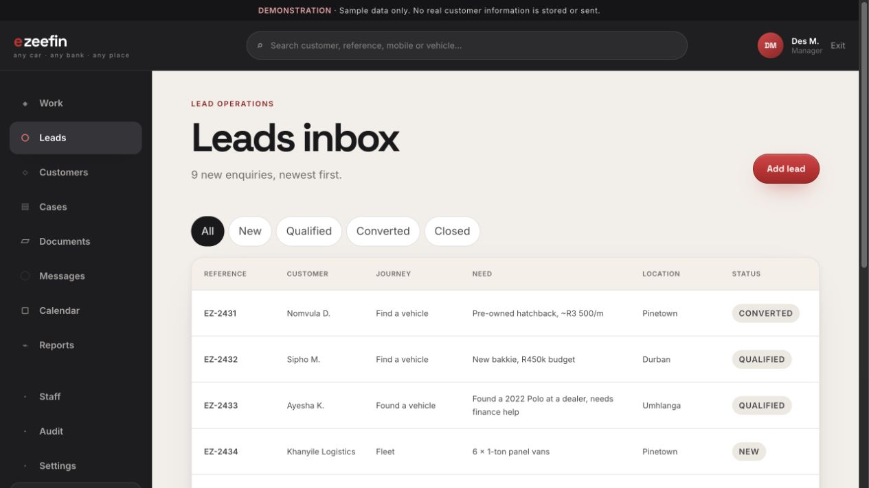
STAFF OPERATIONS
Lead management
/admin/leads
Qualifies, assigns and progresses incoming enquiries.
WHAT TO SHOW
01
Journey type, customer need and current status
02
Filters and saved-view pattern
03
Conversion, follow-up and closure context
WHY IT MATTERS
Protects the original enquiry and consent while creating an accountable response process.
STAFF OPERATIONS
31

Slide 32
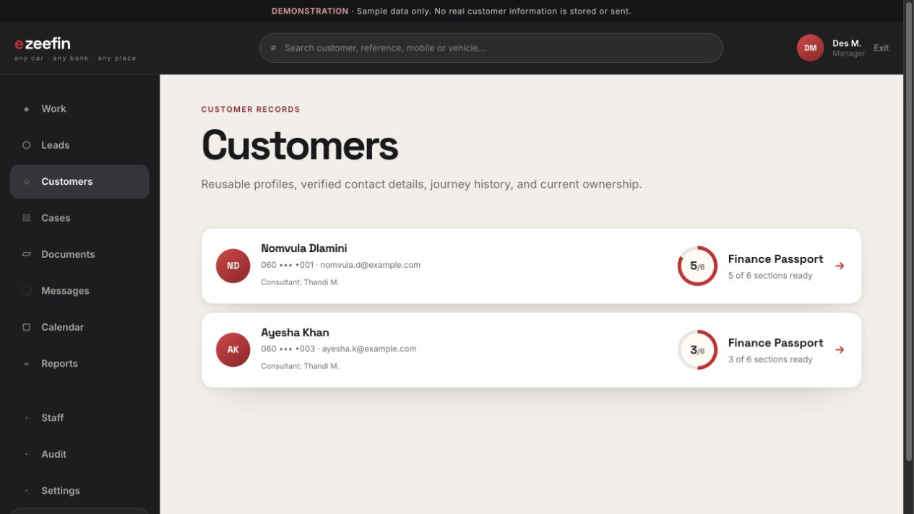
STAFF OPERATIONS
Customer directory
Provides searchable access to long-term customer accounts.
/admin/customers
WHAT TO SHOW
01
Verified contact summary
02
Finance Passport readiness
03
Assigned consultant and active journey context
WHY IT MATTERS
Shifts the operating model from isolated cases to ongoing customer relationships.
STAFF OPERATIONS
32

Slide 33
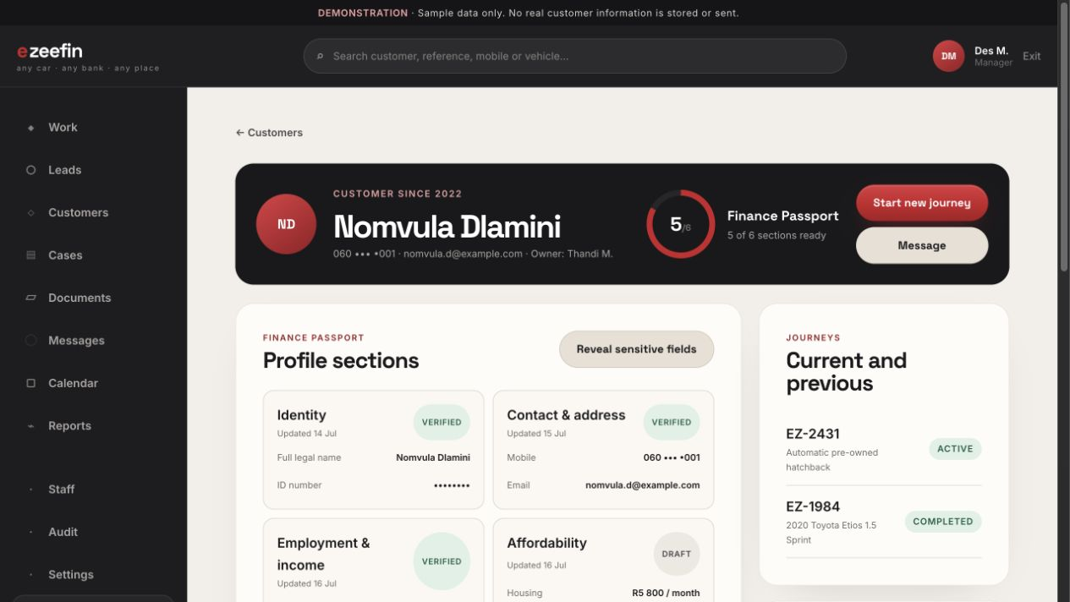
STAFF OPERATIONS
Customer 360°
/admin/customer/customer-1
Combines profile, journeys, document freshness, consent and interaction history.
WHAT TO SHOW
01
Masked sensitive information with reasoned reveal
02
Active and completed journeys
03
Pending profile changes and audit-backed activity
WHY IT MATTERS
Gives staff context without exposing more personal data than necessary.
STAFF OPERATIONS
33

Slide 34
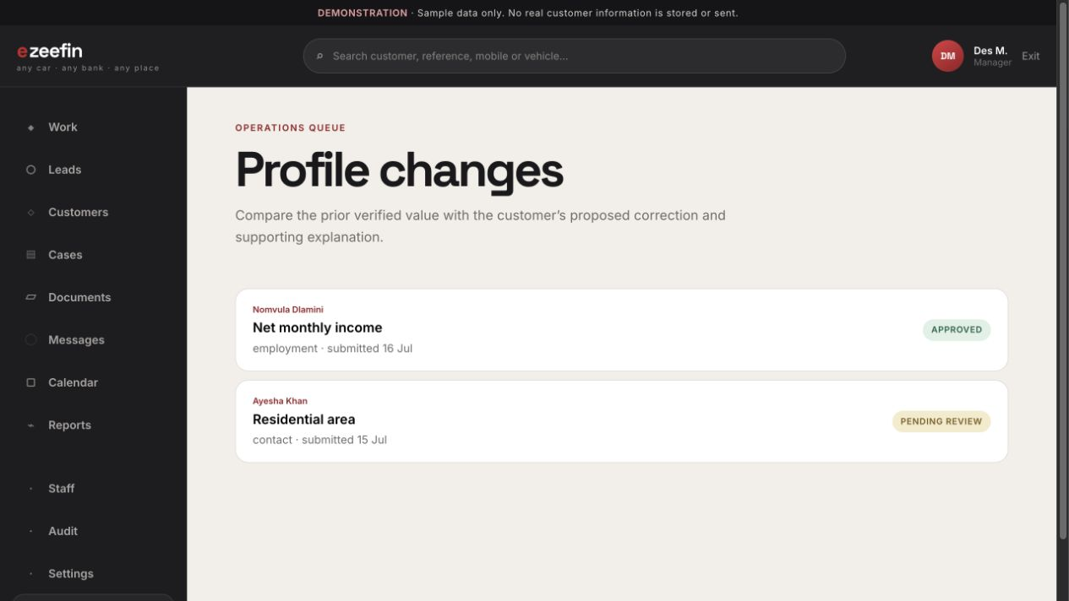
STAFF OPERATIONS
Profile-change reviews
Reviews corrections to previously verified sensitive fields.
/admin/profile-reviews
WHAT TO SHOW
01
Previous verified value and proposed correction
02
Customer explanation and supporting context
03
Approve, reject or request clarification
WHY IT MATTERS
Prevents unreviewed changes from replacing trusted identity, income or banking data.
STAFF OPERATIONS
34

Slide 35
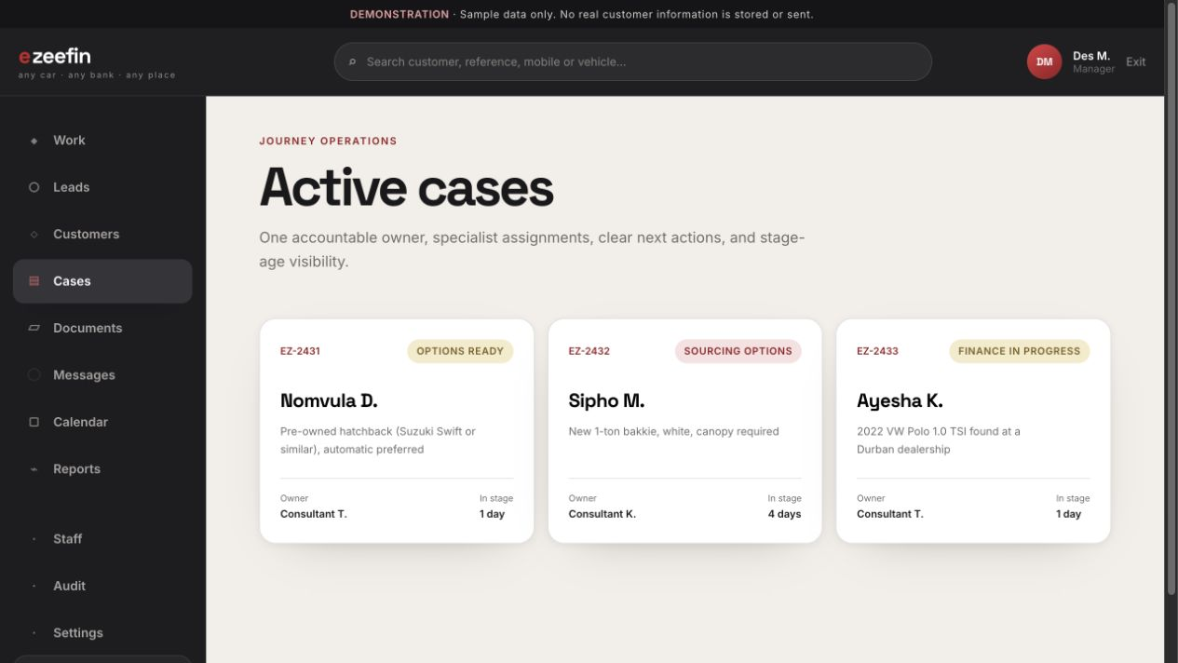
STAFF OPERATIONS
Case list
/admin/cases
Provides a fast scan of active journeys and ownership.
WHAT TO SHOW
01
Reference, customer, stage and priority
02
Age in stage and next action
03
Responsive labeled cards on mobile
WHY IT MATTERS
Supports rapid case triage while retaining a dense desktop view.
STAFF OPERATIONS
35

Slide 36
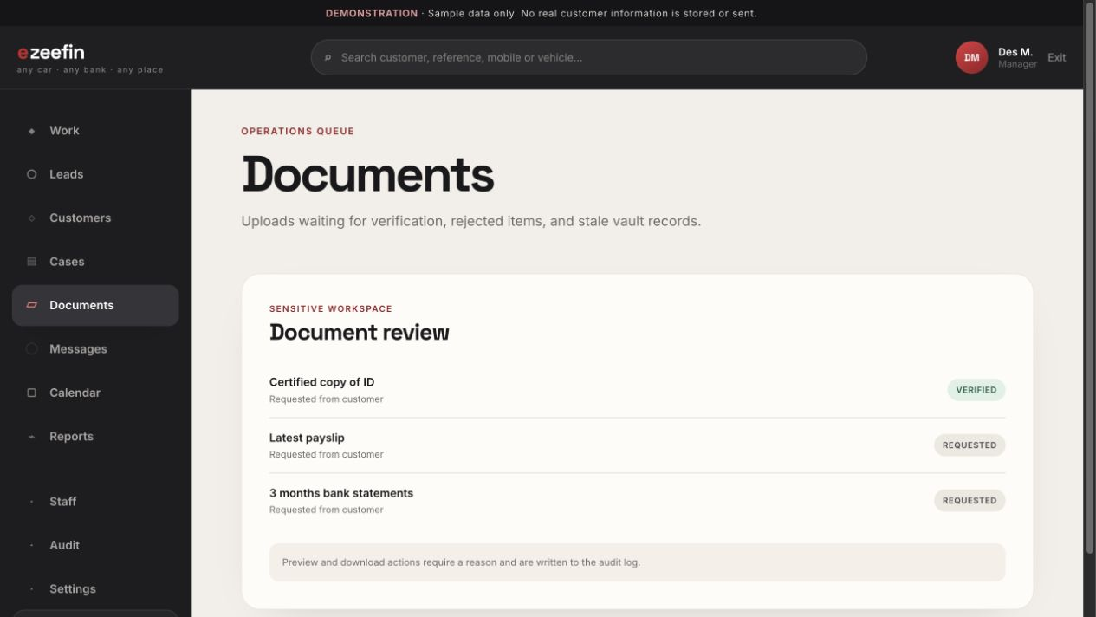
STAFF OPERATIONS
Document review queue
Collects uploads awaiting review across customers and cases.
/admin/documents
WHAT TO SHOW
01
Customer, reference, document type and waiting time
02
Priority and assignment context
03
Direct route into the relevant case
WHY IT MATTERS
Turns document review into a managed service queue.
STAFF OPERATIONS
36

Slide 37
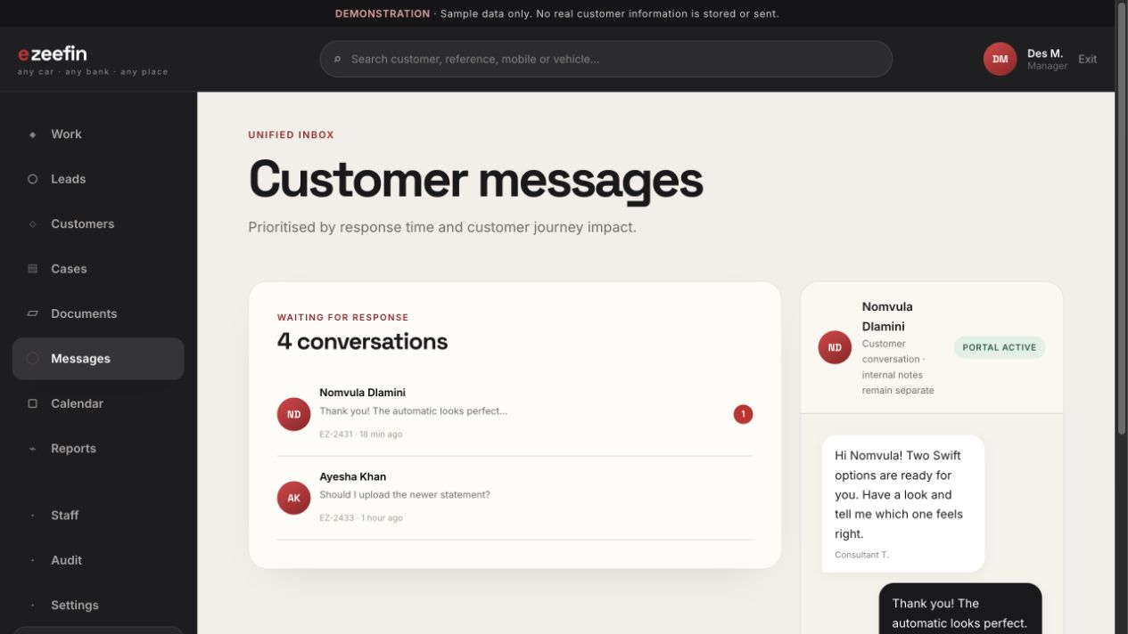
STAFF OPERATIONS
Unified staff inbox
/admin/messages
Prioritizes customer replies by response time and journey impact.
WHAT TO SHOW
01
Conversation queue and unread state
02
Case reference and recent preview
03
Bounded thread with persistent reply composer
WHY IT MATTERS
Helps staff respond promptly without losing case context.
STAFF OPERATIONS
37

Slide 38
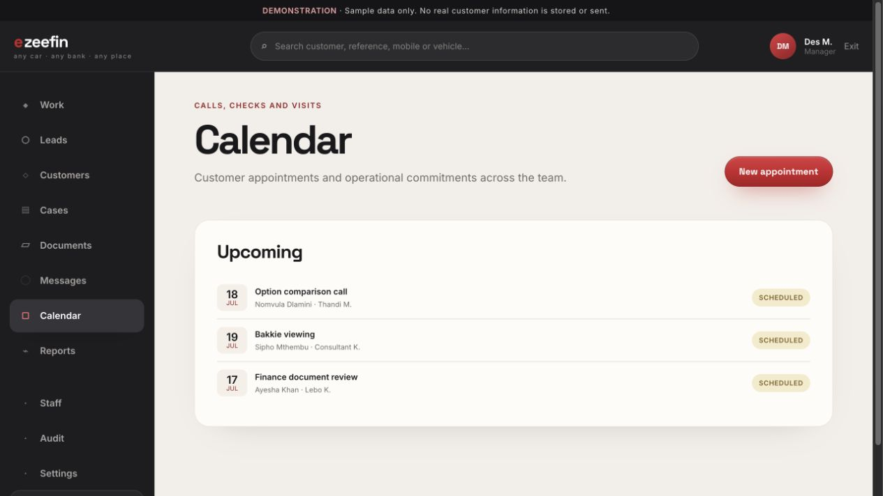
STAFF OPERATIONS
Operations calendar
Coordinates calls, checks, visits, inspections and deliveries.
/admin/calendar
WHAT TO SHOW
01
Appointment type, owner, customer and case
02
Upcoming schedule and status
03
Direct relationship to work queues
WHY IT MATTERS
Keeps time-based commitments visible alongside case work.
STAFF OPERATIONS
38

Slide 39
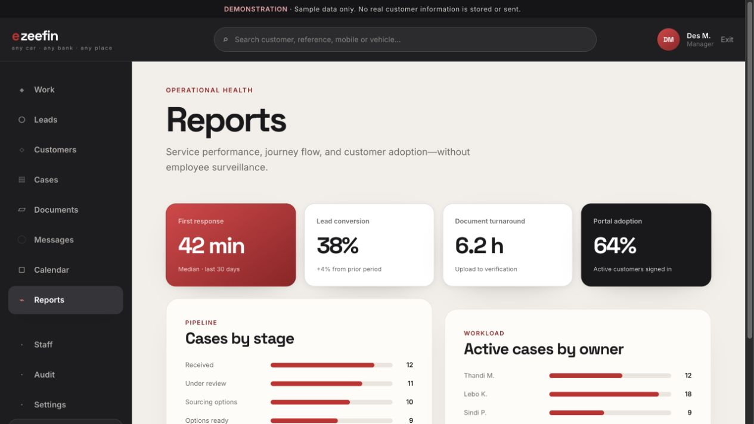
STAFF OPERATIONS
Operational reports
/admin/reports
Summarizes service performance, journey flow and portal adoption.
WHAT TO SHOW
01
Lead response and conversion
02
Stage ageing and review turnaround
03
Workload, selection and notification delivery
WHY IT MATTERS
Supports service improvement without employee-surveillance framing.
STAFF OPERATIONS
39

Slide 40
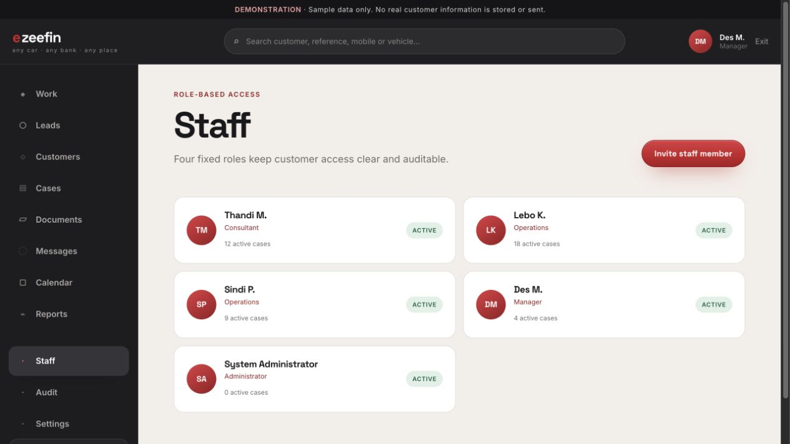
STAFF OPERATIONS
Staff and roles
Shows fixed roles, account status and active workload.
/admin/staff
WHAT TO SHOW
01
Consultant, operations, manager and administrator roles
02
Active, invited and suspended access states
03
Role-gated administration
WHY IT MATTERS
Provides a clear first-version permission model.
STAFF OPERATIONS
40

Slide 41
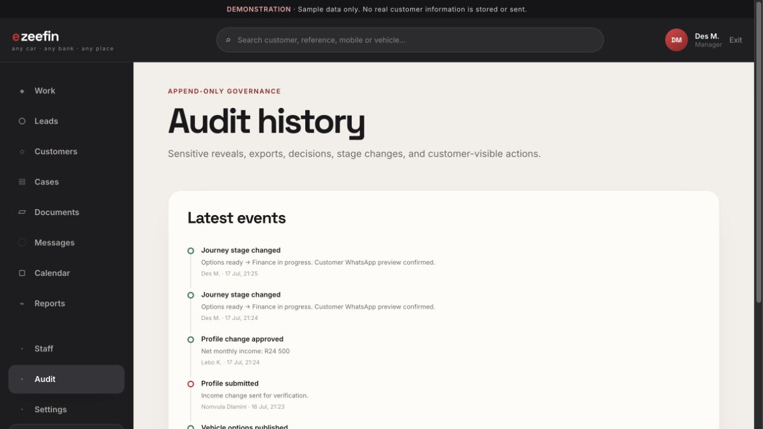
STAFF OPERATIONS
Audit history
/admin/audit
Provides a searchable record of sensitive reveals and mutations.
WHAT TO SHOW
01
Actor, time, reason and affected object
02
Before-and-after context where applicable
03
Profile, document, export and journey events
WHY IT MATTERS
Makes privileged access and operational changes accountable.
STAFF OPERATIONS
41

Slide 42
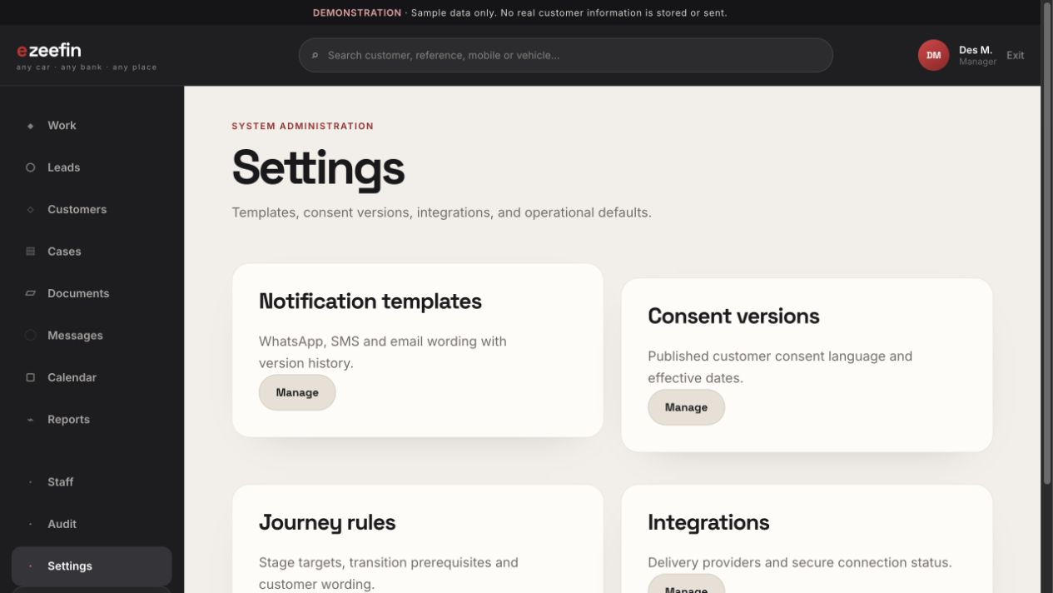
STAFF OPERATIONS
System settings
Centralizes notification templates, consent versions, journey rules and integrations.
/admin/settings
WHAT TO SHOW
01
Versioned customer wording
02
Operational defaults and transition rules
03
Integration status and administrative ownership
WHY IT MATTERS
Keeps high-impact configuration separate from day-to-day case work.
STAFF OPERATIONS
42

Slide 43
43
Every specialist works from the same accountable case.
Show validated transitions, profile snapshots, documents, vehicles, providers and audit history.
CASE WORKSPACE
CASE WORKSPACE
43

Slide 44
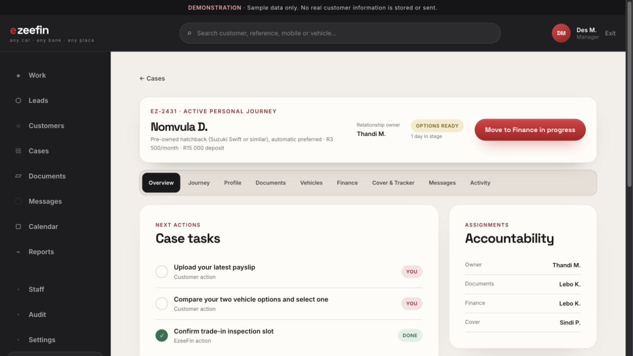
CASE WORKSPACE
Case overview
Shows the immediate operational state and accountability.
WHAT TO SHOW
01
Persistent case header and validated transition action
02
Tasks, documents and specialist assignments
03
Customer-visible next step and internal note area
WHY IT MATTERS
Keeps relationship ownership and operational ownership clear.
/admin/case/c1/overview
CASE WORKSPACE
44

Slide 45
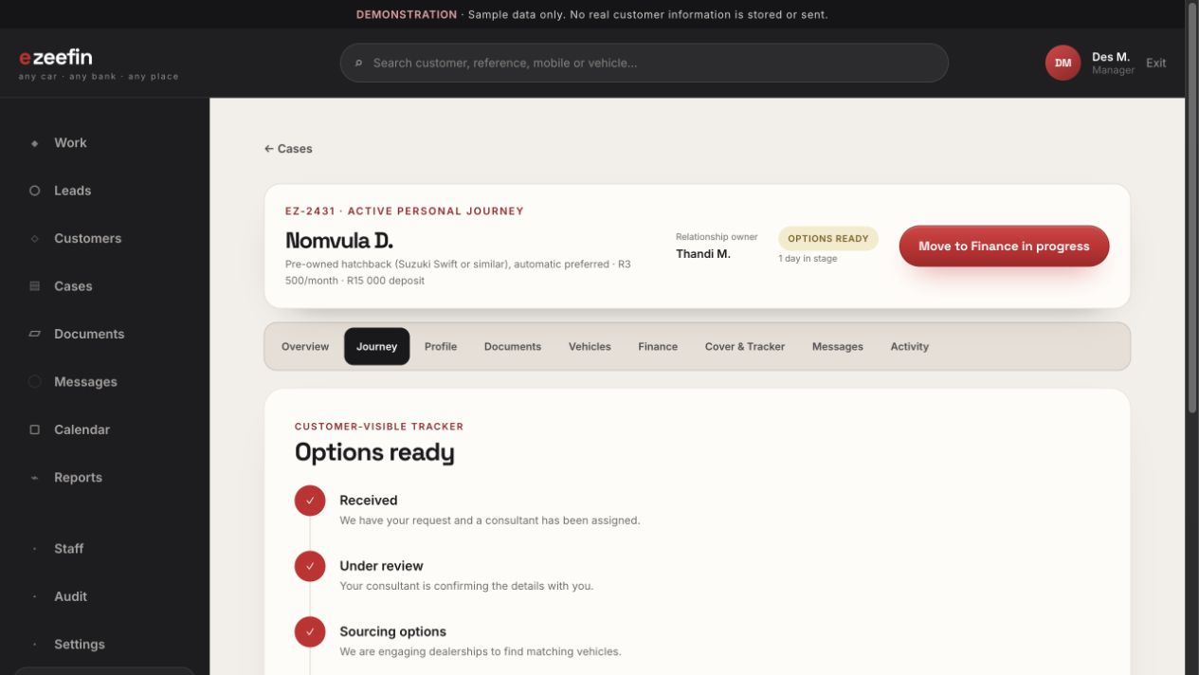
CASE WORKSPACE
Internal journey view
Relates internal progress to the curated customer-visible tracker.
WHAT TO SHOW
01
Current operational stage
02
Customer-safe journey stages
03
Validated transition with notification preview
WHY IT MATTERS
Prevents raw operational outcomes from leaking into the customer experience.
/admin/case/c1/journey
CASE WORKSPACE
45

Slide 46
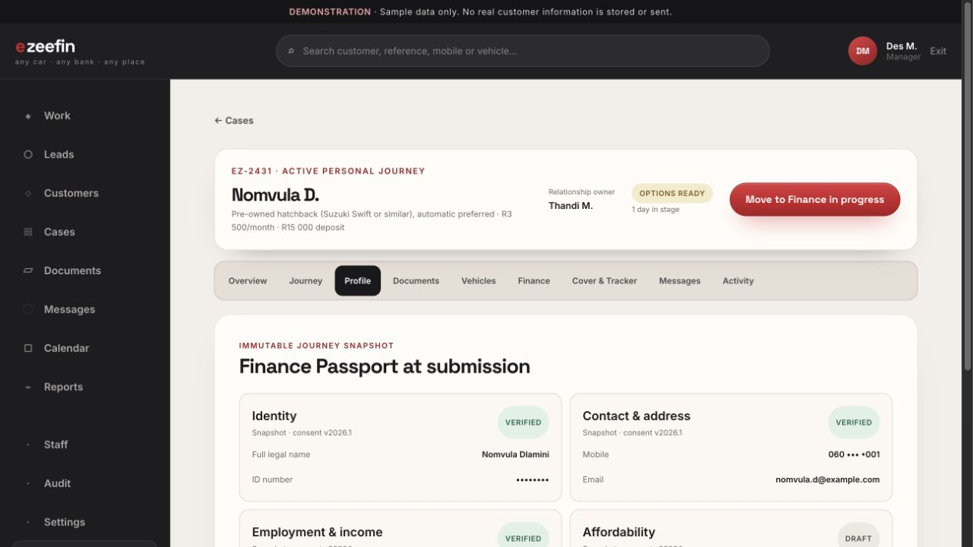
CASE WORKSPACE
Profile snapshot
Shows the immutable Finance Passport snapshot used when the journey was submitted.
WHAT TO SHOW
01
Snapshot date and consent version
02
Masked sensitive fields
03
Profile state independent of later account edits
WHY IT MATTERS
Preserves exactly what was relied on for each journey.
/admin/case/c1/profile
CASE WORKSPACE
46

Slide 47
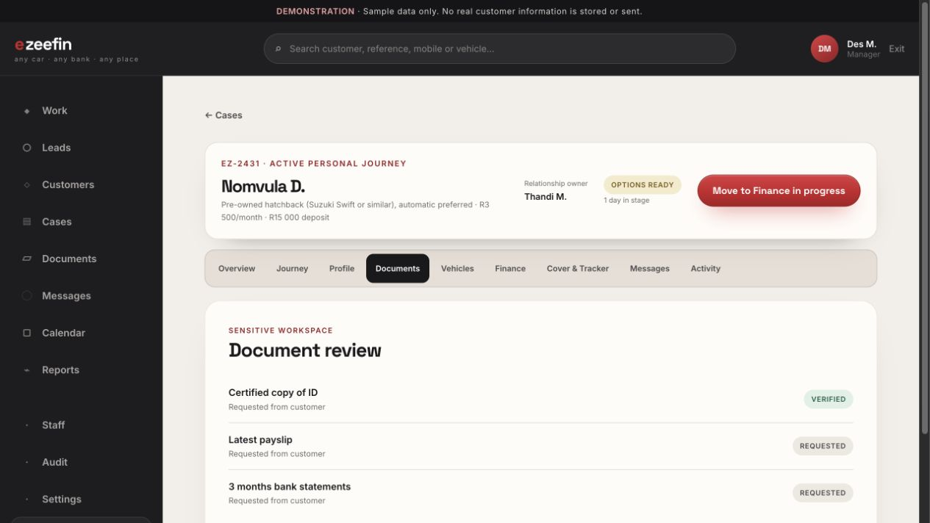
CASE WORKSPACE
Case documents
Requests, reviews and verifies journey-specific documents.
WHAT TO SHOW
01
Approved document types and freshness rules
02
Review, rejection and clarification actions
03
Internal review notes separated from customer reasons
WHY IT MATTERS
Creates a consistent, auditable document-review process.
/admin/case/c1/documents
CASE WORKSPACE
47

Slide 48
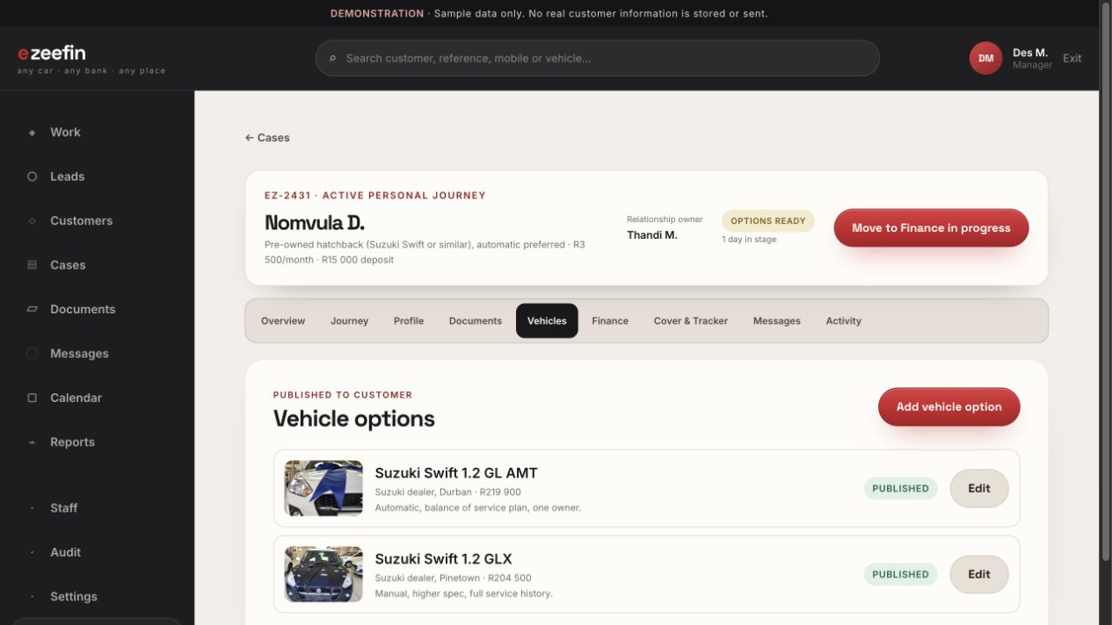
CASE WORKSPACE
Vehicle options
Creates, compares and publishes suitable vehicle options.
WHAT TO SHOW
01
Vehicle, dealership, mileage, price and estimate
02
Published versus internal information
03
Customer selection state
WHY IT MATTERS
Ensures only reviewed options and customer-safe notes are visible externally.
/admin/case/c1/vehicles
CASE WORKSPACE
48

Slide 49
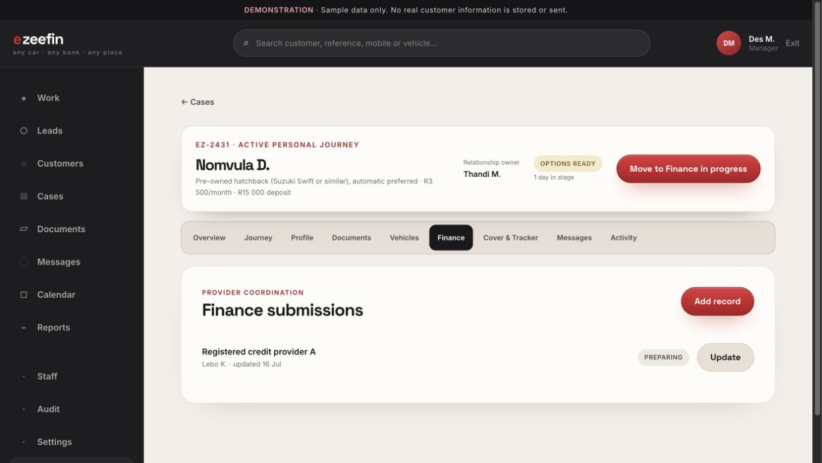
CASE WORKSPACE
Finance coordination
Tracks separate submissions to registered credit providers.
WHAT TO SHOW
01
Provider, owner, status and follow-up date
02
Internal information-required state
03
Safe customer-visible wording
WHY IT MATTERS
Keeps EzeeFin positioned as coordinator rather than credit approver.
/admin/case/c1/finance
CASE WORKSPACE
49

Slide 50
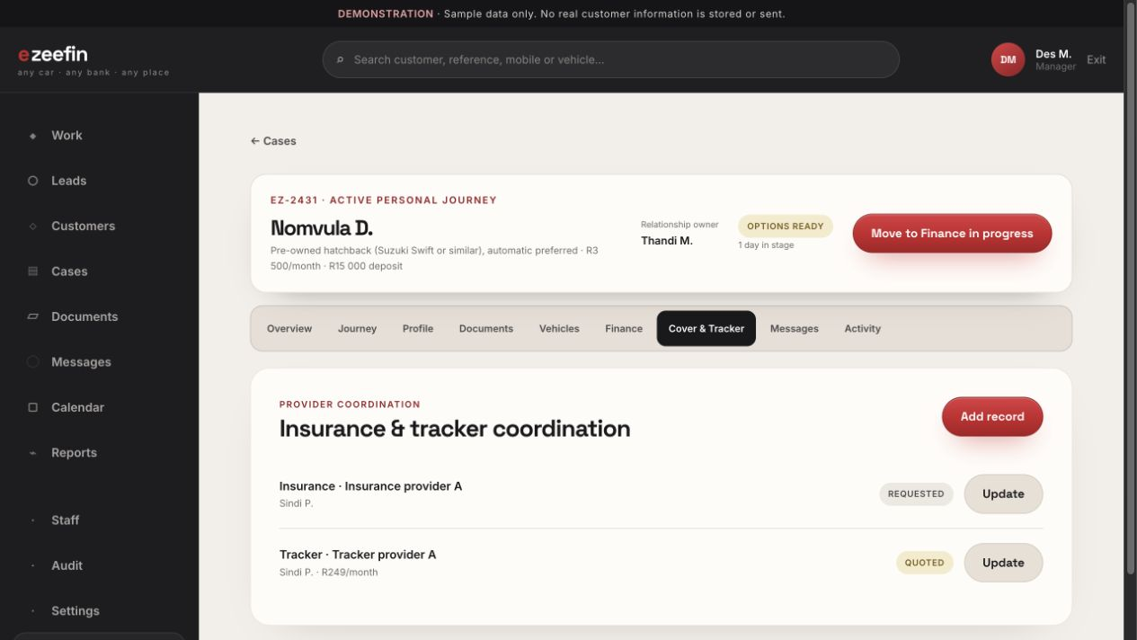
CASE WORKSPACE
Cover and tracker coordination
Tracks quotation requests, terms, expiry and selection.
WHAT TO SHOW
01
Separate insurance and tracker records
02
Provider ownership and quotation status
03
Monthly amount and expiry where applicable
WHY IT MATTERS
Keeps delivery-readiness work visible without implying underwriting.
/admin/case/c1/cover
CASE WORKSPACE
50

Slide 51
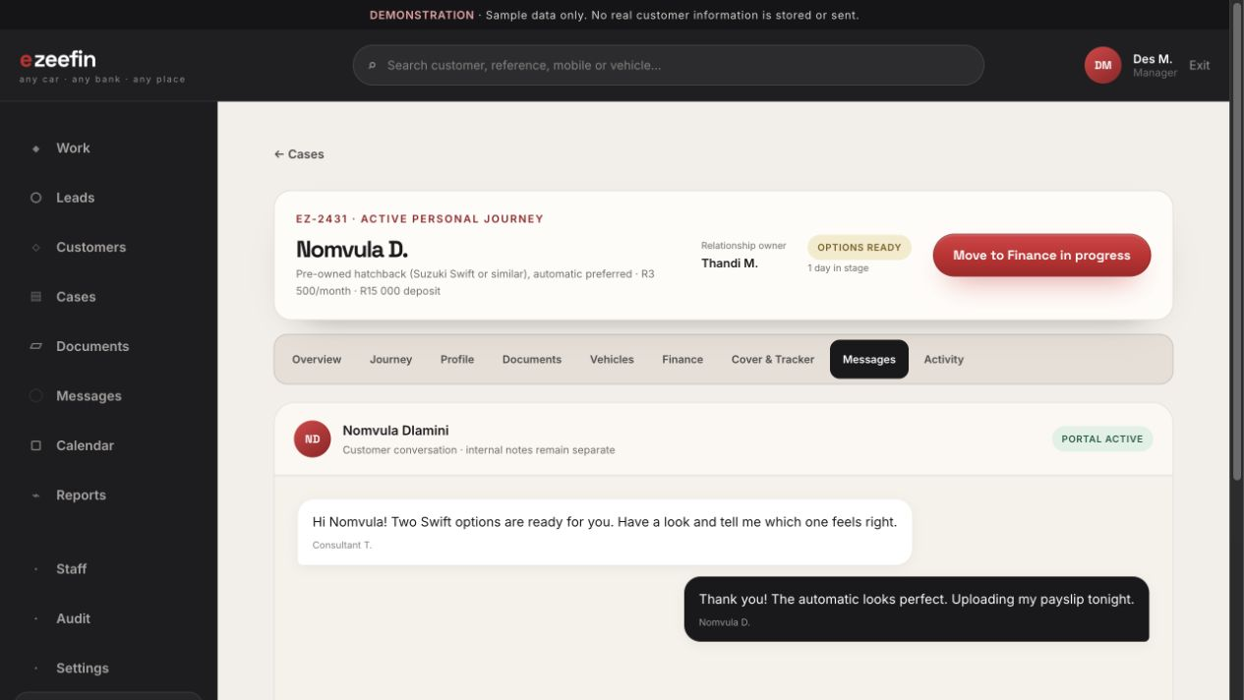
CASE WORKSPACE
Case messages
Manages the customer conversation inside the case context.
WHAT TO SHOW
01
Staff identity, unread and delivery state
02
Persistent composer and templates
03
Clear separation from internal notes
WHY IT MATTERS
Prevents operational notes from appearing in customer communication.
/admin/case/c1/messages
CASE WORKSPACE
51

Slide 52
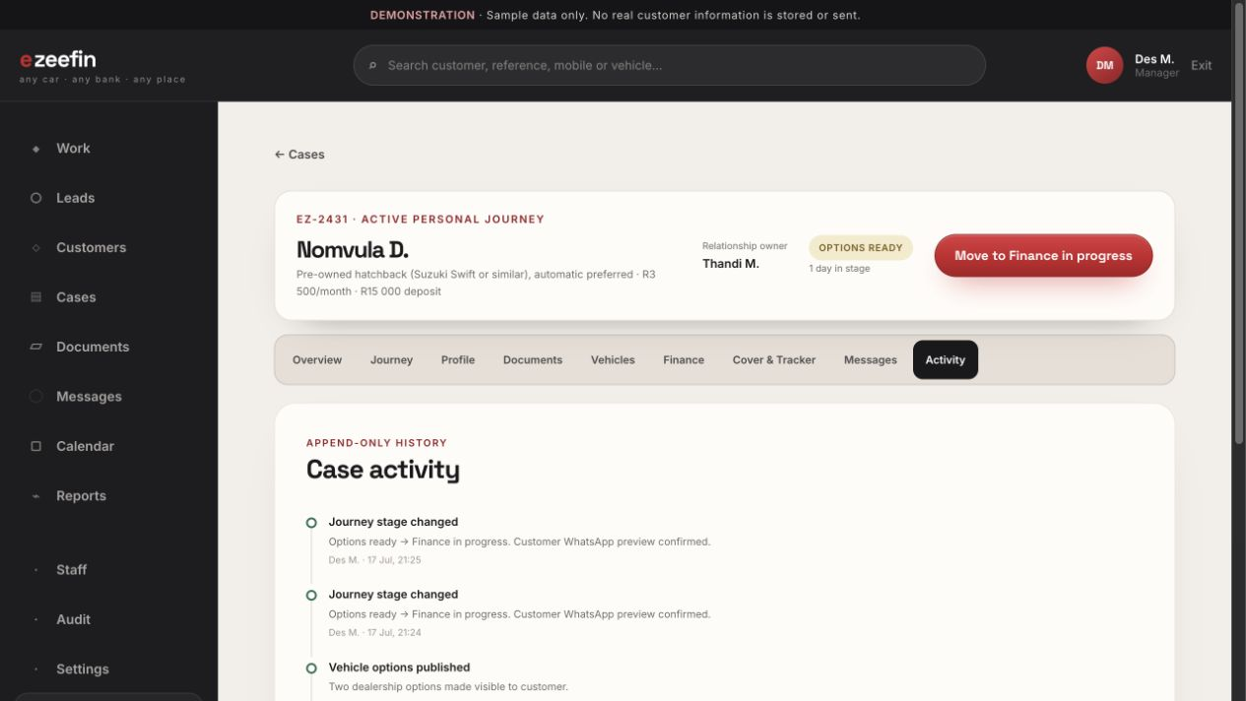
CASE WORKSPACE
Case activity
Shows a chronological, append-only record of important actions.
WHAT TO SHOW
01
Actor, action, subject and timestamp
02
Sensitive reveals and verification decisions
03
Journey transitions and notification events
WHY IT MATTERS
Supports accountability, investigation and compliance review.
/admin/case/c1/activity
CASE WORKSPACE
52

Slide 53
THE HANDOFF
The customer sees one calm journey.
The team sees everything needed to deliver it.
Finish the live demonstration by publishing a validated stage update in the case workspace, then return to the customer Journey page to show the synchronized result.
ezeefin.valosystems.co.za
53

