Slide 1


BACK-OFFICE PORTAL
Smarter inventory.
Stronger operations.
A guided demonstration of multi-site inventory, transfers, counts, assets, reporting, and audit evidence.
Prepared by Valo Systems
DEMO PRESENTATION | JULY 2026
Prepared by Valo Systems | Demonstration edition
01

Slide 2
THE OPERATING OUTCOME
One network. One operational view.
The portal connects daily work to a reliable record that management can explain.
01
02
03
See
Act
Trust
Stock, assets, sites, risks, and pending work in one role-aware view.
Receive, issue, adjust, transfer, count, and maintain assets through guided workflows.
Trace every posted balance to movements, approvals, references, actors, and times.
Simple enough for daily work. Structured enough for review.
Prepared by Valo Systems | Demonstration edition
02

Slide 3
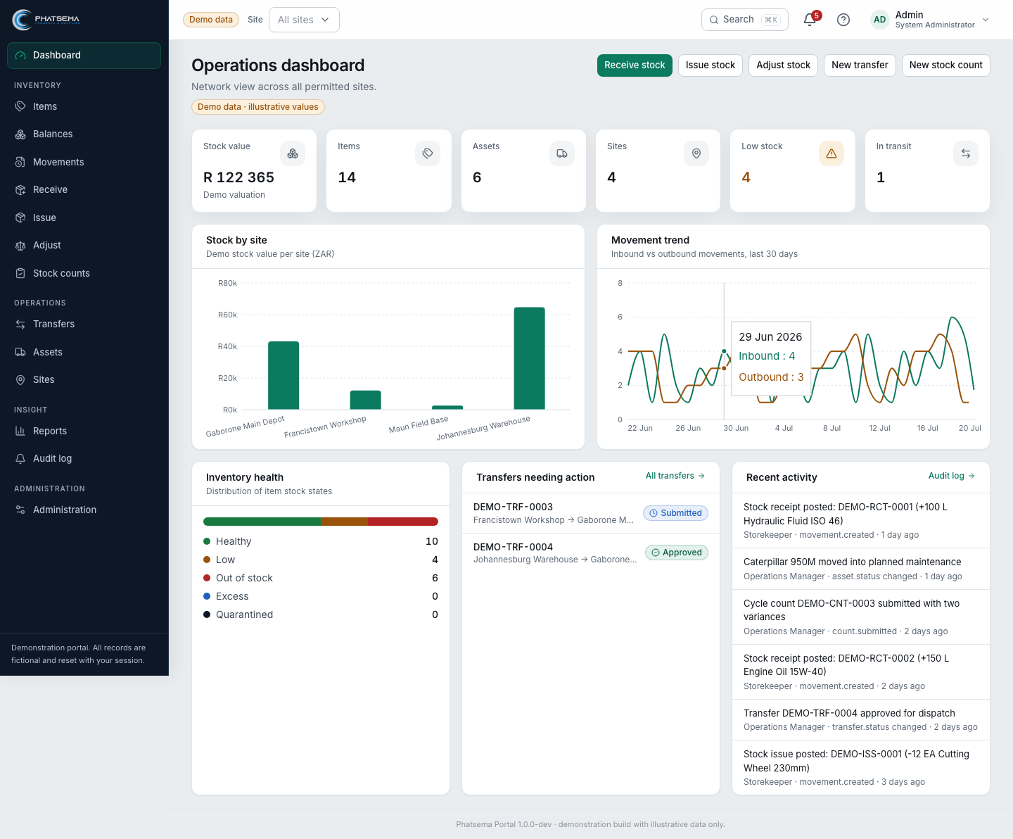
START WITH CONTEXT
The dashboard turns activity into attention
Review the network before opening detailed records.
Network health
Stock value, item health, sites, and in-transit work.
Action queues
Transfers needing attention and recent operational events.
Site scope
All-site or selected-site context follows user authority.
Demo value
R 122 365
Prepared by Valo Systems | Demonstration edition
03

Slide 4
INVENTORY TRUTH
Balances are outcomes, not editable totals
Every posted operation creates an immutable movement, and movements explain the balance.
Receive
Issue
Adjust
Transfer
Count
Inbound
Outbound
Correction
Custody
Assurance
IMMUTABLE MOVEMENT LEDGER
item • site • location • quantity • unit • reference • actor • time
DERIVED BALANCE
Prepared by Valo Systems | Demonstration edition
04

Slide 5
DAILY TRANSACTIONS
Receive, issue, and adjust with clear evidence
The correct workflow should represent what physically happened.
Receive
Issue
Adjust
Where did it arrive?
Where did it leave?
Why is correction valid?
Supplier or delivery reference
Item, unit, quantity
Inbound ledger movement
Recipient and purpose
Availability validation
Outbound ledger movement
Approved reason
Supporting reference
Reviewable correction
Control point: confirm site, location, item, unit, quantity, reason, and source evidence before posting.
Prepared by Valo Systems | Demonstration edition
05

Slide 6
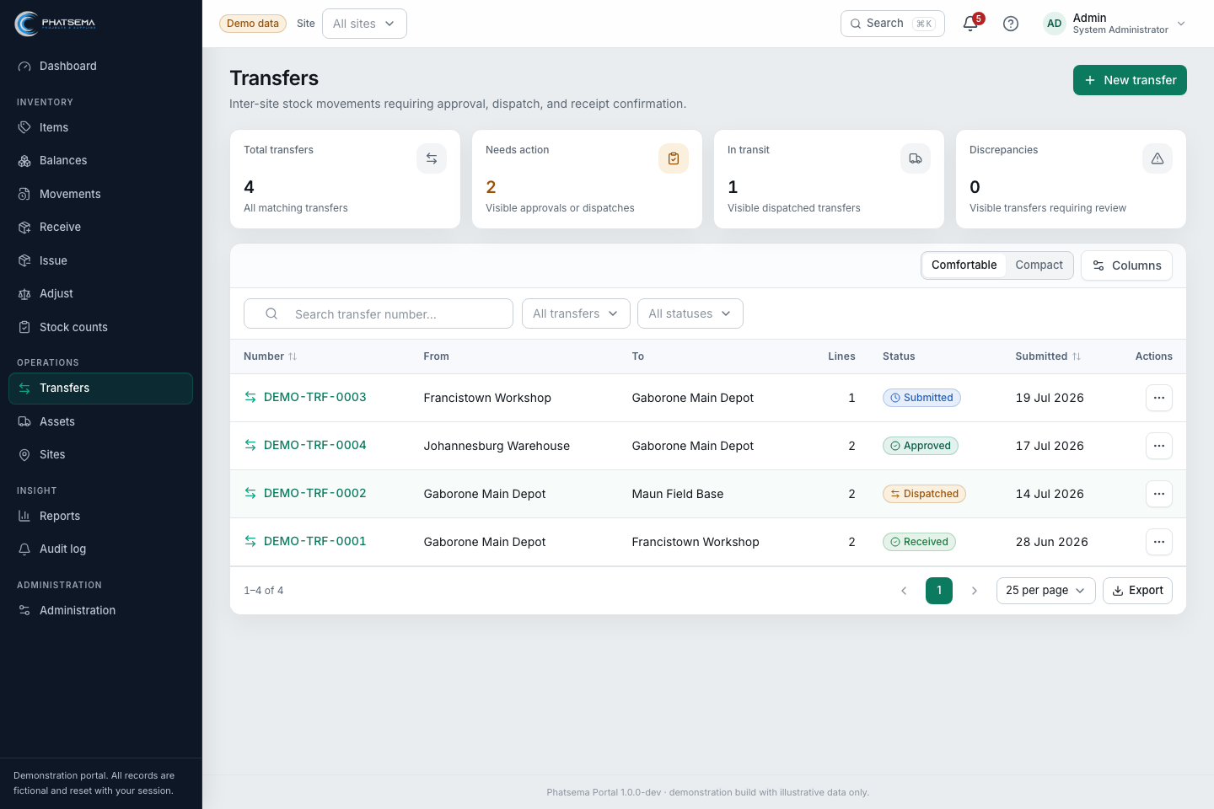
INTER-SITE CUSTODY
Transfers retain responsibility between locations
The source dispatches, the destination receives, and discrepancies remain visible.
Draft
Submitted
Approved
Dispatched
Received
Discrepancy = visible follow-up
Prepared by Valo Systems | Demonstration edition
06

Slide 7
INVENTORY ASSURANCE
Counts correct through review, not silent overwrite
Expected quantity, counted quantity, variance, decision, and posting stay connected.
Define
Capture
Submit
Review
Post
When variance needs attention
Active counts
Posted
With variance
Request a recount, approve with authority, or investigate before posting.
2
1
2
Posting creates authorised adjustment movements and completes the count evidence.
Prepared by Valo Systems | Demonstration edition
07

Slide 8
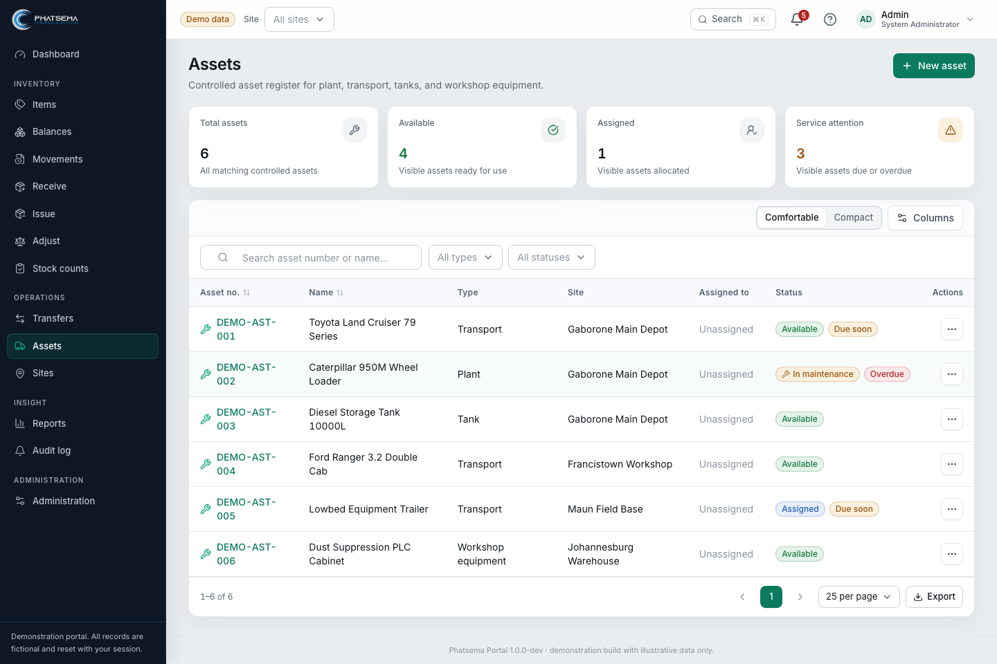
ACCOUNTABLE EQUIPMENT
Assets stay separate from quantity stock
Track identity, ownership, assignment, location, status, and lifecycle history.
Identity
Asset number, category, serial or identifying details.
Ownership
Company-owned, hired, and client-owned equipment.
Responsibility
Site, location, custodian, assignment, and current status.
Lifecycle
Availability, maintenance, unavailability, and retirement.
Prepared by Valo Systems | Demonstration edition
08

Slide 9
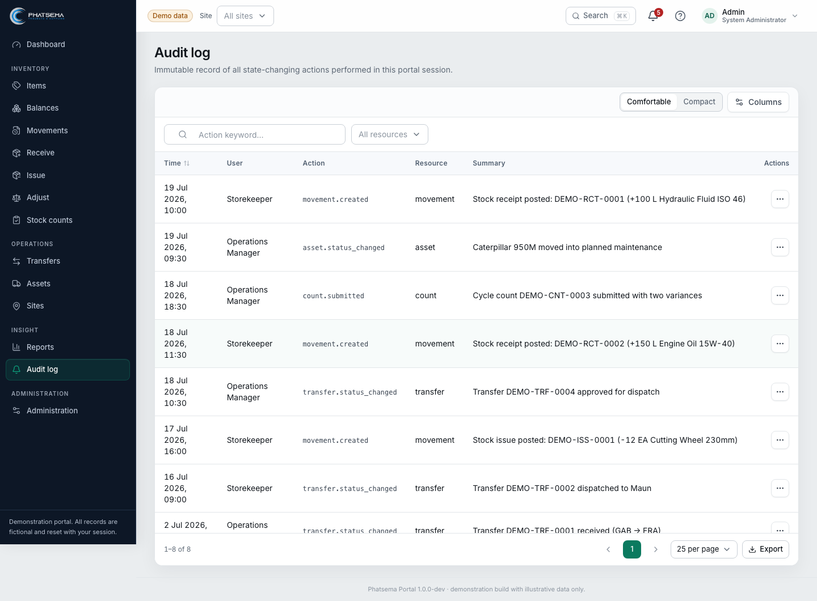
AUDIT READINESS
Evidence is created as work happens
Operational controls and audit records remain connected to the transaction.
Movement evidence
Item, site, quantity, unit, reference, actor, time
Workflow evidence
State history, approval, dispatch, receipt, variance
Access evidence
Role, site scope, user and profile changes
Privacy by design
No passwords, hashes, phone values, or biography contents
Prepared by Valo Systems | Demonstration edition
09

Slide 10
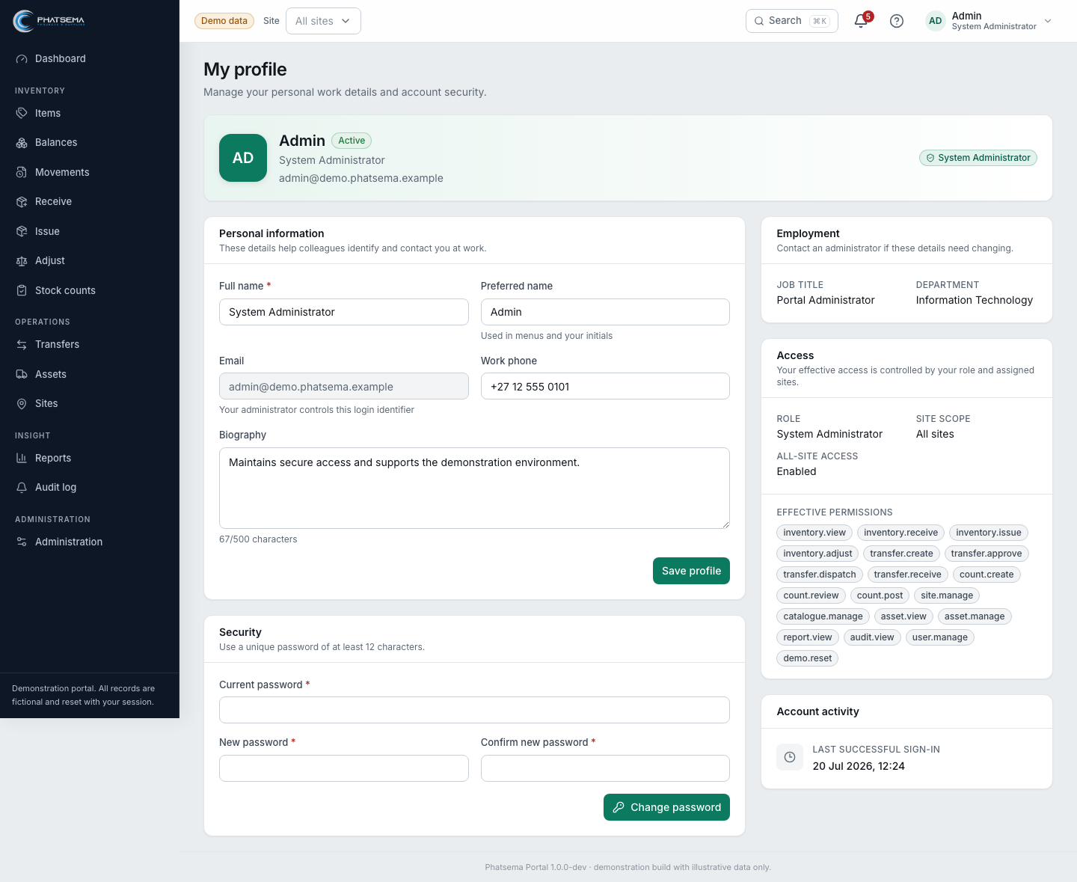
TRUST BOUNDARIES
People see and do only what their work requires
Permissions are role-aware, site-aware, and visible to the user.
System Administrator
Configuration, users, reset, audit
Operations Manager
All sites, approvals, dashboard, reports
Site Manager
Assigned site, counts, transfers, approvals
Storekeeper
Receiving, issues, transfers, counting
Executive Viewer
Read-only dashboard, reports, activity
Prepared by Valo Systems | Demonstration edition
10

Slide 11
GUIDED DEMO
A 25-minute route through the operating story
Use one connected scenario so every screen answers the question created by the previous screen.
01
Dashboard
02
Items
03
Receive / issue
Spot risk and pending work
Confirm identity and stock health
Create controlled movements
04
Transfer
05
Count
06
Audit
Move custody between sites
Review and post a variance
Trace the complete evidence
Prepared by Valo Systems | Demonstration edition
11

Slide 12

From demonstration to dependable operations
The next workshop should convert what the team validates into production decisions.
Confirm the operating model
Sites, locations, ownership, units, master-data responsibility
READY TO VALIDATE
Confirm control authority
Roles, segregation, thresholds, delegation, exceptions
Confirm production evidence
Opening balances, valuation, cutoff, retention, backups, auditor packs
Plan the launch
MariaDB persistence, migration, training, rehearsal, sign-off
phatsema.valosystems.co.za
Prepared by Valo Systems | Demonstration edition
12

