Slide 1
PV204
In-Memory Malware Analysis
Václav Lorenc
Principal Security Engineer, Here Technologies

Slide 2
Notes:
https://xkcd.com/1328/
What’s the real cause of all the security issues on laptops and desktops? This one ☺

Slide 3

Agenda
Motivation!
  No x86 assembly required
  No malware (de)obfuscation magic
How does an OS look “inside”?
  Processes and other data structures
  How the memory is organized
Common tools used for analysis
Searching for system “oddities”
  What are the important system indicators?
Real samples discussed and analyzed! (Labs)

Slide 4
Why memory analysis?
It’s fun!
Acquiring evidence for legal investigations
  It used to be different in the past
Technical simplification of reverse engineering
  No binary obfuscation present – the code has to run
Incident response activities
  Easy way how to learn more about the attackers
  Malicious binary may only be present in memory
  Fast: RAM is (usually) smaller than full hard-drive images

Slide 5
Notes:
https://xkcd.com/1353/
Or you could consider Spectre, which (in 2021) still has some related techniques and attacks and hasn’t been fully mitigated yet.

Slide 6
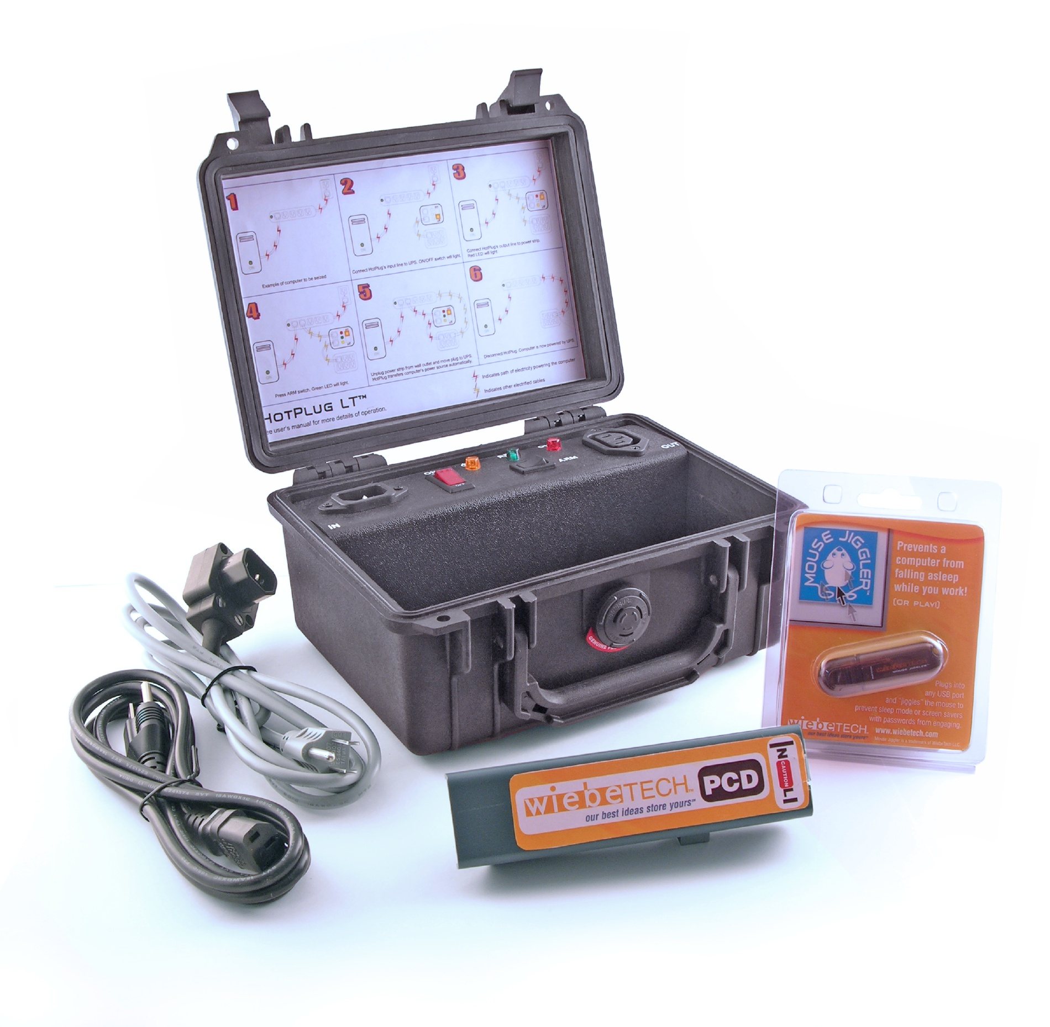
Notes:
Can anybody guess what’s this stuff for? It’s actually used for transportation of desktops/servers from their original location to a forensic lab somewhere else, without any power interruption. So that it can preserve the RAM content.

Slide 7
Challenges in Reverse Engineering (RE)
Assembly language (for multiple platforms)
  Along with undocumented instructions (or behavior)
Anti-debugging tricks
  Exceptions, interrupts, PE manipulations, time checking, ...
Anti-VM tricks
  Uncommon behavior of known instructions
  Registry detections, HW detections
Code obfuscation/packing
  The most challenging to overcome, mostly

Slide 8
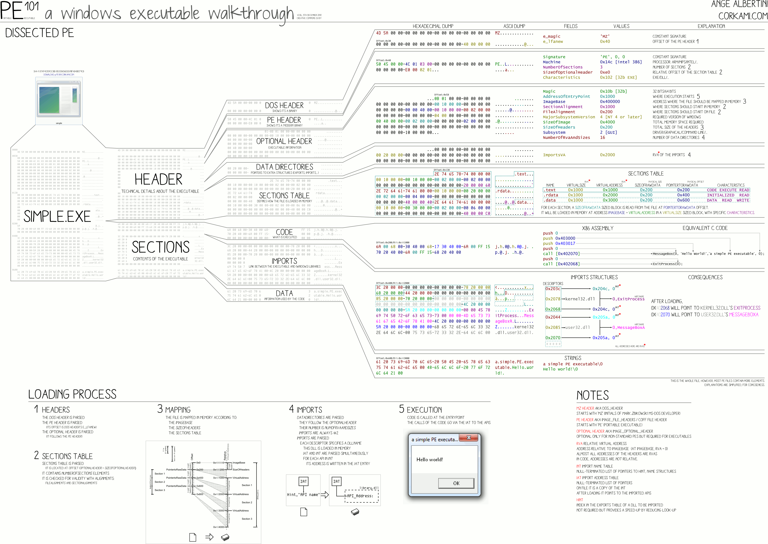
PE File Format

Slide 9

Memory analysis
‘cause reverse engineering ninjas are busy

Slide 10
x86/x64 Memory organization
Physical memory
  RAM; what we really have installed
Virtual memory
  Separation of logical process memory from the physical
  Logical address space > physical (e.g., swap)
  Address space shared by several processes, yet separated
Paging vs. Segmentation
  Possible memory organization approaches
Notes:
A note about aarch64 could be added later in the slides.

Slide 11
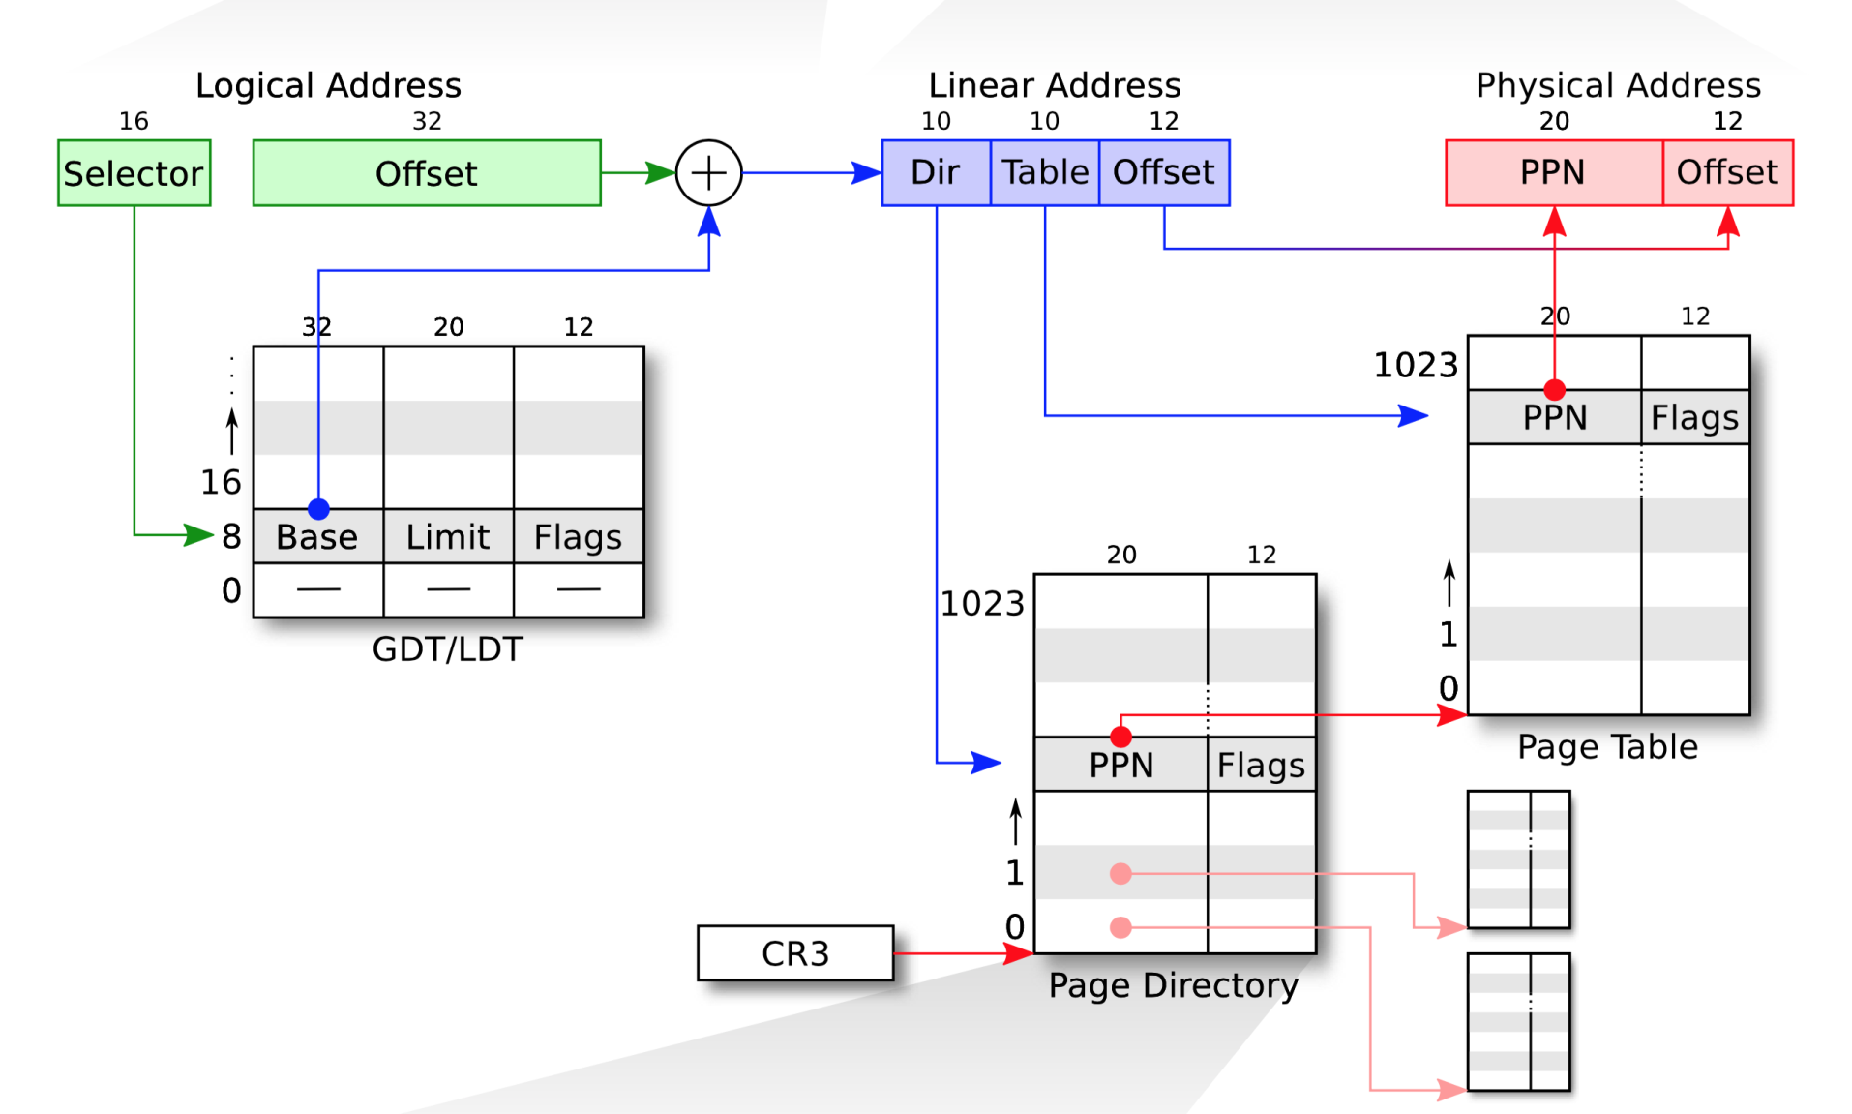
Segmentation
Paging
Physical Address
Notes:
Page sizes: 4 kB, 2 MB, 1 GB (and proposed 512 GB)

Slide 12

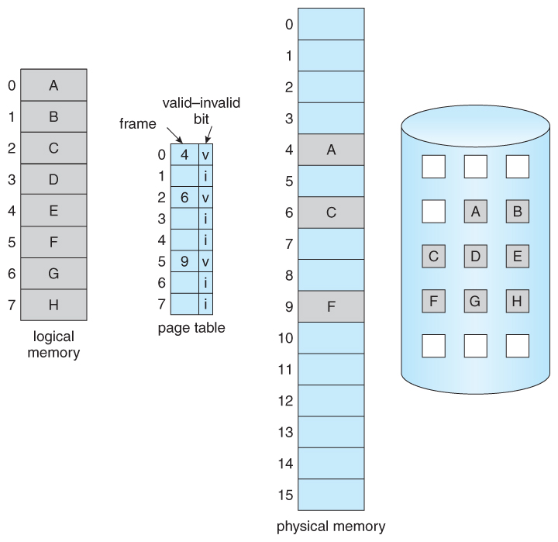
Notes:
https://minnie.tuhs.org/CompArch/Lectures/week06.html
In other worlds, various processes are sharing the physical memory.

Slide 13
Logical vs. Physical

Slide 14
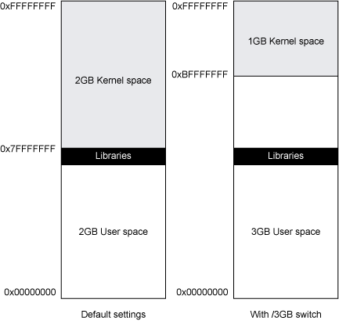
Win32 Address Space

Slide 15
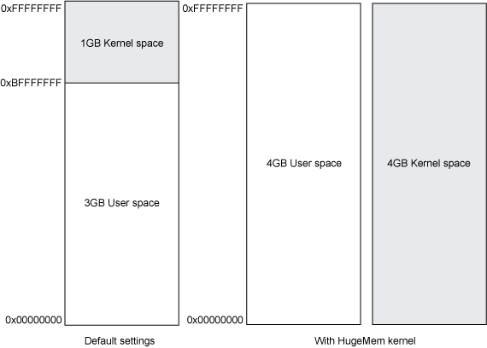
Linux Address Space

Slide 16
Notes:
https://xkcd.com/138/

Slide 17
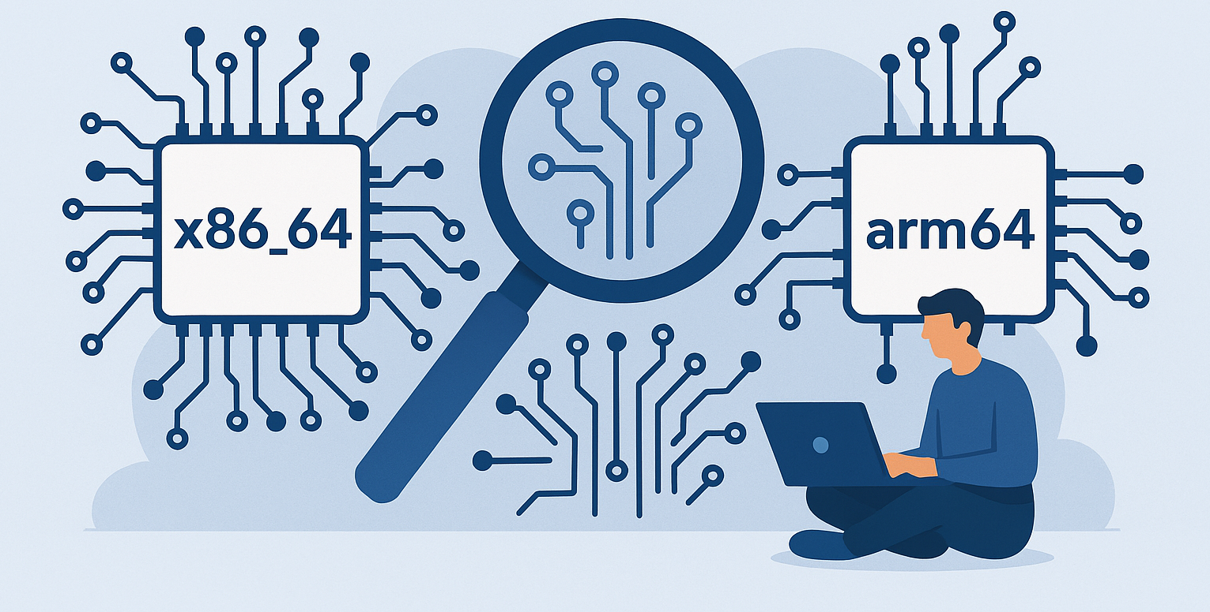

Slide 18
ARM64 Memory organization
Physical memory (RAM)
Paging
4-level page tables
No segmentation available
  Probably the major difference from x86_64
  Not needed by modern applications anyway
Notes:
A note about aarch64 could be added later. In general, it looks somewhat similar to x86_64, there’s a TLB, there are pages (4k or 64k), and multiple levels of page tables (up to XY, I don’t remember now).

Slide 19
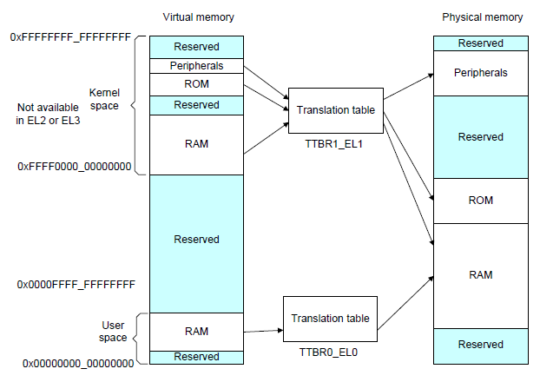
ARM64 Memory organization
Notes:
A note about aarch64 could be added later. In general, it looks somewhat similar to x86_64, there’s a TLB, there are pages (4k or 2MB and 1 GB), and multiple levels (4-level page tables) of page tables

Slide 20

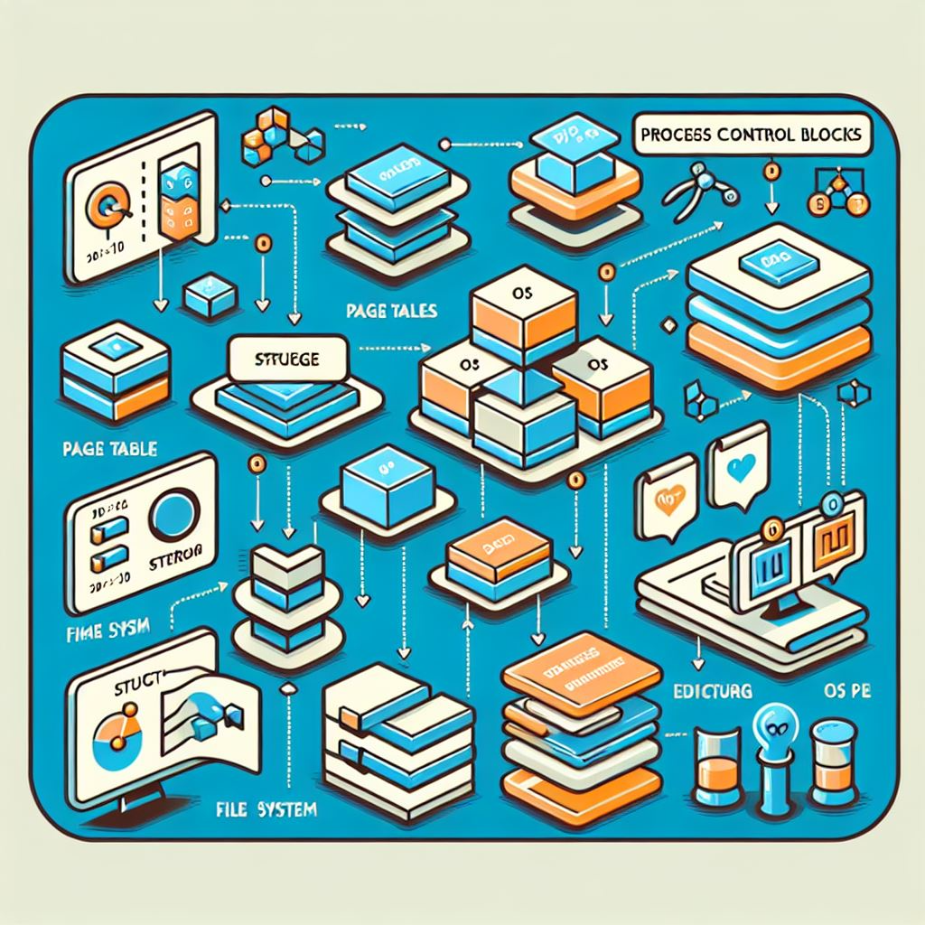
Operating System
Data structures

Slide 21
Operating System Data Structures
How the OS knows about processes, files, …?
  A lot of ‘metadata’ for important data
  Based on C/C++ data structures (see MSDN documentation)
(Double-)linked list
  Another common data structure (not only in OS)
  Method for implementing lists in computer memory
Direct Kernel Object Manipulation (DKOM)
  Used for manipulating the structures to hide malicious stuff

Slide 22
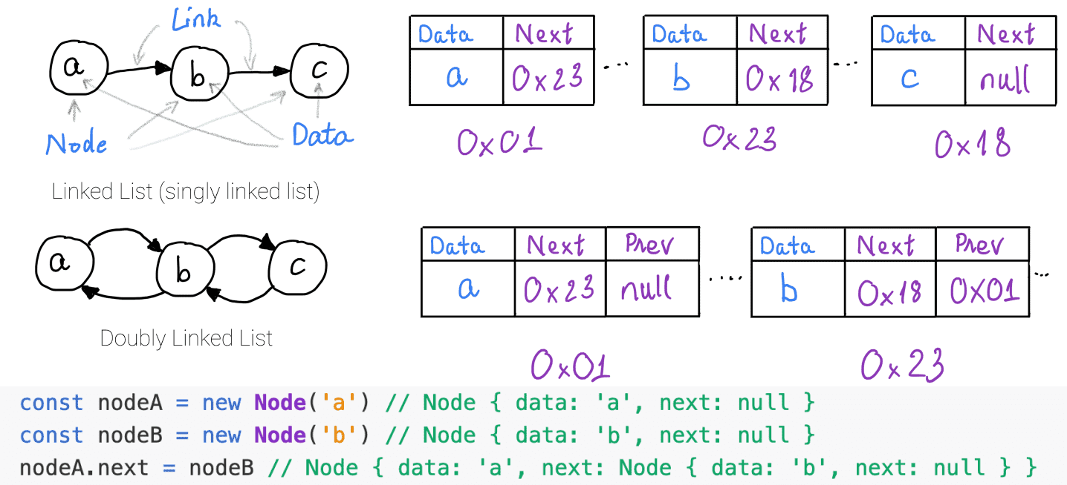
(Double) Linked Lists

Slide 23
DKOM
Direct Kernel Object Manipulation
Dozens of various (double-)linked lists in Windows
  Maintained by kernel
  Processes, threads, opened files, memory allocations, …
DKOM is used by rootkits
  Hiding from the sight of the user
Rootkit paradox
  Rootkits need to run on the system
  … and need to remain hidden at the same time
Memory analysis can help to discover DKOM
  Anti-analysis techniques are known as well
Notes:
http://www.blackhat.com/presentations/bh-usa-04/bh-us-04-butler/bh-us-04-butler.pdf

Slide 24
Interesting OS Structures
Suspicious Memory Pages
Processes
Threads
Sockets (Connections)
Handles (Files)
Recently executed binaries
Modules/Libraries
Mutexes
LSA (Local Security Authority)
Registry
…
Files
Caches (DNS, Prefetch, …)

Slide 25
Memory Pages
Various ‘flags’
  Read/write/executable pages
  Helping OS to organize memory efficiently
Executable + Writable pages
  Why is it bad?
Process Injection Technique(s)
  Allocating a memory that can be modified (unpacked, decoded, decrypted) and executed.
  Used by legitimate processes too (Windows OLE)

Slide 26
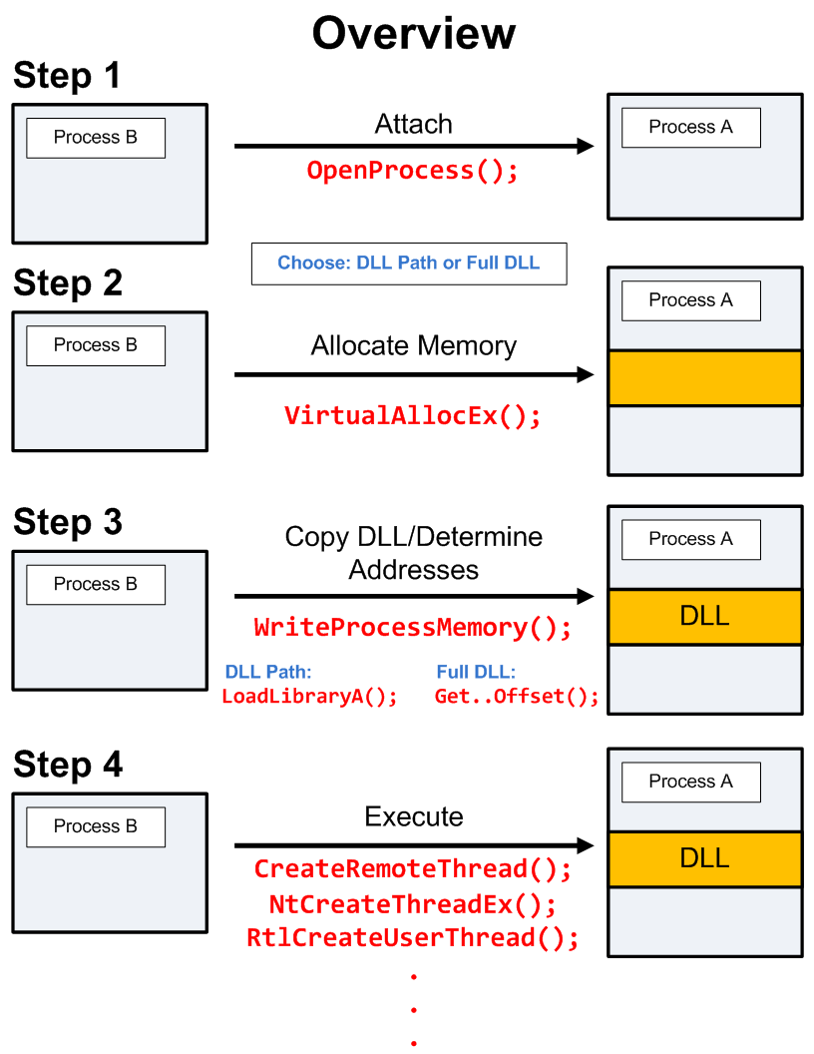
DLL/Process Injection
So that Internet Explorer behaves like a malicious process…

Slide 27
Notes:
https://www.endgame.com/blog/technical-blog/ten-process-injection-techniques-technical-survey-common-and-trending-process

Slide 28

And now something completely
PRACTICAL

Slide 29
Notes:
https://xkcd.com/1197/
The joke is from 2013, but it’s still pretty good and accurate, I am afraid. There’s no extra meaning of this joke right here, it’s just to give you a short break and relax a bit.

Slide 30
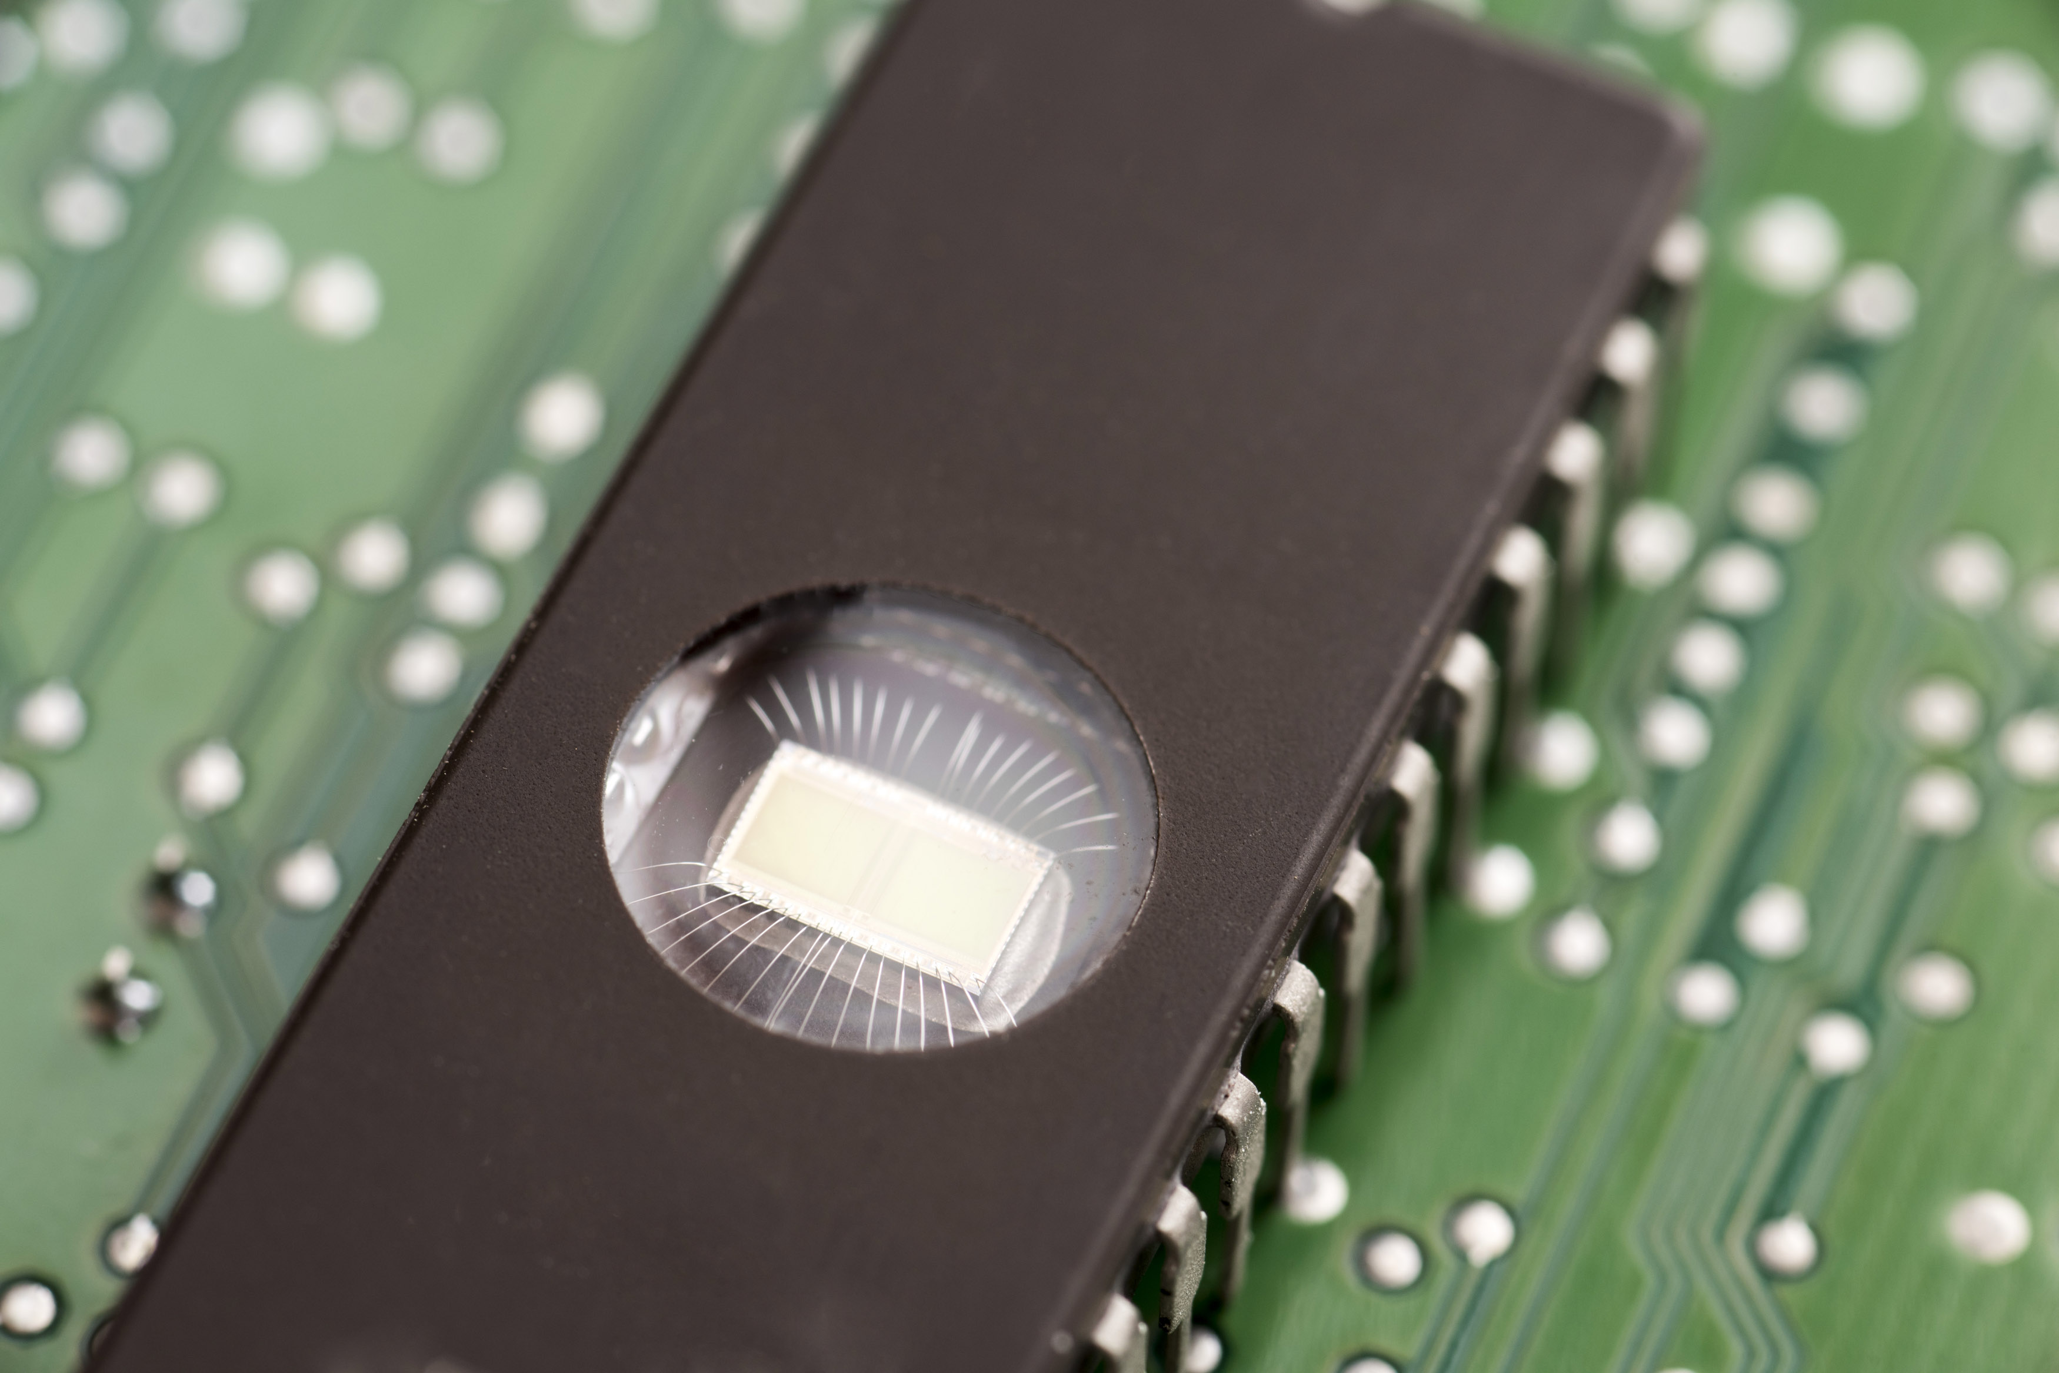
Memory Acquisition
Phase #1

Slide 31
Memory (re)sources
Live RAM
  The most common source for analysis
  Easier to obtain from virtualized hosts
Paging file/Swap
  Used by operating systems to allocate more memory then available RAM
Hibernation file
Memory crash dumps
  Limited analysis options

Slide 32
Memory Acquisition
VM?
Yes
Memory Dump
Snapshot
Clone
No
Running?
No
Hibernation File
Page File (Swap)
Crash Dumps
Yes
Got root?
Dumping locally
Remote access?
Cost / Benefits
Tool Footprint
Yes
No
FireWire
PCI Probes

Slide 33
Memory Acquisition
Virtual Machines
  VMWare, VirtualBox, Qemu, …
Directly from the system!
  if we have permissions to do that
  windd, fastdump, dumpit, memorize, winpmem
  Or we can hibernate the system (hiberfil.sys)
Remotely
  Encase Enterprise, Mandiant Intelligent Response, Access Data FTK

Slide 34
Memory Acquisition
Common collection issues
  Unsupported OS (Linux, MacOS; 32bit/64bit)
  Swap (portions of memory on drive)
  Protected host memory
    Encryption, OS-level protections
  Malware not running inside a virtual machine

Slide 35
Memory Acquisition
Local memory acquisition
  Unless you have plenty of money, try to get root/admin access to the host
  Better to acquire to external storage (USB, network)
  The lower tool’s memory footprint, the better
  If you run malware in a VM, better have less RAM
    Faster analysis
    Configure no swap for the system
    However: malware can check for the available memory

Slide 36
Memory Acquisition
Remote memory acquisition
  Very useful for fast Incident Response
  Requires enterprise licenses for the commercial tools
  Acquisition is done over network
  Agents already in memory, no extra memory demands
  Modern EDR/XDR solutions support this too

Slide 37

Memory Analysis
Phase #2

Slide 38
Memory Analysis Tools
FireEye Redline
  Free, available for Windows
HBGary/GoSecure Responder Pro
  Community Edition used to be available
Volatility Framework
  Open source, no GUI

Slide 39
FireEye Redline
Free tool for Incident Response
  Not open-source, though
  .NET executable (runs only under Windows)
  Support OS X and Linux artifacts too
Nice and simple user interface
  Very nice analysis workflow
  Perfect for searching for string information
  Rates the level of suspiciousness over processes
Sad things
  Memory analysis not reliable, process rating as well
Notes:
Support for OS X and Linux memory artifacts was added in 2020, so it’s rather new.

Slide 40
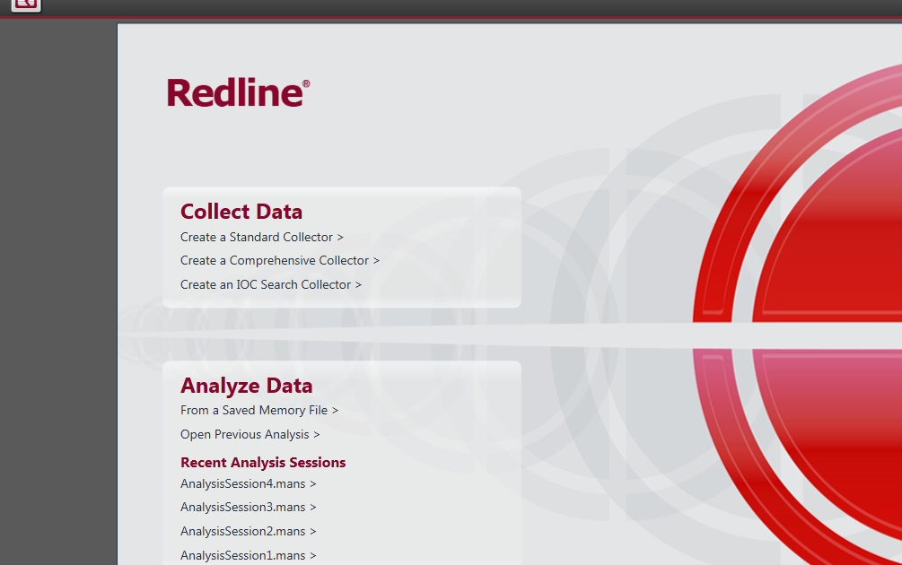
Redline: Start

Slide 41
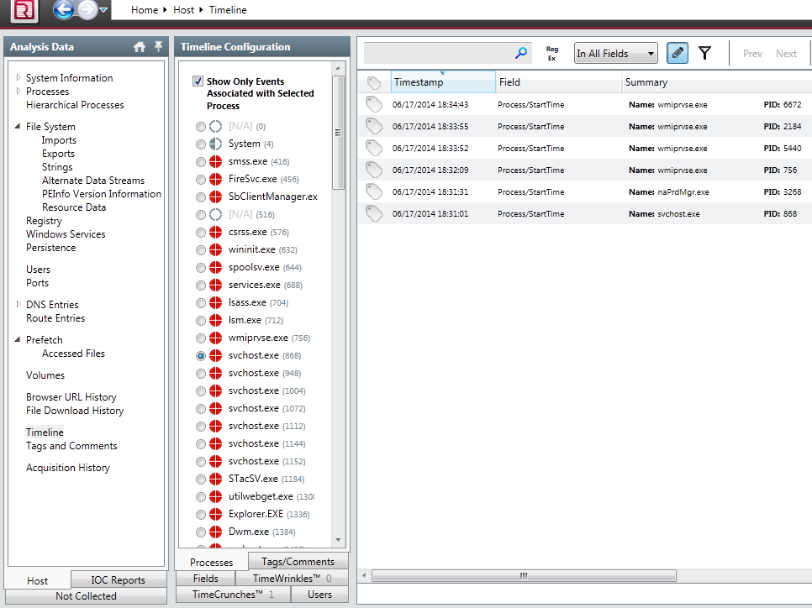
Redline: Timeline

Slide 42
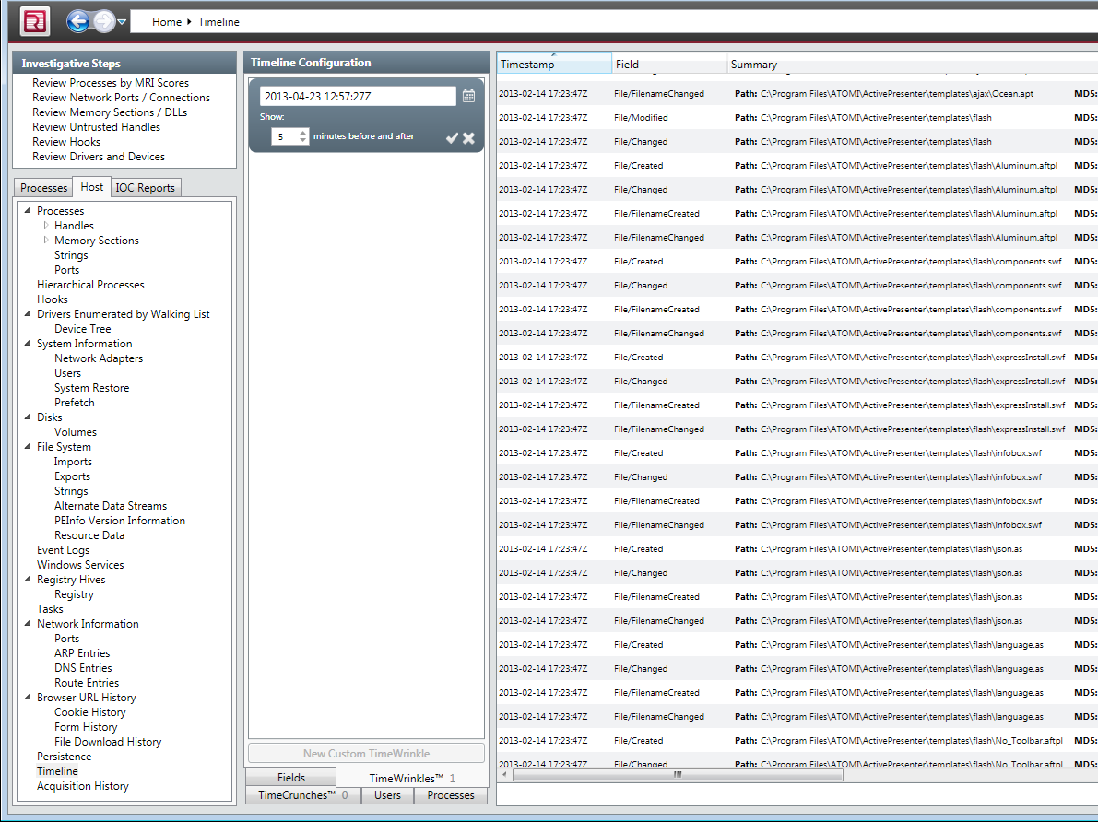
Redline: Time Wrinkles

Slide 43
HBGary Responder (Pro/CE)
Professional Tool
  Very expensive
  Yet not very well maintained in the last few years
Windows only
  .NET written, supports only Windows images
‘Killer’ features
  Digital DNA
    automatic rating of suspicious processes
  Visual ‘Canvas’ debugger
Supports the analysis of (unpacked) binaries
Replaced with CounterTack Responder Pro

Slide 44
HBGary Responder Pro -- DDNA
Examples of the ‘reasoning’ behind DDNA
  Does the process communicate over TCP/IP?
  Does it manipulate with registry?
  Did the analysis reveal any known bad stuff (strings, IPs, mutexes?)
  Does the process access any other process in the system?
  Does it access some system-critical process?
  Did the analysis find any evidence of obfuscation?
Notes:
Obsolete and unavailable at for a long time, but it had interesting features – and there’s a professional alternative already: https://www.gosecure.net/responder-pro
https://cdn2.hubspot.net/hubfs/150964/CounterTack_DDNA_SCMagazine_030117-1.pdf?t=1495723489966&__hstc=&__hssc=&hsCtaTracking=18aabc2a-88fc-46f2-9de8-4de89e22de86%7Cb02adedf-d309-4687-870d-eee1b1675455

Slide 45
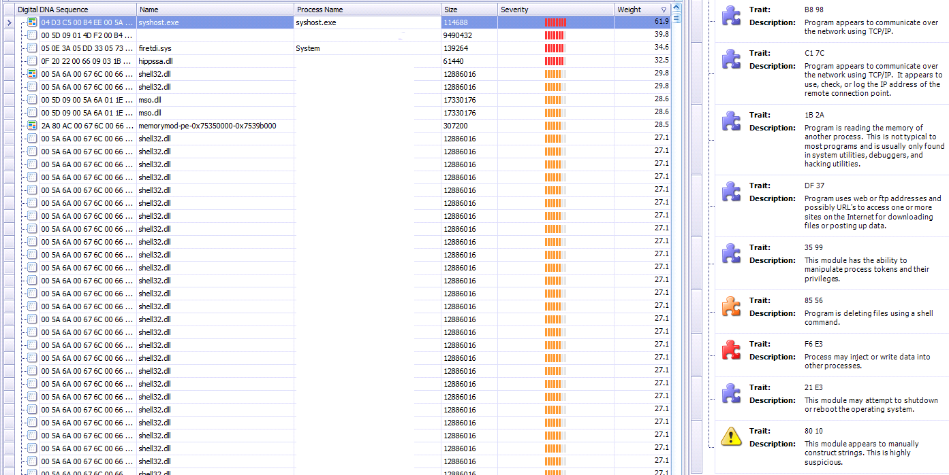
Responder Pro: DDNA

Slide 46
Responder Pro: DDNA

Slide 47
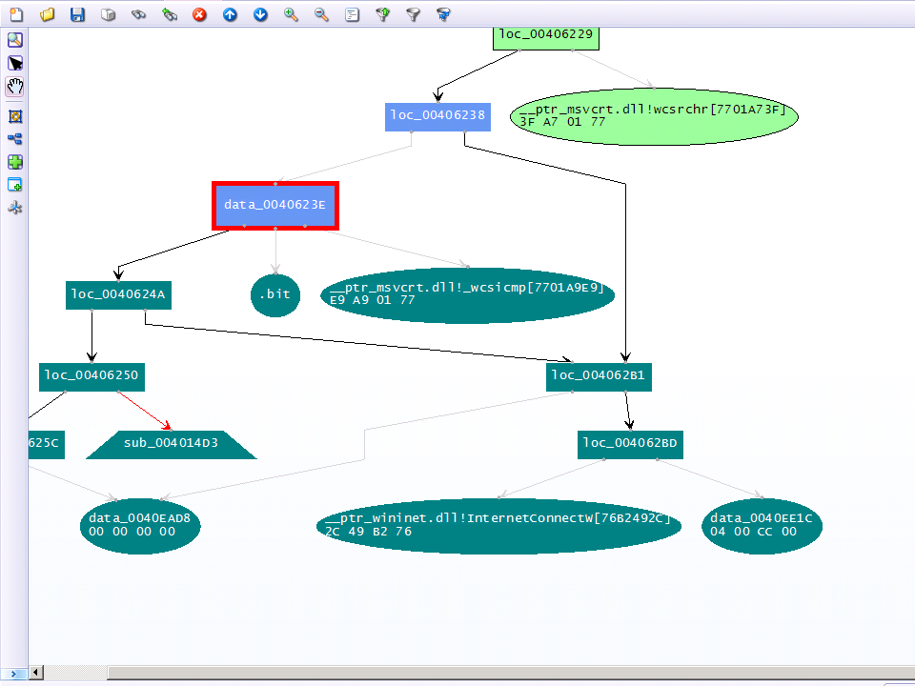
Responder Pro: Canvas

Slide 48
Volatility Framework
Open-source tool
  GPL licensed
Written in Python
  Available for variety of platforms (Linux, Windows, Mac OS)
  Can be automated; many contributed plugins
Supports analysis of memory dumps from various OSs
  Windows, Linux, MacOS, Android
  Both 32-bit and 64-bit versions
Command-line driven
Two (experimental) web GUIs

Slide 49
Additional Important Tools
Strings
  Both *nix and Windows
  Extracts strings information from the file
  Can be used in cooperation with Volatility/Rekall
  Beware of text encoding! (ascii, utf-8, …)

Slide 50
Additional Important Tools
Foremost
  Forensic tool
  Can extract various data files from an image (or process)
    Images, executables, documents, …

Slide 51
Forensic analysis of RAM?
Are there any benefits?
Collecting forensic evidence
  Executable images
  PDF/Doc documents
    Possible origin of the infection?
  Images
  URLs
Getting approximate timeline
  Works better on servers (always online, higher uptime, way more RAM)

Slide 52
What to search for in Operating System?
Command & Control (C2) communication
Hidden processes
Process/DLL injection evidence
Non-standard/infamous binaries/mutexes
Open sockets and files
Registry records
Command-line history
Encryption keys!

Slide 53
Known Bad Mutexes
Conficker: .*-7 and .*-99
Sality.AA: Op1mutx9
Flystud.??: Hacker.com.cn_MUTEX
NetSky: 'D'r'o'p'p'e'd'S'k'y'N'e't'
Sality.W: u_joker_v3.06
Poison Ivy: )!VoqA.I4 (and 10 thousand others)
Koobface: 35fsdfsdfgfd5339
Notes:
http://hexacorn.com/examples/2014-12-24_santas_bag_of_mutants.txt

Slide 54
Known Good Processes/Locations
Process Name | Expected Path
lsass.exe | \windows\system32
services.exe | \windows\system32
csrss.exe | \windows\system32
explorer.exe | \windows
spoolsv.exe | \windows\system32
smss.exe | \windows\system32
svchost.exe | \windows\system32
iexplore.exe | \program files \program files (x86)
winlogon.exe | \windows\system32

Slide 55
Memory tracing
Single process memory focus
Combined emulation & instrumentation
  Better tracking of memory changes (code, data)
  Detailed execution tracing
  Usually with API
Open-source tools available
  Intel PIN
  Frida
  DynamoRIO
  Qiling
Notes:
It’s usually not about snapshotting the memory (or a single memory snapshot), but about tracking changes, tracing code execution, and instrumenting the emulator (or the code) what to do next.

Slide 56
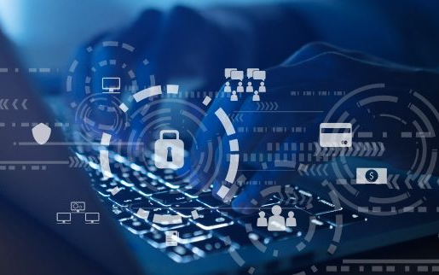
Operational security
Staying safe

Slide 57
Operational Security (OpSec)
Basics of OpSec
  “Think before you act” mentality
  Limited information sharing
Specifics of memory analysis
  You can often upload acquired executables to VirusTotal
    MD5/SHA1 of the dump is different from the executable
    This doesn’t apply for documents/HTML pages!
  However, incomplete binaries still can infect your system!
    Running in VM or other OS is recommended

Slide 58
Recommended Analysis Process
Use Internet! (Google, VirusTotal, …)
Make notes!
  What OS is being analyzed? (imageinfo)
  Network connections? (+ whois records, …)
  Processes (hidden, odd, non-standard; timestamps, …)
  Mutexes (+ files open)
  Dump processes when needed (OpSec!)
  Strings (URIs, C-like strings %s %d, domains, …)
Summarize your findings in final report

Slide 59
More information
Web pages of this course
  https://dior.ics.muni.cz/~valor/pv204
Additional resources
  Public memory images for analysis
  Reverse Engineering for Beginners (amazing PDF doc)
  REMnux: All you need to start with RE
  ContagioDump blog (for additional malware samples)
  Malware Traffic Analysis (both traffic & samples)

Slide 60

Answers & Questions
Thank you for your attention.

Slide 61

Lab

Slide 62
Lab Requirements
Oracle VM VirtualBox
  And enough space on your hard drive (12 GB at least)
Volatility Framework
  Version 2 (version 3 is available in the VM too)
Unix tools
  strings, foremost
Your favorite text editor for notes
Voluntary:
  Javascript/PDF analysis tools

Slide 63
Recommended Analysis Process
Use Internet! (Google, VirusTotal, …)
Make notes!
  What OS is being analyzed?
  Network connections? (+ whois records, …)
  Processes (hidden, odd, non-standard; timestamps, …)
  Mutexes (+ files open)
  Strings (URIs, C-like strings %s %d, domains, …)
  …
Summarize your findings in final report

Slide 64
Volatility2 Framework – cheat sheet
psxview (search for hidden processes)
apihooks
driverscan
ssdt / driverirp / idt
connections / connscan (WinXP, active network connections)
netscan (Win7, opened network sockets and connections)
pslist / psscan (process listing from WinAPI vs. EPROCESS blocks)
malfind / ldrmodules (code injection + dump / DLL detection)
hivelist (registry lookup and parsing) / hashdump
handles / dlllist / filescan (filelist / DLL files / FILE_OBJECT handles)
cmdscan / consoles (cmd.exe history / console buffer)
shimcache (application compatibility info)
memdump / procmemdump / procexedump

Slide 65
Analysis: xp-infected.vmem
Recommended tools
  Volatility (or Redline)
Objectives:
  Get familiar with memory of your first infected system

Slide 66
Analysis: win7_x64.vmem
Recommended tools
  Volatility (or Redline)
Objectives:
  Get familiar with memory of Win7 x64 system
  Can you see any differences from the previous sample?

Slide 67
Analysis: zeus.vmem
Recommended tools
  Volatility
Objectives:
  Find suspicious network connections
  Find process responsible for the network activity
  Can you figure out what infections this

Slide 68
Analysis: zeus2x4.vmem
Recommended tools
  Volatility
Objectives:
  Find suspicious network connections
  Find process responsible for the network activity
  Can you figure out what infections this
  Can you dump the virus configuration?

Slide 69
Analysis: bob.vmem
Recommended tools
  Volatility, Foremost, Strings
Objectives:
  Find suspicious network connections
  Find process responsible for the network activity
  Can you figure out what caused the infection?
  Can you dump the initial source vector?
  What known vulnerability (CVE) has been exploited?

Slide 70
More information
Web pages of this course
  https://dior.ics.muni.cz/~valor/pv204
Additional resources
  Public memory images for analysis
  Reverse Engineering for Beginners (amazing PDF doc)
  REMnux: All you need to start with RE
  ContagioDump blog (for additional malware samples)
  Malware Traffic Analysis (both traffic & samples)

Slide 71
Answers & Questions
Thank you for your attention.

