Slide 1
Software Vulnerability Analysis and Discovery Using Machine-Learning and Data-Mining Techniques: A Survey
Seyed Mohammad Ghaffarian and Hamid Reza Shahriari

Slide 2
Software Vulnerability
A software vulnerability is an instance of a flaw, caused by a mistake in the design, development, or configuration of software such that it can be exploited to violate some explicit or implicit security policy.
error, fault, failure, mistake

Slide 3
Conventional Approaches
Static Analysis
Dynamic Analysis
Hybrid Analysis
Software Penetration Testing
Fuzz-Testing
Static Data-Flow Analysis

Slide 4
Machine-learning and Data-mining techniques
Vulnerability Prediction Models based on Software Metrics
Anomaly Detection Approaches
Vulnerable Code Pattern Recognition
Miscellaneous Approaches

Slide 5
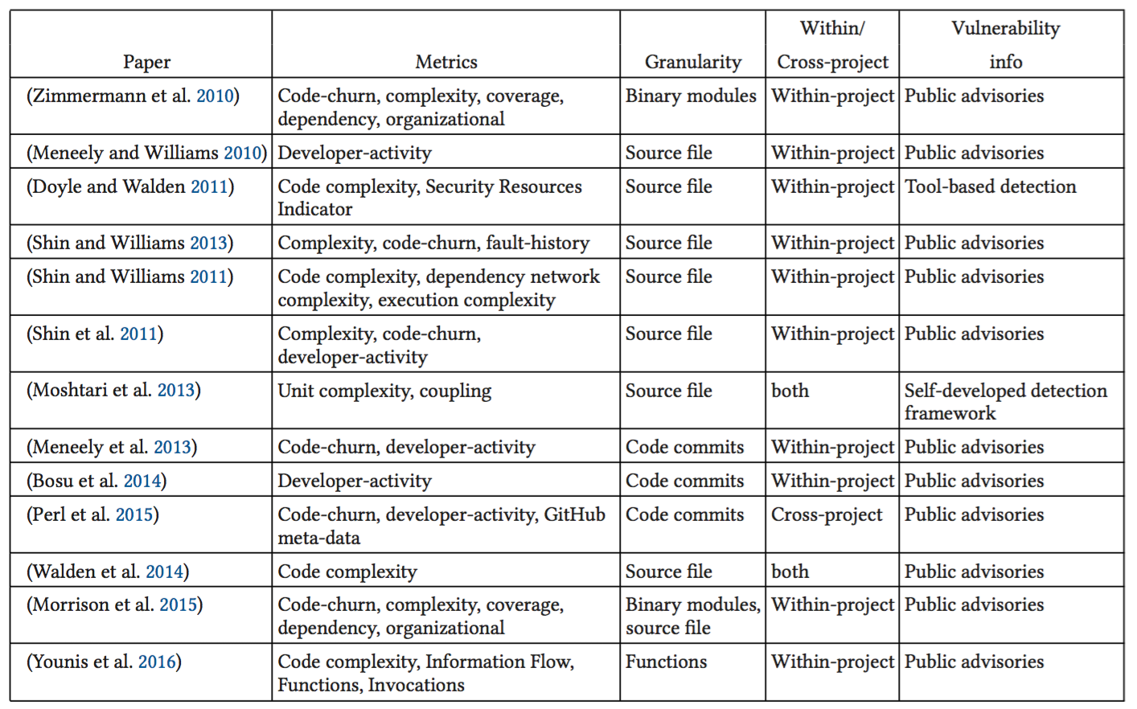
Vulnerability Prediction Models based on Software Metrics

Slide 6
Discussion
Vulnerabilities are few and sparse in the datasets(imbalance class data)
Cross-project studies are few(transfer learning)
Poor results(defining security-specific metrics)
Deep learning

Slide 7
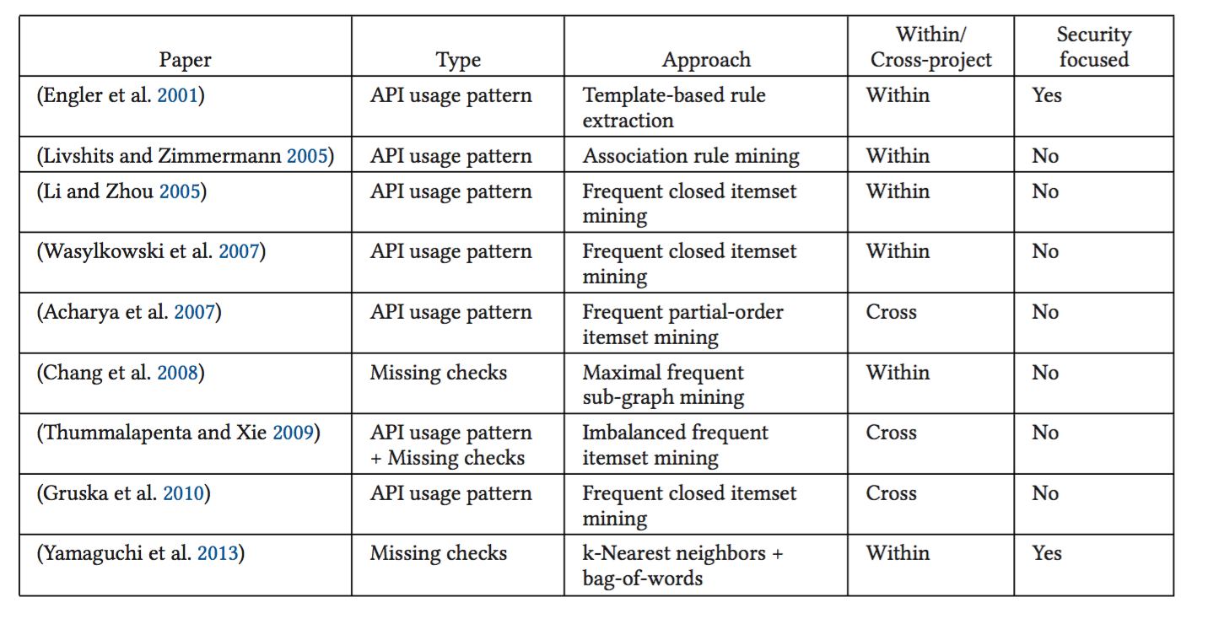
Anomaly Detection Approaches

Slide 8
Discussion
Anomaly detection approaches are only effectively applicable for mature software systems
Anomaly detection approaches are unable to specify the type of defect or vulnerability
False positive rate is high
Graph based detection

Slide 9
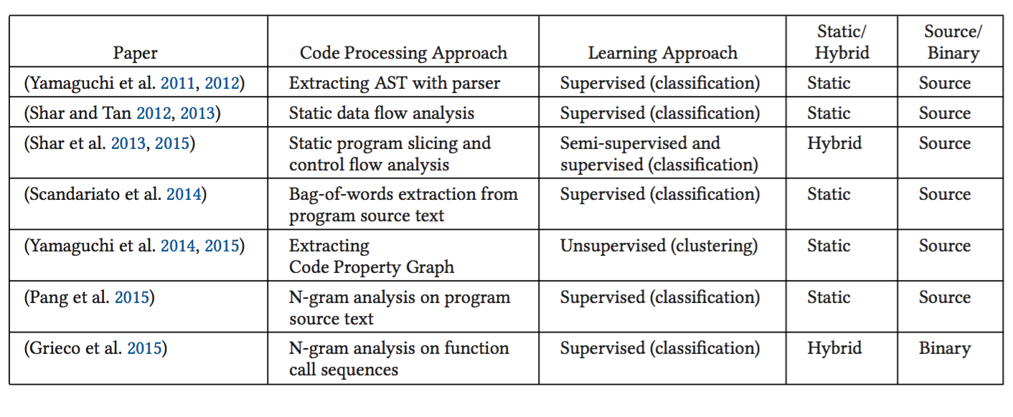
Vulnerable code pattern recognition

Slide 10
Discussion
Specific type of vulnerability is not determined
Define rich feature extraction and description techniques to achieve higher precision and recall
Use deep learning methods to build powerful cross-project vulnerable code pattern recognition systems

Slide 11
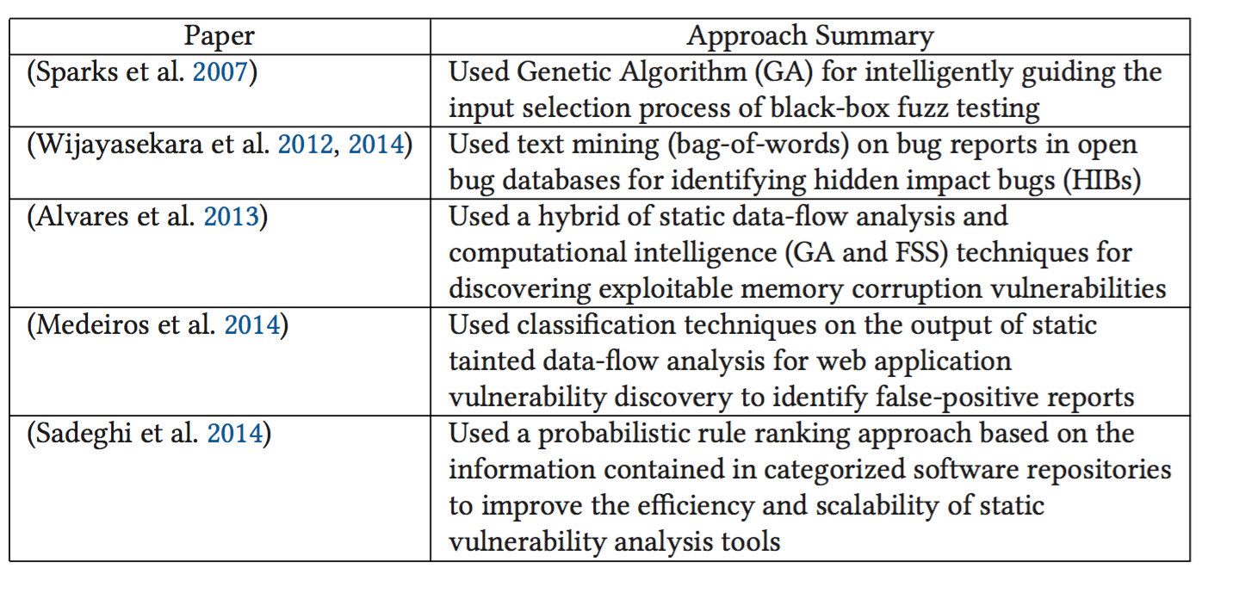
Miscellaneous Approaches

Slide 12
Fruitful research areas
Engineering rich features with high discriminative and expressive power for various types of software vulnerabilities
Designing new machine-learning and data-mining algorithms, tailored to the characteristics of the problem of software vulnerability analysis and discovery

