Slide 1
ULP6613 INTRODUCTION TO DATA SCIENCE · A2
Why do maths exam results differ between Estonian gymnasiums?
Dataset, cleaning and exploratory analysis
Valmar Parts · Chih-Chao Hsu
11 November 2026
Notes:
Our project asks why national maths exam results differ so much between Estonian gymnasiums: between the capital region and the rest of the country, and between schools with different language backgrounds. Today we show the dataset we built from open data, how we cleaned it, and what the exploratory analysis told us before modelling.

Slide 2
THE DATASET
626 school-years from 155 gymnasiums, 2021–2025
Part | What it measures | Source
Y target | Average broad-maths score; number of takers | Haridussilm, exam results by school
X1 teachers | % qualified; % meeting Estonian requirement | Haridussilm, school view
X2 owner | State or municipal school | Haridussilm, students by owner
X3 location | Distance to Tallinn or Tartu (km) | OpenStreetMap school locations
X4 language | Language students wrote the exam in | Haridussilm, exams by language
X5 income | Median gross monthly wage, municipality | Statistics Estonia, table PA107
One row = one school in one exam year. All sources are open, school-level data; no individual students.
Estonia exam gap · A2 · 2
Notes:
Everything comes from open, school-level data, so there is no personal student information. The target is each school’s average score in the broad maths state exam, with the number of students who took it. We joined five groups of explanatory factors: teacher qualification, school owner, distance to Tallinn or Tartu, the language students wrote the exam in, and municipal wage level. The result is one table of 626 school-years from 155 gymnasiums, 2021 to 2025.

Slide 3
FROM RAW TO PROCESSED
Nine raw files become one master table
RAW (data/raw)
CLEANED TABLES
MASTER
Exam results
3 files: location, instruction language, exam language
Y target
X1 teachers
Master table
626 rows × 19 columns
One row per school and exam year, joined on school name and exam year
Teachers
1 file: qualified teachers by school
X2 owner
Students by owner
3 files: state, municipal, private
X3 distance
Income
2 files: average and median wage
X4 language
OpenStreetMap
Estonia extract with school locations
X5 income
Estonia exam gap · A2 · 3
Notes:
The nine raw files are kept unchanged. Each factor is cleaned in its own section into one common format, then all tables are left-joined onto the target. The exam files feed the target, the exam-language table and the location used for income.

Slide 4
FROM RAW TO PROCESSED
One school, before and after: Abja Gümnaasium
RAW · exam results (broad maths)
Õppeaasta | Sooritajate arv | Keskmine
2020/21 | 1 | (hidden)
2021/22 | 5 | 40.0
2022/23 | 3 | (hidden)
2023/24 | 6 | 19.8
2024/25 | 5 | 25.6
PROCESSED · master row
Abja Gümnaasium, exam year 2022
Fewer than 5 takers: score hidden, row removed
school_name
Abja Gümnaasium
exam_year
2022
average_score
40.0
RAW · teachers (shortened)
cohort_size
5
Indikaator | Year | Väärtused
Kvalifikatsiooninõuetele vastavate õpetajate osakaal … (%) | 2022 | 83,3
Eesti keele oskuse nõuetele vastavad õpetajad … (%) | 2022 | 100
estonian_proficiency_ratio
100.0
teaching_qualification_ratio
83.3
RAW · median wage of Mulgi vald (the school’s municipality)
median_income
1118
Municipality | 2021 | 2022 | 2023 | 2024 | 2025
Mulgi vald | 996 | 1118 | 1224 | 1308 | 1387
2021/22 → 2022 · “83,3” → 83.3 · English names
Estonia exam gap · A2 · 4
Notes:
A worked example with real rows. Abja Gümnaasium has five exam years in the raw file, but two of them have fewer than five takers, so the score is hidden and the row is removed. The remaining row for school year 2021/22 becomes exam year 2022; teacher percentages written with a decimal comma are converted to numbers; and the municipality’s median wage for 2022 is attached.

Slide 5
FROM RAW TO PROCESSED
Abja Gümnaasium, continued: owner and exam language
RAW · students by owner (municipal file)
KOV/Õppeasutus | Õppeasutus | Õppurite arv ap | Õppeaasta
Mulgi vald | Abja Gümnaasium | 61 | 2020/21
Mulgi vald | Abja Gümnaasium | 66 | 2021/22
Mulgi vald | Abja Gümnaasium | 63 | 2022/23
PROCESSED · same master row
Abja Gümnaasium, exam year 2022
school_name
Abja Gümnaasium
exam_year
2022
Abja appears only in the municipal file (the state file has no row for it), so ownership = municipal. The student count itself is not used.
ownership
municipal
RAW · exam language (broad maths, one row per language)
take_estonian_exam
1
Õppeaasta | Soorituskeel | Sooritajate arv
2021/22 | Eesti keel | 5
2022/23 | Eesti keel | 3
2023/24 | Eesti keel | 6
take_exam_in_ukranian
0
take_exam_in_russian
0
Distance to Tallinn or Tartu is computed from school coordinates and is not shown here.
Pivoted into 0/1 flags: students sat the exam in Estonian, Ukrainian or Russian (1 = yes).
Estonia exam gap · A2 · 5
Notes:
The rest of the same master row. Ownership comes from which Haridussilm student file the school appears in: municipal or state. Exam language comes from a long file with one row per school, year and language, which we pivot into three 0/1 flags. For Abja Gümnaasium in 2022 the students wrote only in Estonian.

Slide 6
CLEANING DECISIONS
Six choices shaped the final table
1
Broad maths only
Broad and narrow maths are different exams
2
Removed 82 school-years with under 5 takers
Scores are hidden for privacy; filling in would invent data
3
Exam language, not language of instruction
97% of rows say “eesti keel”, even Narva schools
4
Private schools left out (56 rows)
The project covers public gymnasiums
5
One year key: 2024/25 → 2025
The exam is sat in spring; tables must join on the same key
6
Names trimmed, renamed schools matched
Otherwise rows silently fail to join
Estonia exam gap · A2 · 6
Notes:
Six decisions shaped the table. We kept broad maths only, because broad and narrow maths are different exams. We removed 82 school-years where fewer than five students took the exam: Haridussilm hides those scores for privacy, and we checked that this is the only reason scores are missing. We measured language by the language students wrote the exam in, because the official language of instruction says Estonian for 97% of rows, even in Narva. Private schools are outside our scope. And we aligned all tables on one year key and cleaned school names so the joins work.

Slide 7
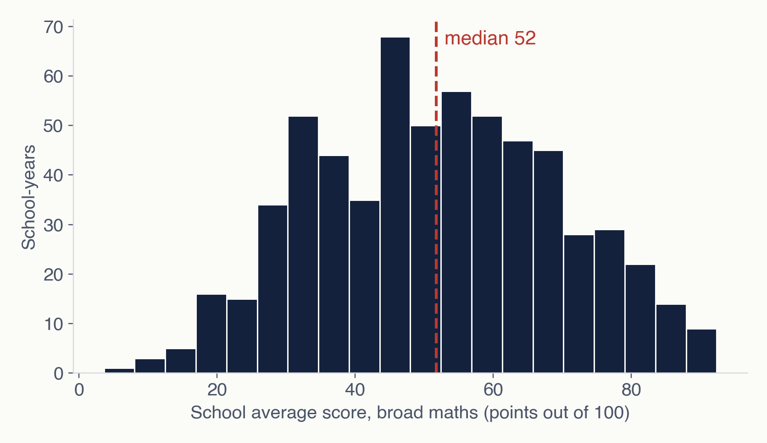
EXPLORATORY ANALYSIS
School averages spread evenly around 52 points
51.7
median school average
38 – 64
range of the middle half of school-years
3.6 – 92.4
lowest to highest school average
Estonia exam gap · A2 · 7
Notes:
Each school-year is one observation: 626 of them. The distribution is roughly symmetric, with mean and median both near 52 points, so the mean is a fair summary. There is no long tail, but there is a wide spread: half of all school-years fall between 38 and 64 points.

Slide 8
FINDING 1 · SCORES BY YEAR
Exam difficulty moves more than schools do
An 11-point swing in two years is the exam changing, not schools.
So we compare each school with its own year: score above or below that year’s average.
National average in broad maths, weighted by takers (points out of 100).
Estonia exam gap · A2 · 8
Notes:
School scores are roughly symmetric around 52 points, from 3.6 to 92.4. The first thing we found is that the national average jumps between years: 51 in 2021, 62 in 2023, back to 55 in 2024. Schools don’t change that fast, so this is the exam’s difficulty. That is why, from here on, we use a year-adjusted score: how far each school is above or below the average of its own year. We also saw that the simple average of schools is 5 to 7 points below the weighted one, which means larger schools score higher.

Slide 9
FINDING 2 · GROUPS OF SCHOOLS
Russian-writing schools are not behind; mixed schools are
School owner
Language students wrote in
Median points above (+) or below (−) the year’s average. Associations, not causes: state gymnasiums are larger county-centre schools; only 52% of Russian-writing students choose broad maths, against 65% of Estonian-writing students.
Estonia exam gap · A2 · 9
Notes:
Comparing groups with the year-adjusted score: state gymnasiums sit about 6 points above their year’s average, municipal schools about 2 below. That is an association; state gymnasiums are larger schools in county centres, some with entrance exams. The surprise was language. We expected schools where students write in Russian to score lower, but in broad maths they don’t. At student level, Russian- and Estonian-writing students are within about 3 points every year. One reason is selection: only 52% of Russian-writing students choose broad maths, against 65%. The lowest group is mixed schools, mostly in Ida-Viru, often in the middle of the language transition.

Slide 10
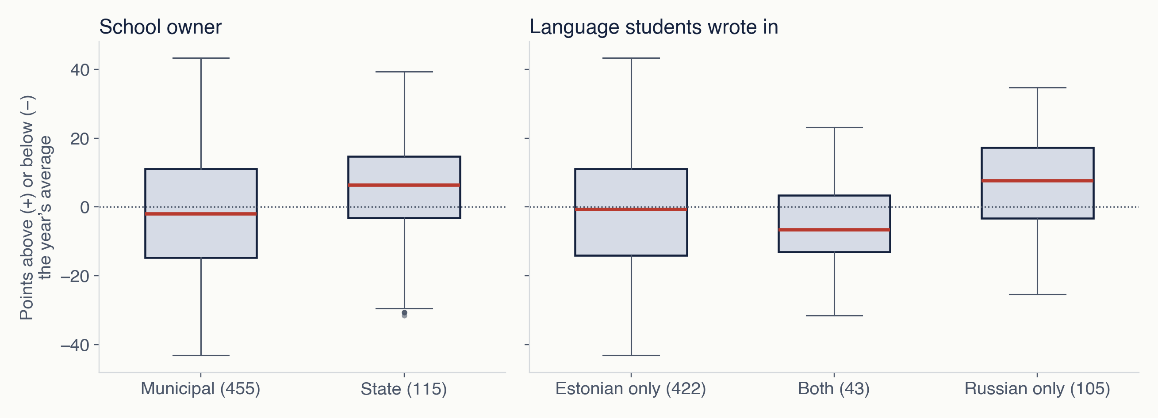
FINDING 2 · GROUPS OF SCHOOLS
Groups differ in the middle, but overlap widely
Red line = median; box = middle half of school-years; dots = unusual school-years. Public schools only: 570 school-years. Differences are associations, not causes.
Estonia exam gap · A2 · 10
Notes:
The same comparison as the previous slide, but showing the whole spread instead of only the medians. State schools sit higher and vary less. Schools where students write in Russian sit higher than Estonian-only schools, and mixed schools sit lowest. In every group the boxes overlap, so group membership alone never decides a school’s score.

Slide 11
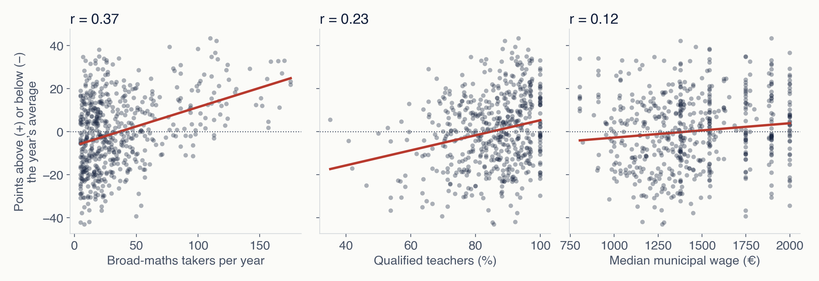
FINDING 3 · FACTORS AND OVERLAPS
School size shows the clearest upward pattern
Each dot is one school-year; the red line is the straight-line fit. Small schools vary widely, while large ones mostly score above their year’s average. Public schools only.
Estonia exam gap · A2 · 11
Notes:
Three scatter plots against the year-adjusted score. School size has the clearest slope, with a correlation of 0.37. Teacher qualification is weaker at 0.23, and municipal wage weakest at 0.12, partly because all schools in a municipality share one wage value, which produces the vertical stripes.

Slide 12
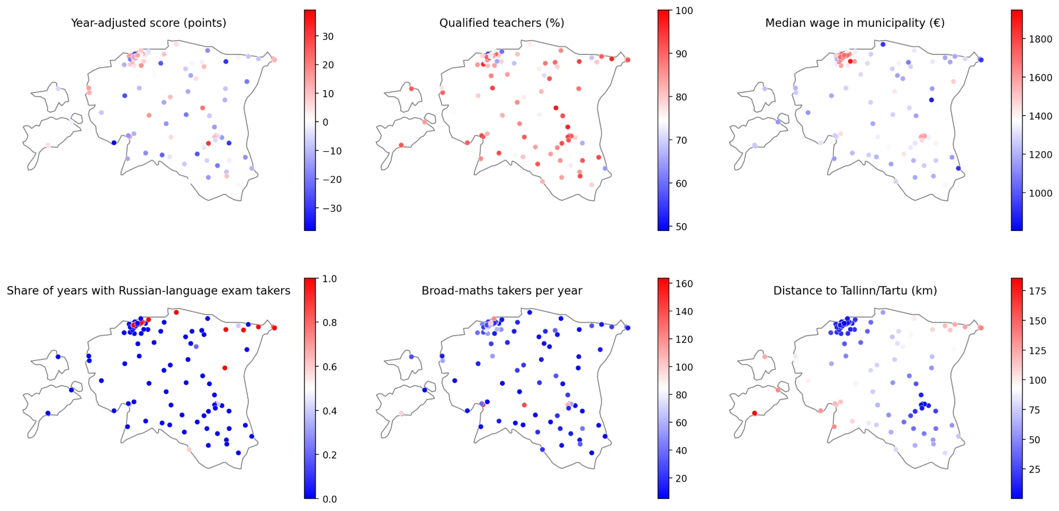
FINDING 3 · FACTORS AND OVERLAPS
Where the factors sit on the map
One dot per public school, averaged over 2021–2025. Russian-language exams, high wages and short distances cluster around Tallinn and in Ida-Viru.
Estonia exam gap · A2 · 12
Notes:
Each dot is a school at its location; colour shows the value of the factor. Russian-language exam takers are concentrated in Tallinn and in the north-east, Ida-Viru. High municipal wages cluster around Tallinn, and the distance map shows the islands and the south-west as farthest from Tallinn and Tartu. Many dots overlap in the Tallinn area.

Slide 13
FINDING 3 · FACTORS AND OVERLAPS
No factor explains much alone, and several overlap
Correlation with the year-adjusted score
Factors that move together
0.99
Average and median wage: we keep the median only
−0.67
Wage and distance to Tallinn or Tartu
−0.62
Estonian requirement % and writing in Russian
Estonia exam gap · A2 · 13
Notes:
Looking at each factor against the year-adjusted score, none is strong on its own. School size is the clearest at 0.37: small schools vary a lot, large ones mostly score above average. Teacher qualification follows at 0.23. Municipal wages are weak, partly because every school in a municipality shares one value. The correlation heatmap also showed overlaps: average and median wage are practically the same, so we keep only the median; wages fall with distance from Tallinn and Tartu; and the Estonian-requirement share is lower where students write in Russian. These overlaps matter for the model.

Slide 14
NEXT: MODELS (A3, 11 DECEMBER)
What the analysis changes in our plan
1
2
3
Rethink the language factor
Model the year-adjusted score
Check overlaps first
Russian-writing students are within about 3 points in broad maths. Mixed schools are the group to explain.
Weighted by number of takers, because small schools’ averages are noisy.
Wage with distance, language with teacher requirement: test with VIF before reading coefficients.
Everything here is an association, not a cause.
Estonia exam gap · A2 · 14
Notes:
Three things change our plan for the models. First, language: the expected Russian-language gap is not there in broad maths, so we will look more closely at mixed schools. Second, we model the year-adjusted score and weight schools by number of takers. Third, before reading any coefficients we check the overlapping factors, for example with the variance inflation factor. And throughout, these are associations, not causes. Thank you, we’re happy to take questions.

