Slide 1
Topic 3: Simple Linear Regression

Slide 2
Outline
Simple linear regression model
  Model parameters
  Distribution of error terms
Estimation of regression parameters
  Method of least squares
  Maximum likelihood

Slide 3
Data for Simple Linear Regression
Observe i=1,2,...,n pairs of variables
Each pair often called a case
Y_{i} = i^{th} response variable
X_{i} = i^{th} explanatory variable

Slide 4
Simple Linear Regression Model
Y_{i} = b₀ + b₁X_{i} + e_{i}
b₀ is the intercept
b₁ is the slope
e_{i} is a random error term
  E(e_{i})=0 and s²(e_{i})=s²
  e_{i} and e_{j} are uncorrelated

Slide 5
Simple Linear Normal Error Regression Model
Y_{i} = b₀ + b₁X_{i} + e_{i}
b₀ is the intercept
b₁ is the slope
e_{i} is a Normally distributed random error with mean 0 and variance σ²
e_{i} and e_{j} are uncorrelated → indep

Slide 6
Model Parameters
β₀ : the intercept
β₁ : the slope
σ^{2 :} the variance of the error term

Slide 7
Features of Both Regression Models
Y_{i} = β₀ + β₁X_{i} + e_{i}
E (Y_{i}) = β₀ + β₁X_{i} + E(e_{i}) = β₀ + β₁X_{i}
Var(Y_{i}) = 0 + var(e_{i}) = σ²
  Mean of Y_{i} determined by value of X_{i}
  All possible means fall on a line
  The Y_{i} vary about this line

Slide 8
Features of Normal Error Regression Model
Y_{i} = β₀ + β₁X_{i} + e_{i}
If e_{i} is Normally distributed then
Y_{i} is N(β₀ + β₁X_{i} , σ²) (A.36)
Does not imply the collection of Y_{i} are Normally distributed

Slide 9
Fitted Regression Equation and Residuals
Ŷ_{i} = b₀ + b₁X_{i}
  b₀ is the estimated intercept
  b₁ is the estimated slope
e_{i} : residual for i^{th} case
e_{i} = Y_{i} – Ŷ_{i} = Y_{i} – (b₀ + b₁X_{i})

Slide 10
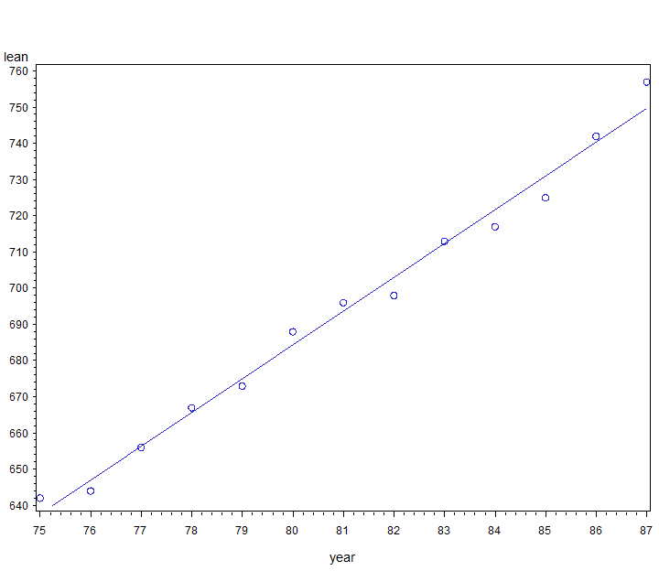
Ŷ₈₂=b₀ + b₁82
e₈₂=Y₈₂-Ŷ₈₂
X=82

Slide 11
Plot the residuals
Continuation of pisa.sas
Using data set from output statement
proc gplot data=a2;
plot resid*year vref=0;
where lean ne .;
run;
vref=0 adds horizontal line to plot at zero

Slide 12
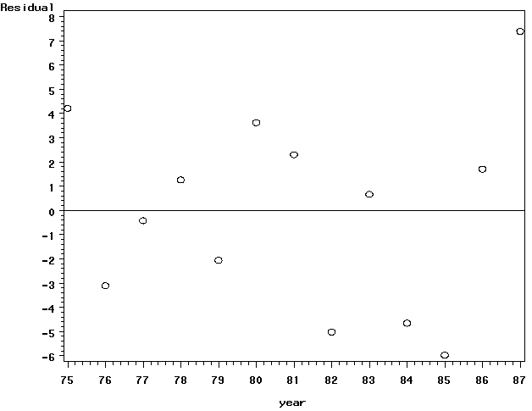
e₈₂

Slide 13
Least Squares
Want to find “best” b₀ and b₁
Will minimize Σ(Y_{i} – (b₀ + b₁X_{i}) )²
Use calculus: take derivative with respect to b₀ and with respect to b₁ and set the two resulting equations equal to zero and solve for b₀ and b₁
See KNNL pgs 16-17

Slide 14
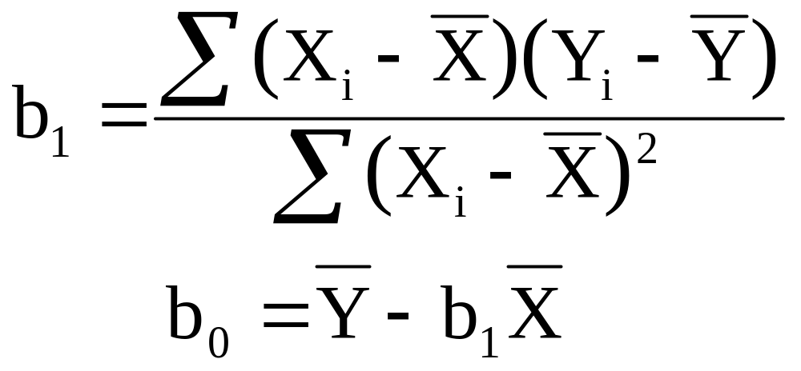
Least Squares Solution
These are also maximum likelihood estimators for Normal error model, see KNNL pp 30-32

Slide 15
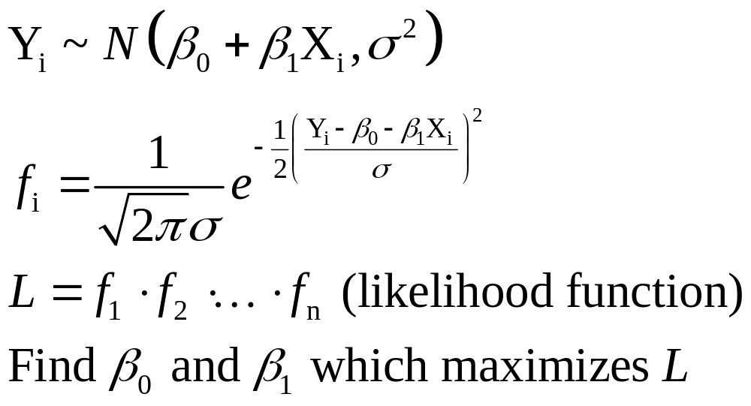
Maximum Likelihood

Slide 16
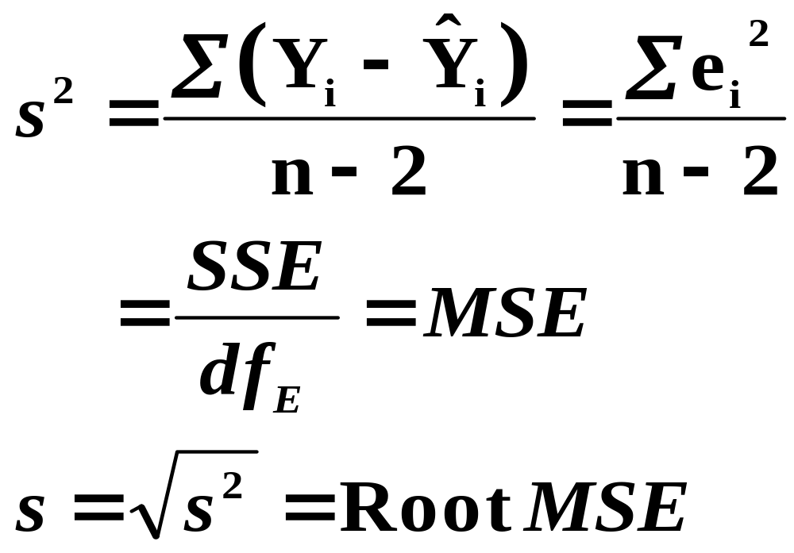
Estimation of σ²

Slide 17
Analysis of Variance
Source | DF | Sum of Squares | Mean Square | F Value | Pr > F
Model | 1 | 15804 | 15804 | 904.12 | <.0001
Error | 11 | 192.28571 | 17.48052
Corrected Total | 12 | 15997
df_{e}
Root MSE | 4.18097 | R-Square | 0.9880
Dependent Mean | 693.69231 | Adj R-Sq | 0.9869
Coeff Var | 0.60271
MSE
s
Standard output from Proc REG

Slide 18
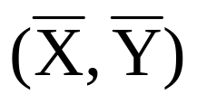
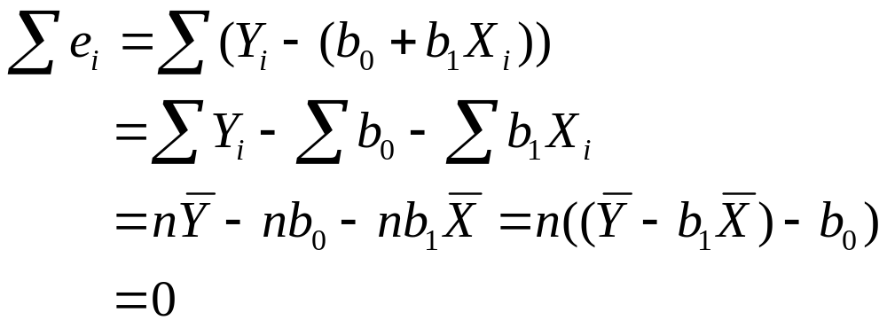
Properties of Least Squares Line
The line always goes through
Other properties on pgs 23-24

Slide 19
Background Reading
Chapter 1
  1.6 : Estimation of regression function
  1.7 : Estimation of error variance
  1.8 : Normal regression model
Chapter 2
  2.1 and 2.2 : inference concerning β ’s
Appendix A
  A.4, A.5, A.6, and A.7

