Slide 1
Basic Malware Analysis Techniques Valery Taustsiakou Itag Skillnet Cybersecurity Student

Slide 2
Type of malware
https://www.malwarebytes.com/computer-worm
Viruses preference is small footprint so source code should be small and language to write a virus should use a system to enable it to be run in a VM by the OS.
Viruses ideally use little RAM so java written viruses are not written because they use VM.
Protect against SQL injection by using double apostrophes instead of single apostrophes for better declaration of variables.
Attackers can compress files to hide their presence. The single .exe file will unpack the entire program once inside the victim machine.
Windows has linux enabled and .sh files are run by attacker .exe file so using the code ./attackfile.sh to run the current directory file.

Slide 3

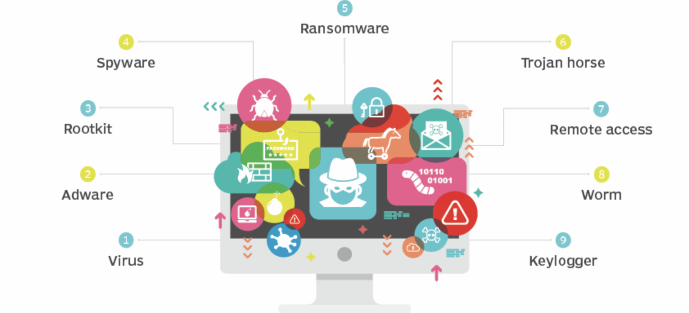
Types of Malware
Trojans use a botnet of connected devices that are compromised in network. This virus enters through a port and other viruses can built on the entry made by trojan.
Worms are individual viruses that recursively increase a network’s bandwidth.
Rootkit refers to admin access in unix systems. Rootkit software that gets in can remotely execute files on your PC.

Slide 4
Stages of Analysis of malware
Behavioural analysis- Antivirus programme signature detection, Process monitor task manager, wireshark tools.
Code analysis: When looking at compiled programs, this process involves using a disassembler, a debugger and, perhaps, a decompiler to examine the program's low-level assembly or byte-code instructions.
Memory analysis: Watch the program dependencies to detect rootkit if there are tied programs that use lots of resources together as a batch folder
Notes:
https://www.sans.org/blog/3-phases-of-malware-analysis-behavioral-code-and-memory-forensics/

Slide 5
Source Code of a Worm virus in Python Code
https://github.com/pylyf/NetWorm/blob/master/worm.py
Scan the open ports. Run a text file with virus from url. Use Threads to spread in C:\\
if __name__ == "__main__":
main()
logger.debug("Downloading passwords...")
url = "https://raw.githubusercontent.com/danielmiessler/SecLists/master/Passwords/Common-Credentials/top-20-common-SSH-passwords.txt"
urllib.request.urlretrieve(url, filename)
logger.debug("Passwords downloaded!")

Slide 6
Connect to FTP and SSH
def download_ssh_passwords(filename):
"""
Downloads most commonly used ssh passwords from a specific url
Clearly, you can store passwords in a dictionary, but i found this more comfortable
logger.debug("Downloading passwords...")
url = "https://raw.githubusercontent.com/danielmiessler/SecLists/master/Passwords/Common-Credentials/top-20-common-SSH-passwords.txt"
urllib.request.urlretrieve(url, filename)
logger.debug("Passwords downloaded!")

Slide 7
Defence techniques
Host based intrusion detection systems (HIDS) such as ossec.net or github.com/Tripwire/tripwire-open-source signature read the log and file monitoring. Scan the image file like OS system file, driver or .exe file
Sandboxing to isolate untrusted data in closed virtual environment to analyse threat e.g. DNS network port attempt, record file creation/deletion, monitor the program instructions b/w API & system calls.
Malware Strings: Static analysis of strings with a function urllib.request.urlretrieve(url, filename).

