Slide 1


GOLD
Mini project - week 4
Eliel, Lara, Valter

Slide 2

PROJECT OVERVIEW
The WorldWideGold is a logistic company for gold that deals with gold miners to buyers.
Our analysts are looking for data patterns to profile the best business scenarios and deliver the trading with profit.
Our research starts from analysing the most relevant mining countries, in order
to identify the major players in gold extraction, and intends to
track the most profiting markets by its demand.

Slide 3

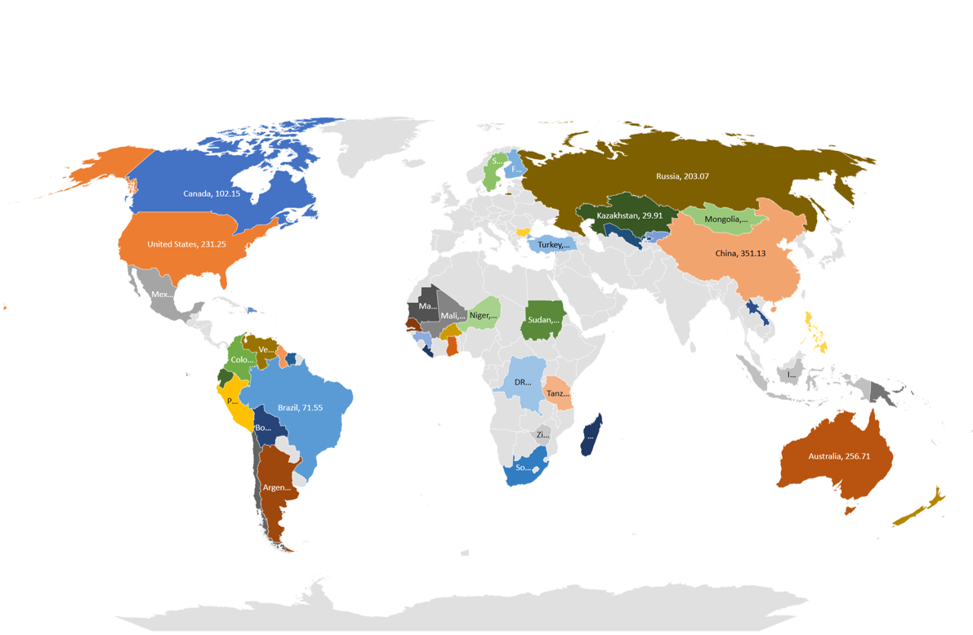
GOLD MINING DATA
We analysed our sources by collecting mining records per year and per ton for the last decade.
At the beginning of the decade, Canada and USA appeared as more involved, while asian countries are now displaying a growth trend.
The countries who play a major role in mining are China, Russian Federation, Australia, USA and South Africa

Slide 4

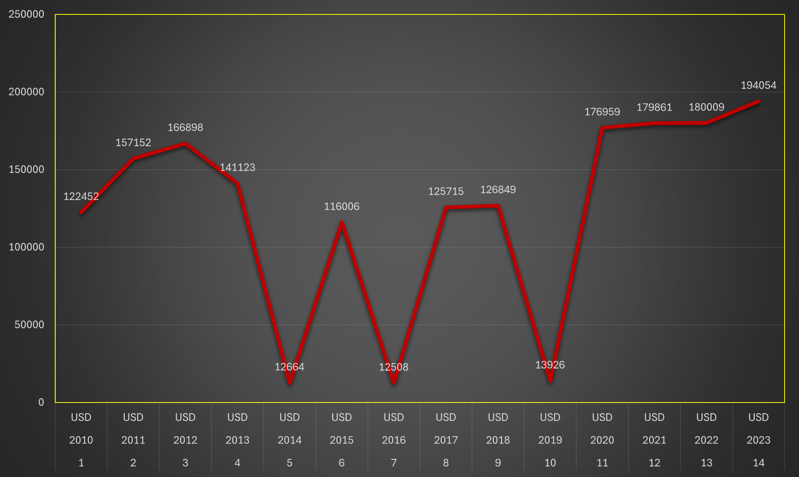
GOLD VALUE IN USD
We now analyse the value of gold in US Dollars throughout the last decade.
We observe three macroscopic falls in 2014, 2016 and 2019, when gold trading in the US became particularly convenient

Slide 5

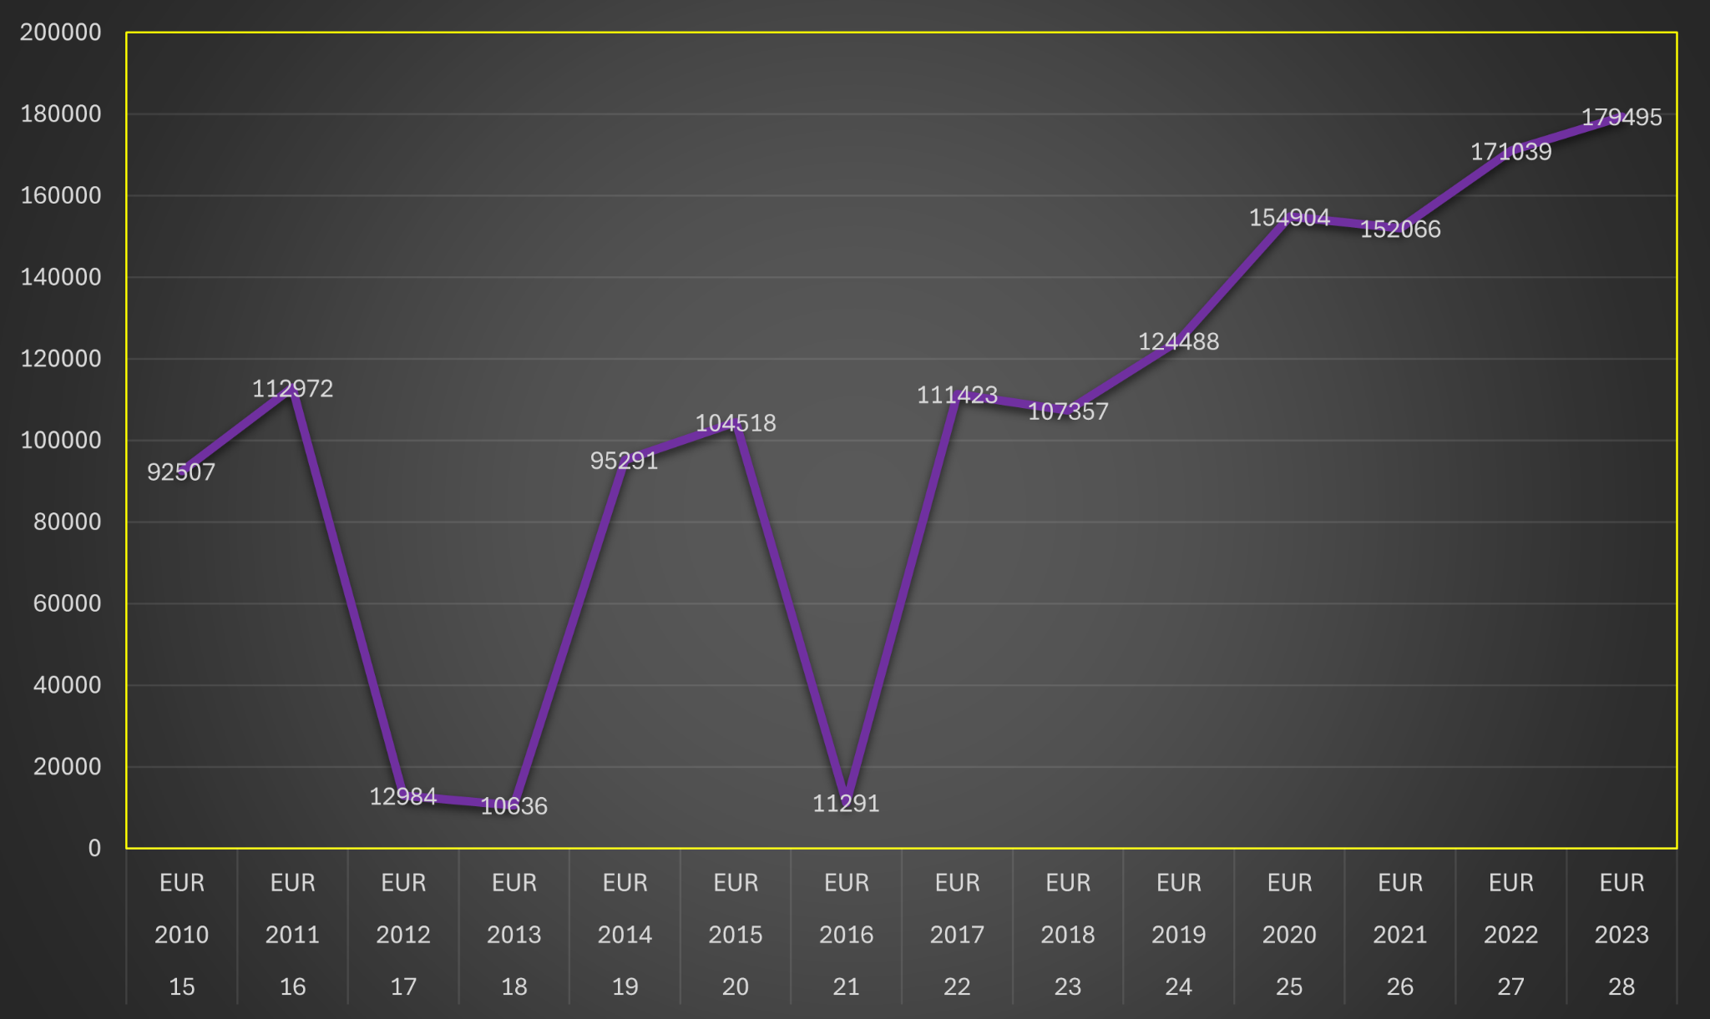
GOLD VALUE IN EURO
As for the Eurozone, we can see a similar fall for 2016.
Differently than the US, Europe has experienced a great fall of gold value between 2012 and 2013, whereas the cost of this metal still was high in America.

Slide 6

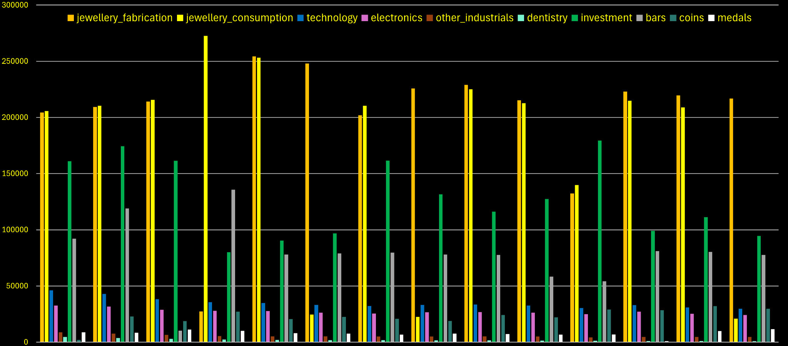
GOLD DEMAND

Slide 7
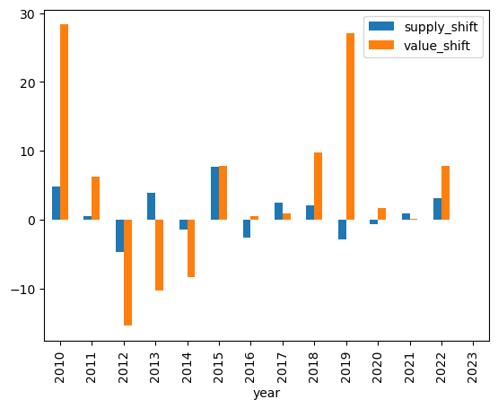
SUPPLY vs
PRICE
We observed that in 71% of times the price of gold moves together with its supply.
For the 28% of times, the price deviates from its supply.
In 2019 the deviation was explosive.

Slide 8


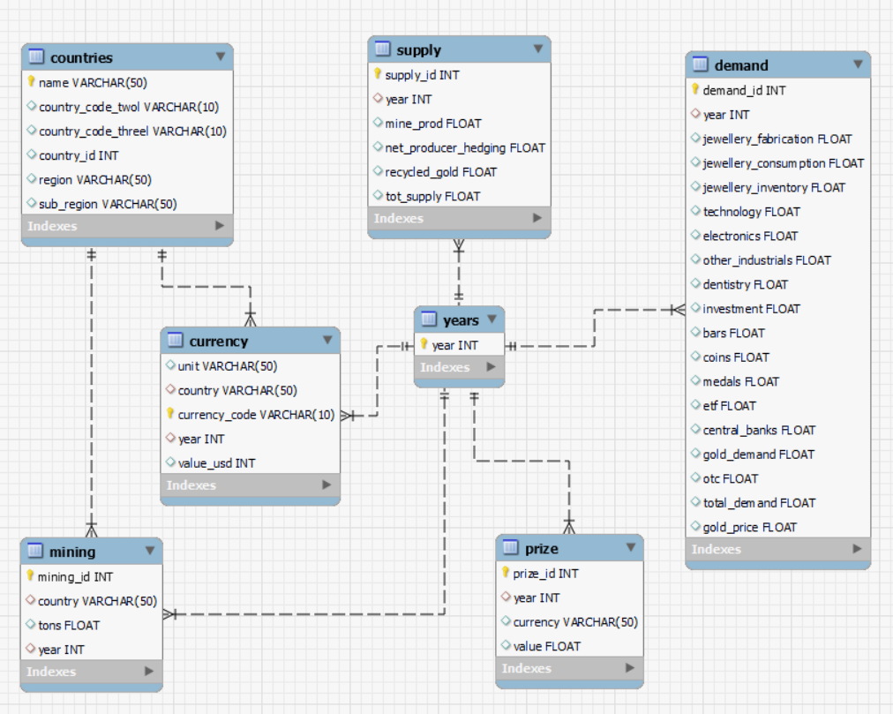
ERD

Slide 9
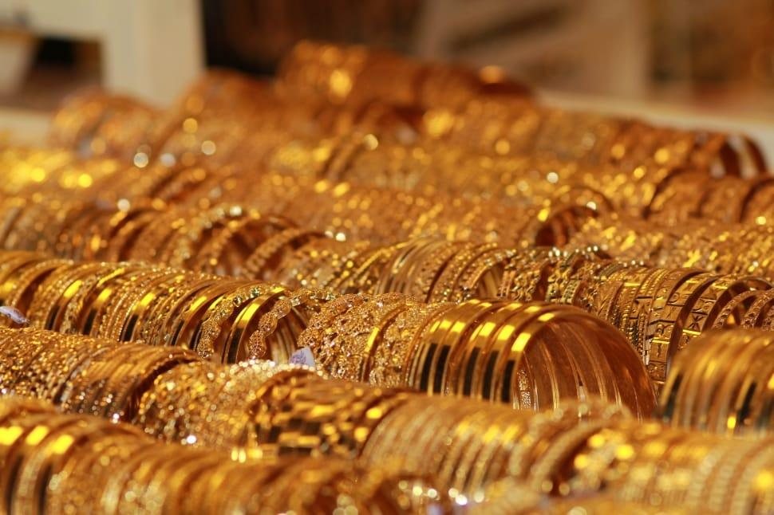
BIGGEST CHALLENGES
Working in synergy between Python and SQL language.
Creating a complex database, and understanding its ERD.
Transposing different shaped values to SQL format.
Interpreting datas to get market relevant hints.
Time management

Slide 10

THANK YOU
And have a GOLDEN weekend!

