Slide 1
Why Are They Spending Trillions on AI?
The numbers and economics behind the AI working-capacity revolution
Author: Valto Loikkanen · v1.0 research package · Factual source cut-off 2026-08-13
Licence: CC BY 4.0 — Attribution 4.0 International
Notes:
This is a neutral research synthesis, not a vendor report or investment recommendation — state that framing before anything else.

Slide 2
Method: Five Evidence Classes
Class | Meaning
OBSERVED FACT | Primary source, checked on/before cut-off
ATTRIBUTED STATEMENT | On-record claim, not auto-proven true
DERIVED CALCULATION | Formula always shown, never just a result
SCENARIO ASSUMPTION | Editable input, not a market figure
INTERPRETATION | Labelled reading, never presented as fact
• Every claim in this deck carries one of these five tags, exactly as in the source paper.
• No fabricated quotes, figures, or URLs; unverifiable items are labelled UNVERIFIABLE rather than smoothed over.
CC BY 4.0 — Valto Loikkanen — factual source cut-off 2026-08-13
Notes:
This slide is the contract with the audience — every number that follows is traceable to one of these five buckets.

Slide 3
How to Use This Research: Six Equal Lenses
• Individual · SME/owner-manager · Finance/infrastructure investor · Government/region/community · AI builder/operator · Educator/researcher/journalist
• No lens is prioritized over any other — a deliberate editorial stance held throughout, not an oversight [INTERP, stated editorial policy].
• Each lens has a different entry point into the same chain: energy → hardware → compute → models → tokens → AI working capacity → work → outcomes → value → agency.
CC BY 4.0 — Valto Loikkanen — factual source cut-off 2026-08-13
Notes:
Tell the room which lens they're likely reading from, but stress that the deck deliberately refuses to rank the six.

Slide 4
Executive Summary: The Chain
• Chain: energy → hardware → compute → models → tokens → AI working capacity → digital work → outcomes → value → agency
• Parallel physical chain: capital + energy + maintenance + utilisation + orchestration → humanoid working capacity
• Headline: Aug 10, 2026 — Nvidia + 6 firms (Apollo, Blackstone, BlackRock, Brookfield, Goldman Sachs, KKR) MOUs to mobilize >$500B [FACT]; Fink: "trillions of dollars over the coming years" [ATTR]
• Ten-second takeaway: trillions are committed on a belief that cheap AI working capacity is coming — working capacity is not value, and nothing here proves that belief right.
CC BY 4.0 — Valto Loikkanen — factual source cut-off 2026-08-13
Notes:
This slide is the whole paper in miniature; everything after it is evidence for or against pieces of this one paragraph.

Slide 5
Part I: Why Are They Spending Trillions?
• Aug 10, 2026: Nvidia signs MOUs with six asset managers/banks to mobilize >$500B in third-party AI-infrastructure capital [FACT, CNBC/Fortune]
• Huang: "each gigawatt is something like $50, $60 billion" [ATTR, Huang]
• Three structurally different, differently-incentivized answers on offer: compute as infrastructure (Huang), intelligence as utility (Altman), superintelligence as personal (Zuckerberg) — shown side by side, none endorsed
CC BY 4.0 — Valto Loikkanen — factual source cut-off 2026-08-13
Notes:
Frame this as the reader's actual question, not a rhetorical one — three interested parties, three different stakes.

Slide 6
Three Voices, Side by Side
Source | Framing | Representative statement | Class
Huang (Nvidia) | Compute as infrastructure | Chips are an "investable asset" | ATTR
Altman (OpenAI) | Intelligence as utility | "Cost falls ~10x/12mo, lower prices → more use" | ATTR
Zuckerberg (Meta) | Superintelligence as personal | "Individual empowerment as source of prosperity" | FACT / ATTR
• None of the three claims is independently audited; that they were said is confirmed, whether they're true is not.
CC BY 4.0 — Valto Loikkanen — factual source cut-off 2026-08-13
Notes:
Resist any temptation to declare a winner here — the paper's whole editorial stance depends on not doing so.

Slide 7
What Would Need to Be True: Bubble, Infrastructure Transition, or Both?
• Supports "transition": signed $500B MOUs are real [FACT]; independent power-demand forecasts (BCG 50-80GW, S&P Global 64.4GW in 2025) are directionally consistent [ATTR, low-confidence sourcing]
• Supports "bubble caution": Huang/Fink's own per-GW and demand figures are self-interested ATTR statements; independent analyst estimates ($35-49B/GW) sit below Huang's $50-60B [ATTR]
• Disciplined position: both readings draw on overlapping, not competing, facts [INTERP] — the same MOU can be real infrastructure and include mispriced capital
CC BY 4.0 — Valto Loikkanen — factual source cut-off 2026-08-13
Notes:
The point is not to pick a side — it's to show the same facts support two different narratives simultaneously.

Slide 8
Part II: Electricity, Power, and Tokens per Watt
• GB300 NVL72 rack: 135kW TDP / 155kW peak per OEM spec [FACT, Lenovo]; NVIDIA itself publishes no power figure
• MLPerf v6.0: "2.5M tokens/sec" is a 4-rack/288-GPU aggregate, not a single-rack figure — a common misattribution corrected here [FACT]
• Tokens/watt is not one number per chip — it ranges roughly 1.7M-5.2M tokens/sec/MW depending on latency tolerance [CALC/INTERP]
CC BY 4.0 — Valto Loikkanen — factual source cut-off 2026-08-13
Notes:
Use this slide to show the paper's discipline in action — catching and correcting a benchmark misattribution rather than repeating it.

Slide 9
Hardware as Capital Equipment, and Its Financing
• Huang frames Nvidia's platform as an "investable asset" [ATTR, Huang, CNBC Aug 10 2026]
• Capital stack observed vs. assumed: DGX Spark $4,699 MSRP [FACT]; HGX B300 has no public price [ASSUMPTION]; GB300 rack ~$4M is an illustrative analyst estimate [ASSUMPTION]
• Depreciation risk: Vera Rubin claimed "up to 10x more tokens/MW" vs GB200 [ATTR, vendor]; SemiAnalysis's independent figure is 2-5.4x [FACT-adjacent]
CC BY 4.0 — Valto Loikkanen — factual source cut-off 2026-08-13
Notes:
Emphasize that today's capital is a bet against a hardware curve both the vendor and independent analysts agree is moving fast.

Slide 10
The Eight Cost Layers (Never Collapsed Into One Number)
• raw energy → hardware-amortized → financed asset → full operating infrastructure → capacity/utilisation → token production → workload/AI-working-capacity → outcome & value (never mechanically derived)
• Worked EUR example: financing term alone moves cost from €0.688/M tokens to €1.435/M tokens at 50% utilisation [CALC]
• Utilisation is usually the single largest lever at every scale [INTERP, cross-workbook pattern]
CC BY 4.0 — Valto Loikkanen — factual source cut-off 2026-08-13
Notes:
This ladder is the spine of the entire cost analysis — every dollar figure later in the deck sits on one specific rung, never blended with another.

Slide 11
Owned Production Cost vs. Retail API Price
• Self-correction preserved deliberately: retail lab prices are a finished, marked-up product price, not a cost basis for owned hardware [method note]
• Retail benchmark: Claude Sonnet 5 $2/$10 per M tokens [FACT]; GPT-5.6 Terra ~$2/$12 [ATTR]; Gemini 3.1 Pro Preview $2/$12 [FACT]
• Owned production: Home $1.37-$11.89/M tokens (canonical); Hyperscale ~$0.091-0.312/M tokens, canonical full-layer, mid $0.133/M [CALC] — Hyperscale sits 1-2 orders of magnitude below retail; Home sits closer to, and at low utilization inside, the cheapest retail floor
CC BY 4.0 — Valto Loikkanen — factual source cut-off 2026-08-13
Notes:
This gap is the point, not a mistake to reconcile — "generate your own power" vs. "buy from the grid." The size of the gap is tier- and utilization-dependent, not a fixed multiple.

Slide 12
Part III: Usage-Intensity Bands
• Four bands (tokens/AI-working-hour, all SCENARIO ASSUMPTION): Chat/advisor (10K-30K) · Active copilot (60K-120K) · Delegated agent (200K-600K) · Heavy multi-agent orchestration (1M-12M+)
• OpenAI's own unaudited telemetry: Codex = 99.8% of weekly internal output tokens; 99th-percentile users ran 60+ agent-hours/day [ATTR, OpenAI, self-reported] — not a general-population statistic
Working capacity | AI | Human
1 working hour | 1 agent x 1h = 1 agent-hour | 1 person x 1h = 1 human-hour
10-team hour | 10 agents x 1h = 10 agent-hrs | 10 people x 1h = 10 human-hrs
1 working day | 1 agent x 8h = 8 agent-hrs | 1 person x 8h = 8 human-hrs
10-team day | 10 agents x 8h = 80 agent-hrs | 10 people x 8h = 80 human-hrs
• Orchestration does not create a different kind of hour — it creates multiple working hours in parallel. Team capacity is workers x hours, on both sides, with no exception.
CC BY 4.0 — Valto Loikkanen — factual source cut-off 2026-08-13
Notes:
Band 4's open-ended ceiling is informed by, not proven by, this one company's internal data. The table is the guardrail against reading a band-4 figure as "one very fast hour" instead of "many parallel ordinary hours."

Slide 13
From Tokens to $/AI-Working-Hour
• Formula: $/AI-working-hour = (tokens/hour ÷ 1,000,000) × ($/M tokens at that tier) [CALC]
• At delegated-agent band, central case: Hyperscale $0.053/hr vs. Home $1.268/hr vs. Retail-API $3.60/hr [CALC] — a ~68x spread across tiers at the same usage band
• Self-hosting is not automatically the cheapest path — its case rests on control and independence, not undercutting retail [INTERP]
CC BY 4.0 — Valto Loikkanen — factual source cut-off 2026-08-13
Notes:
The spread is arithmetic, not opinion — but which column matters depends entirely on which lens is asking.

Slide 14
Quality Multipliers and the Limits of Human/AI Comparison
• Eight factors shape effective working capacity: capability, reliability, initiative, judgment, creativity, context, tools, information [INTERP, author's own framework]
• Reliability and information act as multipliers, not add-ons — unreliable capacity caps how much can safely be delegated
• What IS comparable: throughput, marginal cost, capacity elasticity. What is NOT: workload complexity, quality/correctness, supervision burden, context completeness — kept visibly separate, not folded into one multiplier
• Employer/billable split: owned AI pairs with human employer cost (fully loaded); retail AI pairs with human billable/externally-purchased rate (which embeds its own margin+overhead). Mixing the pairs mixes internal vs. external cost layers.
CC BY 4.0 — Valto Loikkanen — factual source cut-off 2026-08-13
Notes:
This is the guardrail slide against naive "$/hour AI vs. $/hour human" headlines — and against the narrower mistake of picking whichever AI number and whichever human number make the best-sounding comparison.

Slide 15
Part IV: Information as AI's Operating System
• Author's own framing: information is "the operating system for AI" [FACT that phrase appears; INTERP as underlying claim] — disclosed author interest in this framing (Prifina/Digiole/ValtoAI/PIOS/EIOS)
• Same model + different information = very different effective working capacity
• Zuckerberg: "fully private mode...even Meta cannot see" [ATTR]; Altman's usage anecdote implies ~1,000,000x token growth per heaviest user, 2019→2026 [CALC on ATTR inputs]
CC BY 4.0 — Valto Loikkanen — factual source cut-off 2026-08-13
Notes:
Flag the disclosure here explicitly — this section sits closest to the author's own commercial stake.

Slide 16
AI Maturity and the Shifting Human Role
• Two axes: how work gets done (Advise → Cowork → Delegate → Lead) and scale of orchestration (individual → team → workforce) [INTERP, author's framework, partially unverified public form]
• Three framings of the same shift: Altman on freedom/agency [ATTR]; Zuckerberg on balance of power [FACT/ATTR]; Huang on capital allocation [ATTR] — none more correct than the others
• As execution gets cheap, "what should we do" replaces "how do we get it done" as the load-bearing human question [INTERP]
CC BY 4.0 — Valto Loikkanen — factual source cut-off 2026-08-13
Notes:
Each of the six lenses experiences this shift differently — no priority ordering intended.

Slide 17
Value Can Be Positive, Zero, or Negative
• Working capacity ≠ value. Orchestration multiplies capacity, not judgment [INTERP]: "a cheap, fast, wrong answer scaled across a multi-agent team is still cheap and wrong at scale."
• Three human analogies: brilliant professor vs. street-smart entrepreneur; new CEO vs. veteran employee; world-class investor vs. empathetic salesperson — each shows capability ≠ fit ≠ value
• No production tier or ownership architecture is shown by this paper's evidence to be inherently more likely to produce positive value than another
CC BY 4.0 — Valto Loikkanen — factual source cut-off 2026-08-13
Notes:
This is the hinge slide — everything before it is cost/capacity; everything after assumes this boundary holds.

Slide 18
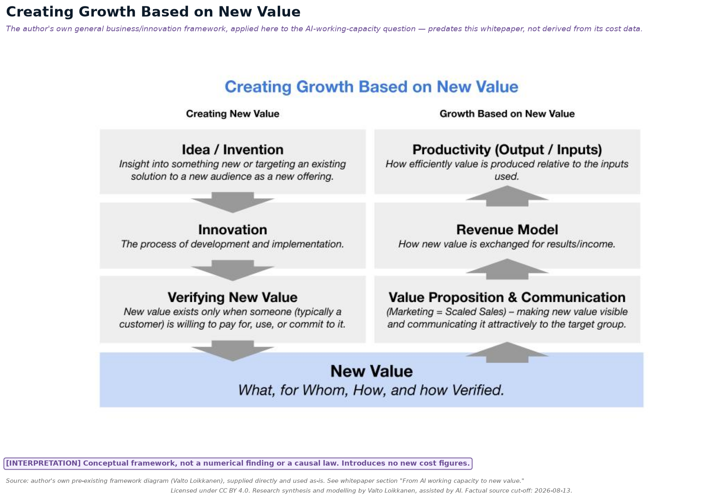
From AI Working Capacity to New Value
• [INTERP] Conceptual bridge, not a numerical finding: capacity created (Parts I-IV) is not automatically growth, income, or social benefit
• Two separate questions: can the capacity be created (cost/utilization model) vs. can it create and capture new value (invention, adoption, revenue model)
• Same boundary applies to any future Scenario Explorer built on this paper's workbooks — it models cost and capacity, not value creation
CC BY 4.0 — Valto Loikkanen — factual source cut-off 2026-08-13
Notes:
This slide is the second hinge — it stops the room from reading "cheaper tokens" as "more growth" without the missing middle step.

Slide 19
Part V: The Ownership Stack
• Layers, each separately ownable: energy, hardware, compute (access), models, information, agents, identity, governance
• Concentration varies sharply by layer: hardware manufacturing is extremely concentrated [FACT/INTERP]; information is the least standardized/portable layer [INTERP]
• No single actor owns "AI" end to end — ownership questions must be asked layer by layer
CC BY 4.0 — Valto Loikkanen — factual source cut-off 2026-08-13
Notes:
Use this to reframe "who owns AI" as a bad question — it's really six or seven different questions.

Slide 20
Six Coexisting Access Models
Model | Note
Centralized platform | Highest convenience, lowest control
Enterprise dedicated | e.g., IBM Cloud/Together AI $240M deal [FACT]
Open models on owned hardware | Up to 1-2 orders of magnitude below retail at hyperscale; narrower at home/cooperative scale
Private/individual ownership | Full control, full capital risk
Cooperative | €19.50-23/mo (DGX Spark pool) or €42/mo (shared workstation-class) — two hardware tiers, not one contested figure [CALC/FACT]
Local/regional capacity | Resilience/sovereignty framing
• None asserted as universally superior — trade-offs differ across scale, cost, privacy, resilience, convenience, control [INTERP]
CC BY 4.0 — Valto Loikkanen — factual source cut-off 2026-08-13
Notes:
The two cooperative figures describe two different hardware tiers (a DGX Spark pool vs. a shared workstation-class machine), not a discrepancy in one estimate.

Slide 21
Electricity-Grid Analogy and Digital Sovereignty Beyond Geography
• Analogy: home solar → cooperative → commercial producer → utility-scale plant → grid exchange, mapped onto AI compute tiers [INTERP, author's own commentary]
• Weakest link: no frictionless spot market for AI compute yet exists, unlike electricity or Bitcoin hashrate [FACT/INTERP]
• Sovereignty reframed via five questions: control, portability, exit, governance, continuity — not just server geography [INTERP, framework proposed in this paper]
CC BY 4.0 — Valto Loikkanen — factual source cut-off 2026-08-13
Notes:
Note explicitly that this analogy is the author's own structural comparison, flagged as such rather than presented as settled.

Slide 22
Part VI: Scale Scenarios, Tier by Tier
Tier | Capital | $/M tokens
Home | $4,699 | $1.37-11.89
Cooperative (DGX Spark pool) | ~$47K | $1.99-7.62
Professional | unofficial/ASSUMPTION | $0.044-0.146 (no opex — least evidenced)
Hyperscale | ~$16M/4-rack | $0.091-0.312, canonical mid $0.133
• Governing levers: utilisation (3.5-4x swing), financing term, interactivity setting — all editable, none a forecast
• Cost-per-hour of capacity is not value — a 500-800x swing between production cost and retail pricing shows how meaningless a bare figure is without its pricing assumption
CC BY 4.0 — Valto Loikkanen — factual source cut-off 2026-08-13
Notes:
State the non-advice boundary explicitly here — every number is a scenario, not a recommendation.

Slide 23
Humanoid Robots as Embodied Working Capacity
• Real market range: Unitree G1 from $13.5K [FACT] to Agility Digit ~$250K [ATTR, secondary]; illustrative €25K base case sits within this spread [INTERP]
• Same utilisation pattern as digital tiers: 2,000→8,000 hrs/yr cuts cost/hour ~3.5-4x [CALC]; electricity is not the binding cost here (unlike token production)
• Scope explicitly narrow: excludes supervision, insurance, downtime — every figure is a cost floor, not a full commercial cost
CC BY 4.0 — Valto Loikkanen — factual source cut-off 2026-08-13
Notes:
Flag this as a "later, illustrative extension," not a general robotics-economics claim.

Slide 24
Part VII: Six Lenses, Equal Weight, No Ranking
• Individual: rent vs. own break-even sits near the copilot band, not chat band
• SME: delivery innovation, not product innovation, is the accessible opportunity [ATTR, author's prior work]
• Investor/Government/Builder/Educator: same MOU and cost figures, read through different risk lenses — interested-party statements (Huang, Fink) flagged consistently as ATTR, not audited fact
CC BY 4.0 — Valto Loikkanen — factual source cut-off 2026-08-13
Notes:
Reiterate — these are grouped for slide economy only, not because any lens outranks another.

Slide 25
Closing: Opportunity, Not Inevitability
• Capital and infrastructure figures (Parts II-IV) support reading this as opportunity, not destiny [INTERP, editorial choice]
• The unknown variable: adoption, organizational change, and time — not model capability — appear to be the binding constraint [INTERP]
• Closing synthesis: "how do we get it done" is getting cheaper faster than most say plainly; "what should we do" has not gotten any easier at all
CC BY 4.0 — Valto Loikkanen — factual source cut-off 2026-08-13
Notes:
End on the open question, not a resolved answer — the paper deliberately does not decide this for the reader.

Slide 26
Licence and Attribution
• Licensed under CC BY 4.0. Suggested attribution: Research synthesis and modelling by Valto Loikkanen, assisted by AI.
• This material is educational research and scenario analysis — not investment, legal, tax, procurement, or policy advice.
• Companion workbooks (Global Baseline, AI Working-Capacity Conversion, Token-Factory Scenarios, Investment-Thesis Notes, Humanoid Working-Capacity, Localized/EUR-Finland template) available for readers to rebuild any model with their own inputs.
Notes:
Close by pointing to the workbooks as the place where the audience can go build their own numbers.

