Slide 1
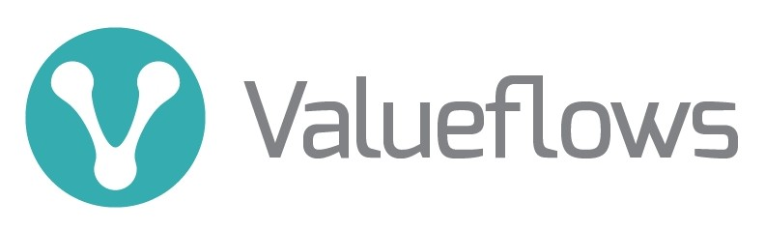
A vocabulary for economic networks
https://valueflo.ws

Slide 2
Valueflows is a standard vocabulary
Value Flows is a set of common vocabularies to describe flows of economic resources of all kinds within distributed economic ecosystems
Its purpose is to enable inter-networking among many different software projects
It supports
  Exchange (mutual credit, marketplace, offers/requests, etc.)
  Production/creation (manufacturing, supply chain, distribution, digital creation, services, etc.)
  Planning, local/regional analysis, budgeting, etc.

Slide 3
Valueflows history
Grew out of discussions in a loomio group called Open App Ecosystem, started by Enspiral people (still exists)
People wanted to work towards interoperability of smaller apps
This needs vocabularies and protocols – economic, social, etc.
Several people came together in around 2015 to start work on the economic piece, with varying experience in developing economic applications, but mostly based on input-process-output patterns
There is now a fairly stable core vocabulary and model, and a handful of projects are using it; we expect to do another round of additions and refinements when these projects are implemented, especially on the less stable parts

Slide 4
REA core definitions
REA stands for Resources, Events, Agents. It started out as an enterprise accounting model but has developed into an overall economic model for networks.
Agents are Economic Agents, who perform Economic Events affecting Economic Resources. Agents can be individual persons or organizations.
An Economic Event can take actions like create, change, consume, or use Economic Resources, or transfer them from one Agent to another, or transport them from one place to another.
Economic Resources could be
Useful goods and services
Money, tokens, credits
Labor power, skills
CO2, methane, heat, air, water, soil microbiota

Slide 5

Levels of the ontology
The Knowledge level represents classification, policies, procedures, rules and patterns. This is where each network or community can configure the core concepts to fit their needs.
The Plan level represents offers, requests, schedules and promises.
The Observation level represents what really happened.

Slide 6
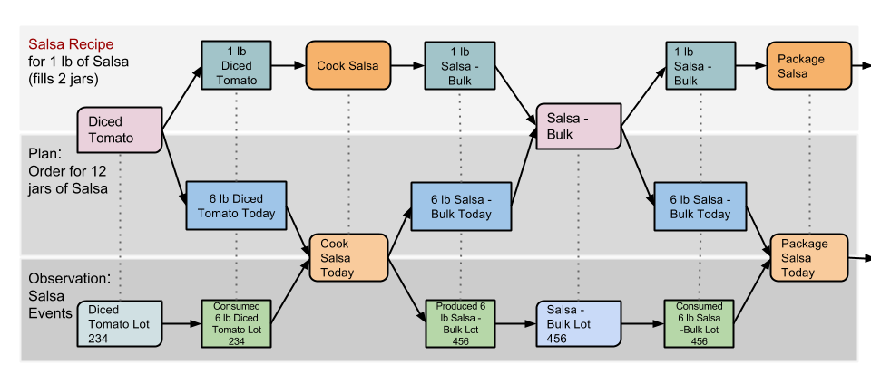
Operations on the levels
This salsa diagram shows the “layers”, recipe (knowledge), plan, actuals (observation). All layers follow basically the same input-process-output pattern.

Slide 7

Operations: input-process-output
On the observation layer, these flows would have quantities which could automatically update inventory.
Processes can be configured at any level that makes sense to the users. For example, having 3 processes in this flow allows operational flexibility: The baker can make a lot of dough and use it for blueberry and pumpkin pie, as well as apple pie. Then she might want to bake different kinds of pies in one oven at the same time too, or freeze half of the unbaked apple pies to bake later.

Slide 8
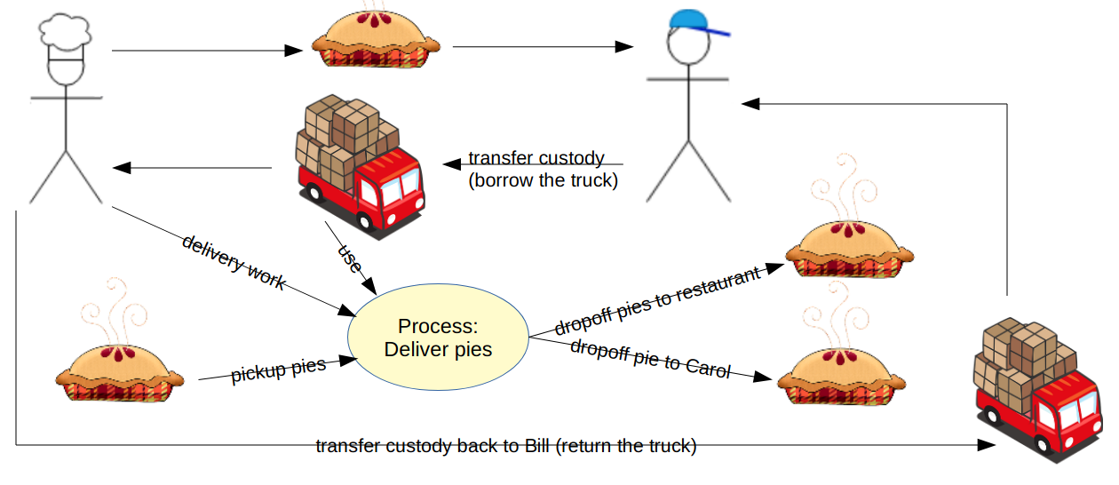
Operations: exchange and distribution
Transfer of resources, transportation of resources, and production of resources can all connect into larger flows.

Slide 9
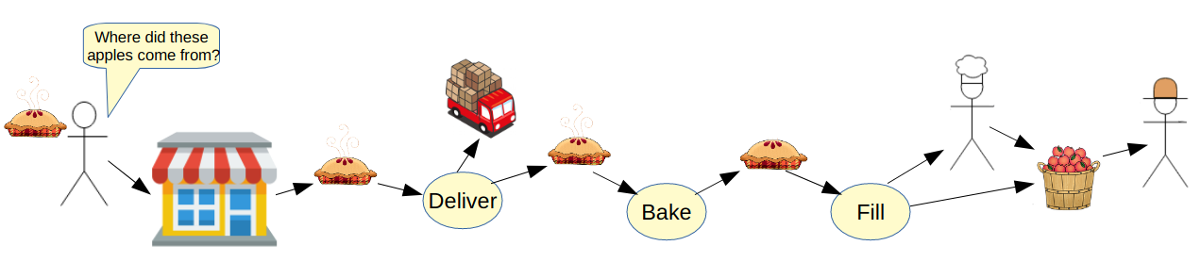
Operations: tracking and tracing
One of the most-often used traces is to find the origins of health problems like mad cow disease and tainted drugs and food. In Valueflows terms, that would start with the economic resource that caused a problem, and trace back along the chain of resource flows to the source or sources of the resource. Then it might be necessary to also track forwards from the source(s) to find everything else that might include that source(s).
A nicer story: A restaurant customer might find out that the pies are made by a local baker who uses all organic ingredients. They might find out that the apples come from a cooperative worker-owned apple orchard.

Slide 10
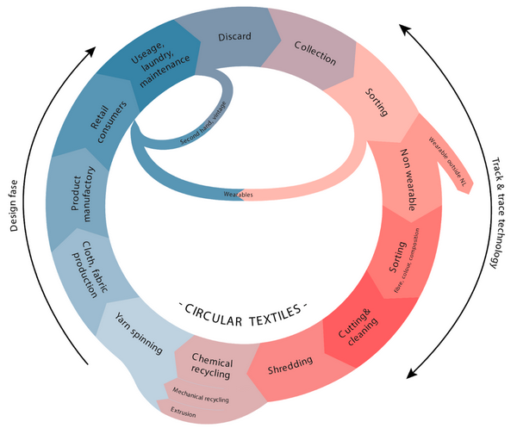
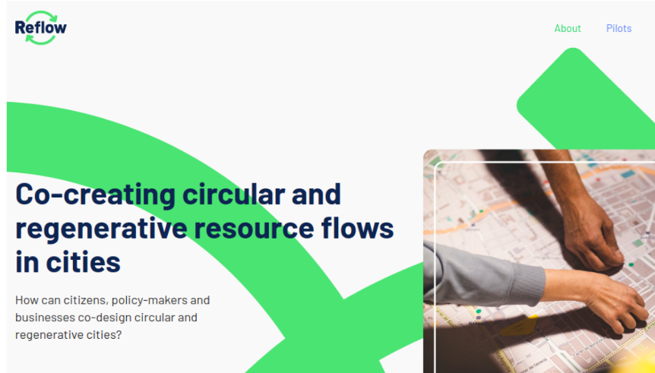
Circular Economy
Reflow is a project in process that is using Valueflows for municipality-wide circular economy projects in Europe. In Amsterdam, they are working with the textile industry.
There is a new project called FabCity:Hamburg building on Reflow.
Notes:
6 pilots, each focusing on one industry, working with operational and analytical levels

Slide 11

Analytical
This was done in Nova Scotia with a group called Ecology Action Center, at the provincial level. We can see the comparison of different fishing methods, and their estimated effects on fishing grounds.
They wanted to aggregate operational data to do analysis, but didn’t get that far.

Slide 12

Networks of networks?

Slide 13
Distributed framework projects
hREA: https://github.com/holo-rea/ecosystem/wiki using https://holochain.org/
Bonfire: http://bonfirenetworks.org/ using http://activitypub.rocks/
These generic backend frameworks (in process) can be accessed by frontends created for specific use cases.

