Slide 1


A alueflows
Story about
Pie

Slide 2



Part 1: Making Pies
Alice, Bill, and Carol are agents. An agent can be a person or an organization (formal or informal). For this example we just have people, but you can imagine organizations doing the same things.
Alice (a baker) Bill (has a truck) Carol (an apple grower)

Slide 3


Alice bakes pies. Pies are economic resources, yum.
So to start our story, Alice gets apples from Carol. She has promised Carol one pie per half-bushel of apples. This is the first transfer of that exchange.

Slide 4




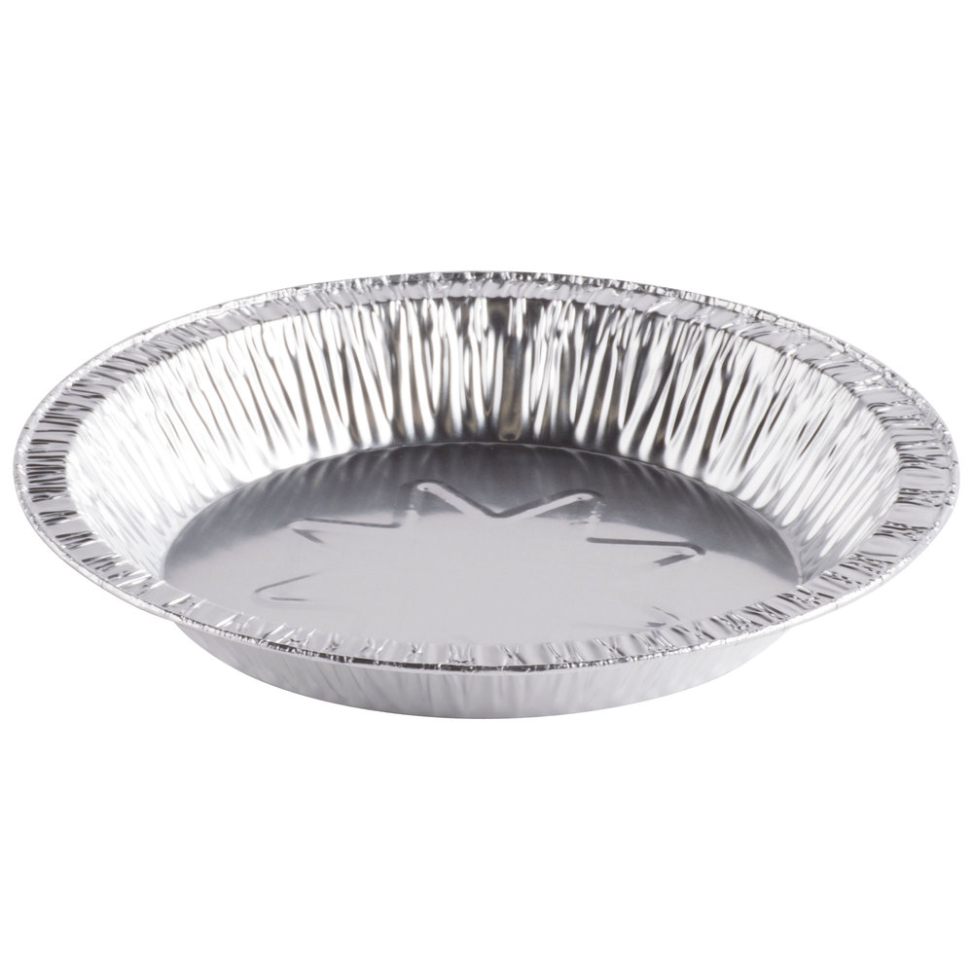

Alice makes her pies in 3 steps. Each step is a process with input and output economic events (the lines) that can affect economic resources.
First, she makes the crust.
piecrust work
produce dough in pans
Process:
Make dough
consume butter
consume flour
consume water
consume pie plates
produce dough for tops
use rolling pin

Slide 5


Then she makes the filling and fills the crusts.
mixing and finishing work
Process:
Fill crusts
consume apples
produce unbaked pies
consume cinnamon
consume sugar
consume dough in pans
consume dough for tops

Slide 6


Then she bakes the pies.
work baking
Process:
Bake pies
consume unbaked pies
produce baked pies
use oven
Maybe you are wondering why Alice chose to configure this as 3 processes. Well, it gives her a lot of flexibility. For example, she can make a lot of dough and use it for blueberry and pumpkin pie, as well as apple pie. Then she might want to bake different kinds of pies in one oven at the same time too, or freeze half of the unbaked apple pies to bake later.

Slide 7
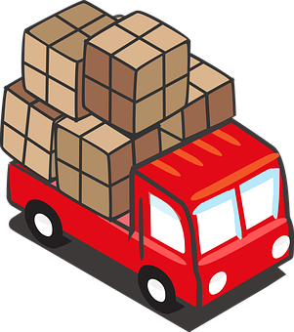
Alice borrows Bill’s truck to deliver her pies to a restaurant that made a special order. In return for the use of his truck, she gives Bill a pie. Note that Valueflows handles any type of economic resource, Alice could have just as easily given Bill money for use of his truck. But pies are more fun.
transfer custody
(borrow the truck)
delivery work
use
dropoff pies to restaurant
Process:
Deliver pies
dropoff pie to Carol
pickup pies
transfer custody back to Bill (return the truck)

Slide 8


So now Alice has made and delivered her pies, creating flows of value. We can follow the flows forwards and backwards. What if the restaurant that has bought some of Alice’s pies wants to tell its customers about where the pies come from?
If they trace the flows backwards, they might find out that the pies are made by Alice, who is a local baker and they can see that she uses all organic ingredients. They might find out that Alice gets her apples from Carol, who is a cooperative worker-owned apple orchard. That all makes the restaurant customers even more hungry for apple pie….
Where did these
apples come from?
Deliver
Bake
Fill

Slide 9
Part 2: Planning
Alice needs to schedule her bakery work so everything she needs gets made, all the ingredients are available when she needs them, the equipment is all available for all the different things she creates, etc. In short, she needs a plan.
To keep it simple, let’s check in on Alice as she plans to make the apple pies from Part 1.
Planning starts with what you want, the independent demand. The restaurant wants 20 apple pies by Thursday 3pm. Alice also wants 8 apple pies to have for sale in the bakery, plus one for Bill and one for Carol. So her total independent demand for the plan for Thursday is 30 apple pies.

Slide 10
Alice’s plan looks something like this. Of course, this is simplified, for example there would be quantities and scheduled times on all of these lines. On a plan, the lines are commitments rather than economic events, although they look pretty much the same, which is by design. Commitments are promises for economic events that have not happened yet.
work
consume
work
work
consume
Process:
Make dough
produce
consume
Process:
Fill crusts
Process:
Bake pies
produce
produce
consume
produce
consume
consume
consume
consume
use
consume
use
consume

Slide 11
Alice already has a standing agreement with Carol to trade apples for pies, because Carol gives away pieces of pie to customers who pick their own apples. But the restaurant pies are a special order, which Alice promised to deliver. And Alice doesn’t have a truck, so she publishes a proposal, which has intents instead of commitments. Intents are looking for matches so there can be some commitments.
?
request
offer
or
offer
money
This is Alice’s proposal. The lines are the intents, and the only agent we know is Alice.

Slide 12
Bill finds Alice’s proposal and agrees to loan her his truck. Bill wanted the pie in return, who wouldn’t? Alice also didn’t have enough apples onhand, so she arranged with Carol to get some more. Now she has the agreements she needs.
The lines here are commitments. The pies and apples are not real yet either, so are just resource specifications. Bill committed use of the actual specific truck though, it is an economic resource.

Slide 13
As you might expect, when the economic events are recorded, they explicitly fulfill commitments, if planning was done. And if someone commits to an intent, the commitment explicitly satisfies that intent.
?
Alice wants someone to loan her a truck
satisfies
Bill commits to loaning Alice a truck
fulfills
Bill drops off the truck to Alice

Slide 14

Part 3: The recipe
But Alice usually makes the same kinds of things over and over. Planning those each time takes a lot of time…. unless you have recipes that can generate plans for you. We all know about recipes for pies, but we are using that term here to include anything you can make, provide as a service, and really anything you do more-or-less the same way each time.
Software that generates plans from recipes can actually be pretty smart. It can check for what Alice already has in inventory and schedule only the remainder needed, for example. It can tell Alice what inputs she doesn’t have enough of and can either generate a plan from a recipe that makes those or schedule trading for those ingredients.

Slide 15
Not surprisingly, the recipe looks a lot like the plan. Except there aren’t any specific economic resources, only resource specifications. And there aren’t processes, only process specifications. And there aren’t any real agents assigned, only the types of work that is needed.
dough work
mixing work
baking work
consume
consume
Make dough
produce
consume
Fill crusts
Bake pies
produce
produce
consume
produce
consume
consume
consume
consume
use
consume
use
consume

Slide 16
Some other differences between the recipe and the plan:
The quantities are often different because the quantities in the recipe are adjusted to fit what the plan needs to output in the end
The recipe has no dates or times, while the plan is scheduled with specific dates and times
mixing work 1.5 hours
The Recipe
mixing work 2.5 hours
The Plan
consume 10
Fill crusts
consume 30
Fill crusts
Thursday
10am
consume 10
produce 10
consume 30
produce 30
consume 15 g
consume 45 g
consume 400 g
consume 9 kg
consume 1200 g
consume 27 kg

Slide 17
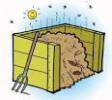
Just to complete the circle of this story, here is what the plan vs the observable making of the pies might look like. It took a little longer than planned because Alice dropped a pie, which went into the compost.
mixing work 2.5 hours
The Plan
mixing work 3 hours
The Observations
consume 30
Fill crusts
Thursday
10am
consume 30
Fill crusts
Thursday
10am
consume 30
produce 30
consume 30
produce 29
consume 45 g
consume 45 g
fail 1
consume 1200 g
consume 27 kg
consume 1200 g
consume 27 kg

Slide 18
Thank you for listening to the story of the apple pies. We hope this has helped you to understand Valueflows and the REA (Resource-Event-Agent) model it is based on.
Image attribution:
https://classroomclipart.com
http://www.iconarchive.com
https://pixabay.com
https://www.flaticon.com/
https://findicons.com
http://clipart-library.com

