Slide 1

REA accounting for the climate
https://valueflo.ws

Slide 2
REA Accounting for the Climate
REA Ontology
REA stands for Resources, Events, Agents.
It started out as an enterprise accounting model but has developed into an overall economic model for networks.
The traditional double entry accounting (Assets - Liabilities = Owner Equity) model does not work for networks, because a network does not have a singular ownership.
The REA economic model does work.
Climate accounting for the earth’s networks of resource flows needs REA or something like it.

Slide 3
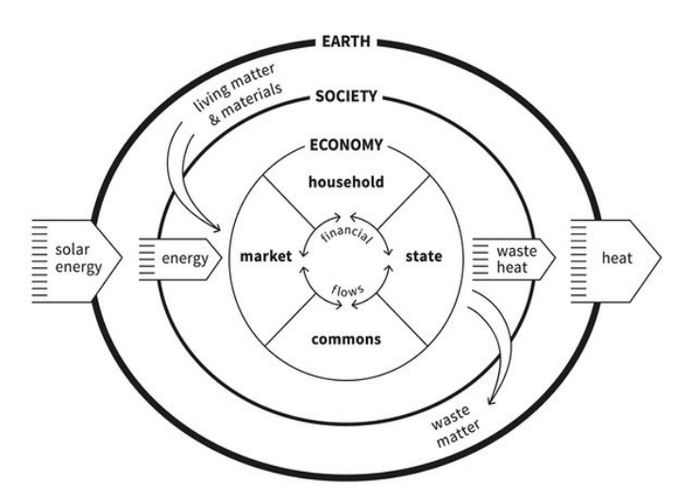
REA Accounting for the Climate
Valueflows
Value Flows is a set of common open vocabularies based on REA. It describes flows of economic resources of all kinds within networked economic ecosystems.
But it works for everything in this version of Kate Raworth’s doughnut model, not just the Economy circle.
And it’s a lot easier to record and analyze all these circles of resource flows with a common vocabulary.

Slide 4
REA Accounting for the Climate
REA core definitions
Agents are Economic Agents, who perform Economic Events affecting Economic Resources. Agents can be individual persons or organizations…. or ecological agents?
An Economic Event can take actions like create, change, consume, use, or destroy Economic Resources, or transfer them from one Agent to another, or transport them from one place to another.
Economic Resources could be
Useful goods and services
Money, tokens, credits
Energy
Labor power, skills
Pollutants, CO2, methane, heat
Air, water, soil microbiota

Slide 5
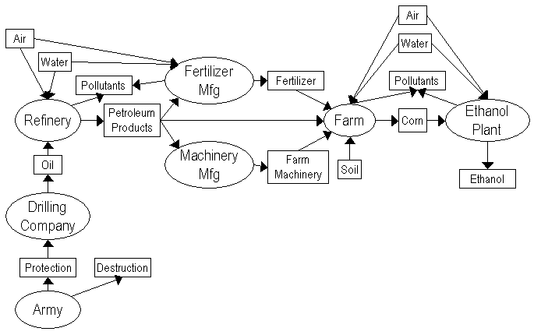
REA Accounting for the Climate
Input-Process-Output
The basic pattern for modeling resource flows is input-process-output. Resource flows can be of any length, or circular.

Slide 6
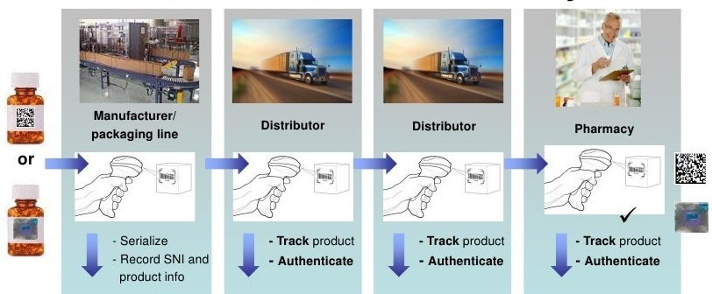
REA Accounting for the Climate
Track and trace
Resource flows can be traced and tracked, to see the whole history of a resource, or what happened to a resource after it was produced.
Material Passport. Drawing on feature of multiple signature aggregation, Reflow can be used to implement a material passport for circular economy applications to maintain the genealogy of a specific product, providing authenticated information about the whole set of actors, tools, collaborations, agreements, efforts and energy involved in its production, transportation and disposal.
[Dyne.org, 2020]
www.fda.gov https://arxiv.org/pdf/2105.14527.pdf

Slide 7
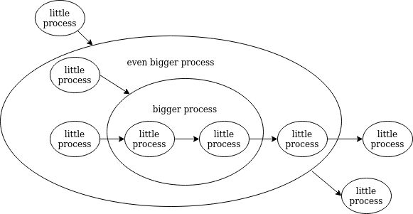
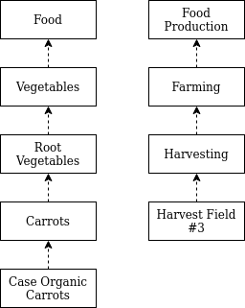
REA Accounting for the Climate
This works at different levels...
Notes:
Can record at different levels;
can aggregate to higher levels;
can use information gained from higher levels to make decisions for lower levels.
Taxonomies, etc.

Slide 8

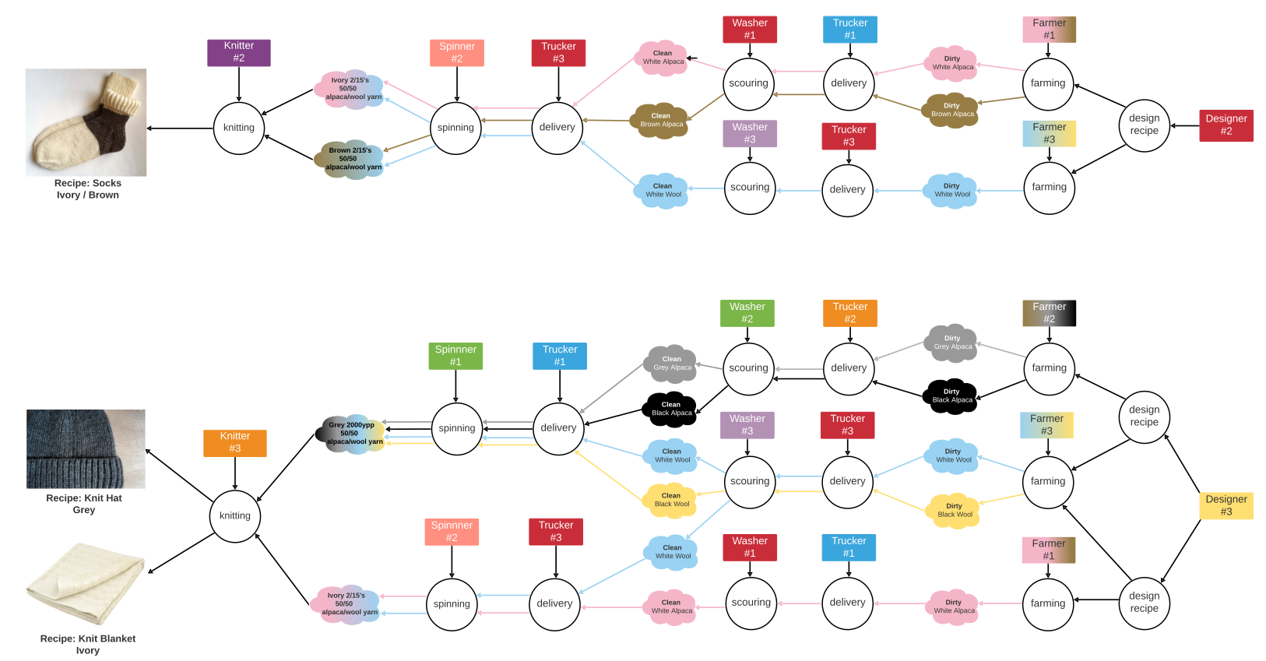
REA Accounting for the Climate
Operations: supply chain
“New York Textile Lab designs yarns and textiles. The fibers we use are grown on healthy, climate beneficial soil within our region, and we partner with mills and manufacturers that are local, transparent, and ethical.”

Slide 9


REA Accounting for the Climate
Operations: supply chain
NY Textile Lab is one network of Fibershed.
“We are a network of farmers, ranchers, land-managers, designers, ecologists, sewers, knitters, felters, and natural dyers, spinners and mill operators that have defined a strategic geography to work and create within. We develop regional fiber systems that build soil & protect the health of our biosphere.”

Slide 10
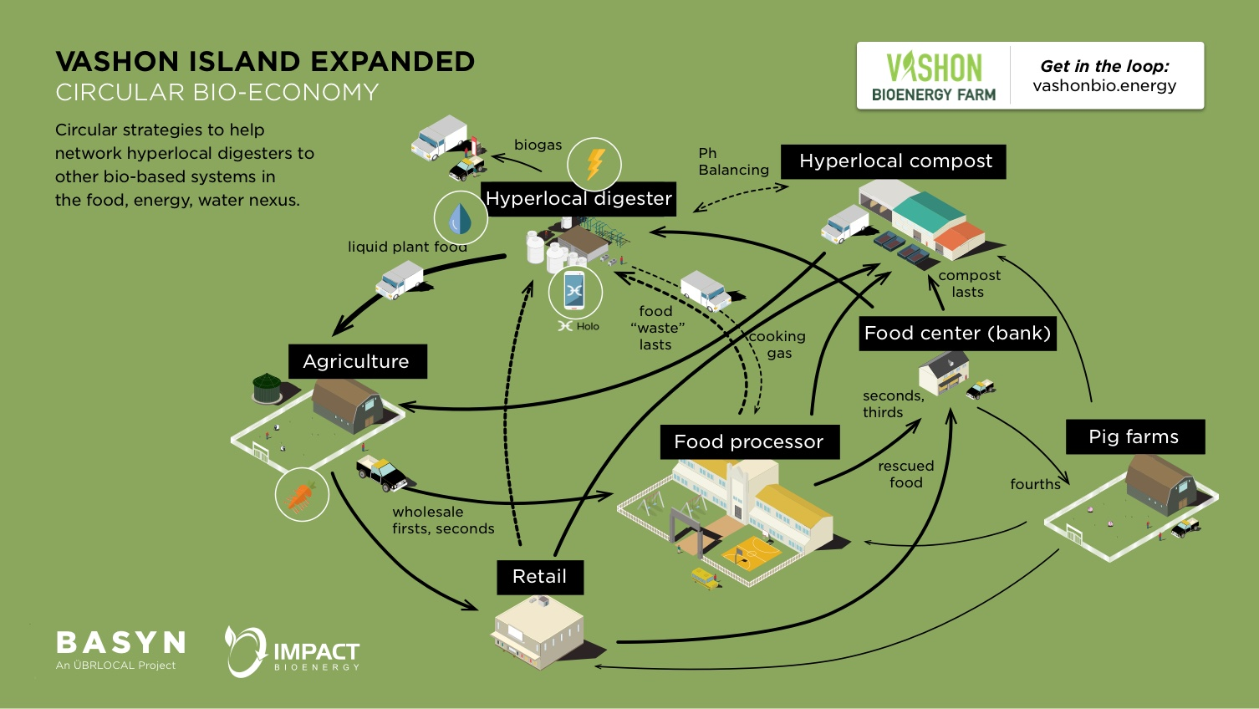
REA Accounting for the Climate
Operations: circular economy

Slide 11
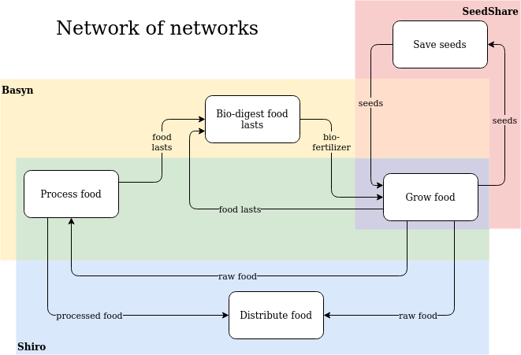
REA Accounting for the Climate
Operations: networks of networks

Slide 12
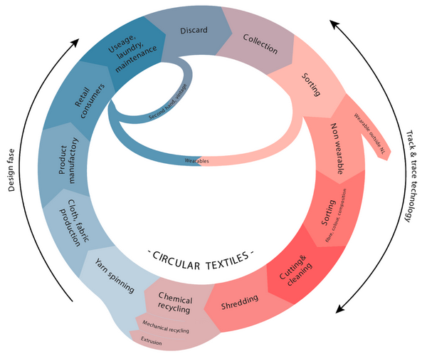
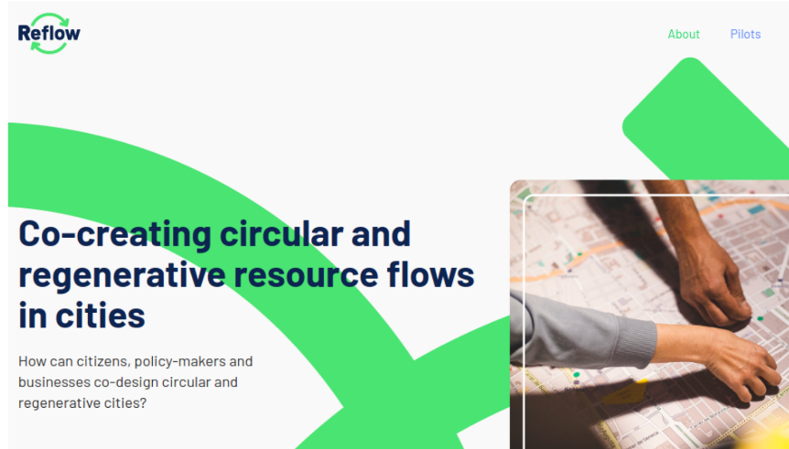
REA Accounting for the Climate
Operations: municipal
Reflow is a project in process that is using Valueflows for municipality-wide circular economy projects in Europe.
Industries include wastewater heat, food market, textiles, plastics, energy monitoring, event construction.
Notes:
6 pilots, each focusing on one industry, working with operational and analytical levels

Slide 13

REA Accounting for the Climate
Analytical: provincial
This was done with a group in Nova Scotia with a group called Ecology Action Center, at the provincial level. We can see the comparison of different fishing methods, and their effects on fishing grounds.
Notes:
A regional scope, again one industry. From this analysis, they created a co-op for sustainable fishing and markets for the co-op

Slide 14
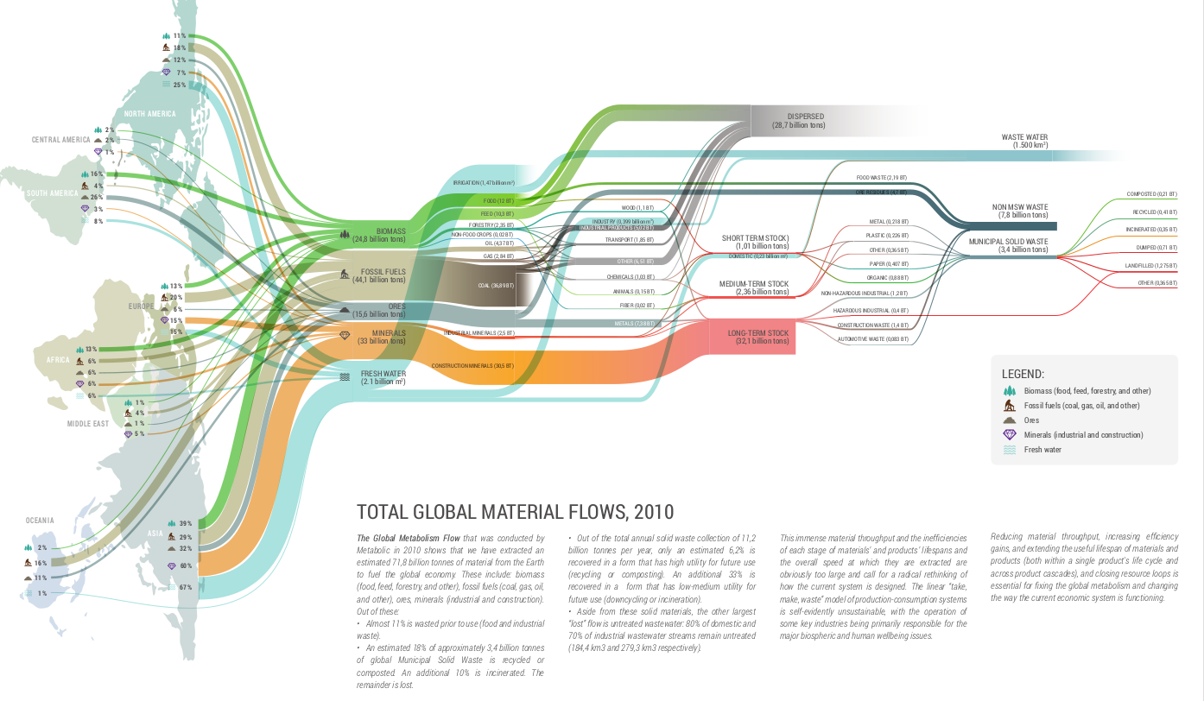

REA Accounting for the Climate
…. or global
Notes:
We were not working with Metabolic when they created this, but it is a great example of visualization of global resource flows.

Slide 15
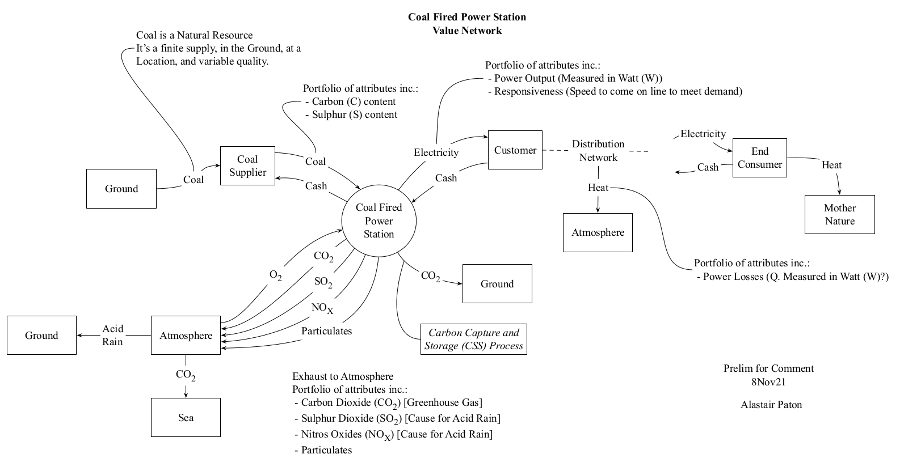
REA Accounting for the Climate
Current discussion
Notes:
We were not working with Metabolic when they created this, but it is a great example of visualization of global resource flows.

Slide 16
REA Accounting for the Climate
Accounting without resource flows
If continuous resource flow data is not available, accounting can be done by aggregating economic (and ecological) events.
Since events are what affect resources, including “externalities”, if anything resembling event data is available, so is much of the accounting data, and can be “sliced and diced” by organization, location, type of event, type of resource, or whatever is available.

Slide 17
REA Accounting for the Climate
Links and references
Value Flows documentation: http://valueflo.ws
Many REA links: https://valueflo.ws/appendix/rea.html
Kate Raworth’s doughnut: https://www.kateraworth.com/
Nova Scotia fish project: http://locecon.org/nova-story/
Reflow: https://reflowproject.eu/
Dyne: https://www.dyne.org/
Metabolic: https://www.metabolic.nl/
NY Textile Lab: https://www.newyorktextilelab.com/
Fibershed: https://fibershed.org/
Basyn: https://www.youtube.com/watch?v=08OPo6zWdlw&t=1s
Shiro: https://shirocoop.xyz/
Seedshare: https://www.hypergroove.org/seedshare
Notes:
In the order they appeared in the slides

