Slide 1

That’s our resource!

Slide 2
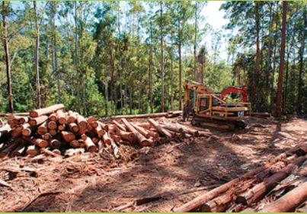
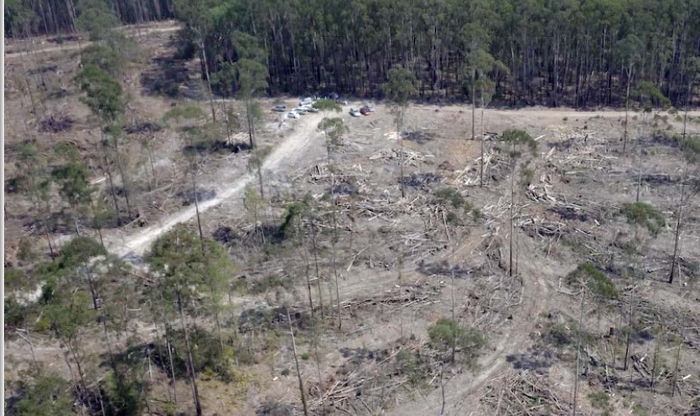
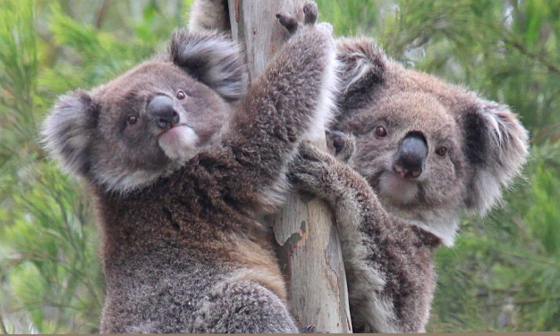
Logs
Logging
Timber company
Chips
Equipment
Forest
Dead habitat
Now what???
Displaced

Slide 3
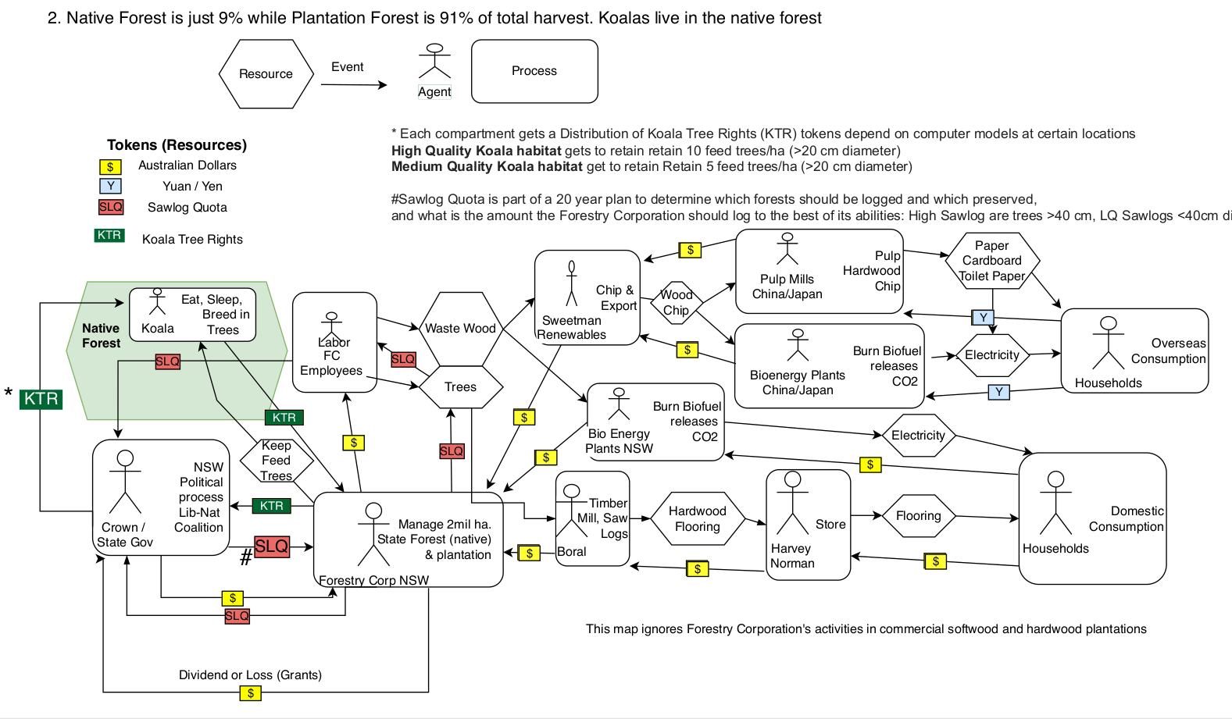
This is the current situation.

Slide 4
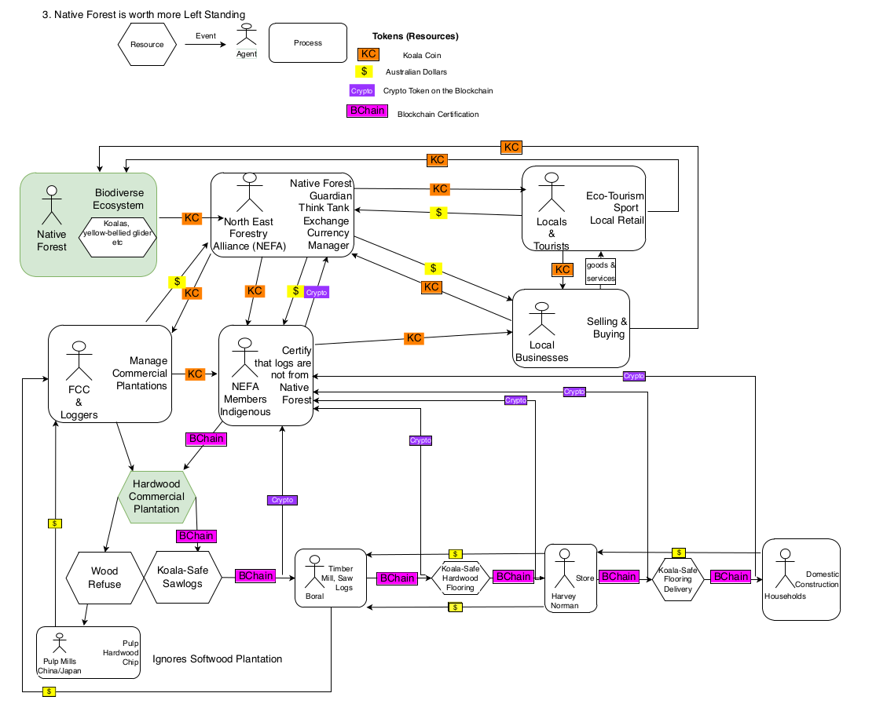
This is the proposed situation.

