Slide 1
Blood Bank Management System
Full Stack Web Application | Java Spring Boot | Angular | MySQL | Developed by Nikil Valusa

Slide 2
Project Overview
The Blood Bank Management System is a scalable full-stack web application designed to manage blood stock, user registrations, and urgent requirements. It streamlines the blood donation process, supporting both users and admins with efficient operations and real-time data updates.
Tech Stack: Java Spring Boot, Angular, REST APIs, MySQL, Swagger, Docker

Slide 3
Key Features
User Registration & Login with validations
Blood availability search by area, state, blood group
Admin CRUD operations for blood inventory
Real-time filtering and urgent requirements list
REST APIs with Swagger documentation
Future-ready architecture for JWT and cloud deployment
Landing Page showcasing the Blood Bank System entry point with Admin and User login options.

Slide 4
Functionalities
• Created two microservices as part of the project and connected it using Rest template.
• Implemented Junit and Mockito frameworks to test the modules of service and controller layers.
• Implemented swagger to build API documentation with different endpoints.
• Created custom exception handling for different modules to maintain normal flow of application.
• Involved in developing the UI using Html, CSS and Angular framework.
• Used Spring boot and JPA repository to manage the user data such as create, read, update and delete.
• Implemented validations for client side and server side for properties and attributes.

Slide 5
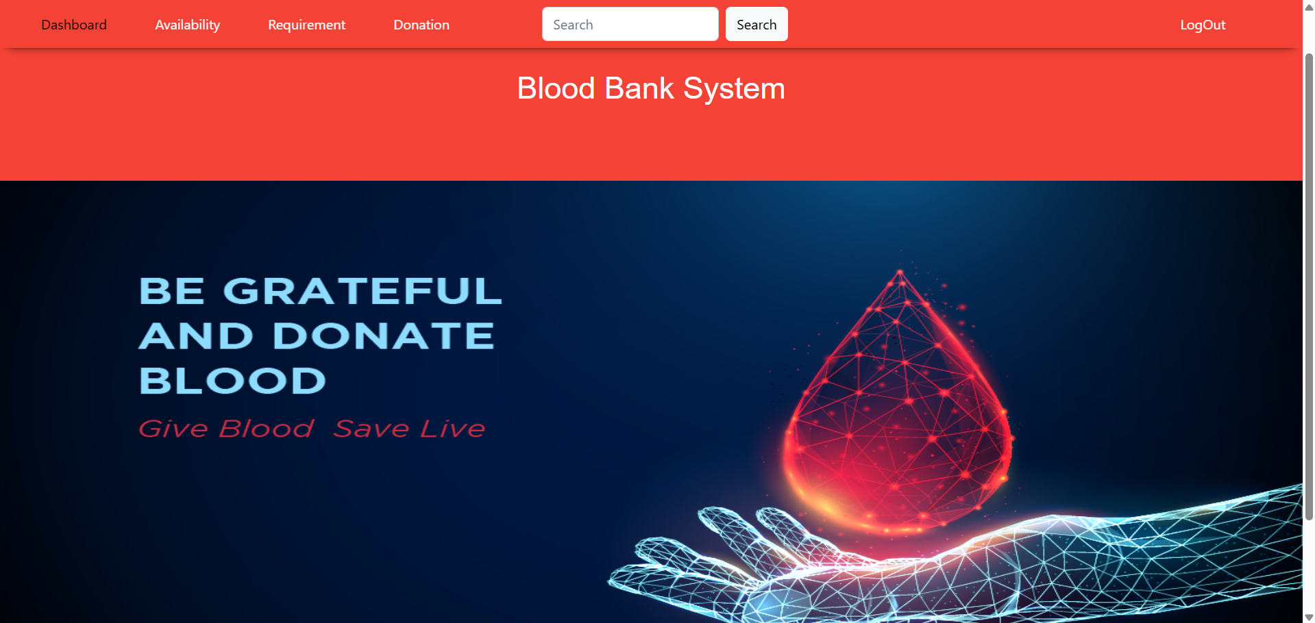
Dashboard
Detailed Blood Record View displaying individual blood donation details fetched from the database.

Slide 6
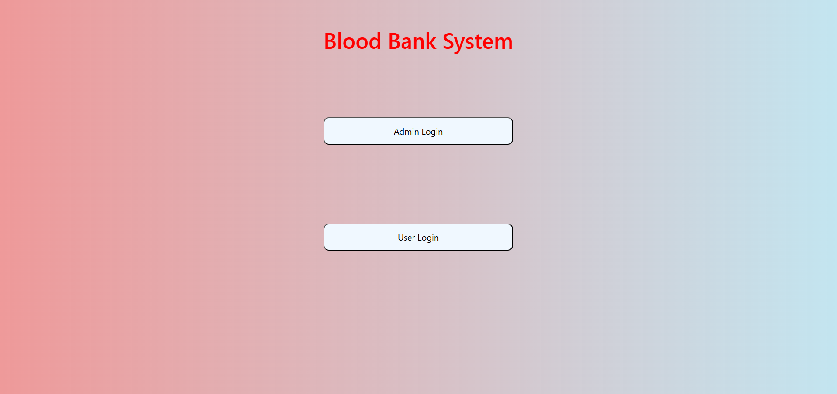
Landing Page
Admin Dashboard - Blood Availability Table displaying available blood records with update and delete actions.

Slide 7
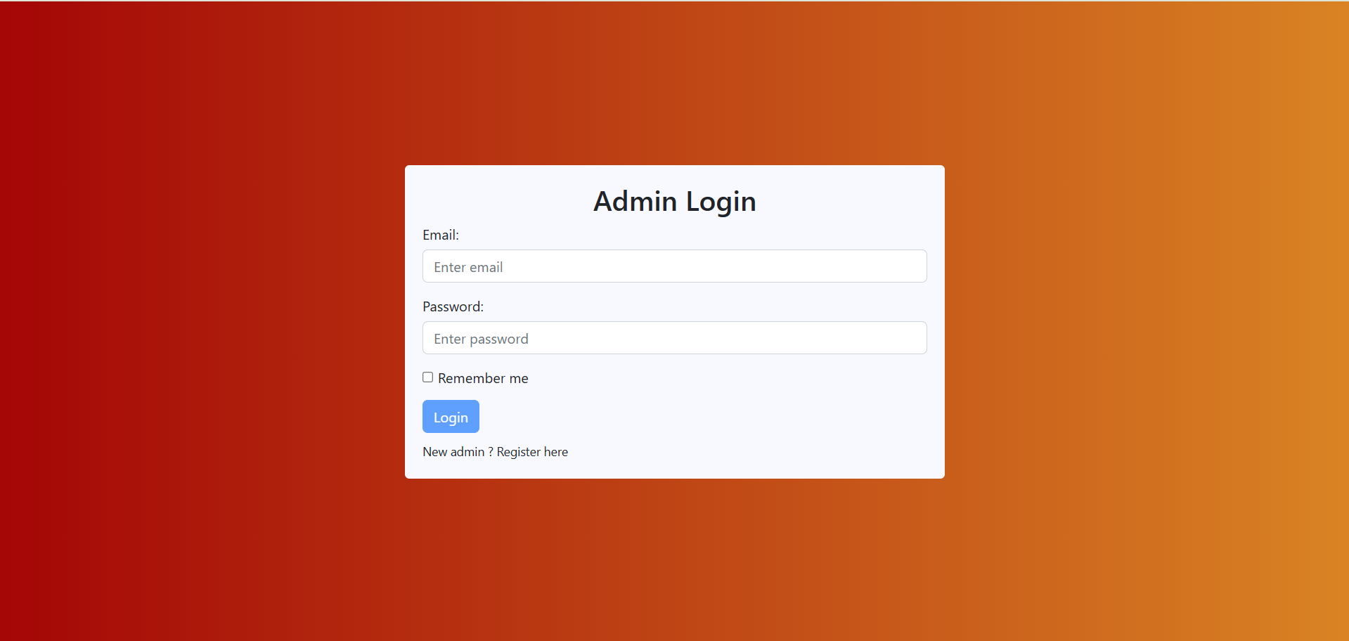
Admin Login Screen
Add Blood Details form for the Admin to register new blood records in the system.

Slide 8
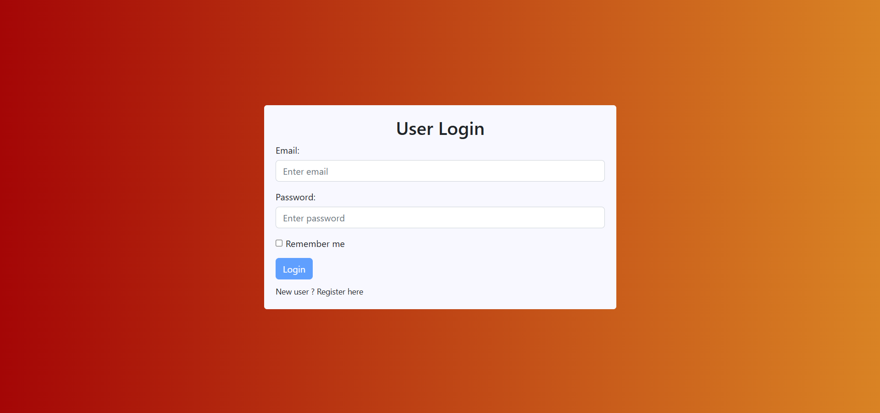
User Login Screen
Dashboard Banner promoting blood donation awareness to motivate users.

Slide 9
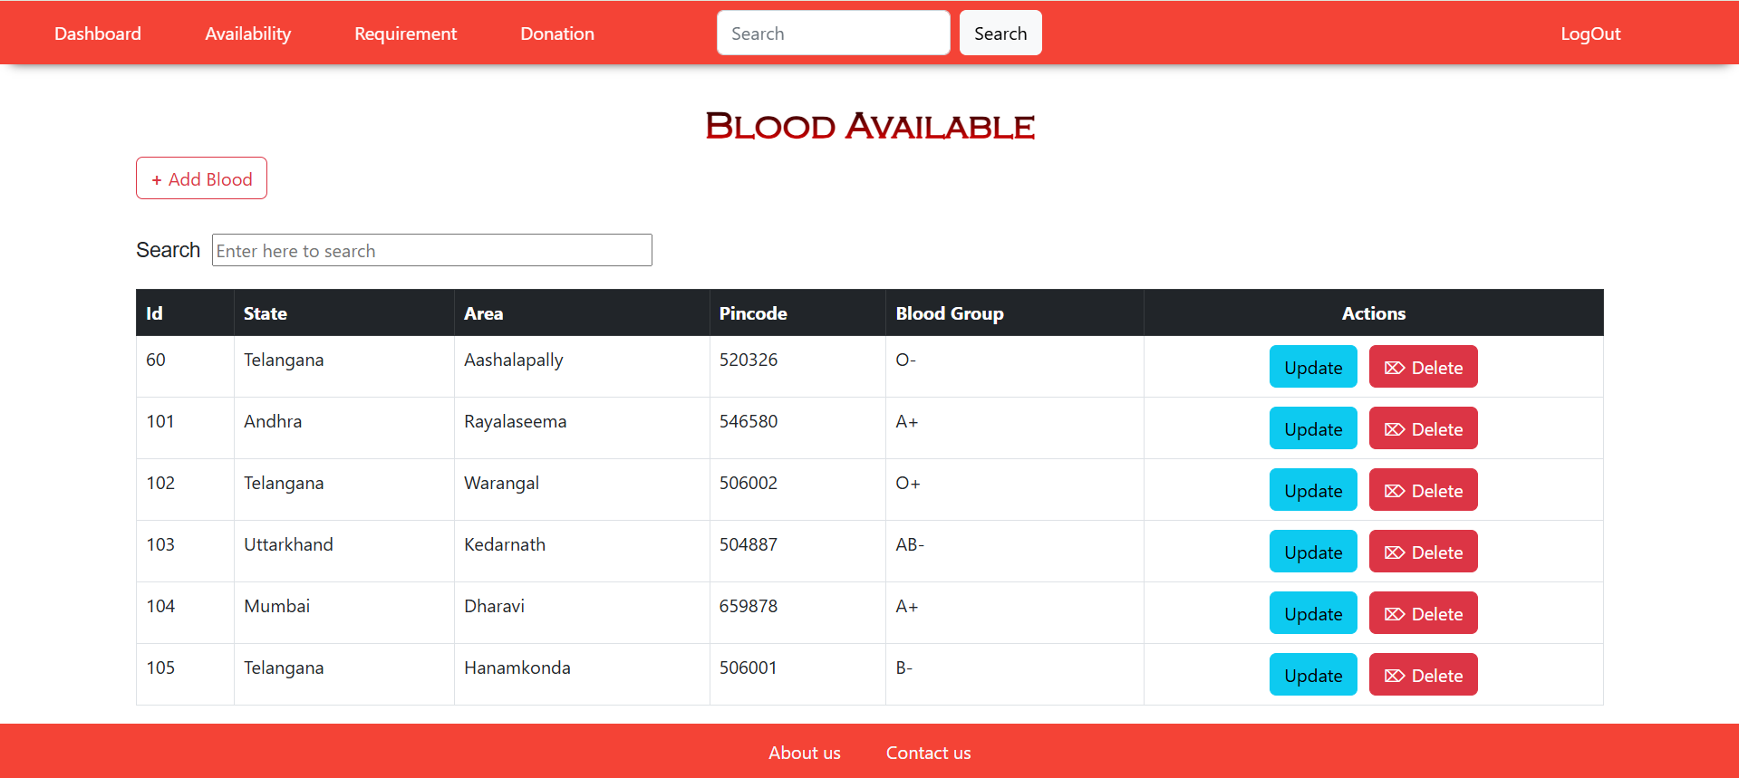
Blood Availability (Admin)
User View of Blood Availability table showcasing records with blood group, state, area, and detailed view.

Slide 10
REST API Endpoints
/user/register (POST) - Register a new user
/user/login (POST) - User login
/admin/register (POST) - Admin registration
/admin/login (POST) - Admin login
/blood/available (GET) - List all blood entries
/blood/add (POST) - Add new blood record (Admin)
/blood/update/{id} (PUT) - Update blood record
/blood/delete/{id} (DELETE) - Delete blood record
/blood/urgent (GET) - List urgent blood requirements
Admin Login Page enabling secure access for administrators to manage blood inventory.

Slide 11
Technology Stack
Backend: Java, Spring Boot, Spring Data JPA, RESTful APIs
Frontend: Angular, TypeScript, HTML5, CSS, Bootstrap
Database: MySQL
Tools: Swagger UI, Maven, Docker, Postman
Deployment Ready: AWS Elastic Beanstalk / Azure
User Login Page allowing users to securely check blood availability and raise requests.

Slide 12
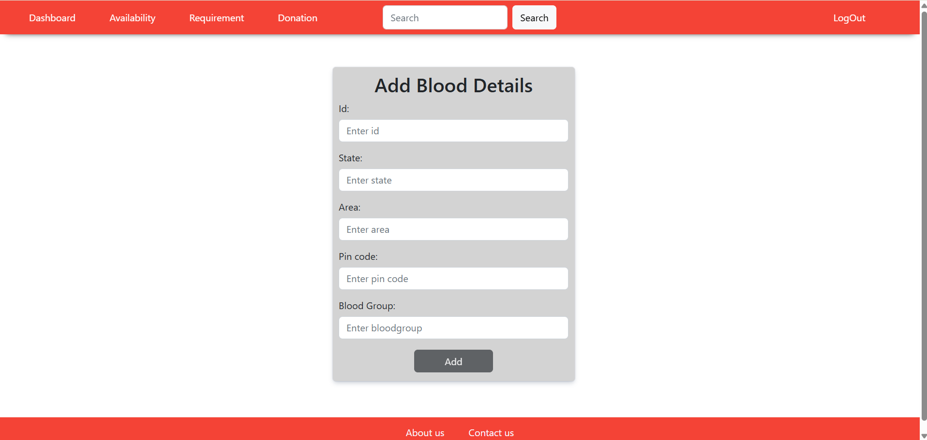
Add Blood Record Form
Urgent Blood Requirement page listing critically needed blood groups and locations.

Slide 13
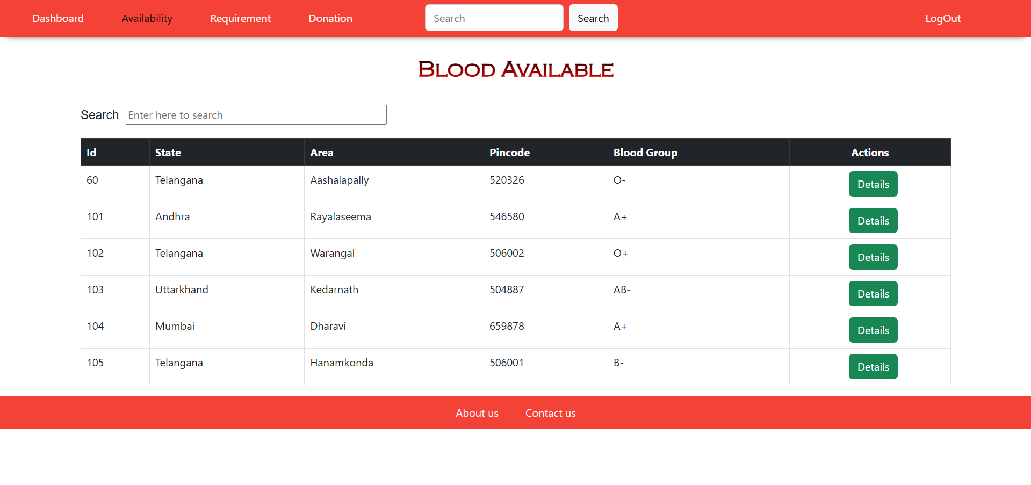
User Blood Availability View

Slide 14
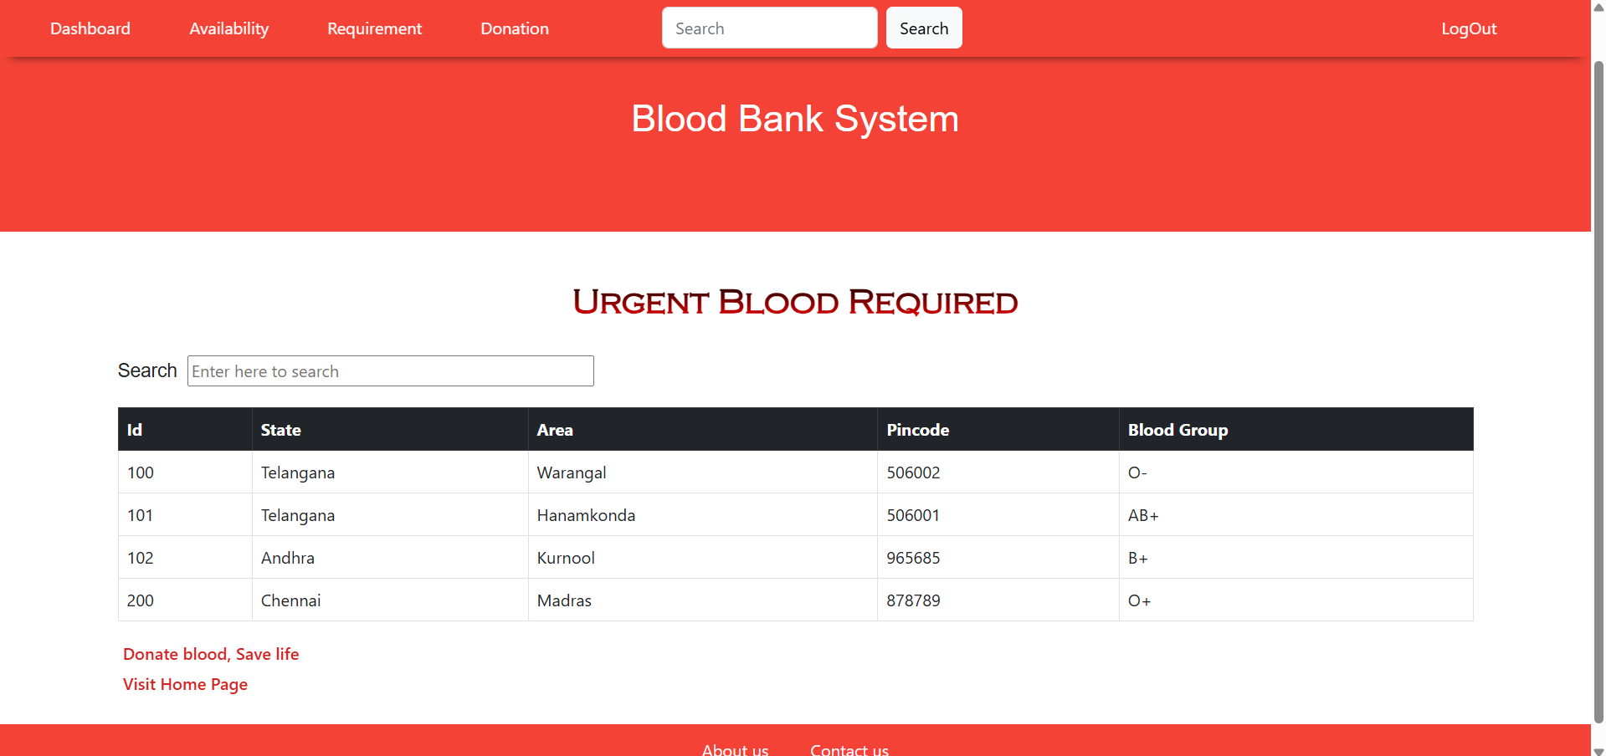
Urgent Blood Requirement List

Slide 15
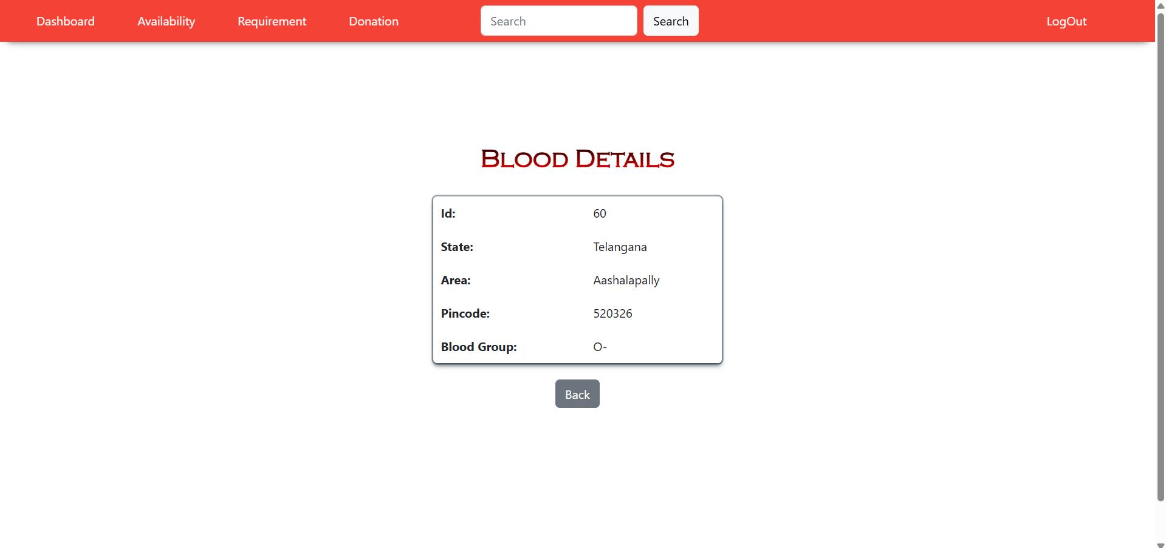
Detailed Blood Record View

Slide 16
Deployment Ready
✅ Spring Boot backend ready for AWS / Azure
✅ Angular frontend compatible with Netlify / Vercel
✅ MySQL database configurable locally and on the cloud
✅ Docker-ready architecture for containerization

Slide 17
Conclusion
The Blood Bank Management System is a comprehensive full-stack project designed with best coding practices, modular architecture, and a clean user interface. It enhances the blood donation process while supporting future scalability, cloud deployment, and advanced features like JWT security.
Developed by Nikil Valusa

