Slide 1
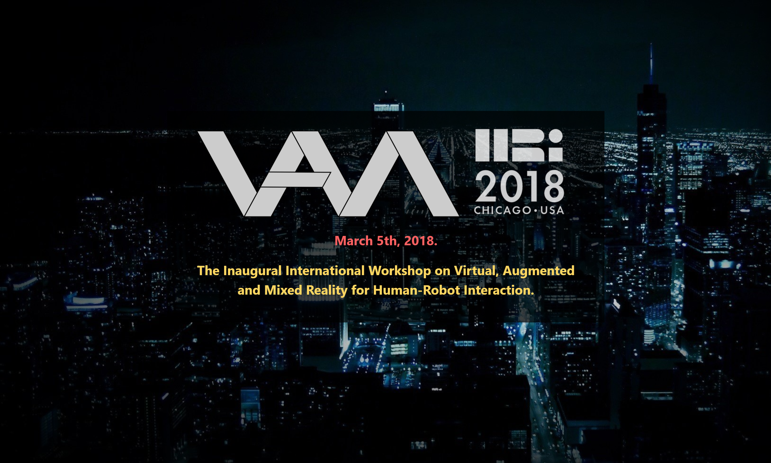
[CFP] Inaugural Workshop on Virtual, Augmented and Mixed Reality for Human-Robot Interaction
Collocated with HRI 2018, Chicago
[link] http://vam-hri.xyz/ [contact] vamhri2018@easychair.org
The 1st International Workshop on Virtual, Augmented, and Mixed Reality for Human-Robot Interaction (VAM-HRI) seeks to bring together researchers from different areas of the HRI, Robotics, Artificial Intelligence, and Mixed Reality communities with the goal of identifying and codifying the challenges in the emerging area of mixed reality interactions between humans and robots. While there has been sporadic work in this area during the last decade, with interest mostly confined to industrial applications, recent advances in the space of mixed reality technologies have opened up exciting avenues of research in the field of HRI. This is thus the first workshop of its kind at an academic AI or Robotics conference and is intended to serve as a timely call to arms to the academic community in response to the growing promise of this emerging field.
We welcome contributions across a wide range of topics but not necessarily limited to:
Mixed reality intention communication
AR-based behavior explanation
AR/VR for robot testing and diagnostics
VR for HRI human-subject experimentation
Efficient representations for AR/VR
Mixed-reality language grounding
AR-augmented natural language generation
Mixed reality robot control interfaces
Hardware/software for MR-based HRI
Identification and analysis of HRI problems that can benefit most from emerging AR and VR technologies.
Submission Instructions
FULL PAPERS: 6-8 page papers presenting novel work.
EXTENDED ABSTRACTS: 2-4 page papers presenting previous, current, or proposed work.
Submit here → https://easychair.org/conferences/?conf=vamhri2018
All submitted papers should conform to the 2017 ACM SIG Proceedings format (as used for the HRI main conference). Papers will undergo mutual review; as such, authors of submitted papers will be expected to provide a small number of reviews for fellow authors. All accepted papers will be accompanied by lightning talks and poster presentations and will be archived on the workshop website.
SUBMISSIONS DEADLINE: February 9th, 2018
NOTIFICATION OF ACCEPTANCE/REJECTION: February 16th, 2018
Organizing Committee
Tom Williams, Colorado School of Mines
Daniel Szafir, University of Colorado Boulder
Tathagata Chakraborti, Arizona State University
Heni Ben-Amor, Arizona State University
Advisory Board
Matthias Scheutz, Tufts University
Subbarao Kambhampati, Arizona State University
Bilge Mutlu, University of Wisconsin – Madison
William Hoff, Colorado School of Mines

