Slide 1




CaDoD: Phase 3 Cats vs Dogs Detector
Group 25
Martin Breth
mbreth@iu.edu
Vicente De Leon
vdeleonw@iu.edu
Kelly Craig
craigke@iu.edu
Courtney Payton
coupayto@iu.edu

Slide 2
Project Description
The goal of this project is to create machine learning pipelines for classification and object detection of cat and dog images. The dataset for this project includes 12,966 RGB colored cat and dog images and image bounding box information. We performed the following preprocessing steps: rescaled the images to be all the same size, took the RGB intensity values and flattened them from a 3D array to a 2D array, and image augmentation. After preprocessing we conducted feature engineering with histogram of oriented gradients (HOG) algorithm. This data entered into our regression and classification pipelines with parameter tuning. The regression model was built to predict an accurate bounding box around a cat or dog in an image. We accomplished this by using a linear regression model and we optimized the model by testing ridge, lasso, and elastic net regularization techniques. Our classification pipeline was created to predict whether an image contained a cat or dog. We optimized the classification prediction by testing logistic regression, naive bayes (gaussian and bernoulli), and k nearest neighbor models.

Slide 3
Exploratory Data Analysis
The data set for this project contains 12,966 RGB images of cats and dogs with various shapes and aspect ratios. In addition, data containing image bounding box coordinates of the object are stored in a .csv file. There are 6,855 data points classified as dogs and 6,111 as cats.
In the next few slides, we will display visual representations of the data set with examples of image count bar plots, correlation map, histogram and bar plots of image size count

Slide 4
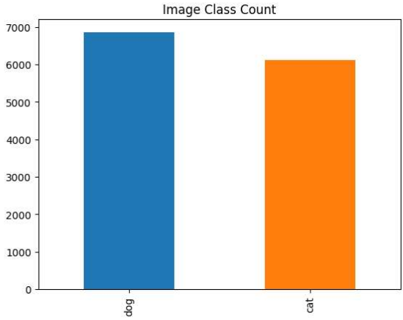
Exploratory Data Analysis
Notes:
This is a bar plot of the image class count for dogs and cats. There are 6,855 dog images and 6,111 cat images.

Slide 5
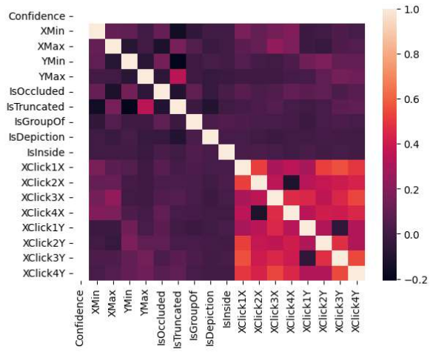
Exploratory Data Analysis
This is the correlation matrix with the range from +1 to -1 where +1 is highly and positively correlated and -1 will be highly negatively correlated.
Notes:
XClick1X, XClick2X, XClick3X, XClick4X, XClick1Y, XClick2Y, XClick3Y, and XClick4Y columns are correlated.

Slide 6
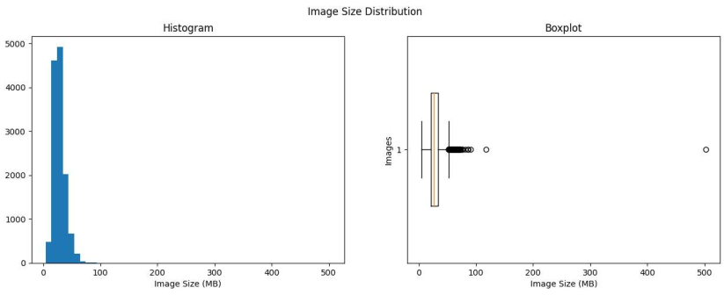
Exploratory Data Analysis
Notes:
This is a histogram and boxplot of the all the image shape counts in MB. 512x384 is the image size that occurs the most.

Slide 7
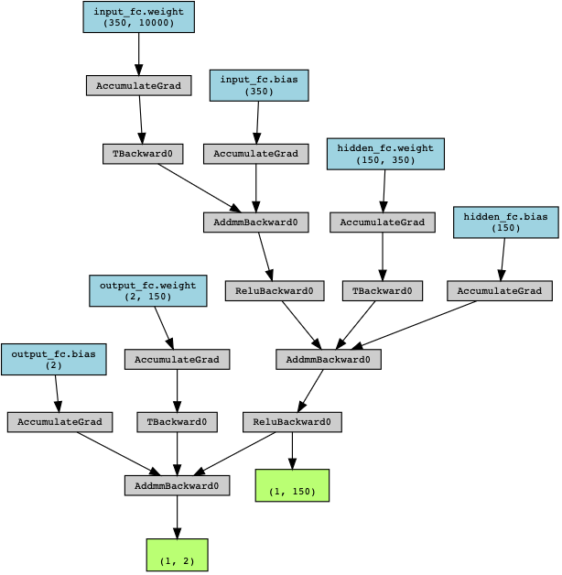

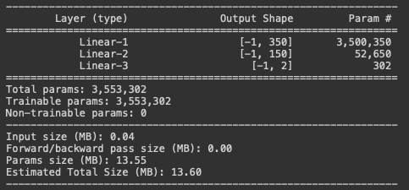
MLP Classification Model
PyTorch transform for data aug.
Optimizers: Adam, SGD, RMSprop
Input: 1x100x100
Output: 2 classes (cat and dog)

Slide 8
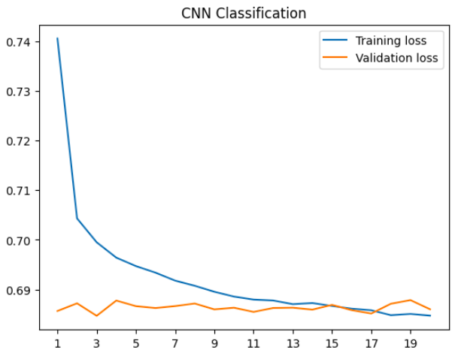
Convolutional Neural Network (CNN)
Multi-headed cat-dog detector using the OOP API in PyTorch
Incomplete
Images -> Cat/Dog & bounding box coordinates
Loss: CXE + MSE
CNN for Classification
Images -> Cat/Dog
Loss: CXE

Slide 9
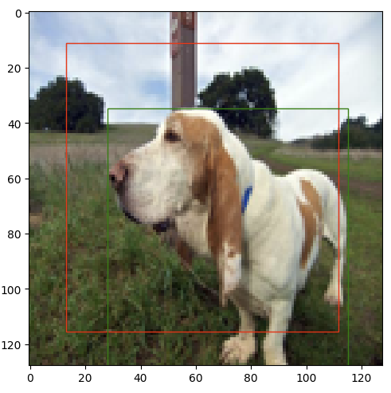
PyTorch model for regression with MLP
Input: Images
Output: Bounding Box Coordinates
5 Experiments total:
Baseline
Batch size
Regularization (adam - weight decay)
Optimizers: Adam and SGD
Image Augmentations - (bounding box updated)
Green = True
Red = Predicted

Slide 10

Alex Net
Implemented an architecture of AlexNet to fit our data
Reshaped test and train values to fit classification Alexnet model
Likely overfitting due to large parameters
Notes:
The final model is an application of AlexNet, with our own implementations for train and test values. AlexNet is known to be one of the most efficient models for image detection, and we wanted to explore the implementations as a stretch goal, and continue to explore this route for phase 4.

Slide 11
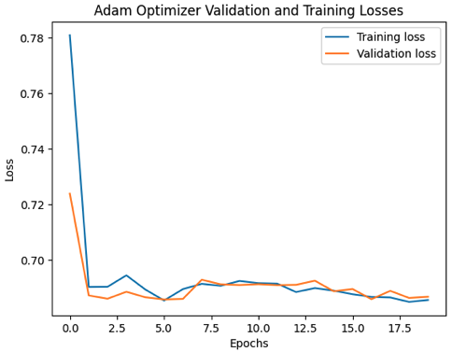
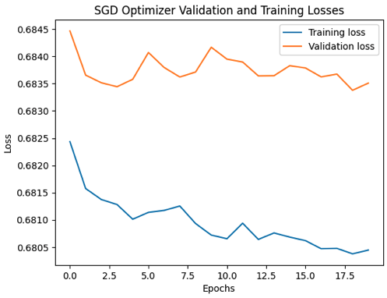
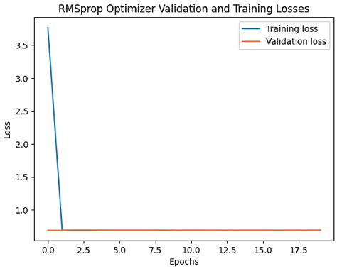
MLP Classification Classification Optimizer Graphs
Training and Validation losses were behaving correctly for each optimizer.

Slide 12
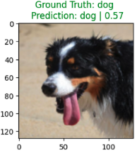
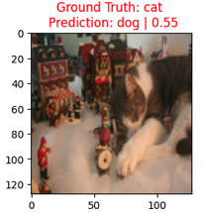
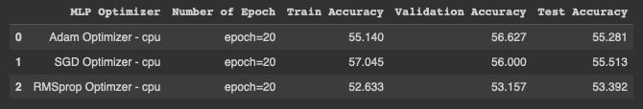
Results MLP Classification
Mixed results after every training.
RMSprop has the highest Train accuracy
Adam has the highest Validation accuracy.
SGD optimizer had the highest Test accuracy.
Classification report and confusion matrix showed that we needed a more complex MLP model for better results.
Problem: it classifies more dog images than cat images

Slide 13
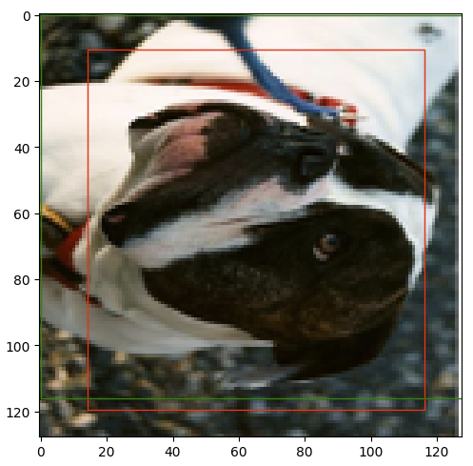
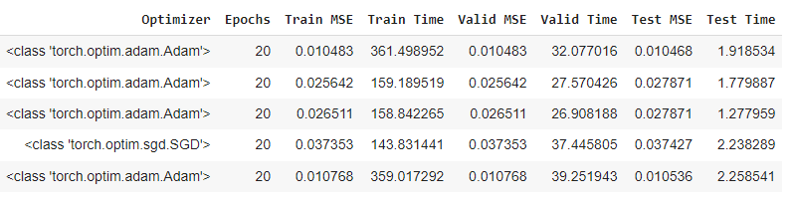
Results Regression
Best Model:
Adam optimizer
small batches (96 train, 32 test)
No regularization or augmentation
Improvements:
Add more types of augmentation to the dataset
Try difference metrics like intersection over union
Image after 90 degree Rotation

Slide 14
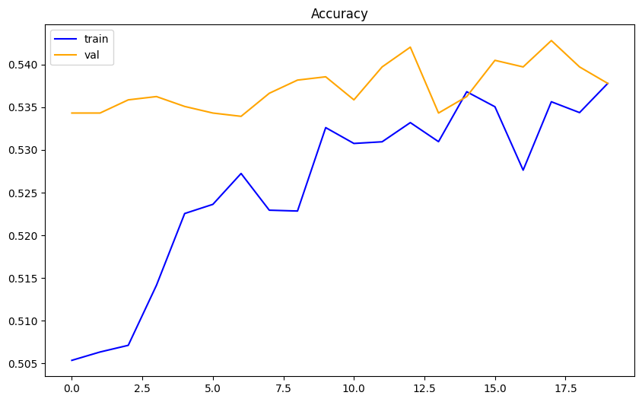
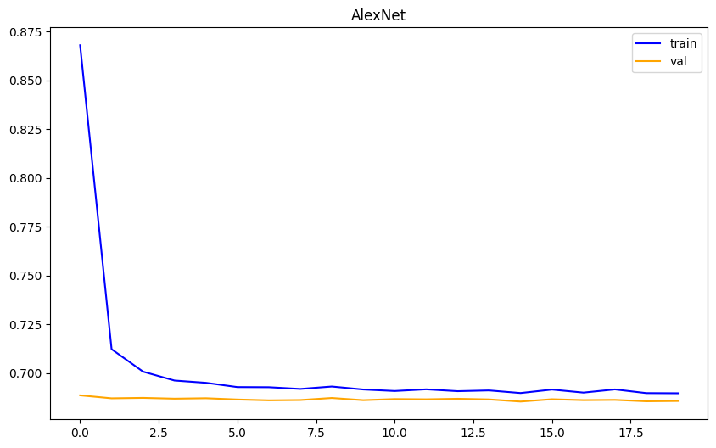
Results AlexNet
Results from the implementation of this model with 20 epochs received a highest test accuracy of 54.28% and loss of 0.6857
Notes:
Since this model has numerous parameters, it is very likely there is overfitting.
In phase 4, I believe this model can achieve optimal results through applying data augmentation steps like crop and rotation we did in phase 2. I would also like to test different optimizers, learning rates, and a larger set of epochs.

Slide 15
Conclusion
In conclusion, our project focuses on developing optimal cat and dog image detection machine learning techniques. Our goal is to improve accuracy in both our classification and regression models through implementing various preprocessing methods and creating neural networks. We created a PyTorch implementation of Multi-Layer Perceptron (MLP) regression and classification neural networks along with Alexnet framework adoption that is known to be one of the most efficient models for image detection. The best model for MLP Pytorch regression had an MSE of 0.01 and used an adam optimizer, small batches (96 for training, 32 for test), and no regularization. The CNN for classification after 20 epochs with SGD optimizer had testing accuracy 55.55%. For Alexnet, the best results yielded a test accuracy of 54.28%, train accuracy of 53.78% and their respective losses of 0.6863 and 0.6897. We found out that our best classification model using SGD optimizer gave the best train accuracy for 57% and the best test accuracy for almost 57%.

