Slide 1

Electronic Voting System

Slide 2

Overview
The purpose of this project, Online Voting System is to conduct an election procedure online to make the voting process convenient and efficient for the citizens of India.

Slide 3

Introduction
Electronic Voting System(EVS) is an application to automate the process of planning and managing the voting system, as well as the actual voting activity.
EVS is defined with three types of users (Administrator, Electoral Officer & Voter).

Slide 4
Technologies
Frontend
Backend
Html & Css
React Js
Css Bootstrap
React Bootstrap
Material UI
Redux
Jest
Java
Spring Boot
Postgresql
J-unit

Slide 5
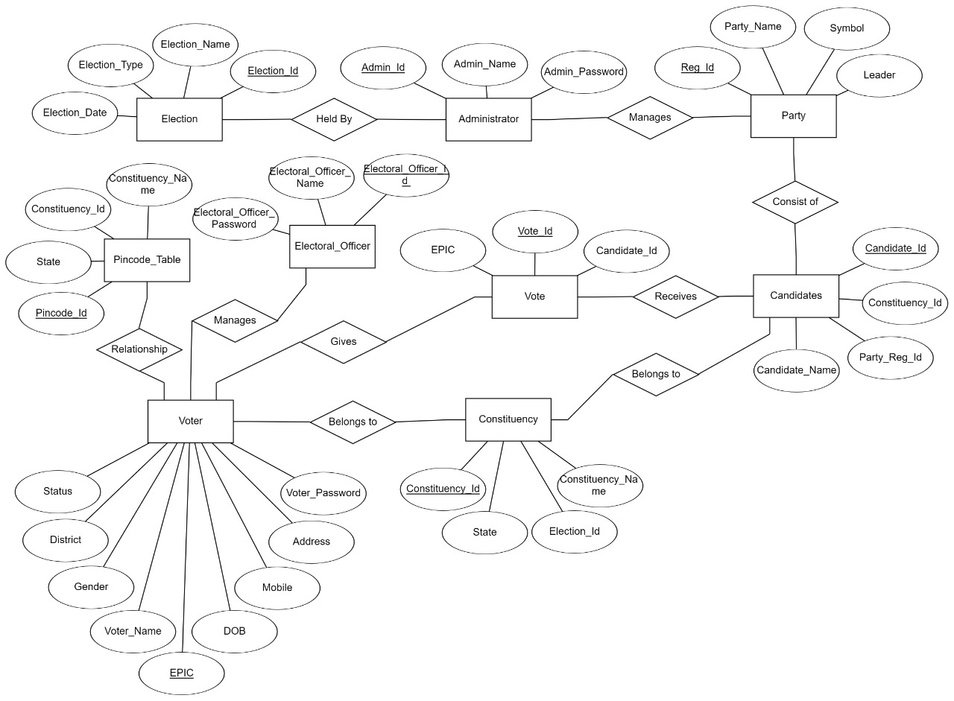
ERD Snapshot

Slide 6
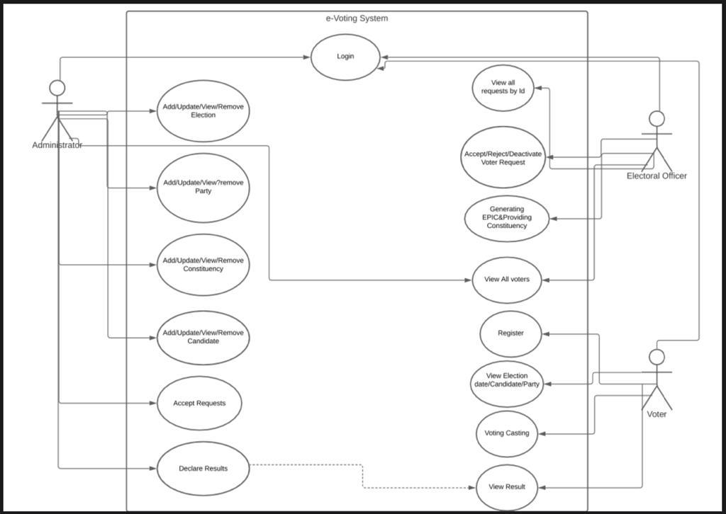
Use Case Diagram

Slide 7
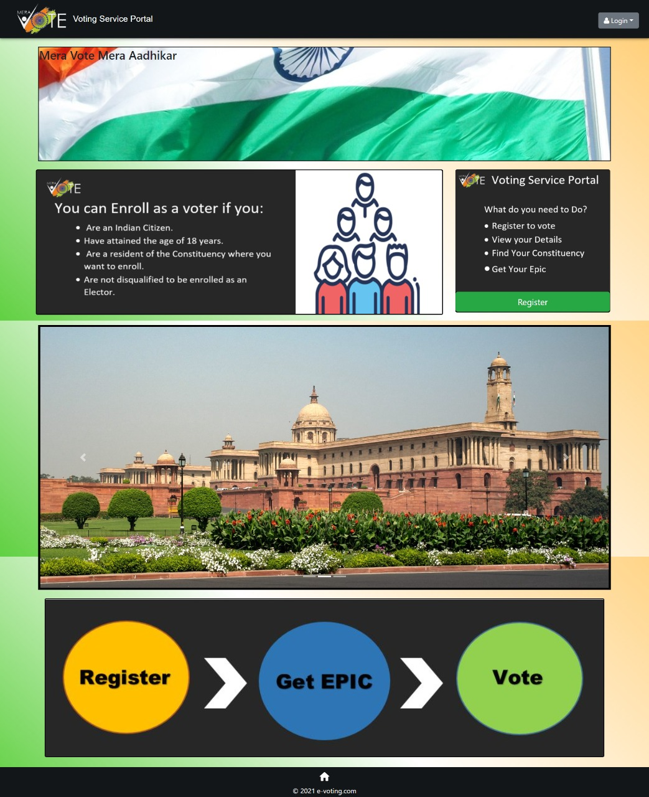

Slide 8
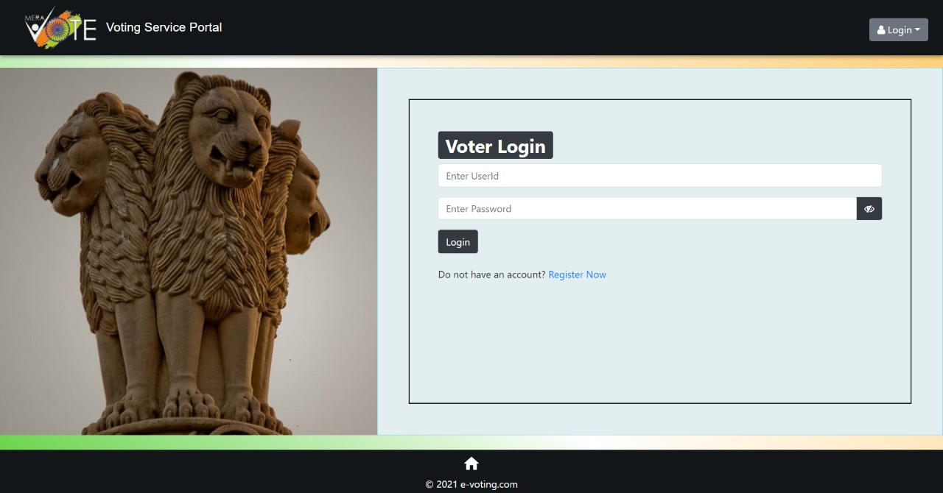
Login Page

Slide 9
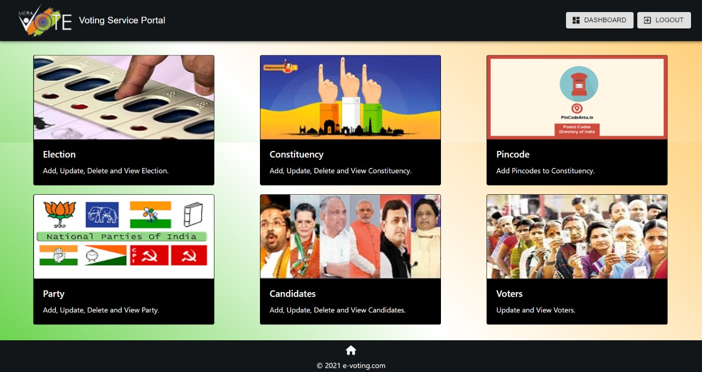
Admin Dashboard

Slide 10
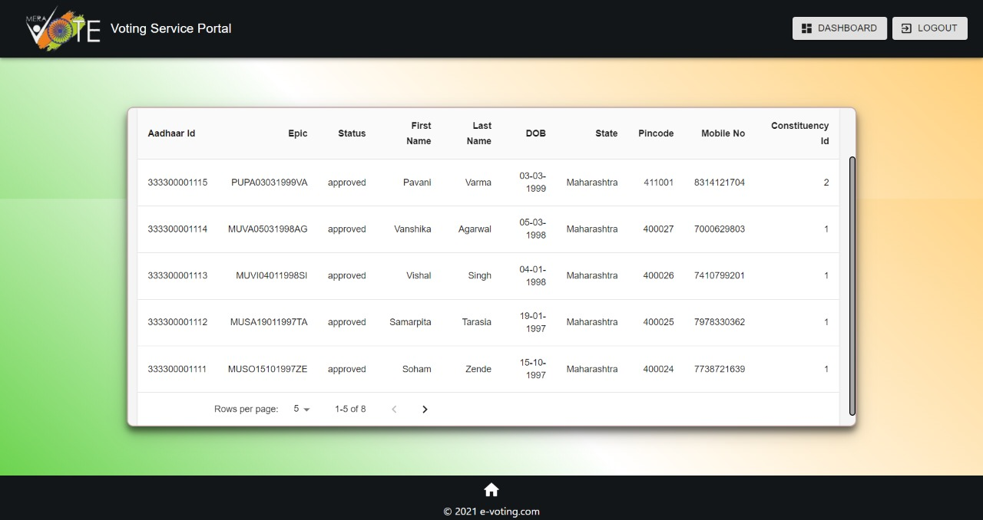
Electoral Officer Table

Slide 11
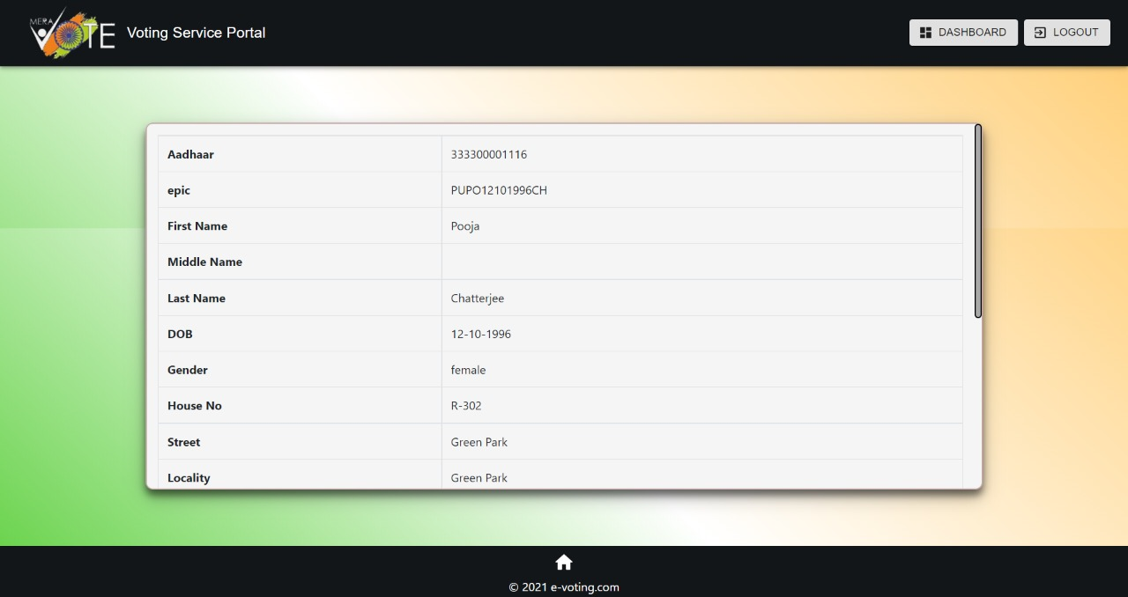
Voter profile

Slide 12
Conclusion
Electronic voting system is emerging as significant alternative to the conventional system in the delivery of reliable and trusted election.
Here, we have implemented the frontend and the backend, which results to a successful execution our project, e-Voting System.

Slide 13


