Slide 1
Summer 2022 (CS-7000-108)
Vamsi Krishna Muppala
R11770853

Slide 2
Epilepsy
Brain cells communicate with other by swapping the chemicals, when they do this ,they generate electricity.
Seizures: The sudden burst of that electrical activity can cause a person to experience new sensations or movements. (Firing rate increases and group of neurons fires at the same time).
Epilepsy: It is a condition that causes people to have seizers.(person has repeated seizures)
Types :
Tonic-clonic seizure: Person falls on the floor and whole body jerks.
Focal seizure: only one part of the brain is affected.
Absence seizure: person might seem distant for a moment.
Myoclonic seizure: One part of the body suddenly jerk.
Tonic seizure: Where the person will be suddenly stiff .
Atonic seizure: Where all their muscles relaxes at once.
Tests:
Prolonged video EEG done during a stay in the epilepsy monitoring unit.

Slide 3
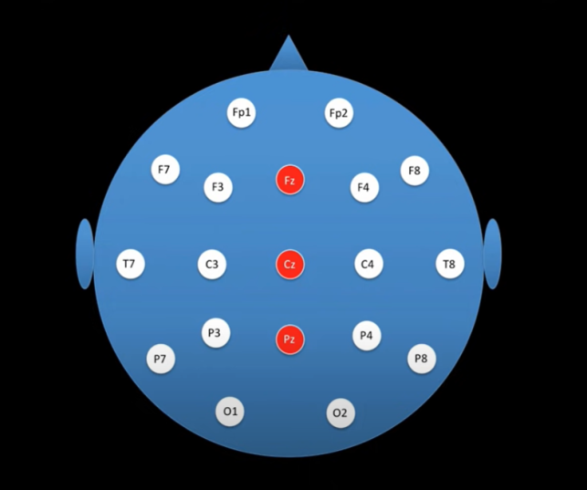
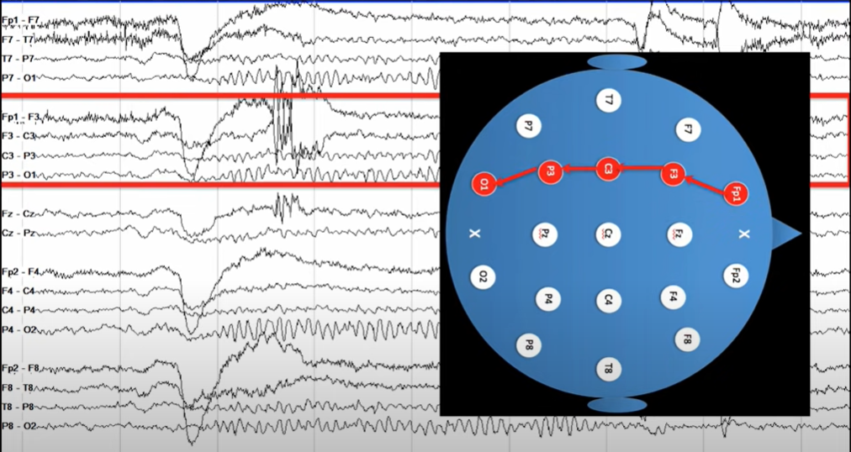
EEG
Used to measure the electrical activity of the brain .
It helps to identifying the type of epilepsy ,what may be triggering the seizures and how to treat it.
It detects the activity of large groups of neurons that are active at the same time.

Slide 4
Phases of an EPILEPTIC Seizures:
Pre-ictal state:
An hour duration before each seizure.
Ictal state:
During a seizure.
Inter-ictal state:
Between two successive seizures.
During seizure, the EEG can show sinusoidal activity pattern. i.e.; rhythmic pattern.
Normally evolution in frequency and amplitude of rhythmic patterns are observed during seizures.

Slide 5
Machine Learning Algorithms
Linear Regression
Logistic Regression
Decision Tree
SVM (Support Vector Machine) Algorithm
Naive Bayes Algorithm
KNN (K- Nearest Neighbors) Algorithm
K-Means
Random Forest Algorithm
Dimensionality Reduction Algorithms
Gradient Boosting Algorithm

Slide 6
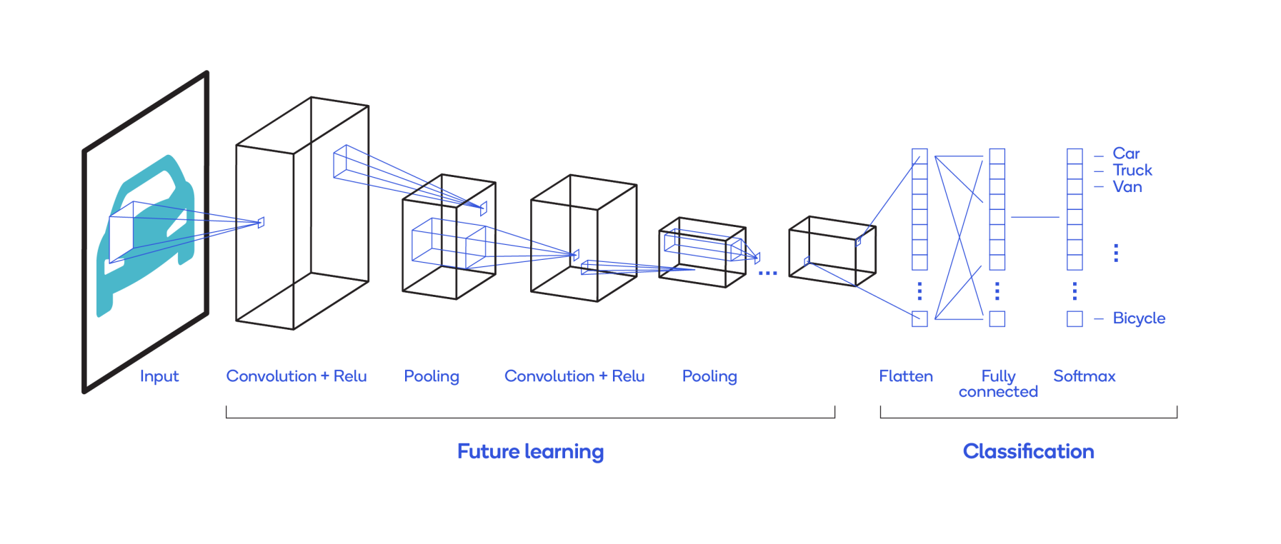
Convolution Neural Network
It is used because it can detect patterns and widely used for image processing.
Convolution Layer: It contains filters which is basically a matrix with random values ,which is used to extract features from the images.
ReLU Layer: It is a non-linear layer.
Padding: We add padding at the corner of the image to solve the border problem and preserve the same information.
Pooling: Down sample the detection of features in feature maps.

Slide 7
Literature Overview/Abstract:
In this paper,have used the frequency domain features to extract information from EEG signals. They have used non-linear techinques and deep machine learning techniques based on multilayer perceptrons to improve he accuracy of seizure detection.[1]
They have used two approches ,XGBoost is used for the Machine learning approach and ANN is used for Deep learning approach. Also,10-fold cross validation is used for the validation purpose.[2]
The main aim is to extend the conventional approach of epileptic seizure detection utilizing raw power spectra of EEG signals and use of Convolutional neural networks (CNN). It utilizes wavelet transform to compute the frequency characteristics of multi-channel EEG signals.[3]
This paper provides an up-to-date review of the recent epileptic seizures approaches. It is focused mainly on feature extraction methods and classification algorithms.The algorithms discussed are Naïve Bayes, Support Vector Machine (SVM), and Linear Discriminant Analysis (LDA); and also LSTM, CNN .[4]
In this Paper ,they have combined deep learning framework to jointly extract multi-view features from both unsupervised multi-channel EEG reconstruction and supervised seizure detection. They have constructed a new autoencoder-based multi-view learning model by incorporating both inter and intra correlations of EEG channels to maximize the power of multi-channel information. They have develop a channel-aware seizure detection module that guides the model to focus on important and relevant EEG channels via a channel-wise competition mechanism.[5]
CNN-BiRNN mainly consists of three parts: the multi-scale convolution model(to extract multi-scale features), the attention model(exploits the differences among channels for seizure detection), and the multi-stream bidirectional recurrent(the robust temporal features are obtained) model.Moreover a channel dropout method is proposed, for the model training stage, to obtain inconspicuous characteristics from all the channels of a certain EEG signal.[6]
Have proposed an automated system to classify the EEG data into ictal, non-ictal, and pre-ictal classes using ResNET-50, a subclass of convolutional neural networks, by converting 1D EEG data into 2D EEG images.[7]
A novel convolutional neural network is proposed to analyze time, frequency, and channel information of EEG signals. . The model uses three-dimensional (3D) kernels to facilitate the feature extraction which helps to have more flexible receptive fields. [8]
Proposed model is a Multi-scale 3D-CNN along with bidirectional Gated Recurrent Unit (GRU) with Deep Neural Network (DNN) model for non-patient-specific detection using multi-channel scalp EEG signals.. The EEG signals are transformed to frequency domain using Short Time Fourier Transform (STFT) to extract spectral features.[9]
In this paper ,they have investigated on deep network architectures i.e. stacked autoencoders and convolutional networks, for unsupervised EEG feature extraction.The proposed EEG features are used to solve the prediction of epileptic seizures via Support Vector Machines.[10]

Slide 8
A hybrid model ,convolutional neural network (CNN) is used for automatic feature extraction of EEG signals and support vector machines (SVM) is used for epileptic seizure classification.[11]
They have proposed an end-to-end deep learning solution using a convolutional neural network (CNN) in this paper.In CNN, one and two dimensional kernels are adopted in the early- and late-stage convolution and max-pooling layers,respectively. [12]
In this paper, nine machine learning algorithms(Gaussian Naïve Bias (GNB), K-Nearest Neighbor (KNN), Decision Tree (DT), Random Forest (RF), AdaBoost (AdaB), Support Vector Machine (SVM), Gradient Boosting (GB), Multilayer Perceptron (MLP) and XGBoost (XGB)) have been noted and detailed comparative analysis has been exhibited for both hyperparameter tuning and without hyperparameter tuning.Random search cross validation has been used for tuning the hyperparameters.[13]
This paper analyzes on the detection of EEG epileptic seizures using Autoencoders, CNN, and a multi class Stacked Autoencoder-CN model.[14]
In this Paper ,to detect the epileptic seizures support vector machine model is used . Support Vector Machine (SVM) is a classifier formally defined by a separating hyperplane being based on training data (supervised learning) and the algorithm outputs representing the optimal hyperplane.The adopted approach was to extract features from the data in order to be used to train and test data by using machine learning models in MATLAB.[15]
This paper presents the research work provides a comprehensive review for all the state-of-the art ML techniques applied for seizure detection at an early stage by using Electroencephalograph (EEG) signals.[16]
The aim is to implement convolutional neural network (CNN) model with residual layers and an EEG-specific convolutional long short-term memory (ConvLSTM) model.[17]
In this paper, a patient specific seizure detection system using channel-restricted convolutional neural network(CR-CNN) with deep structure is represented. EEG are auto-memorized based on back-propagation mechanism.[18]
This paper presents various neural network architectures to identify if a person has epileptic seizure or not. This is done by extracting different statistical features like mean, median,standard deviation from the collected EEG signals.The three network architectures like Feed Forward network, Elman Network, Cascade Forward Backpropagation Network are used and compared using various performance measures.[19]
In this paper ,they have three stages: In first stage, DWT is used for EEG signal decomposition into its corresponding sub bands. In second stage, extraction of the statistical features from each subband and finally classification of the EEG signals into epileptic seizure and normal has been done using SVM.[20]

Slide 9
In this paper,the work presents a deep learning based multi-scale frequency band feature fusion method to classify seizure EEG signals. All the input signals are transformed into frequency sub-band domain using wavelet transform. Then three different sub-band combinations are formed and are separately given to the convolutional neural network (CNN) to extract the convoluted features.These obtained individual feature maps are combined to form a multi-scale frequency band feature vector. Finally, the Fuzzy based SVM is trained with the resultant feature vector for seizure classification.[21]
A neural network is designed based on a convolutional neural network (CNN) and trained on the electroencephalogram (EEG).[22]
A study on the classifiers used in machine learning and comparing the accuracy between the classifiers.Support Vector Machine(SVM), Extreme Gradient Boosting(Xgboost), Decision Tree Classifier, Linear Discriminant Analysis(LDA), Perceptron, Naive Bayes Classifier, k-Nearest Neighbor(k-NN), and Logistic Regression are eight of the most widely used machine learning classification algorithms used to classify EEG based mostly Epileptic Seizures.[23]
In this paper a novel approach named CC-ELM of automatic epileptic EEG signals detection is proposed.The proposed approach adopts biclustering to perform an unsupervised dimension reduction, which is more suitable to the characteristic of EEG signals.[24]
In this paper they proposed a novel multi-view learning framework with a unified multi-domain feature learning method for seizure epilepsy detection. The discrete wavelet transform (DWT) method to generalize selected five-channel signals into five sets of sub-band frequency components corresponding to five views, which enhances intra-view coherence and cross-view complementary efficiently. Moreover a unified feature learning method is proposed with common spatial patterns (CSP) for statistical and morphological features and a semi-supervised maximum mean discrepancy autoencoder (semi-MMDAE) for cross-channel time-frequency domain representations extraction.[25]
The author proposed a lightweight CNN architecture for seizure classification.[26]
Have proposed a computationally efficient algorithm for seizure detection. Instead of using a purely data-driven approach, we develop a hybrid model-based/data-driven method,combining convolutional neural networks with factor graph inference. Proposed method can generalize well in a 6 fold leave-4-patient out evaluation.[27]
In this study, we present an XGBoost-based method to detect seizures in EEGs. Sixty-four features were selected as the input to the training set, and Synthetic Minority over-sampling Technique was used to balance the dataset.[28]
This paper is based one Deep learning based on 1D convolutional neural networks , as used as models for DL, VGGNET, and ResNet.[29]
In this paper, seizure activities of EEG signals have been detected exploiting 1-D convolutional neural network architecture of deep learning algorithm. It involves the smallest and simplest 1-D convolutional neural network architecture for automated feature selection.[30]

Slide 10
This paper attempts to utilize the Convolutional Neural Network (CNN) classifier by applying the preprocessing steps on the dataset. Divided the samples into separate frequency bands and the parameters are taken for calculating each discrete wavelet transform. The average of the CNN columns is then concatenated with the 4 level Discrete Wavelet Transform operated on the Pre-Processed EEG Signal with Power spectrum calculation value for each frequency band by using machine learning techniques.[31]
The main objective of this work is to provide an ANN framework with optimized performance related to seizure detection.A machine learning framework is employed for seizure detection where the two-layer feature extraction with ANN classifiers are used to categorize seizure and non-seizure data. To get better performance, the dataset are identified through bayes-optimization method.[32]
In this paper the EEG signals were characterized by wavelet, sample and spectral entropy approach and the recurrent neural network classifier is used for the automated detection of epileptic seizures.[33]
In this paper propose a unique mapping of seizure EEG signal for efficient processing with the DRNN. This mapping helps to simultaneously learn both temporal and spatial features of raw seizure EEG respectively.[34]
The proposed system uses a one-dimensional convolutional neural network (CNN) as a preprocessing front-end and a bidirectional long short term memory (Bi-LSTM) recurrent neural network as a back-end.It is without the overhead of features extraction. The evaluation of the proposed system is conducted using k-fold cross-validation to ensure its robustness.[35]
The proposed method uses Long Short-Term Memory (LSTM) neural networks to extract the representative EEG features pertinent to seizures.[36]

Slide 11
Dataset:
CHB-MIT: Collected from Children’s Hospital Boston,with a sampling rate of 256Hz.The recordings are collected from 23 subjects and have been grouped into 24 cases, chb01 – chb24. Cases chb01 and chb21 were obtained from the same subject 1.5 years apart with 22 subjects of which 5 are male, aged 3 to 22 years, and 17 are female, aged 1.5 to 19 years. Each case has 9 to 42 EDF recordings that are mostly 1 to 4 hours long. The sampling frequency of the signals is 256 Hz with 16 bit resolution.In total, the dataset contains 686 EDF files. Of these, 141 files contain one or more seizures with a total of 198 seizures.
UCI machine learning repository: The data set consists of 11500 instances, 179 attributes and there are 5 cases. The data set was shuffled in every 4097 data points into 23 parts, every part consists of 178 data points for 1 second. Every data point is the value of the EEG recording at a diverse point in time. The rejoinder variable is y in column 179, the Explanatory variables X1, X2, ………………....., X178 and y comprises the group of the 178-dimensional input vector.Precisely, y in {1, 2, 3, 4, 5}: Case 5 is (Eyes open, means when they were recording the EEG signal of the brain the patient had their eyes open). Case 4 is (Eyes closed, means when they were recording the EEG signal the patient had their eyes closed). Case 3 is (They could identify where the region of the tumor was in the brain and recording the EEG activity from the healthy brain area). Case 2 is (They recorded the EEG from the area where the tumor was located). Case 1 is (Recording of seizure activity).
Seoul National University Hospital (SNUH) Scalp EEG database: Database consists of 25 patients containing 53 seizure events. The EEG signals each patient contains 21 channels with a 10-20 international system, and with a sampling rate of 200 Hz.
The Kaggle dataset consists of 5 dogs and 2 humans: All fifive dogs are sampled at 400Hz, four of them are recorded with 16 electrodes and one with 15 electrodes. As to human patients, their sample rate is 500Hz, one is recorded with 15 electrodes and one with 24 electrodes.
Temple University Hospital (TUH): It consists of both EEG and ECG data information, which we separately used. There are 1,095 sessions with 540 patients (174 participants with seizures) in the training set, and 228 sessions with 46 patients (36 patient with seizures) in the development set.
University of Bonn: It has five types of EEG signals. Each set contains 100 files. These EEG signals are sampled at 173.61 Hz and of 23.6 s duration. Sets A and B are taken from five healthy subjects with eyes open and eyes closed, respectively. Sets C, D, and E come from five epileptic subjects. Sets C and D are seizure-free interictal signals whereas set E contains only seizure signals.

Slide 12
Summary:
Name | Dataset | Methodology | Result
Automated EEG-Based Epileptic Seizure Detection Using Deep Neural Networks[1] | CHB-MIT | Power spectrum density (PSD) and fourier transform is used for preprocessing. Deep Neural Network | The multilayer perceptron with two hidden layers provides the highest accuracy.
Efficient Approach to Detect Epileptic Seizure using Machine Learning Models for Modern Healthcare System[2] | Epileptic Seizure is retrieved from the UCI machine learning repository . | ANN XgBoost | Artificial Neural Network (ANN) gave 98.26% accuracy. XGBoost gave 96.6% accuracy.
Epileptic Seizure Detection Using Multi-Channel EEG Wavelet Power Spectra and 1-D Convolutional Neural Networks[3] | CHB-MIT | Fast Fourier transform and Wavelet transform. CNN | An accuracy of 97.25% is achieved using using WT* 93.01% we achieved using FFT
A Review of Machine Learning Approaches for Epileptic Seizure Prediction[4] | CHB-MIT Intracrania Freiburg dataset ,merged into the European Epilepsy Database. | SVM ,The Linear Discriminant Analysis The three linear classifiers; SVM, K-Nearest Neighbor (KNN) and Naïve Bayes. CNN LSTM is used recently in seizure prediction in RNN. | The results are compared.
A Multi-View Deep Learning Framework for EEG Seizure Detection[5] | CHB-MIT | EEG Spectrogram Representation EEG Multi-View Feature Learning Denoising Autoencoder ,Convolutional Autoencoder | STFT-mConvA model is able to achieve higher average Accuracy at 94.37% .

Slide 13
Name | Dataset | Methodology | Result
Automatic Epileptic Seizure Detection via Attention Based CNN-BiRNN[6] | CHB-MIT | Channel Dropout: The Multi-scale convoulution model The Multi-stream Bidirectional Recurrent Model. | The proposed model has a high specificity of 0.9394 and a high sensitivity of 0.9288.
Epileptic Seizure Prediction using EEG Images[7] | CHB-MIT | ResNet-50 of 50 layers is used. The optimizer used was Adam Optimizer, and the loss was Categorical Cross Entropy. | The training and validation phases provided accuracies of 99.47% and 94.98%, respectively.
A Novel Multi-scale Dilated 3D CNN for Epileptic Seizure Prediction[8] | CHB-MIT | First convert and stack EEG signal into a 3D tensor by short time Fourier transform (STFT) CNN with ReLu activation fuction. | Our model has highest accuracy (80.5%) and sensitivity (85.8%) when compared to other models.
A Novel Multi-scale 3D CNN with Deep Neural Network for Epileptic Seizure Detection[9] | CHB-MIT Seoul National University Hospital (SNUH) Scalp EEG database | STFT is used for preprocessing 3D-CNN Module for feature extraction. RNN Module with one layer of bidirectional GRUand Classification. | Sensitivity of 89% for CHB-MIT Sensitivity of 97% for SNUH.
Detection of Epileptic Seizures using Unsupervised Learning Techniques for Feature Extraction[10] | CHB-MIT | Autoencoders Proposed Network Architecture with 3 1D convolutional layer and SVM classifier. Parameter tunning is used. | A mean accuracy of 92.12% is achieved.

Slide 14
Name | Dataset | Methodology | Result
A novel epileptic seizure detection system using scalp EEG signals based on hybrid CNN-SVM classifier.[11] | CHB-MIT | STFT to extract features from both frequency and time domains CNN-SVM model is used. | Average accuracy is 96.86%
An End-to-End Deep Learning Approach for Epileptic Seizure Prediction[12] | CHB-MIT The Kaggle dataset consists of 5 dogs and 2 humans. | 1D and 2D kernels for convolution. rectified linear unit (ReLU) activation function. Output layer uses Softmax activation function | CHB-MIT sensitivity,FPR and AUC reach 98.8%, 0.074, and 0.988 respectively. For Kaggle dataset reaches average 93.5% sensitivity, 0.063 false prediction rate(FPR), and 0.981 AUC score.
Detection of Epileptic Seizure from EEG Signal Data by Employing Machine Learning Algorithms with Hyperparameter Optimization [13] | UCI Epileptic Seizure dataset. | 4-fold cross validation for training and testing. Hyperparameters have been tuned with a view to accomplishing better performance.RandomSearchCV is used. | SVM performed the best in terms of accuracy with over 97.86%.
Identification of Epileptic Seizures using Autoencoders and Convolutional Neural Network [14] | CHB-MIT P300 dataset | DWT to analyze raw EEG signals. AE,CNN and Stacked AE-CNN is used. | SAE-CN classifier outperformed the AE and CNN model for both dataset.
Epileptic Seizure Classification based on Supervised Learning Models [15] | CHB-MIT | To filter the signal EEGlab(wavelet) was used. Supervised classifier learner Support Vector Machine (SVM) that uses a linear kernel. | Accuracy of EEG signals is 99.9%

Slide 15
Name | Dataset | Methodology | Result
A Study on EEG Signals for Epileptic Seizure Detection using Machine Learning Classifiers [16] | CHB-MIT Ramaiah Medical College and Hospital as RMCH University of Bonn. | Research work provides a comprehensive review for all the state-of-the art ML techniques applied for seizure detection. | Provides insights on early prediction, feature selection and evaluation methodologies. Using a hybrid or integrated approaches using machine learning techniques.
A comparative study of AI systems for epileptic seizure recognition based on EEG or ECG [17] | Temple University Hospita(TUH) Royal Prince Alfred Hospital (RPAH) dataset. | Short-time Fourier transform (STFT) for preprocessing. CNN-residual network,ReLU activation function. | Study ECG can achieve a comparable result with EEG frontal and parietal focal seizures has AUC of 0.21 and 0.11 respectively.
Epileptic Seizure Detection Using Deep Convolutional Network [18] | CHB-MIT | CR-CNN is accomplished using TensorFlow framework. Two CR-CNN are used. | The average latency to detect a seizure range from 2.33 seconds to 22.00 seconds and about half of seizures were detected no late than six seconds after occurrence.
Development of Neural Network Classifier For classification of epileptic seizures in EEG signals [19] | University of Bonn | Discrete Wavelet Transform Feed forward neural network Cascade Forward BP- NN Elman Network | Feed Forward , accuracy of 98.5%. Cascade Forward BP- NN, accuracy of 99%. Elman Network, accuracy of 99.5%
Epileptic Seizure Detection Using Discrete Wavelet Transform Based Support Vector Machine [20] | University of Bonn | Discrete Wavelet Transform for feature extraction. Support Vector Machine is used as a classifier. | The optimization is obtained at level five where accuracy is 95%.

Slide 16
Name | Dataset | Methodology | Result
A 1-D CNN-FSVM Model with a multi-scale sub-band feature learning for automated seizure detection [21] | Bonn University | EEG is transfered to frequency using WT. Used CNN and Fuzzy support vector machine. | 99.02% of accuracy in the case of healthy and ictal class.
A Convolutional Neural Network for Seizure Detection [22] | CHB-MIT | CNN with 13 layers and 5-fold cross-validation. | CNN showed a very high binary accuracy of 96.74%
Classification Algorithms Used In The Study of EEG-Based Epileptic Seizure Detection [23] | Bonn university | Study on the classifiers used in machine learning and comparing the accuracy between the classifiers. | SVM has the highest accuracy of 96.84% and lowest for perceptron model.
A Novel Approach for Epileptic EEG Signals Classification Based On Biclustering Technique [24] | Bonn university | CC biclustering and Constructing the bicluster membership matrix. Extreme learning machine. | Accuracy of 98% is achieved.
A Multi-View Unified Feature Learning Network for EEG Epileptic Seizure Detection [25] | CHB-MIT | Preprocessing: WT. Construction of Multi-view Learning Framework. Unified Multi-domain Feature Learning Network. Classification and Decision Fusion Module. | The accuracy is higher.

Slide 17
Name | Dataset | Methodology | Result
Detection of Epileptic Seizures using Convolutional Neural Network [26] | University of Bonn | Lightweight CNN architecture. Three layers are used and finally batch normalization. | High accuracy is achieved in 20 epochs with few trainable parameters for binary classification.
Efficient Epileptic Seizure Detection Using CNN-Aided Factor Graphs [27] | CHB-MIT | 1D CNN Architecture. Factor Graph Based Inference. | Achieves up to 5% improvement in performance compared to prior work, while maintaining much lower computational complexity.
Epileptic Seizure Detection in Clinical EEGs Using an XGboost-based Method [28] | TUH-EEG Corpus | Data Pre-processing: Notch Filter Feature Estimation: TKEO Classification Algorithms: XGBoost Data Post-processing. | Sensitivity of 20.00% and FA/24hr of 15.29 by using four channels.
Epileptic Seizure Detection using EEG Signals based on 1D-CNN Approach [29] | CHB-MIT | Seizure detection using VGGNET Seizure detection using ResNet | VGGNET reached an accuracy value of 97.32%, with ReLu. ResNet reached an accuracy value of 97.60% with Elu.
Seizure and Non-Seizure EEG Signals Detection Using 1-D Convolutional Neural Network Architecture of Deep Learning Algorithm [30] | University of Bonn | A CNN has three layers. One input layer, one output layer and multiple hidden layers. Two non linear activation functions have been used, sigmoid and softmax. | Accuracy result for A-E through the proposed methodology is 99.4%.

Slide 18
Summary:
Name | Dataset | Methodology | Result
Epileptic Seizure Detection using Multicolumn Convolutional Neural Network.[31] | Bonn University | DWT is performed on the raw EEG signal into 2-D image form. Multi column CNN is applied . | 99.99 % of accuracy of the recognition rate out of the online Bonn database.
Epileptic Seizure Detection using Two-Layer Feature Extraction and Hyper-Parameter Optimization [32] | CHB-MIT | Two-layer Feature Extraction. Hyperparameter Optimization ANN Classification | 98.07% of accuracy is obtained.
Automated Detection of Epileptic Seizures Using Wavelet Entropy Feature with Recurrent Neural Network Classifier [33] | Bonn university | Wavelet entropy and spectral entropy are used as feature extraction parameters. Recurrent Neural Neywork Classifiers | Overall classification accuracy of 99.75 was achieved.
Deep Recurrent Neural Network for Seizure Detection [34] | CHB-MIT | EEG Dataset Processing with DRNN. DRNN Architecture. | The DRNN architecture successfully detects 100% seizure events with a mean detection delay of 7 sec .
Deep Convolutional Bidirectional LSTM Recurrent Neural Network for Epileptic Seizure Detection [35] | Bonn university | 1D Convolutional neural network. Bidirectional LSTM. Unified Multi-domain Feature Learning Network. Classification and Decision Fusion Module. | Normal and ictal cases has achieved a 100% accuracy. Normal, interictal and ictal cases accomplished a 98.89% average overall accuracy.

Slide 19
Name | Dataset | Methodology | Result
Robust Detection Of Epileptic Seizures Using Deep Neural Networks [36] | University of Bonn | The time-series EEG signals are divided into non-overlapping segments of a specific length. The deep learning model of LSTM was deployed to extract the discriminative EEG features that best describe seizure characteristics. MaxPooling layer. | For the ideal conditions, i.e., when the EEG signals are completely free of noise; we could our proposed model achieves an accurancy of 100%.

Slide 20
Conclusion:
Each methodology has it advantages and are efficient in classifying the seizures using EEG.
We could mostly see ,the EEG images are preprocessed before classification .The widely used technique for preprocessing is discrete wavelet transform.
CNN is used for processing the data and classification.
For the dataset CHB-MIT: The highest average accuracy is obtained when we use the CNN-SVM .From the paper[11] , the average accuracy of 96.86% is achieved,CNN with 13 layers and 5-fold cross-validation[22] also achieves highest accuracy.
There are papers where Hyperparameter Optimization is used and have achieved highest accuracy for dataset UCI Epileptic Seizure dataset.[13]
For the dataset University of Bonn: The highest accuracy is achieved when us use the methodologies like Multi-column CNN[31],CNN and Fuzzy support vector machine[21] are applied.

Slide 21
Reference:
J. Birjandtalab, M. Heydarzadeh and M. Nourani, "Automated EEG-Based Epileptic Seizure Detection Using Deep Neural Networks," 2017 IEEE International Conference on Healthcare Informatics (ICHI), 2017, pp. 552-555, doi: 10.1109/ICHI.2017.55.
T. I. Rohan, M. S. U. Yusuf, M. Islam and S. Roy, "Efficient Approach to Detect Epileptic Seizure using Machine Learning Models for Modern Healthcare System," 2020 IEEE Region 10 Symposium (TENSYMP), 2020, pp. 1783-1786, doi: 0.1109/TENSYMP50017.2020.9230731.
R. V. Sharan and S. Berkovsky, "Epileptic Seizure Detection Using Multi-Channel EEG Wavelet Power Spectra and 1-D Convolutional Neural Networks," 2020 42nd Annual International Conference of the IEEE Engineering in Medicine & Biology Society (EMBC), 2020, pp. 545-548, doi: 10.1109/EMBC44109.2020.9176243.
S. Selim, E. Elhinamy, H. Othman, W. Abouelsaadat and M. A. -. Salem, "A Review of Machine Learning Approaches for Epileptic Seizure Prediction," 2019 14th International Conference on Computer Engineering and Systems (ICCES), 2019, pp. 239-244, doi: 10.1109/ICCES48960.2019.9068190.
Y. Yuan, G. Xun, K. Jia and A. Zhang, "A Multi-View Deep Learning Framework for EEG Seizure Detection," in IEEE Journal of Biomedical and Health Informatics, vol. 23, no. 1, pp. 83-94, Jan. 2019, doi: 10.1109/JBHI.2018.2871678.
C. Huang, W. Chen and G. Cao, "Automatic Epileptic Seizure Detection via Attention-Based CNN-BiRNN," 2019 IEEE International Conference on Bioinformatics and Biomedicine (BIBM), 2019, pp. 660-663, doi: 10.1109/BIBM47256.2019.8983420.
F. George et al., "Epileptic Seizure Prediction using EEG Images," 2020 International Conference on Communication and Signal Processing (ICCSP), 2020, pp. 1595-1598, doi: 10.1109/ICCSP48568.2020.9182327.
Z. Wang, J. Yang and M. Sawan, "A Novel Multi-scale Dilated 3D CNN for Epileptic Seizure Prediction," 2021 IEEE 3rd International Conference on Artificial Intelligence Circuits and Systems (AICAS), 2021, pp. 1-4, doi: 10.1109/AICAS51828.2021.9458571.
G. Choi et al., "A Novel Multi-scale 3D CNN with Deep Neural Network for Epileptic Seizure Detection," 2019 IEEE International Conference on Consumer Electronics (ICCE), 2019, pp. 1-2, doi: 10.1109/ICCE.2019.8661969.
A. -M. Tăuţan, M. Dogariu and B. Ionescu, "Detection of Epileptic Seizures using Unsupervised Learning Techniques for Feature Extraction," 2019 41st Annual International Conference of the IEEE Engineering in Medicine and Biology Society (EMBC), 2019, pp. 2377-2381, doi: 10.1109/EMBC.2019.8856315.

Slide 22
A. Saidi, S. Ben Othman and S. Ben Saoud, "A novel epileptic seizure detection system using scalp EEG signals based on hybrid CNN-SVM classifier," 2021 IEEE Symposium on Industrial Electronics & Applications (ISIEA), 2021, pp. 1-6, doi: 10.1109/ISIEA51897.2021.9510002.
Y. Xu, J. Yang, S. Zhao, H. Wu and M. Sawan, "An End-to-End Deep Learning Approach for Epileptic Seizure Prediction," 2020 2nd IEEE International Conference on Artificial Intelligence Circuits and Systems (AICAS), 2020, pp. 266-270, doi: 10.1109/AICAS48895.2020.9073988.
A. A. Rahman et al., "Detection of Epileptic Seizure from EEG Signal Data by Employing Machine Learning Algorithms with Hyperparameter Optimization," 2021 4th International Conference on Bio-Engineering for Smart Technologies (BioSMART), 2021, pp. 1-4, doi: 10.1109/BioSMART54244.2021.9677770.
P. Divya et al., "Identification of Epileptic Seizures using Autoencoders and Convolutional Neural Network," 2020 8th International Conference on Intelligent and Advanced Systems (ICIAS), 2021, pp. 1-6, doi: 10.1109/ICIAS49414.2021.9642570.
R. M. AILENI, S. PAŞCA and A. FLORESCU, "Epileptic Seizure Classification based on Supervised Learning Models," 2019 11th International Symposium on Advanced Topics in Electrical Engineering (ATEE), 2019, pp. 1-4, doi: 10.1109/ATEE.2019.8725004.
T. J. Rani and D. Kavitha, "A Study on EEG Signals for Epileptic Seizure Detection using Machine Learning Classifiers," 2021 6th International Conference on Communication and Electronics Systems (ICCES), 2021, pp. 369-375, doi: 10.1109/ICCES51350.2021.9488951.
Y. Yang, N. D. Truong, C. Maher, A. Nikpour and O. Kavehei, "A comparative study of AI systems for epileptic seizure recognition based on EEG or ECG," 2021 43rd Annual International Conference of the IEEE Engineering in Medicine & Biology Society (EMBC), 2021, pp. 2191-2196, doi: 10.1109/EMBC46164.2021.9630994.
L. Zou, X. Liu, A. Jiang and X. Zhousp, "Epileptic Seizure Detection Using Deep Convolutional Network," 2018 IEEE 23rd International Conference on Digital Signal Processing (DSP), 2018, pp. 1-4, doi: 10.1109/ICDSP.2018.8631789.
V. S. Jebakumari, D. Shanthi and D. Devaraj, "Development of neural network classifier for classification of epileptic seizures in EEG signals," 2017 2nd International Conference on Communication and Electronics Systems (ICCES), 2017, pp. 980-986, doi: 10.1109/CESYS.2017.8321228.
Deshmukh, R. Ingle, V. Kehri and R. N. Awale, "Epileptic seizure detection using discrete wavelet transform based support vector machine," 2017 International Conference on Communication and Signal Processing (ICCSP), 2017, pp. 1933-1937, doi: 10.1109/ICCSP.2017.8286736.

Slide 23
S. K. C. Reddy and M. Suchetha, "A 1-D CNN-FSVM Model with a multi-scale sub-band feature learning for automated seizure detection," 2022 International Conference on Advances in Computing, Communication and Applied Informatics (ACCAI), 2022, pp. 1-6, doi: 10.1109/ACCAI53970.2022.9752500.
O. Kaziha and T. Bonny, "A Convolutional Neural Network for Seizure Detection," 2020 Advances in Science and Engineering Technology International Conferences (ASET), 2020, pp. 1-5, doi: 10.1109/ASET48392.2020.9118362.
M. Umme salma and Najmusseher, "Classification Algorithms Used In The Study of EEG-Based Epileptic Seizure Detection," 2021 2nd International Conference on Smart Electronics and Communication (ICOSEC), 2021, pp. 1518-1521, doi: 10.1109/ICOSEC51865.2021.9591824.
Q. Lin et al., "A novel approach for epileptic EEG signals classification based on biclustering technique," 2016 International Conference on Machine Learning and Cybernetics (ICMLC), 2016, pp. 756-760, doi: 10.1109/ICMLC.2016.7872982.
Y. Liu and Y. Li, "A Multi-View Unified Feature Learning Network for EEG Epileptic Seizure Detection," 2019 IEEE Symposium Series on Computational Intelligence (SSCI), 2019, pp. 2608-2612, doi: 10.1109/SSCI44817.2019.9002782.
S. Gupta, M. Sameer and N. Mohan, "Detection of Epileptic Seizures using Convolutional Neural Network," 2021 International Conference on Emerging Smart Computing and Informatics (ESCI), 2021, pp. 786-790, doi: 10.1109/ESCI50559.2021.9396983.
B. Salafian, E. Fishel Ben, N. Shlezinger, S. de Ribaupierre and N. Farsad, "Efficient Epileptic Seizure Detection Using CNN-Aided Factor Graphs," 2021 43rd Annual International Conference of the IEEE Engineering in Medicine & Biology Society (EMBC), 2021, pp. 424-429, doi: 10.1109/EMBC46164.2021.9629917.
L. Wei and C. Mooney, "Epileptic Seizure Detection in Clinical EEGs Using an XGboost-based Method," 2020 IEEE Signal Processing in Medicine and Biology Symposium (SPMB), 2020, pp. 1-6, doi: 10.1109/SPMB50085.2020.9353625.
D. Sagga, A. Echtioui, R. Khemakhem and M. Ghorbel, "Epileptic Seizure Detection using EEG Signals based on 1D-CNN Approach," 2020 20th International Conference on Sciences and Techniques of Automatic Control and Computer Engineering (STA), 2020, pp. 51-56, doi: 10.1109/STA50679.2020.9329321.
T. T. Chowdhury, A. Hossain, S. A. Fattah and C. Shahnaz, "Seizure and Non-Seizure EEG Signals Detection Using 1-D Convolutional Neural Network Architecture of Deep Learning Algorithm," 2019 1st International Conference on Advances in Science, Engineering and Robotics Technology (ICASERT), 2019, pp. 1-4, doi: 10.1109/ICASERT.2019.8934564.

Slide 24
I. Bhattacherjee, "Epileptic Seizure Detection using Multicolumn Convolutional Neural Network," 2020 7th International Conference on Computing for Sustainable Global Development (INDIACom), 2020, pp. 58-63, doi: 10.23919/INDIACom49435.2020.9083698.
P. S, B. P, V. S and S. K, "Epileptic Seizure Detection using Two-Layer Feature Extraction and Hyper-Parameter Optimization," 2022 6th International Conference on Computing Methodologies and Communication (ICCMC), 2022, pp. 1489-1492, doi: 10.1109/ICCMC53470.2022.9753964.
S. Pravin Kumar, N. Sriraam and P. G. Benakop, "Automated Detection of Epileptic Seizures Using Wavelet Entropy Feature with Recurrent Neural Network Classifier," TENCON 2008 - 2008 IEEE Region 10 Conference, 2008, pp. 1-5, doi: 10.1109/TENCON.2008.4766836.
L. Vidyaratne, A. Glandon, M. Alam and K. M. Iftekharuddin, "Deep recurrent neural network for seizure detection," 2016 International Joint Conference on Neural Networks (IJCNN), 2016, pp. 1202-1207, doi: 10.1109/IJCNN.2016.7727334.
A. M. Abdelhameed, H. G. Daoud and M. Bayoumi, "Deep Convolutional Bidirectional LSTM Recurrent Neural Network for Epileptic Seizure Detection," 2018 16th IEEE International New Circuits and Systems Conference (NEWCAS), 2018, pp. 139-143, doi: 10.1109/NEWCAS.2018.8585542.
R. Hussein, H. Palangi, Z. J. Wang and R. Ward, "Robust Detection of Epileptic Seizures Using Deep Neural Networks," 2018 IEEE International Conference on Acoustics, Speech and Signal Processing (ICASSP), 2018, pp. 2546-2550, doi: 10.1109/ICASSP.2018.8462029.

