Slide 1
Vamp plugins
Chunks of compiled program code delivered in shared library files (DLLs), which can be loaded and used by a compatible host
Extract partially structured data (“features”) from audio input
No display or interaction, just calculation
Examples – note onset detector, chromagram value calculation, amplitude tracker
Vamp is not an acronym

Slide 2
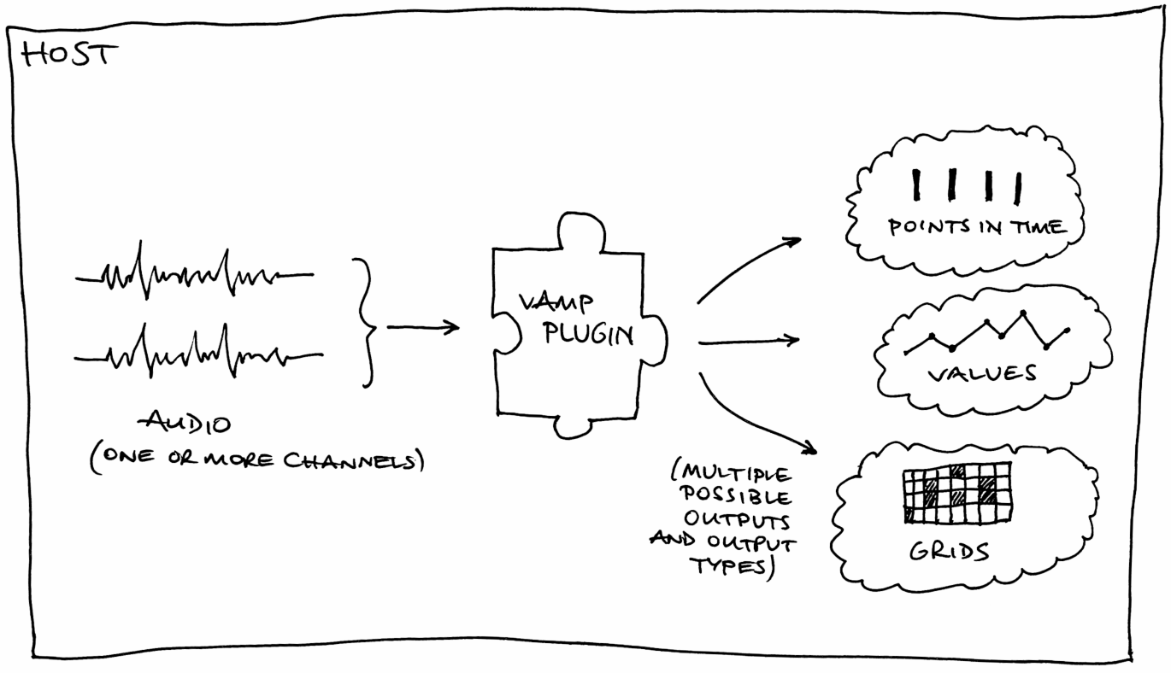
A Plugin in its Natural Habitat

Slide 3
Philosophical notes
Nothing very clever about Vamp; it just fills a need
Much drawn from existing audio processing APIs
Complications mostly from the fact that a plugin may legitimately want to return almost anything
Classic data description problem:
  How far do the plugin and host need prior mutual understanding about the meanings of the data being returned?
  Where to draw the line between “a fixed set of possible feature types” and “anything at all”?

Slide 4
Things a Plugin May Need
Always
  Basic descriptive data:
  Identifier, name, description, maker etc
  Processing preferences:
  Input domain, step size, block size, channel count
  Output descriptors
  process and getRemainingFeatures methods
Sometimes
  Parameters: descriptors, get and set methods
  Programs: list of names, get and set methods

Slide 5
Plugin Lifecycle
Plugin library loaded
Plugin object constructed, with sample rate
Host queries: outputs; preferred input step & block size, domain, channel count; parameters & programs
Parameters and programs set
Plugin initialised with step & block size, channels
Repeated calls to process
One call to getRemainingFeatures

Slide 6
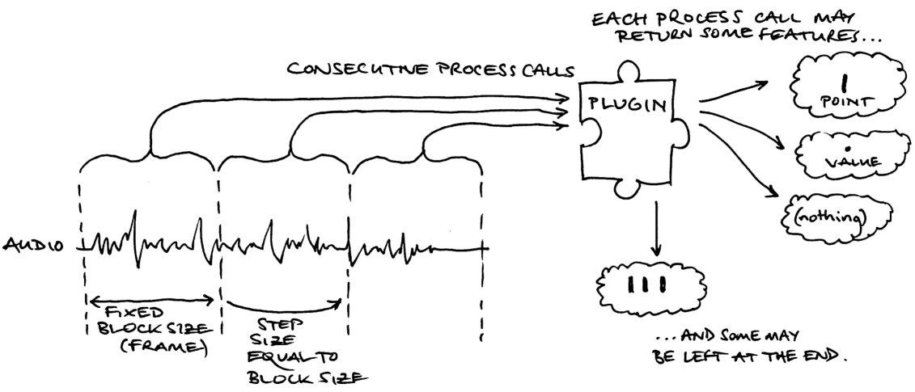
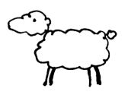
Processing – time domain input

Slide 7
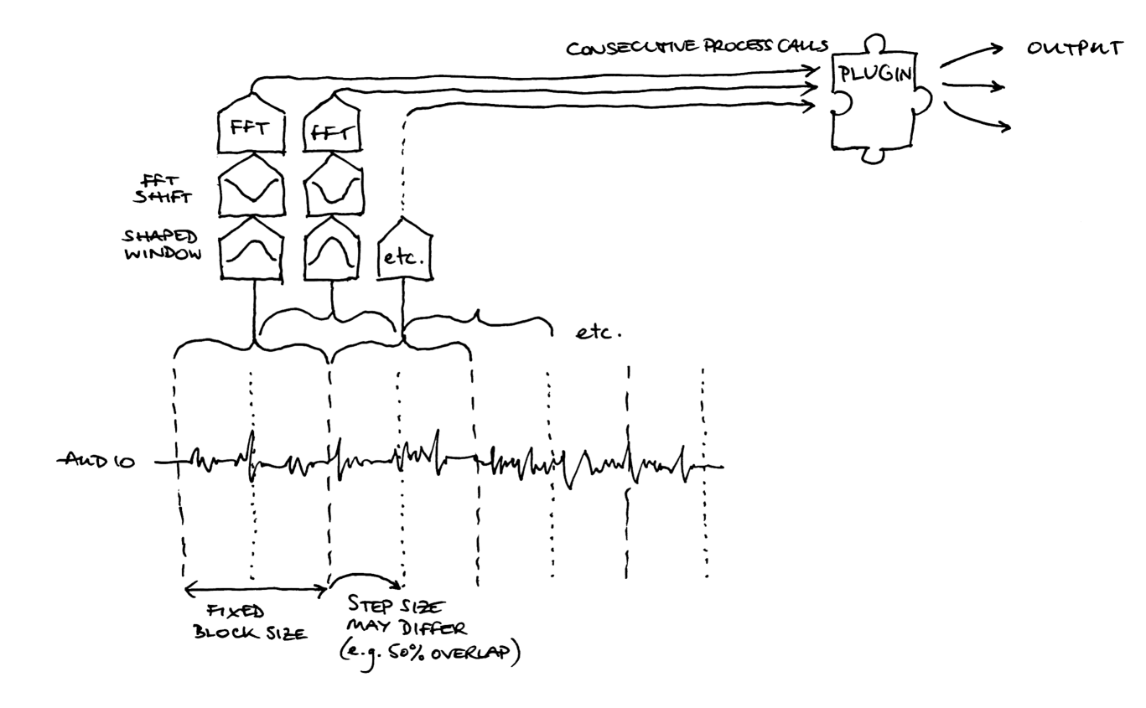
Frequency-domain input

Slide 8
What does a plugin return?
Plugin may have many outputs, and always calculates all of them: host doesn't choose up front
Each call to process or getRemainingFeatures may return zero or more “features” per output
A feature has
  Time (implicit or explicit)
  Zero or more values
  An optional label
Empty features are perfectly valid

Slide 9
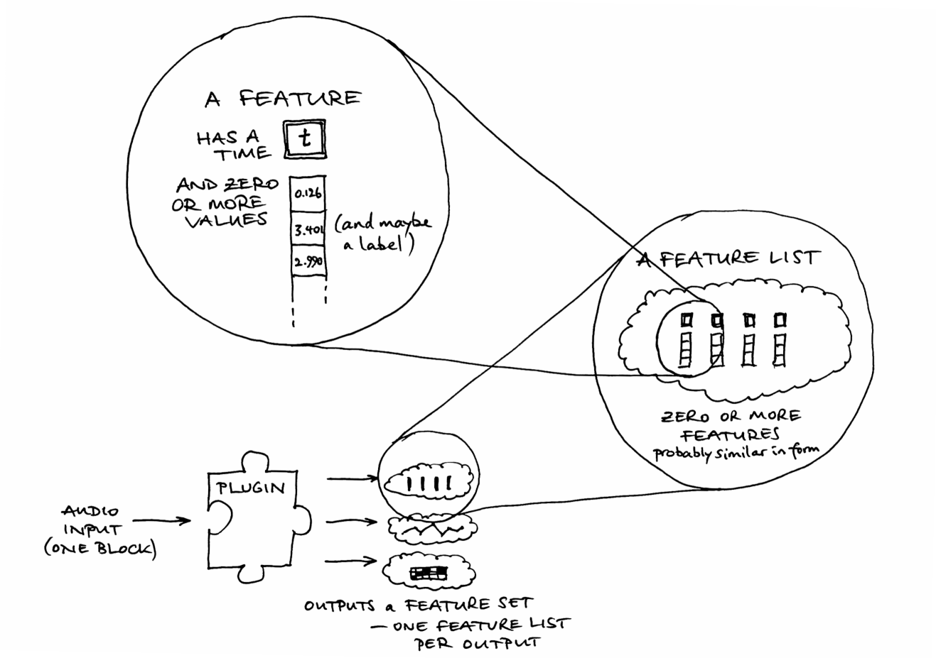

Slide 10
What does a feature represent?
Something that happened at a particular time
  Note onset
  Column of data for a chromagram plot
  Amplitude estimated from a particular region of input
Time may be
  Explicit: timestamp in the feature object
  Implicit: deduced by the host based on the time in samples of the data passed in to process
  this depends on the “sample type” for the output

Slide 11
Values of a feature
A feature may have values associated with it
  Note onset (from simple onset detector) has no values
  Column of chromagram data has lots of values
  Amplitude has one value
Host's understanding of the “meaning” of a feature depends on which output it is returned on
Output descriptor may supply units, bin labels (for multi-value features), minimum/maximum extents
In future: known feature types via RDF

Slide 12
Some Limitations
All values in a single feature must have same unit
  Many real examples of features as points in multidimensional space are not comfortably handled
  No proper way to express “duration” of a feature, a very common requirement
No inputs other than audio – no plugin chaining
Partial input blocks not supported
  host has to zero-fill last block, can't tell plugin it is incomplete

Slide 13
Pros and Cons compared with Matlab
Pros
  Can be used in many different host applications
  Doesn't require big commercial supporting framework
  May run faster or handle larger data sets
Cons
  Useless without a host
  Needs to be recompiled for every target platform
  Familiarity with C or C++ required
  Things Matlab does by magic have to be written by hand
  Algorithm must support block-by-block processing

Slide 14
More
Website:
  http://www.vamp-plugins.org/
Forum (complaints and announcements):
  http://www.vamp-plugins.org/forum/
Programmers Guide coming up “any day now”:
  http://www.vamp-plugins.org/develop.html
  just as boring as this presentation, but much longer
Vamp SDK v1.2 out this week as well, perhaps

