Slide 1
Java Data Objects

Slide 2
Overview of JDO
JDO supports:
  The storage of Java objects in a database:
    An object store, or
    A relational store.
  Access to the stored Java objects:
    Through queries embedded in Java.
    By iterating through the instances of a class.
    By navigating between objects in the database.
Database objects are created and manipulated in the same way as main memory objects.

Slide 3
Writing JDO Applications
From scratch:
  Java classes are implemented as normal, adhering to certain restrictions on the types that can be stored in the database.
  Java methods can use JDO functionality to access and manipulate database data.
  A description file describes what classes are database classes, etc.
Based on existing Java classes:
  Java classes are checked to see if they adhere to certain restrictions the types that can be stored in the database.
  Methods won’t initially use JDO functionality, but top-level programs must be adapted to access database data.
  A description file describes what classes are database classes, etc.

Slide 4
Registering a Persistent Class
MyClass.java
[1. Import]
javax.jdo
…
2. compile
MyClass.class
DB
3. store
metadata
Descriptor
File
3. enhance

Slide 5
Object Database Notions
Extent:
  The collection of instances of a class.
Orthogonal Persistence:
  The length of time that a data item can exist is independent of its type.
Persistence by reachability:
  An object can be made to persist either explicitly, or by being referenced by a persistent object.

Slide 6
Persistence by Reachability
p
commit
p
o
o
q
q

Slide 7
JDO Data Model
JDO data model ≅ the Java type system.
Features:
  Classes.
  Inheritance.
  Members.
  Collections.
Restrictions:
  Only certain collection types can be stored in the database.
  Only serialisable library types can be stored in databases.
Additions:
  Keys.
  Collection types.
  Vendor-specific features (e.g. indexes, clustering).

Slide 8
JDO Supported Types
Primitives:
  Boolean, byte, short, char, int, long, float, double.
java.lang:
  Wrappers for primitives, plus String, Number, Object.
java.util:
  Locale, Date.
  Collections.
java.math:
  BigInteger, BigDecimal.

Slide 9
Collections
JDO includes the following Collection classes:
  Set:
    HashSet, Hashtable, TreeSet.
  List:
    ArrayList, LinkedList, Vector.
  Map:
    HashMap, TreeMap.
Arrays:
  JDO supports one dimensional arrays.

Slide 10
Trains Database Schema
1
*
*
1
Station
Visit
Train
DistrictStation
MainStation
LocalTrain
InterCity
See handout/tutorial for the JDO
schema and example programs.

Slide 11
Train Class (nothing to see)
class Train {
protected int tno ;
protected Station source ;
protected Station dest ;
protected Vector route ;
protected char type ;
// Mandatory 0-ary Constructor
public Train ( ) {}
public Train (int the_no, Station the_source,
Station the_dest, Vector the_route)
{ tno = the_no ; source = the_source ;
dest = the_dest ; route = the_route ; type = 't' ;
}
…
}

Slide 12
Minimal Descriptor File
<?xml version="1.0" encoding="UTF-8"?>
<!DOCTYPE jdo SYSTEM "jdo.dtd">
<jdo>
<package name="">
<class name="DistrictStation">
<class name="InterCity">
<class name="LocalTrain">
<class name="MainStation">
<class name="Station">
<class name="Train">
<class name="Visit">
</class>
</package>
</jdo>

Slide 13
Creating a Persistent Object
Connect to the database.
Open a transaction.
Create the Java object.
Store the Java object.
Commit the transaction.

Slide 14
Step 1: Connect
import javax.jdo.* ;
import com.poet.jdo.*;
…
java.util.Properties pmfProps = new java.util.Properties();
pmfProps.put(
"javax.jdo.PersistenceManagerFactoryClass",
"com.poet.jdo.PersistenceManagerFactories" );
pmfProps.put(
"javax.jdo.option.ConnectionURL",
"fastobjects://LOCAL/MyBase" );
PersistenceManagerFactory pmf =
JDOHelper.getPersistenceManagerFactory( pmfProps );
PersistenceManager pm = pmf.getPersistenceManager();

Slide 15
Steps 2-5: Do the business
Transaction txn = pm.currentTransaction();
txn.begin();
…
Station source = …;
Station dest = …;
LocalTrain tr = …;
…
tr = new Train(tno, source, dest, new Vector ());
pm.makePersistent (tr)
…
txn.commit();
This will also ensure that source and dest persist.

Slide 16
Compiling in FastObjects
>javac *.java
Note: Trains.java uses or overrides a deprecated API.
Note: Recompile with -deprecation for details.
>ptj -enhance -update -schema MySchema
FastObjects SDK Toolkit, Version 9.5.12.98.
Copyright (C) 1996-2004 POET Software Corporation
Info: Read metadata 'C:\JDOTrains\package.jdo'
Info: Enhanced class '.\DistrictStation.class'
Info: Enhanced class '.\Visit.class‘
…
Access to poet://LOCAL/MySchema failed
[the schema was not found (-2031)].
Create a new schema (y/n)? y
Info: Created schema: poet://LOCAL/MySchema
…

Slide 17
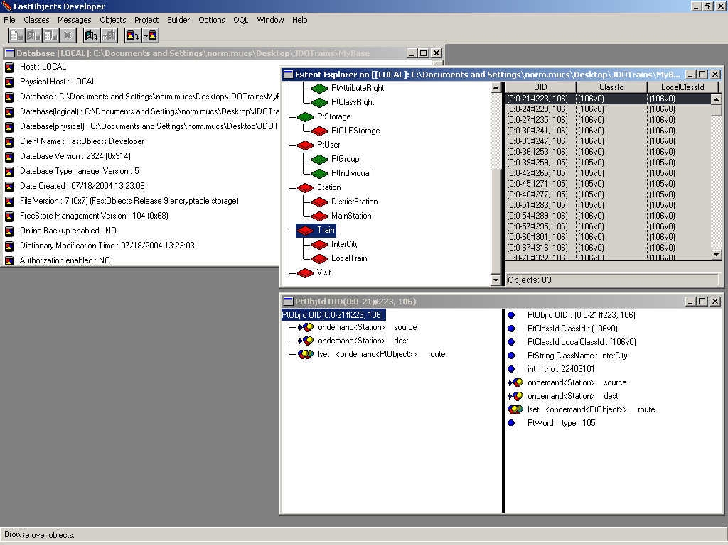
Viewing Objects in FastObjects

Slide 18
JDO Classes - 1
JDOHelper
PersistenceManagerFactory
1
Transaction
1
*
1
PersistenceManager
*
Extent
1
*
PersistenceCapable
Query
*

Slide 19
JDO Classes - 2
JDOHelper: Static utility operations for creating PersistenceManagerFactory objects and enquiring about instances.
PersistenceManagerFactory: A factory for creating PersistenceManager objects.
PersistenceManager: Manages access to a collection of persistent objects (comparable to a Connection in JDBC).

Slide 20
JDO Classes - 3
PersistenceCapable: Interface implemented by database classes; normally added during enhancement.
Transaction: Supports grouping of operations for commit/rollback.
Extent: Enables access to the instances of a class (and its subclasses).
Query: Provides declarative access to persistent objects.

Slide 21
Database Properties
The following are among the properties that can be set for a PersistenceManagerFactory:
  The name of the underlying persistence manager.
  The name of the database that is to be accessed using that persistence manager.
  The username and password to be used to access the database.
  Various features of cache and transaction management.
These properties are set using a Properties object that provides key → value pairs.

Slide 22
Setting Property Values
java.util.Properties pmfProps = new java.util.Properties();
pmfProps.put(
"javax.jdo.PersistenceManagerFactoryClass",
"com.poet.jdo.PersistenceManagerFactories" );
pmfProps.put(
"javax.jdo.option.ConnectionURL",
"fastobjects://LOCAL/MyBase" );
pmfProps.put(
"javax.jdo.option.ConnectionUserName",
“norm" );
pmfProps.put(
"javax.jdo.option.ConnectionPassword",
“notMyRealPassword" );
PersistenceManagerFactory pmf =
JDOHelper.getPersistenceManagerFactory( pmfProps );

Slide 23
PersistenceManager Class
The PersistenceManager Class has many operations, including:
  Transaction currentTransaction();
  void deletePersistent(Object obj);
  void makePersistent(Object obj);
  void getExtent(Class c, boolean subclasses);
  void newQuery();
As such, it is central to the explicit interaction of a client with a database.

Slide 24
Transactions
All updates to a database must take place as part of a transaction.
The Transaction class supports operations such as:
  void begin();
  void commit();
  void rollback();
  boolean isActive();

Slide 25
Extents
An extent is the collection of instances in a class.
Note that:
  In relational databases, a table definition associates the definition of a type with a stored collection of its instances.
  In object-oriented programming, there is not always a direct way of iterating over the instances of a class.

Slide 26
Extents in Action
// Print information about all trains
PersistenceManager pm = …
Transaction txn = pm.currentTransaction();
txn.begin();
Extent trainExtent = pm.getExtent( Train.class, true );
Iterator iter = trainExtent.iterator();
while ( iter.hasNext() )
{
Train tr = (Train) iter.next();
tr.print();
}
txn.commit()

Slide 27
Access by Navigation - 1
Once a persistent object has been retrieved, related persistent objects can be retrieved by navigating.
As would be expected:
  Single-valued relationships are followed using “.” notation.
  Multiple-valued relationships are represented and accessed using collections.
  No additional syntax is required in either case.
Note that navigating through relationships is comparable to relational joins.

Slide 28
Access by Navigation - 2
class Train {
…
public void print ()
{
System.out.print ("Train number : " + tno + "\n" +
"Source : " + source.getName() + "\n" +
"Destinantion : " + dest.getName() + "\n" +
"Type : " + this.getType() + "\n" ) ;
Iterator iter = route.iterator();
while ( iter.hasNext() )
{
Visit the_route = (Visit) iter.next() ;
the_route.print() ;
}
}
}

Slide 29
Updates
The modification of members and of collections is the same as in Java.
Deletion is more complex:
  The notion of extent to some extent conflicts with persistence by reachability, as an explicitly made persistent object will continue to live in an extent even when no other object refers to it.
  Thus while objects become persistent by reachability, there is no persistent garbage collection in JDO.

Slide 30
Deletion
An object can be explicitly deleted from the data store using the following operations on PersistenceManager:
  void deletePersistent(Object obj)
  void deletePersistentAll(Object[] objs)
  void deletePersistent(Collection objs)
There is potential to create persistent dangling references by deleting an object, but not the references to it (yug).

Slide 31
Deleting a Station
Deletion thus needs to be designed based on application requirements.
A possible approach for Station:
  Disallow deletion of any station that is the source or destination of any train.
  Allow deletion of a station to which there are visits, and delete the relevent visits.
Writing a program that implements this behaviour is part of the tutorial.

Slide 32
Configuration File - 1
The JDO standard includes an XML DTD for a file that specifies properties of classes that cannot be captured in Java, such as:
  primary-key: uniqueness constraint.
  embedded: description of clustering.
  element-type: typing for collections.

Slide 33
Configuration File - 2
The configuration file provides scope for vendor extensions.
FastObjects extensions include:
  alias: for multiple-language access.
  index: for more efficient querying.
  unicode: to save space (false for ASCII).
  database: name of database file.
  extent: to save space (false for no extent).

Slide 34
Example Configuration File
<?xml version="1.0" encoding="UTF-8"?>
<!DOCTYPE jdo SYSTEM "jdo.dtd">
<jdo>
<extension vendor-name="FastObjects"
key="database" value="MyBase"/>
<extension vendor-name="FastObjects"
key="schema" value="MySchema"/>
<package name="">
…
<class name="Station">
<field name="visits">
<collection element-type="Visit"/>
</field>
</class>
</package>
</jdo>

Slide 35
JDOQL
JDOQL:
  Is only for use embedded in Java programs.
  Is thus seen as complementary to extents and navigation.
  Pros/cons of embedded queries as against navigation?
Scope:
  Query only – no schema or data modification.
  Principal model involves filtered access to extents, as an alternative to iteration.
  Less expressive than OQL.

Slide 36
Example: Look for a Station
Extent ext = pm.getExtent(Station.class, true);
Query qry = pm.newQuery();
qry.declareParameters("String name");
qry.setFilter("this.name == name");
qry.setCandidates(ext);
Collection res = (Collection) qry.execute(argv[0]);
Iterator iter = res.iterator();
if (iter.hasNext())
{ // There should be exactly one
Station foundStn = (Station) iter.next();
foundStn.print();
} else {
System.out.println("Station " + argv[0] + " not found");
}

Slide 37
Features of Example – 1
A query is represented as an object:
  Query qry = pm.newQuery();
A query returns a subset of a given collection:
  qry.setCandidates(ext);
A filter describes which of the values in the collection should feature in the result:
  qry.setFilter("this.name == name");

Slide 38
Features of Example - 2
Queries can be passed parameters, which have to be declared:
  qry.declareParameters("String name");
Parameters can be set when a query is executed:
  Collection res = (Collection) qry.execute(argv[0]);
Query results are collections, and thus can be iterated over:
  Iterator iter = res.iterator();

Slide 39
Class Query
Queries can be constructed using the following operations on PersistenceManager:
  Query newQuery();
  Query newQuery(Extent candidates);
  Query newQuery(Extent candidates, String filter);
  Query newQuery(Class candidateClass, Collection candidates);
  Query newQuery(Class candidateClass, Collection candidates, String filter);
The Collection or Extent should contain persistent instances from the same PersistenceManager as the Query.

Slide 40
Formal Query Parameters
Parameters are declared using the following operation on Query:
  void declareParameters(String parameters);
Parameters are comma separated, and can have any type that can be stored in a JDO database. Example:
  qry.declareParameters("String dest, Train trn");

Slide 41
Actual Parameters
Parameters values can be passed using the following operations on Query:
  execute:
    Object execute();
    Object execute(Object par1);
    Object execute(Object par1, Object par2);
    Object execute(Object par1, Object par2, Object par3);
  executeWithMap, which contains parameter name → value pairs.
    Object executeWithMap(HashMap map);
Primitives are wrapped (e.g. int → Integer)

Slide 42
Types in Queries
The type namespace for queries automatically includes:
  The candidate class, and other classes in the same package.
  Classes in java.lang.*.
Other classes can be imported as in:
  qry.declareImports(“import java.util.Date”);

Slide 43
Filters
A filter is a boolean expression evaluated for each value in the given Extent or Collection.
Filters use syntax for boolean expressions that is familiar from Java.
A filter can access the fields of a class even if they are private, but cannot invoke methods.
A filter is defined for a query either using newQuery() or:
  void setFilter(String filter);

Slide 44
Operators
Equality:
  ==
  !-
Comparison:
  <
  <=
  >
  >=
Boolean:
  &
  &&
  |
  ||
  !
In JDOQL, as there are no side-effects:
  & ≡ && (conditional and)
  | ≡ || (conditional or)

Slide 45
Examples - 1
Find all trains that start at argv[0] and end at argv[1]:
Query q = pm.newQuery(Train.class);
q.declareParameters("String src, String dst");
q.setFilter("source.name == src && dest.name == dst");
Collection result = (Collection)
q.execute(argv[0], argv[1]);

Slide 46
Examples - 2
Find all the trains that visit argv[0]:
System.out.println("Visit " + argv[0]);
Query q = pm.newQuery(Train.class);
q.declareParameters("String p");
q.declareVariables("Visit v");
q.setFilter("(route.contains(v) && v.place.name == p)");
result = (Collection) q.execute(argv[0]);

Slide 47
Navigation in JDOQL
Navigating through collections:
  boolean contains(Object o) is used with an and expression to yield true if at least one collection element matches the condition.
  The parameter to contains() is a variable that has to have been declared using declareVariables() on Query.
Path expressions navigate through single-valued relationships, as in Java.

Slide 48
Not in JDOQL
JDOQL in JDO 1.0 does not support:
  Joins.
  Aggregation.
  Nested queries.
  Updates.
  Interactive queries.
  Multiple programming-language embedding.

